Slide 1
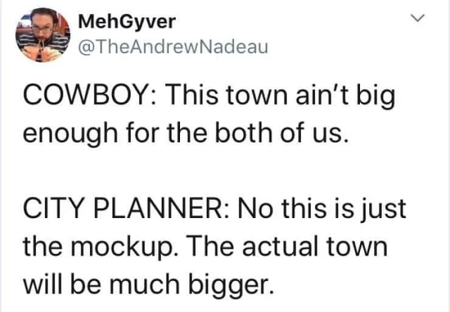
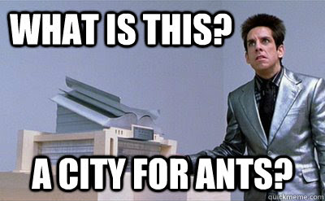
Planning Essentials
May 15th, 2025
Office of Planning - Juli Yoder, AICP
Principal Planner/ Manager
Notes:
-Good Morning!
-Juli Yoder (Principal Planner/ Planning Manager)
-Presenting about Planning Essentials
-Some of this may seem obvious
-Important to lay a good planning foundation before hearing from other great speakers

Slide 2
TO PLAN OR NOT TO PLAN…
WHAT is it?
WHY do we do it?
WHO does it?
HOW do you do it?
WHAT do you do with it when you’ve got it?
Notes:
Today we’re going to discuss the basics of planning and why it’s important.
I’m going to define planning, talk about who plans, and then we will discuss the roles everyone plays in the planning process. (next slide)

Slide 3
TO PLAN OR NOT TO PLAN…
Plan - Verb
Definition:
to arrange the parts of
to devise or project the realization or achievement of
To think in advance about a method
Plan - Noun
Definition:
a detailed formulation of a program of action;
a method devised for doing something or achieving an end, involving a series of actions
Notes:
The word "plan" can be both a verb and a noun. As a verb, it means to arrange or think ahead about a method—describing the process of planning. In the context of comprehensive planning, it refers to the act or process of planning. (next slide)

Slide 4
TO PLAN OR NOT TO PLAN…
Plan - Verb
Definition:
to arrange the parts of
to devise or project the realization or achievement of
To think in advance about a method
Plan - Noun
Definition:
a detailed formulation of a program of action;
a method devised for doing something or achieving an end, involving a series of actions
Notes:
As a noun, the word "plan" refers to the document that outlines a community’s vision for the future and the steps to achieve it. It serves as a key tool for expressing goals and guiding actions toward those goals. (next slide)

Slide 5
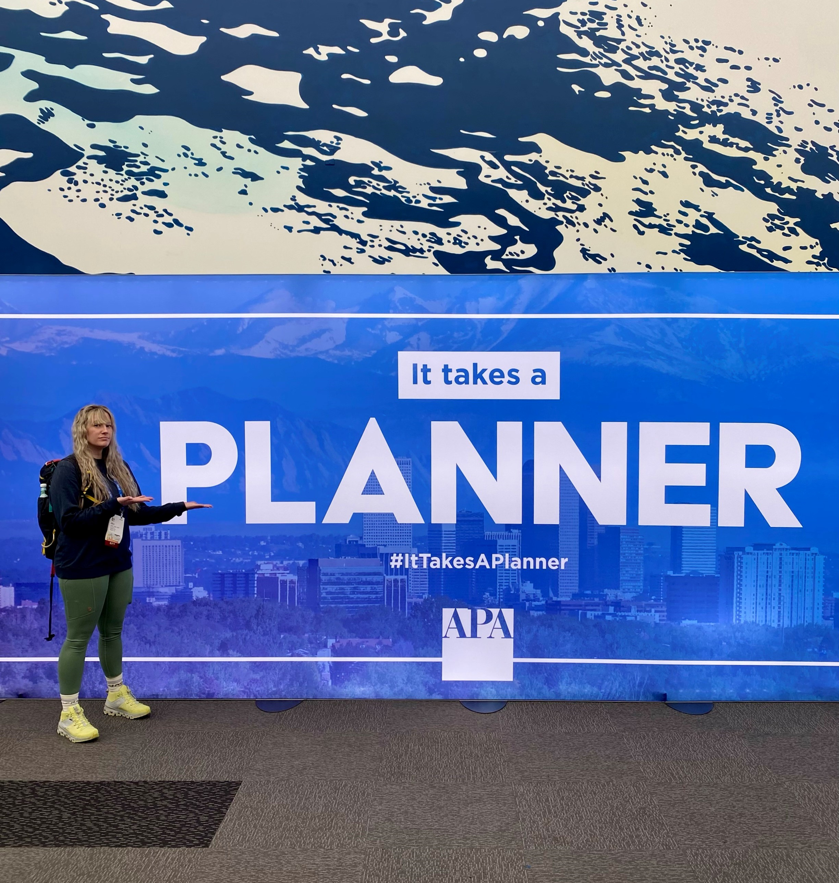
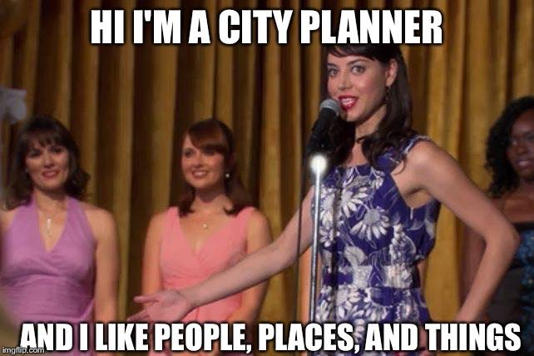
WHAT IS PLANNING?
Notes:
Planning Provides a Vision for Your Community Today — and What You Want Your Community to Be in the Future
The goal of planning is to maximize the health, safety, and economic well-being for all who live, work, and visit your community. This involves thinking about how we can move around our community, the businesses and attractions we want, where we want to live, and opportunities for recreation. Planning helps create communities of lasting value. (next slide)

Slide 6
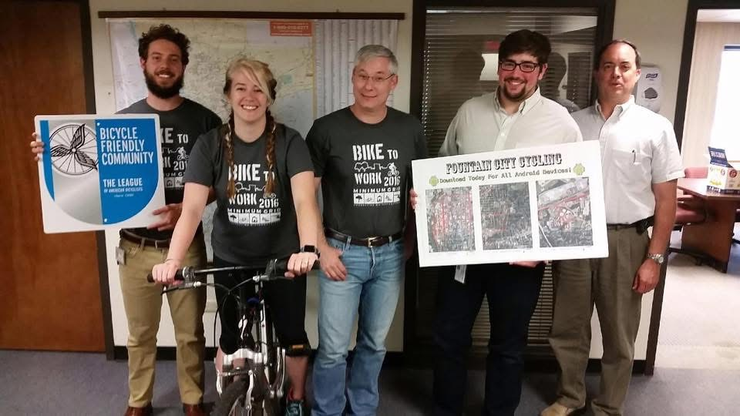
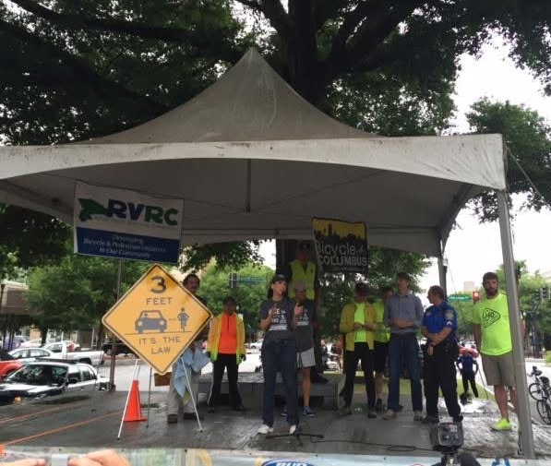
WHAT IS PLANNING?
Notes:
As planners and elected officials, it is our job to work with residents guiding the layout of our community. One of the greatest challenges in this process is to imagine what can and should happen to a community: how it could grow and change, and what it should offer residents in the future. (next slide)

Slide 7
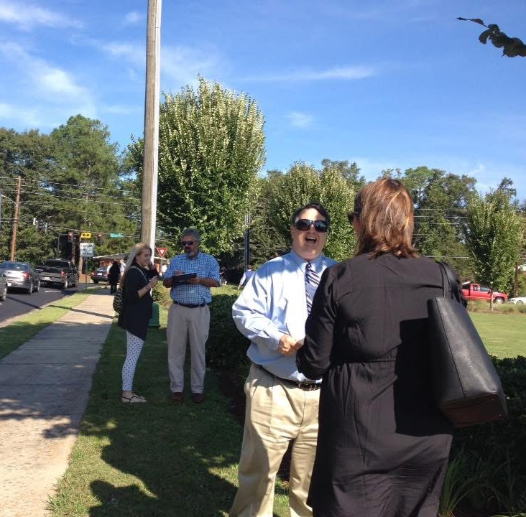
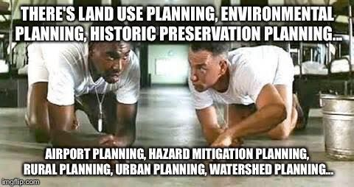
WHAT IS PLANNING?
Notes:
It is important to remember that everything is related to everything else. Planners believe that all aspects of a community are interconnected, so planning should be comprehensive. Issues like transportation must be considered alongside related factors such as land use and housing, as no single element can be addressed in isolation. (next slide)

Slide 8
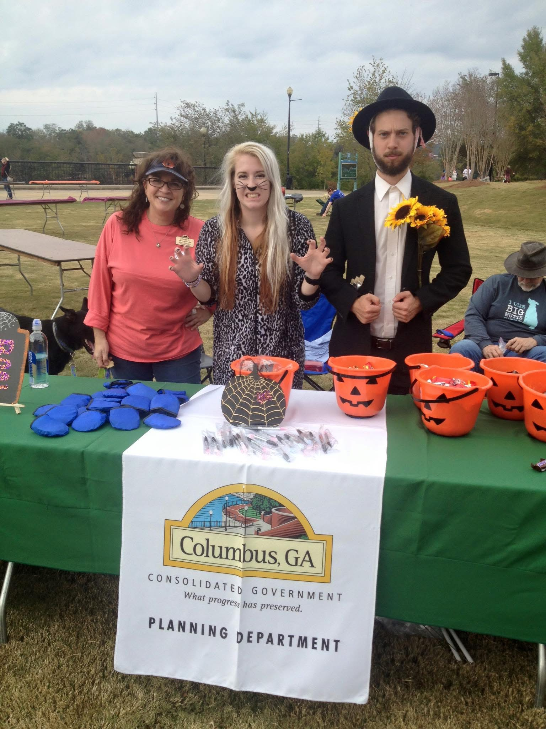
WHY PLAN?
Planning for YOUR Community:
Helps protect property rights/values
Certainty is good for economic development
Helps maintain and improve your quality of life
Protect public investments: It’s your money, after all
Provides a forum to reach consensus
Notes:
Why not plan? Why not create a road map for your community moving into the future.
Everyone makes plans. Sometimes we plan to accomplish specific goals. Other times, we plan to avoid otherwise negative outcomes (like running out of candy at the planning department’s Halloween table). These are the same basic reasons why cities and counties choose to plan. Though planning requires time and money, it’s a worthwhile investment because it brings significant social, economic, and environmental benefits—usually far greater than the cost of doing nothing. (next slide)

Slide 9
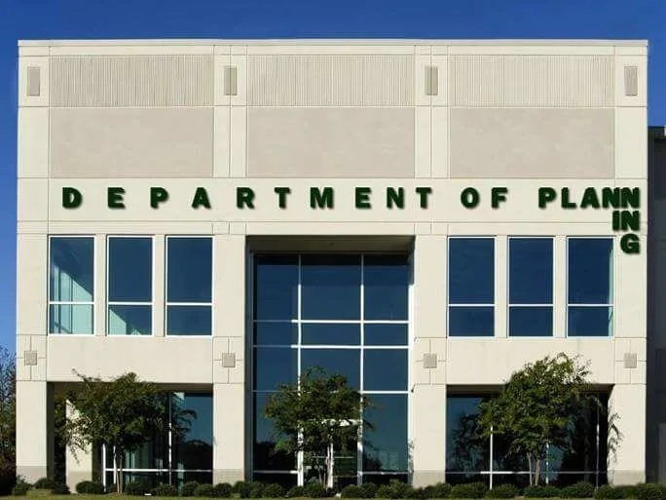
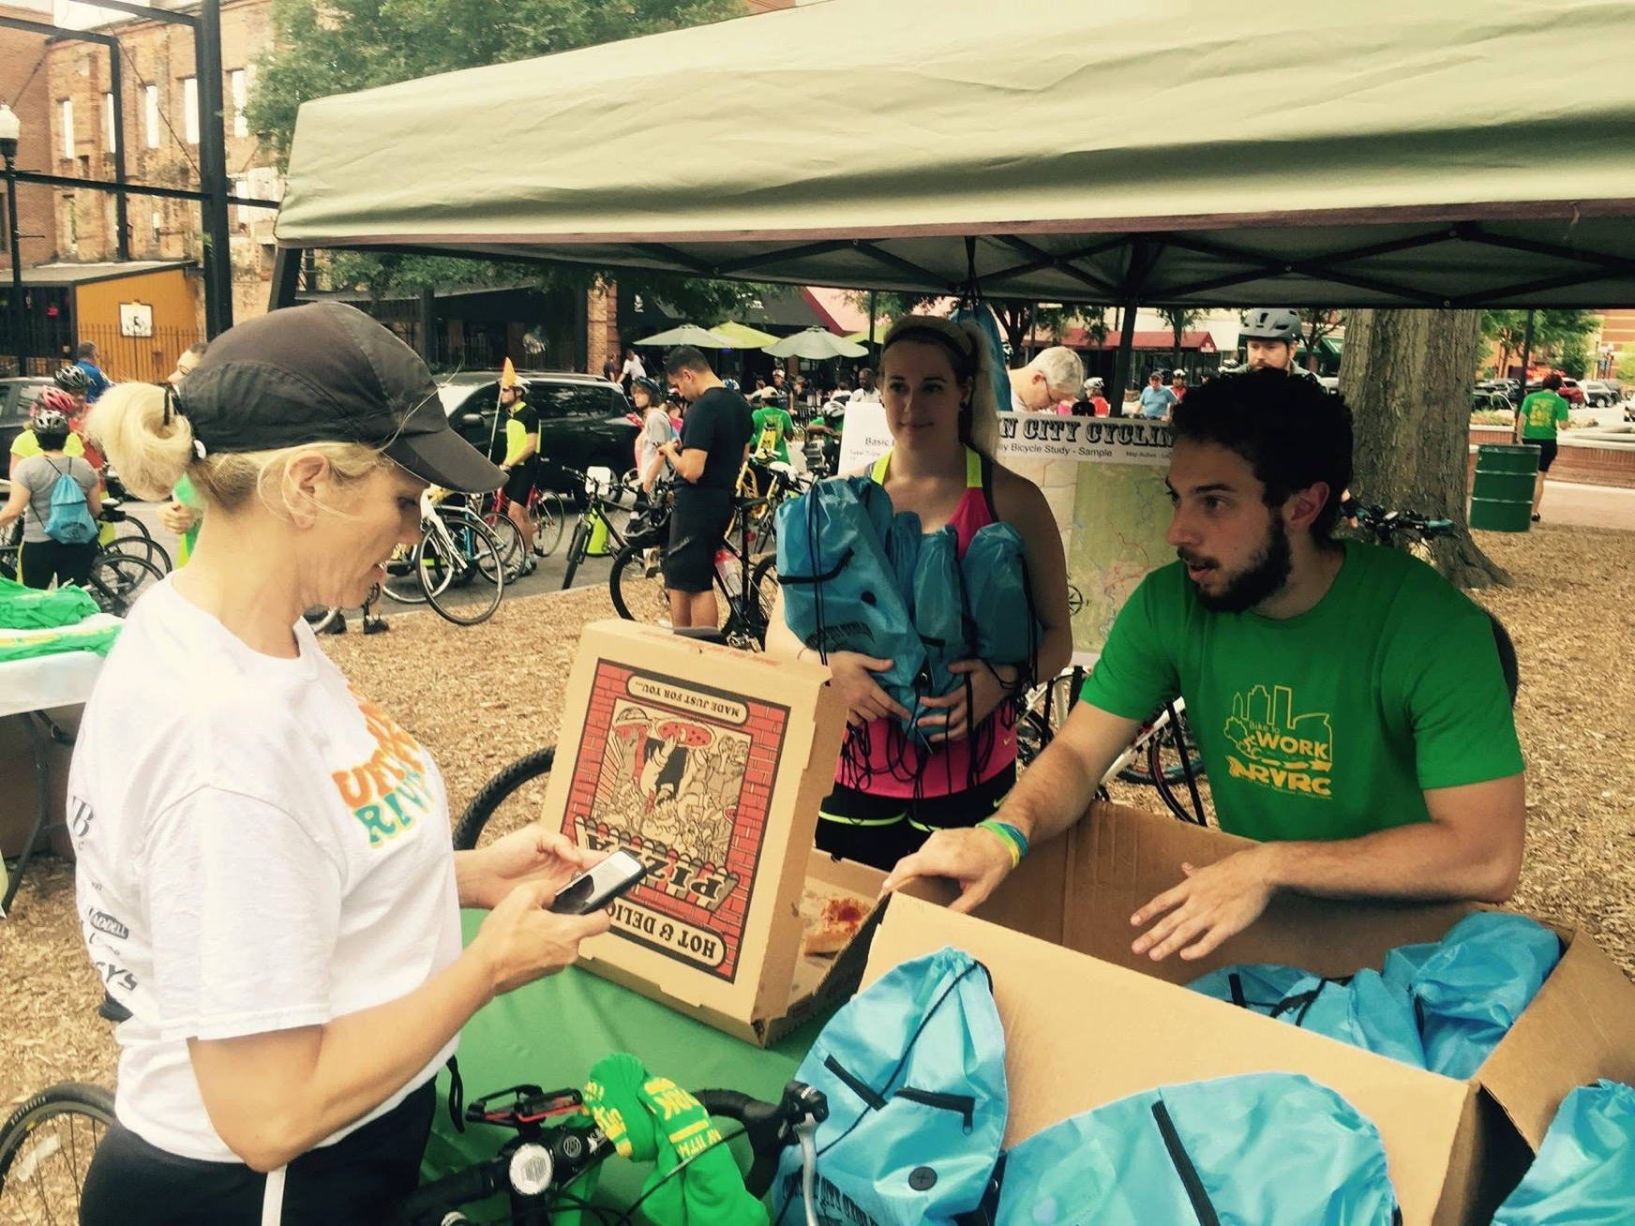
WHY PLAN?
Planning for YOUR Community:
Helps protect property rights/values
Certainty is good for economic development
Helps maintain and improve your quality of life
Protect public investments: It’s your money, after all
Provides a forum to reach consensus
Notes:
Communities that don't plan often react to problems instead of proactively shaping their future. While planning can't predict everything, using the best information and inclusive processes help communities better handle challenges and seize opportunities for positive change. (next slide)

Slide 10
WHY PLAN? Social Benefits
Notes:
Planning helps communities build consensus on shared goals by involving the public in a participatory process. This process highlights common concerns and opportunities, educates participants, and fosters a sense of ownership—making it more likely the community will work together toward meaningful progress. (next slide)

Slide 11
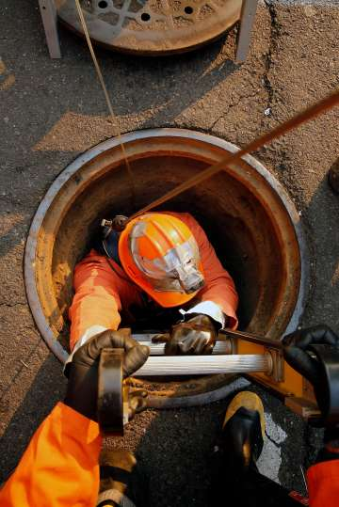
WHY PLAN? Economic Benefits
Notes:
Planning also helps communities make smarter decisions about when and where to invest in infrastructure and services. Since these investments often use a large portion of local tax revenue, planning ensures resources are used efficiently. It also helps people understand the financial impact of different types of development and land use. (next slide)

Slide 12
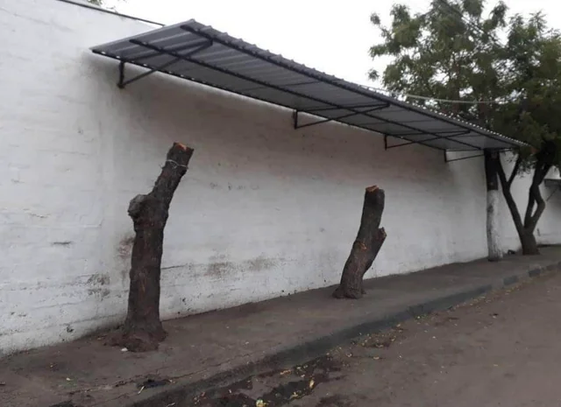
WHY PLAN? Environmental Benefits
Notes:
Lastly, planning helps communities make informed decisions about how and when to use natural resources. Since resource use affects everyone, planning ensures that environmental impacts are considered and that choices about development or conservation benefit the whole community. (next slide)

Slide 13
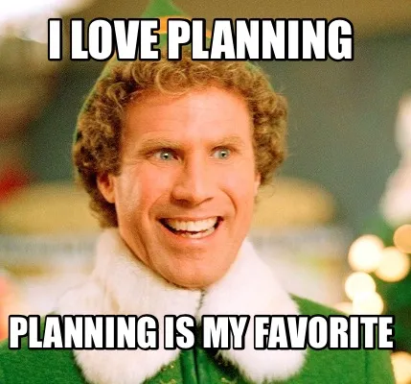
WHO PLANS?
EVERYONE – the plan should involve the entire community
Elected Officials
Local Government Staff
Consultants, Developers
Appointed Officials
Regional Commissions
State of Georgia
Notes:
Everyone has a role in planning, and collaboration is key to a successful, inclusive comprehensive plan.
Elected Officials hold responsibility for the plan's adoption and success.
Local Government Staff oversee the day-to-day operations of the plan, and the planning process.
Consultants and developers should be included because they need to know where the community desires to see growth, and where you’re planning for it to happen.
Appointed Officials typically are community leaders who can help spread awareness.
Regional Commissions offer insight into both local and regional planning trends and needs.
Finally, your state plans, and we can help you plan! (next slide)

Slide 14
PLAN MAKING
Notes:
Communities create plans to define their desired future and how to achieve it. Once adopted by local governing bodies, these plans guide decisions and policies affecting the community's future. They should be regularly reviewed and updated to reflect changing conditions and values, serving as key tools for shaping a city or county's development. (next slide)
----------------------------------------------------------------------------------------------------------------------------------------------------------------------
A small, isolated, rural community that is not growing or is declining may get by with just a comprehensive plan. Rapidly growing suburbs or cities may need the full complement of plan types.
What types of plans a community should have depends on its size, relationship to surrounding communities, whether the population is growing or declining, etc.
Left: City of Atlanta SHIFT ATL mobility plan
Right: City of Fayetteville downtown master plan (transportation)

Slide 15
WHAT COMMUNITY PLANS DO
Predict future population, housing, and employment trends
Protect and preserve future land needs
Assure adequate public facilities and services
Protect existing and future public investment
Protect environment
Reflect community values
Don’t you want to know how many houses you will need? New jobs?
Don’t you want to make sure you have enough land available to grow?
Don’t you want to have enough water for the community?
Don’t you want to save money by continuing to use what you already have paid for?
Don’t you want to make sure your natural and historic resources are protected?
Don’t you want your community to be what YOU want it to be?
Notes:
The local comprehensive plan is a community’s official statement about how it hopes to grow or change over the next 20 or so years. Comprehensive plans differ from other local plans in terms of scope, geographic coverage, and legal authority. While different communities will choose to emphasize different themes in their plans, the hallmark of an effective plan is that it provides valuable guidance to public- and private-sector decision makers. (next slide)

Slide 16
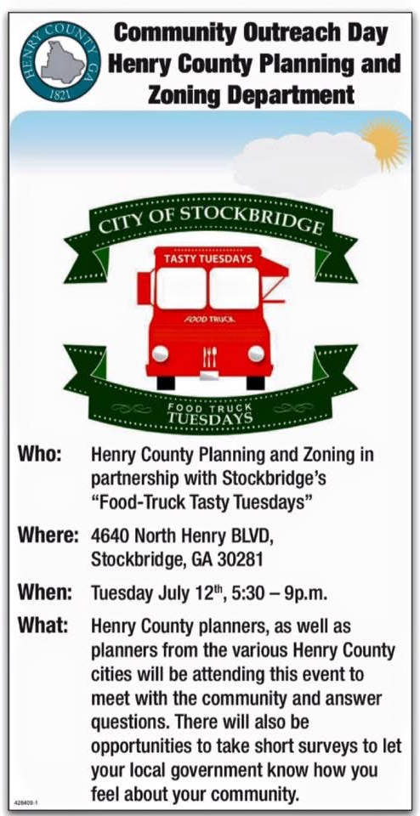
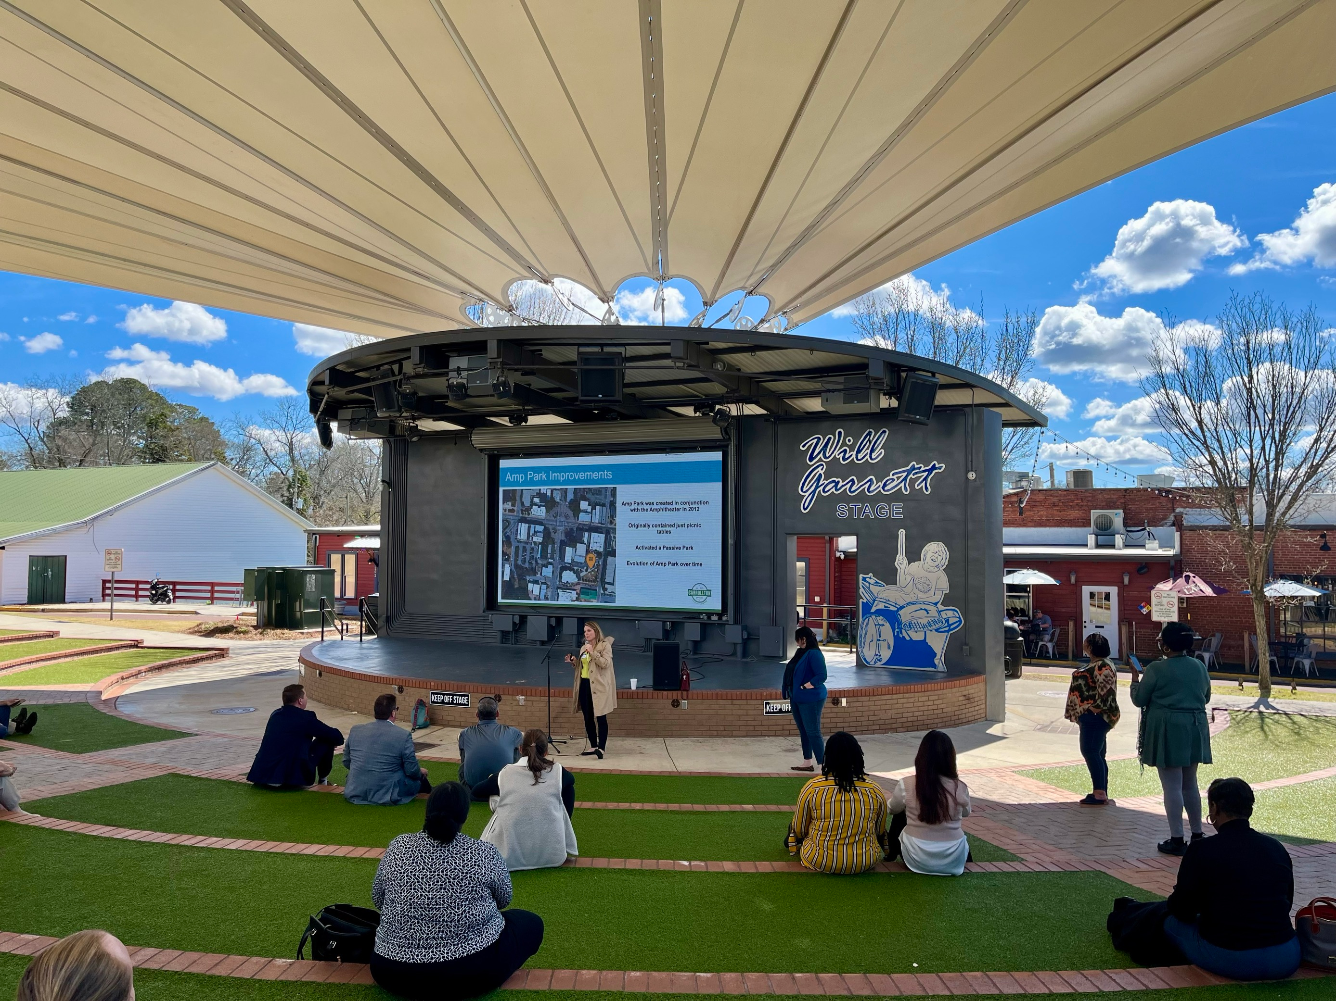
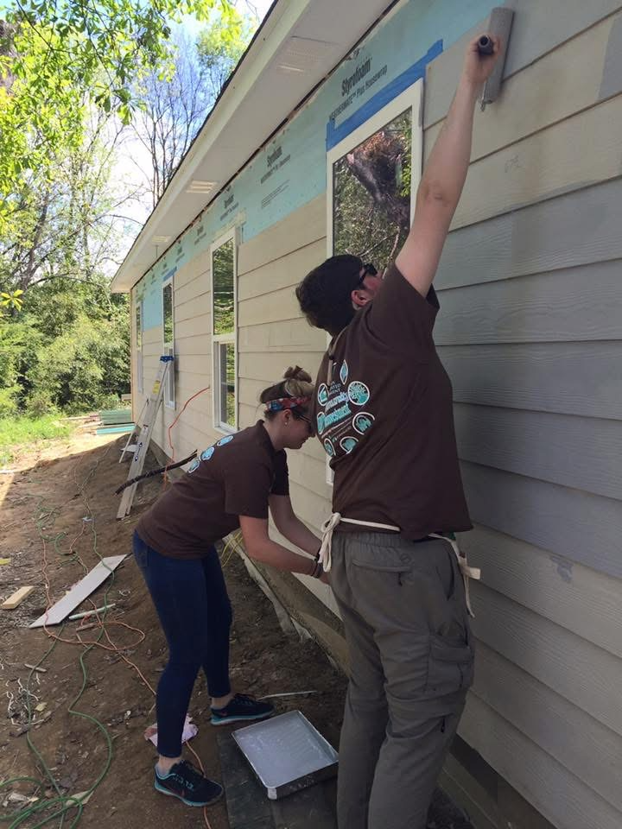
WHAT COMMUNITY PLANS DO
Notes:
Community plans help guide desired growth, protect existing assets, ensure resources and budgets are prepared, and reflect the community's goals and vision for its future. (next slide)

Slide 17
DO PLANS MATTER?
Notes:
Plans matter a great deal. —they guide public and private investments, shape zoning and development regulations, and influence many aspects of community life, including jobs, health, housing, and the environment. Most importantly, they serve as a roadmap to a sustainable future, ensuring long-term well-being for the community. (next slide)

Slide 18
IF WE DON’T PLAN!
Notes:
If you don’t plan, you run the risk of losing what was once was unique to your community! (next slide)

Slide 19
IT ISN’T JUST DCA
Notes:
It isn’t just DCA that requires plans. For example, the USDA Natural Resources Conservation Service also requires communities to have a comprehensive plan to receive funding from them. This way, they know you’re spending your money – and theirs- wisely. (next slide)

Slide 20
HOW WE DO IT IN GEORGIA
1st passed in 1989
DCA administers the Local Planning Rules
Rules revised several times
Provides eligibility for state funds, QLG
Georgia Planning Act is the foundation for community planning across the State
Notes:
The Georgia Planning Act is the foundation for community planning across the State. It was first passed in 1989, and the most recent revision went into effect on October 1st, 2018. The most important addition being the broadband element for Comprehensive Plans. (next slide)

Slide 21
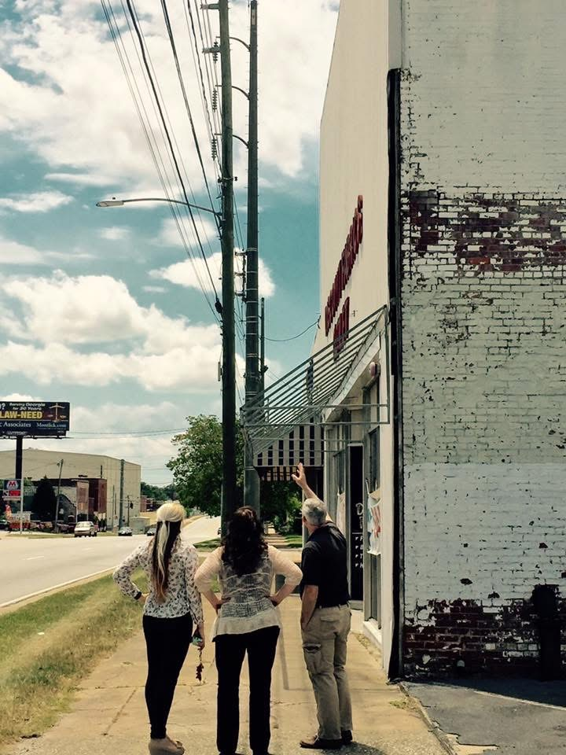
LOCAL COMPREHENSIVE PLANS
Help develop & support policies
Direct capital improvements
Help set the budget
Evaluate future development
See the future
Set the future
Guide economic growth
Guide land development
Notes:
The local comprehensive planning process gives a community an opportunity to step back and see the big picture. This makes the comprehensive plan an important tool for coordinating local decision making. It serves as the legal foundation that legitimizes local development regulations – and provides predictability for applicants, showing what types of development are likely to be approved.

Slide 22
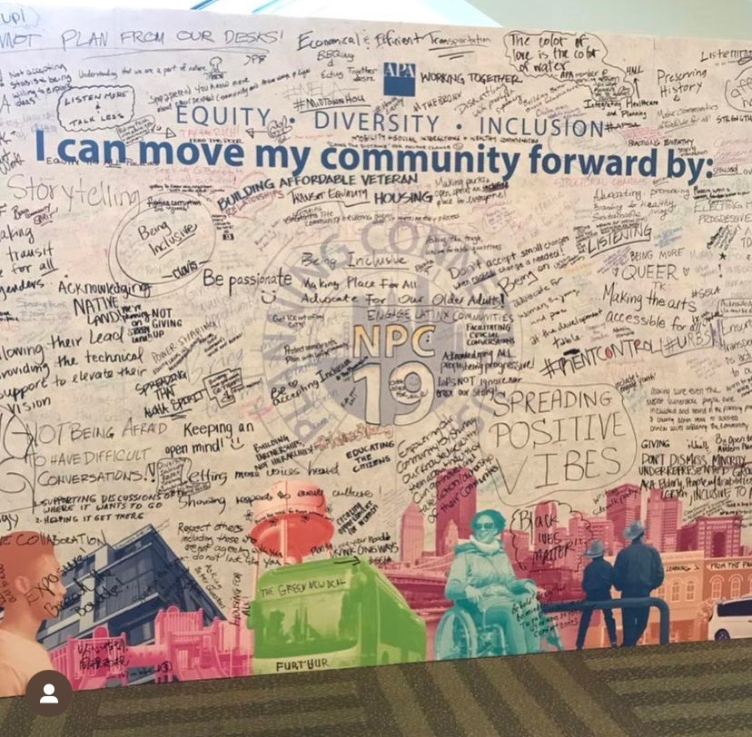
LOCAL COMPREHENSIVE PLANS
Celebrate the community
Improve community health
Address housing issues
Upgrade local infrastructure
Gives the public a voice
Represents everybody
See opportunities not just issues
Provide solutions
Notes:
The data gathering and analysis that informs a comprehensive plan also improves the factual basis for land-use decisions. Finally, the comprehensive planning process builds an informed constituency. As planners, public officials, and community members exchange ideas and listen to alternative perspectives, they become invested in the vision of the plan and more willing to assist in implementing plan policies. (next slide)

Slide 23
LOCAL PLANNING TOOLS
Future Development Map in the comp plan
Zoning Ordinance and Map
Unified Development Code
Special ordinances for trees, signs, etc.
Design Guidelines (historic districts, etc.)
Others specific to your local government
Notes:
Listed on this slide are examples of tools that can guide your planning efforts. These tools are designed to be specific to your community or a specific area in your community. This can include codes, maps, or design guidelines for example. (next slide)
Note:
The sign ordinance is tied to the 1st amendment. It must not be content based.
Tree ordinance – some communities create ordinances that address environmental and aesthetic issues. For example, ordinances are created for historic districts.

Slide 24
ZONING DEFINED
Notes:
Zoning is the local government's power to regulate private property to protect public health, safety, and welfare—essentially deciding what can go where. A valid zoning ordinance must include an accurate zoning map; without it, the ordinance isn’t legally enforceable. (next slide)

Slide 25
ZONING ORDINANCE
Zoning Map
Administrative Procedure
District Requirements
Site Design
Notes:
Generally speaking, your zoning ordinance should include a zoning map, and may also include site design standards, zoning district requirements, and administrative procedure for board functions. (next slide)

Slide 26
WHO’S INVOLVED?
On the local level:
Elected Officials: State, County, City
Appointed Boards and Commissions
Planning Staff
Development Community
Public
Notes:
So who is involved in the planning process? This should include elected officials, appointed boards and commissions, planning staff, the development community, and of course the public.
Consensus building is often the most challenging part of planning. It involves protecting the rights and needs of all community members and requires balancing diverse priorities. Because of this complexity, much of the planning process is devoted to dialogue with stakeholders to ensure the plan reflects shared values and goals. (next slide)

Slide 27
ELECTED OFFICIALS
Legislative Actions
Responsibilities
Notes:
Now, let’s briefly talk about the roles of elected officials in the planning process… (next slide)

Slide 28
ACTIONS
Legislative (elected officials)
Such things as:
Adopting the zoning ordinance
Adoption of amendments to the ordinance that change the text
Rezoning of property
Special use permits
Administrative
Anything else
Notes:
They perform legislative actions, such as adopting the zoning ordinance and voting on rezoning's. (next slide)

Slide 29
LEGISLATIVE RESPONSIBILITIES
Set plan in motion
Create a capable board
Establish policy
Change policies/ordinances
Give sense of direction
Make final decisions
Notes:
Elected officials also have many legislative responsibilities such as providing a sense of direction for the jurisdiction, making final decisions, and appointing board or commission members. (next slide)

Slide 30
PLANNING COMMISSION AUTHORIZATION
Contained in your ordinance - Administration (the commission as well as the elected body and staff)
Planning Commission
Creation, Appointment, Terms
Organization, Rules, Staff
Functions and Duties
Role and responsibilities of the elected body
All procedures and standards
Notes:
Shifting to planning commissions, their authorization should be contained in your ordinance, and should include items such as the terms for the commission members and their functions and duties. (next slide)

Slide 31
PLANNING COMMISSION
FIVE GOALS OF PLANNING COMMISSION
Remember what the purpose of “zoning” really is
Carry out development review process within the legal framework and requirements of state and local law
Effectively deal with the local political will
Act as an arbiter between government staff, applicant, citizens, land owners, and other parties
Review projects in view of standards and technical criteria which are applicable
Notes:
Planning commissions should roughly have 5 goals or aspirations:
1. Stay focused on their core purpose.
2. Operate within the legal framework of state and local laws.
3. Effectively deal with the local political will.
4. Serve as impartial mediators among stakeholders.
5. And lastly, they should review projects and requests in view of the standards and technical criteria which are applicable. (next slide)

Slide 32
PLANNING COMMISSION
QUALIFICATIONS
Be a resident
Willingness and dedication
Interest in community planning
Desire to assist in implementation
Willingness to encourage and accept input
Ability to maintain an objective approach
Notes:
What are the qualifications to be on the planning commission?
1. Generally, be a resident of the appropriate jurisdiction.
2. Sometimes commission meetings are held at odd times, and can last hours, so it is crucial that members have a willingness to participate and a dedication to the effort.
3. They should have an interest in community planning, and a desire to assist in implementation.
4. Discussions are frequent, so it is important that members have a willingness to encourage and accept input.
5. And last but certainly not least, an ability to maintain an objective approach. (next slide)

Slide 33
PLANNING COMMISSION
ROLES
Prepare comprehensive plan
Advise on planning
Work within established policies/codes
Recommend changes to policies/codes
Implement plan with local government
Notes:
Members of planning commissions have various roles which may vary based on jurisdiction, but some typical roles are recommending changes to policies and codes, and implementing the plan with the local government. (next slide)

Slide 34
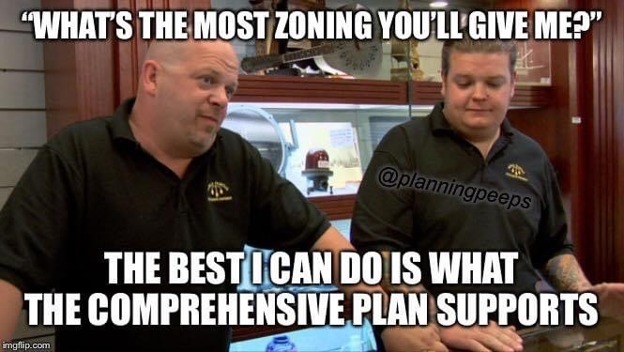
PLANNING COMMISSION: TIPS
Are environmental impacts reduced or eliminated by conditions or are there overriding considerations?
Is decision supported by findings of fact based on substantial evidence in the record?
Anything else?
Does it meet all applicable zoning and subdivision requirements?
Is the proposal consistent with the Comp Plan?
FOLLOWING THE LAW - ASK THESE QUESTIONS
Notes:
Following the law is obviously important, and here are just a few questions members of the planning commission should be asking themselves when making decisions to assist with that. Is this proposal consistent with the Comprehensive Plan? Does it meet all applicable zoning and subdivision requirements? And of course, many other considerations not listed here. (next slide)

Slide 35
PLANNING COMMISSION: MEMBERS
BEING EFFECTIVE
Learn meeting procedures (Robert’s Rules of Order)
Stay informed
Keep communication open
Be an effective leader
Follow the law
Notes:
Planning commission members should take it upon themselves, if not offered through their jurisdiction, to learn meeting procedures. They should stay informed about the requests and projects before them, keep communication open, be an effective leader, and of course they should follow the law! (next slide)

Slide 36
PLANNING COMMISSION: MEETING BASICS
Notes:
Some meeting basics for commission members to remember:
1. Respect the majority vote
2. No voice counts more than another.
3. Only one topic will be considered at a time.
4. Follow the adopted agenda and procedures for the board.
5. Comments should always be directed to the chair, and it is good practice that the public, when speaking, directs their comments to the chair as well.
6. Deliberations and decisions should be made publicly. (next slide)

Slide 37
AGENDA
Introduction of reports/documents
Approval of minutes
Old business
New business
Other business
Adjournment
Notes:
A typical planning commission agenda looks something like this. Some agendas may include more or less. (next slide)

Slide 38
ACTIONS: What are your choices?
Approve
Deny
Postpone
Approve with Conditions
Notes:
What are the planning commission member’s choices when making a decision? They can approve, approve with conditions, deny, or postpone. (next slide)

Slide 39
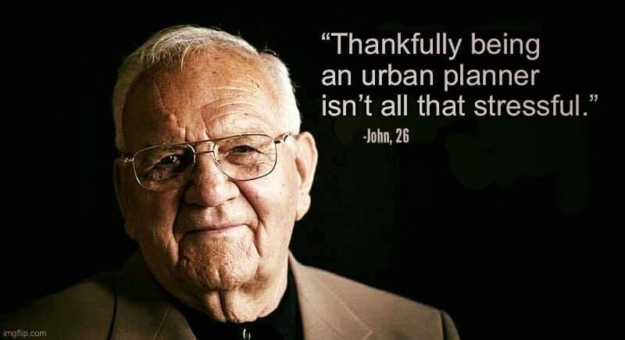
LOCAL STAFF RESPONSIBILTIES
Administer code
Provide full and accurate information and background to applicant, developers, boards, commissions, and landowners
Reports/recommendations based on fact (plan/code)
Administrative permits
Notes:
Now, broadly speaking, let’s talk about local staff responsibilities. Of course, they administer the code. They provide accurate information and background to applicants, developers, boards, commissions, and landowners. They prepare reports and recommendations based on facts using plans and codes. And some also issue administrative permits. (next slide)

Slide 40
DEVELOPMENT COMMUNITY
Acts as agents for property owners or neighborhood
Professional wisdom and experience
Notes:
Regarding the development community, what are their roles? They can act as agents for property owners or a neighborhood, and can provide professional wisdom and experience. (next slide)

Slide 41
WHO IS THE DEVELOPMENT COMMUNITY?
Real estate agents/brokers
Land developers/speculators
Residential and commercial builders
Apartment developers and landlords
Lawyers
Engineers, architects, surveyors
Bankers
Consultants
Trade groups/special interest groups
Notes:
So who is the development community? They could be anyone from lawyers, to real estate agents, and developers or landlords. (next slide)

Slide 42
THE PUBLIC
Plans belong to the community
Publishing hearing agenda in various media outlets is good tool
Handouts and visuals can help individuals understand in process
Notes:
And last but certainly not least, is the public. Planning first and foremost, is serving the public’s interests. (next slide)

Slide 43
FINAL WORDS
Notes:
In closing, here are a few things to keep in mind going forward:
1. Plans are a guide, codes and ordinances are the law, but they should work hand in hand to achieve a desired future.
2. Staff, boards, and commissions must be objective, consistent, and fact-based.
3. Plans are living documents and must evolve with changing conditions.
4. Implementation and enforcement are important.
5. And focus must be sustained by staff and elected officials. (next slide)

Slide 44
Juli Yoder, AICP
Principal Planner/ Planning Manager
planning@dca.ga.gov

