Slide 1
Georgia
Planning & Financial Resources for
Affordable Housing

Slide 2

Why is Planning for Housing Important?

Slide 3

Housing is an
Economic Development Issue
Housing availability and affordability are essential in attracting new businesses
When workers spend more on housing, they spend less on goods and services in the local economy
Housing is a
Transportation Issue
Rising housing costs = longer commutes
Notes:
Did you know that the shortage of affordable housing costs the American economy an estimated $12 trillion a year in lower wages and productivity?

Slide 4


Over the last five years, Georgia has witnessed record-breaking economic development, with over 2,000 new or expanded site locations and 268,000 jobs added to the economy.
“In the same five years, we’ve experienced unprecedented economic growth in every corner of the state, housing inventory has decreased by over 60%, making the dream of homeownership unattainable for nearly four million Georgians,” said Daniela Perry, vice president of the Georgia Chamber Foundation.

Slide 5




Fast Facts
Georgia's housing inventory has decreased by 60% over the last 5 years.
29% of children live in high housing cost-burdened households.
The number of first-time home buyers has declined by 8% over the last year.
The average county in Georgia has seen a 53.6% increase in monthly housing payments.
SOURCE: State of Housing Report, GA Chamber of Commerce, State of Housing Report | Georgia Chamber of Commerce

Slide 6
Housing Costs
Columbus-Muscogee County - $179,874 = 3.8% increase
Macon-Bibb County - $166,248 = .4% increase
Augusta-Richmond County - $183,865 = .1% increase
Chatham County/Savannah - $351,852 = .6% increase
Fulton County/Atlanta - $435,769 = 2.6% decrease
State of Georgia - $336,660 = .5% decrease
*Over the past year and goes to pending in around 30 days. Source, Georgia Housing Market: 2025 Home Prices & Trends | Zillow

Slide 7
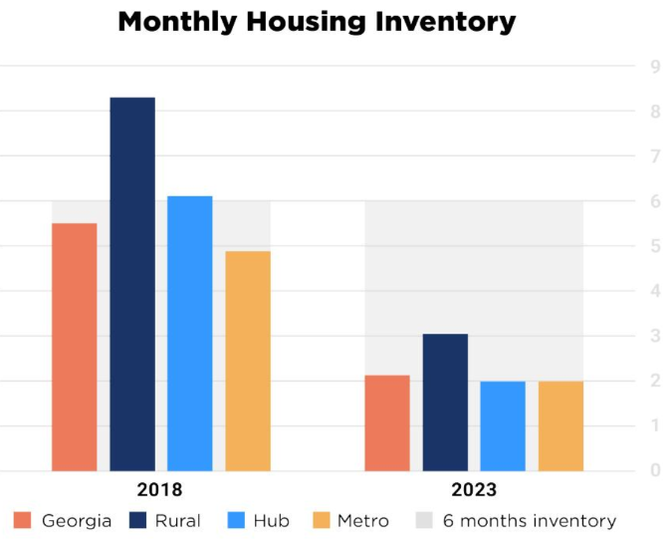
Housing Inventory
A healthy community housing stock level is around 6 months of supply. From November 2018 to November 2023, the number of Georgia counties with at least a 6-month supply of housing dropped from 75 to only 9 counties. This indicates that the rate at which new housing is being developed is not adequate to accommodate our state’s population growth rate.
SOURCE: State of Housing Report, GA Chamber of Commerce, State of Housing Report | Georgia Chamber of Commerce

Slide 8
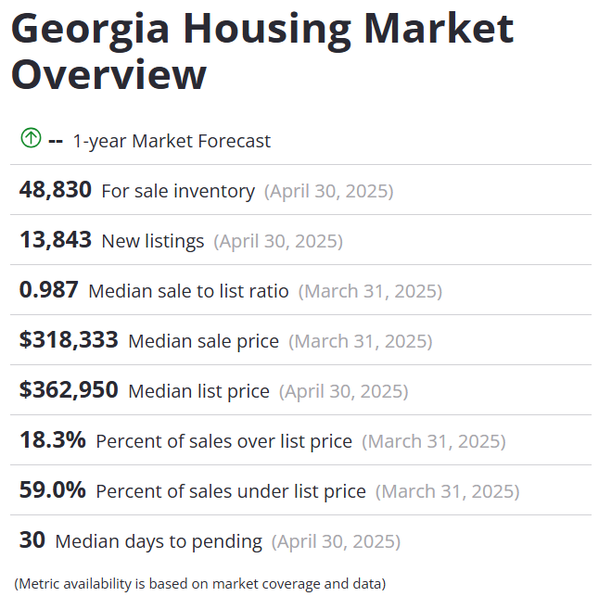
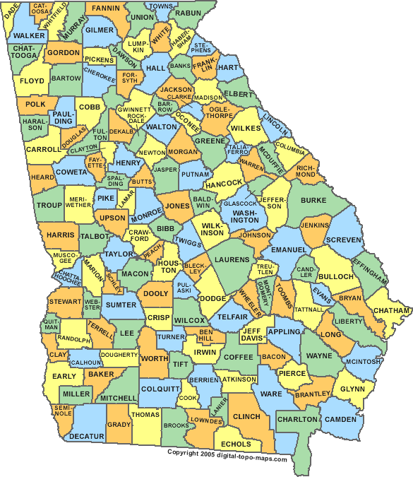

Slide 9


Slide 10
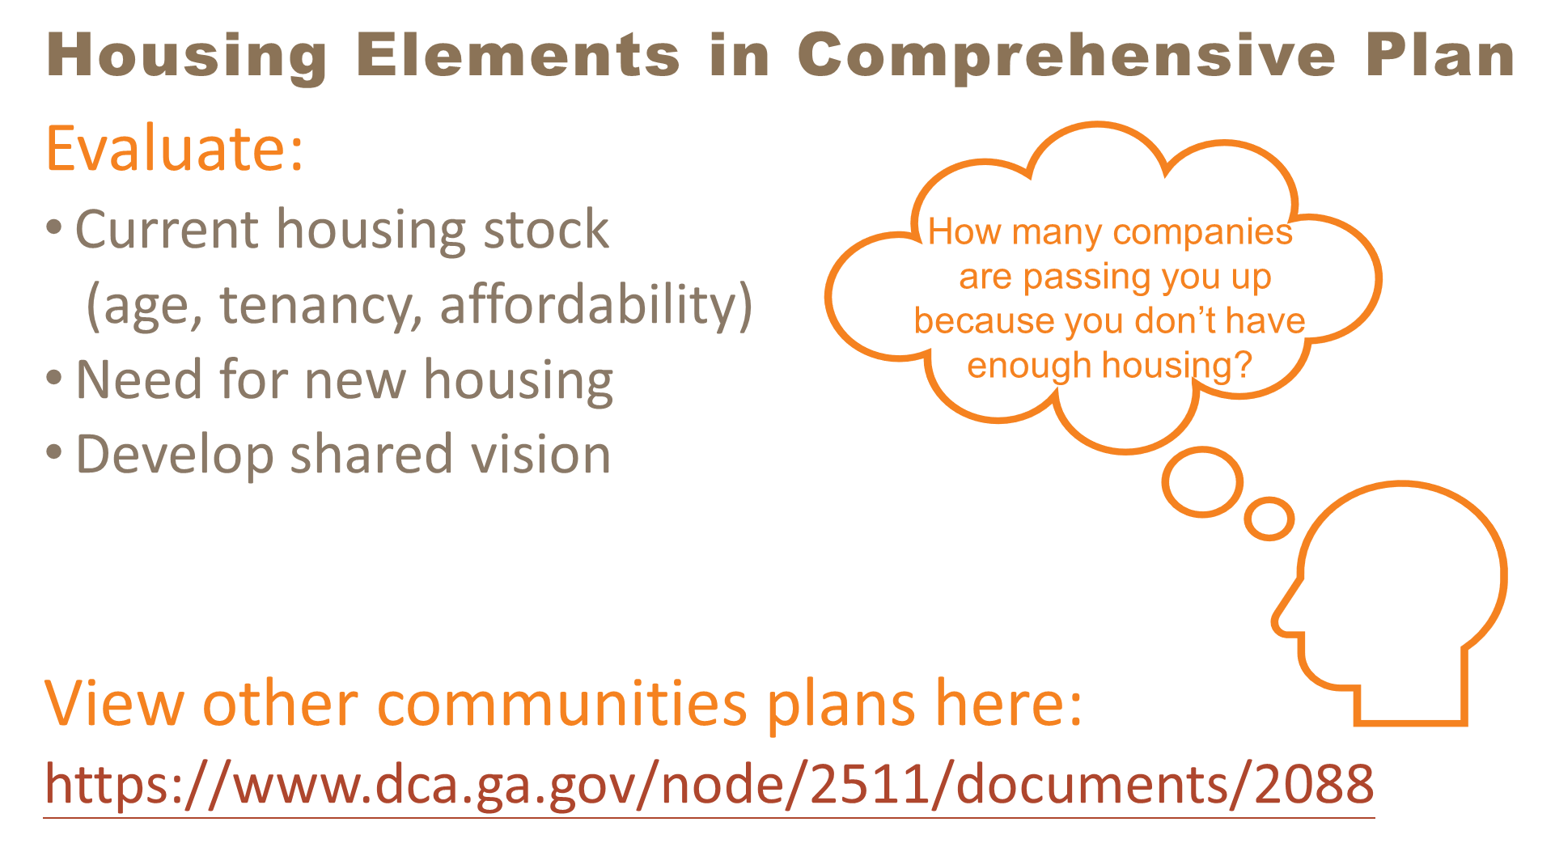

Slide 11
Create a Housing Market Study
DCA LIHTC Guide Link
Presentation on Planning & Zoning for Affordable Housing from DCA 2020 Fall Conference Link
Georgia Initiative for Community Housing (GICH)
Georgia Housing Planning Resources

Slide 12

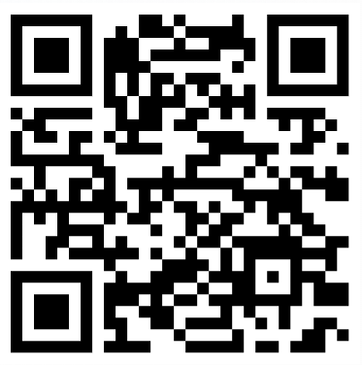
Georgia DCA Resources
60+ Programs
Local Reps in 12 GA Regions
Planning Resources for Local Governments
13 Affordable Housing Programs
26 Community & Economic Development Programs

Slide 13
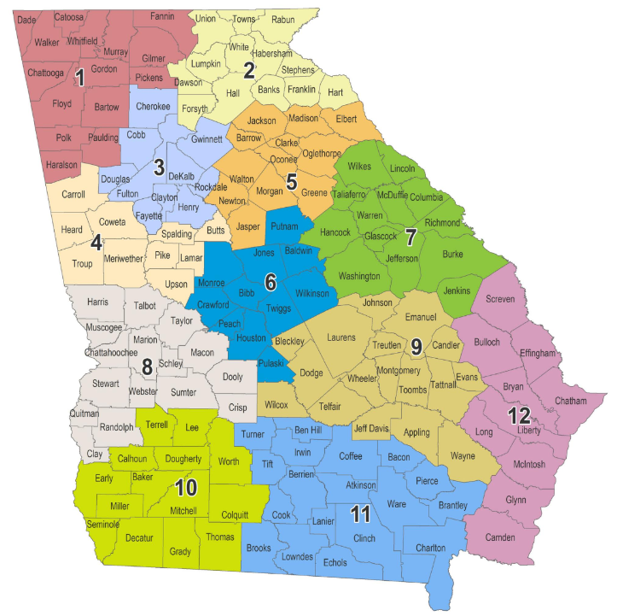
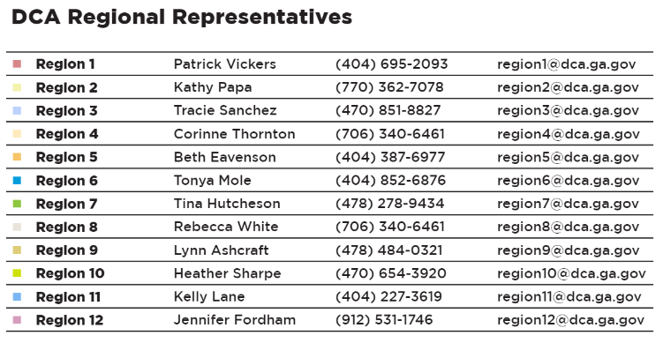
DCA Regional Representatives
Contact: Corinne Thornton, Director Corinne.Thornton@dca.ga.gov
706-340-6461

Slide 14
Planning Resources for Affordable Housing

Slide 15





Georgia Initiative for Community Housing
GICH
GICH helps communities improve their quality of life and economic vitality through the development of locally-driven housing and revitalization strategies. This is achieved through:
Technical assistance
Collaboration
Expert presenters
Training
Facilitation
Consensus building
Networking
Mentoring

Slide 16
Home Ownership
Programs

Slide 17

Community HOME Investment Program
CHIP
Available to local governments, housing authorities, and non-profits
$1.5 Million for Single-Family Construction
$500K for Owner-Occupied Rehabilitation
Homeowners/homebuyers income must be under 80% AMI

Slide 18
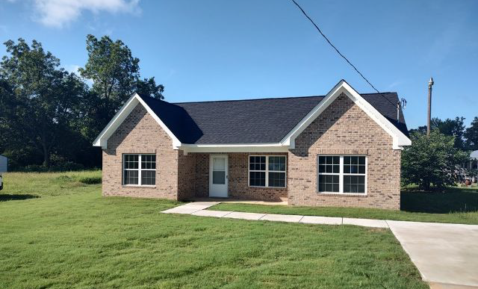
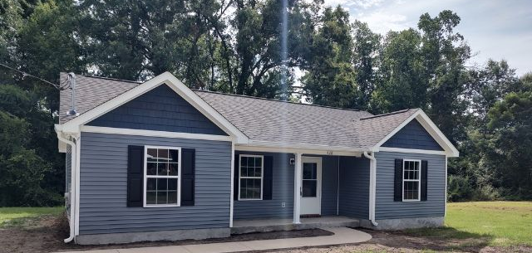
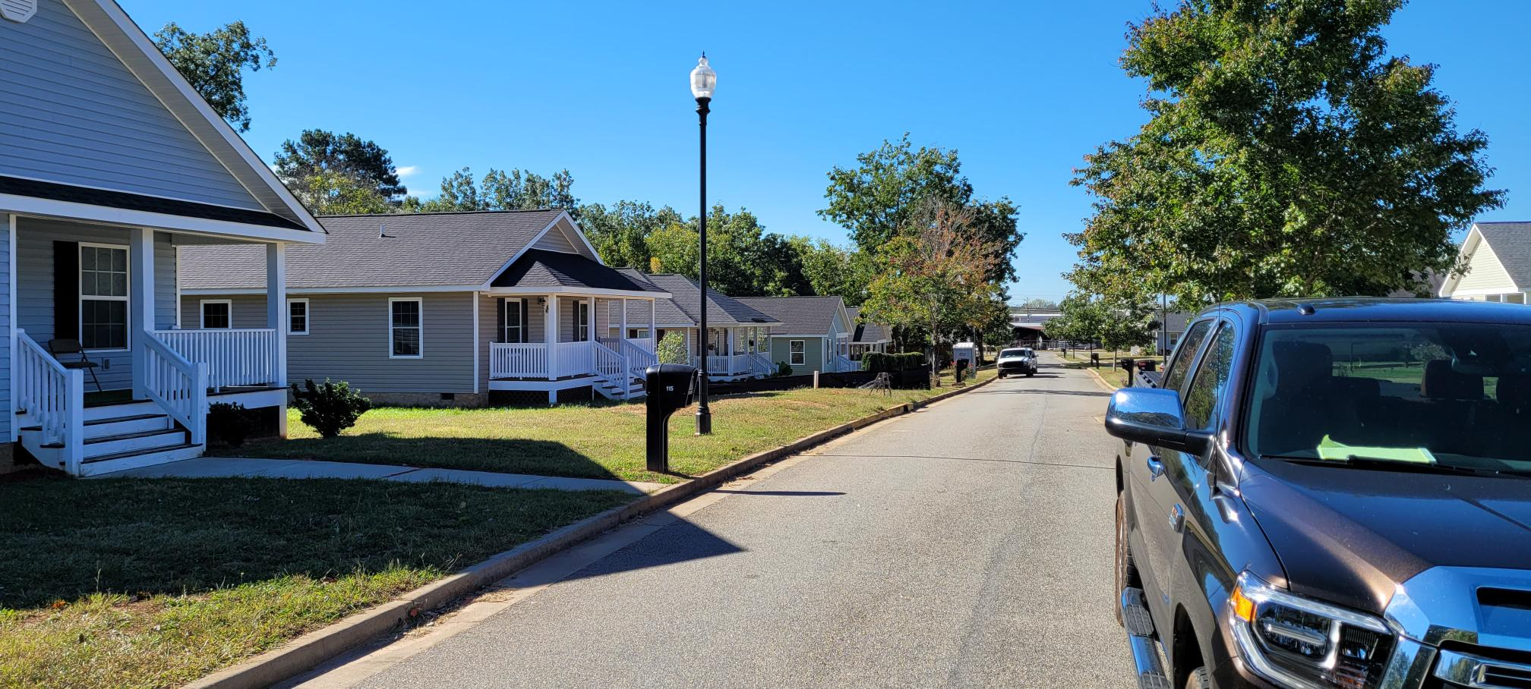
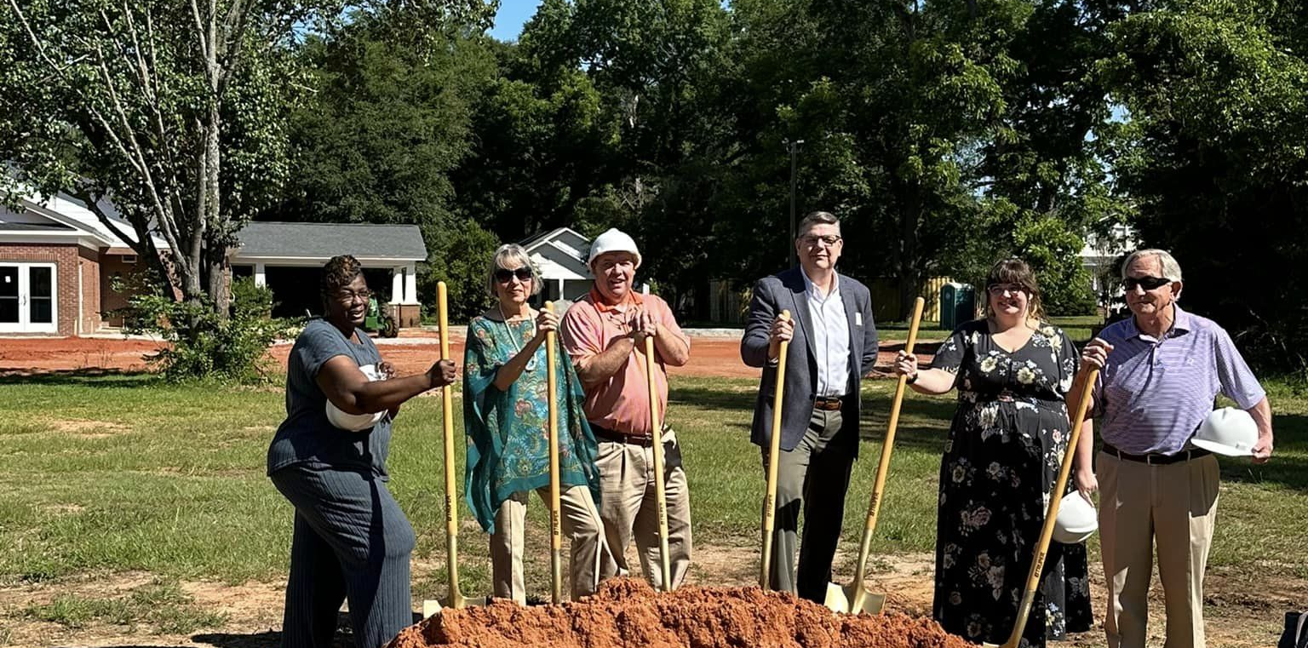
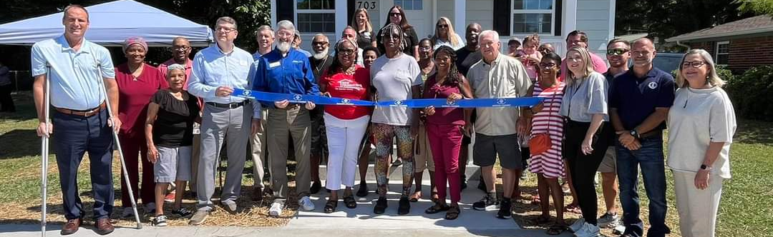

Slide 19
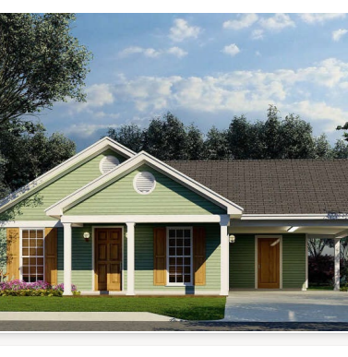
Rural Workforce Housing Initiative
Single-family homes for use as a primary residence with a sale price of between $125,000- 290,000.
Maximum $1 million loan (Loan Term – 2 years from Award date)
The project must be completed, the Home must be sold to an owner-occupied Homebuyer, and the loan must be repaid to DCA within two years.
Applications will be accepted quarterly. (The second Friday of the following months: January, April, July, and October.) Prior to submitting the pre-application, an initial project assessment meeting must be held with the DCA Regional Representative. Pre-applications are due 30 days before the full application.

Slide 20
Housing Development
Programs

Slide 21
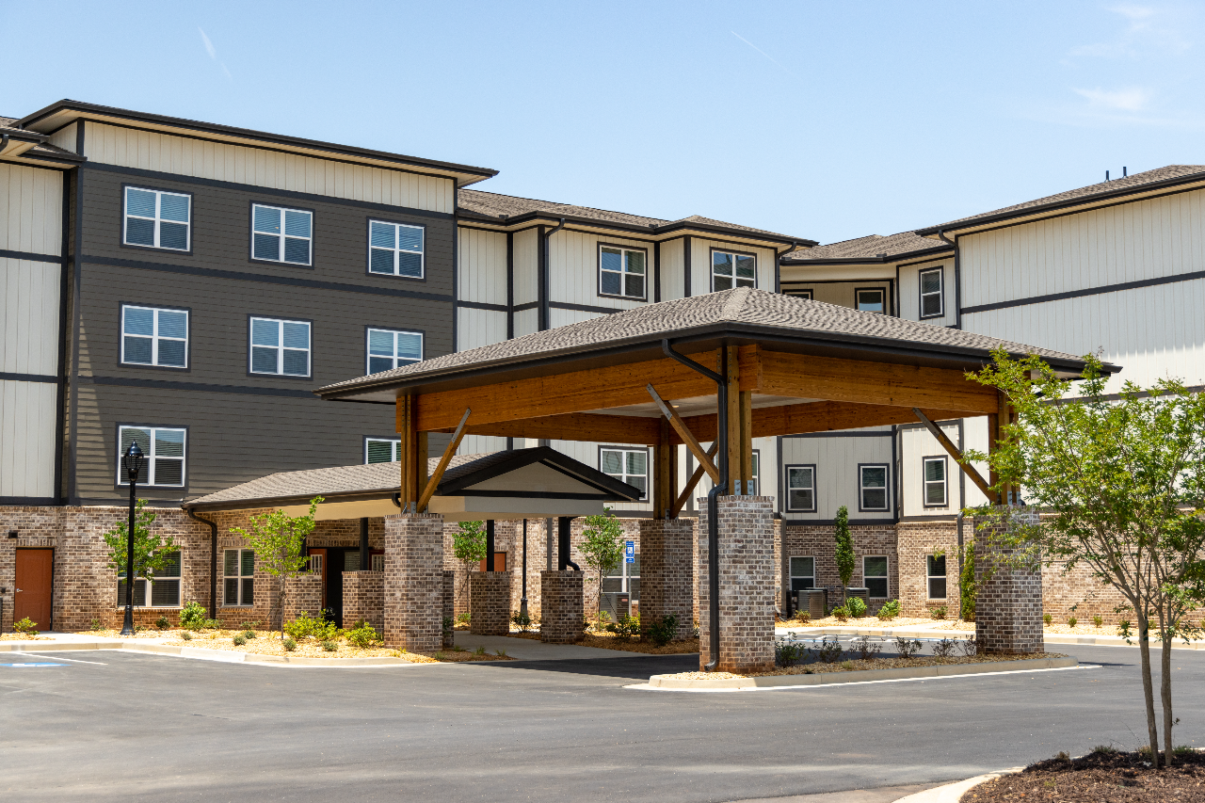
Housing Tax Credits
The Housing Tax Credit Program produces rental housing for households with incomes between 20% and 80% of the Area Median Income.
Provides tax credits for new construction or acquisition/rehab
Must remain affordability for 20+ years
Housing provided for families or senior citizens

Slide 22
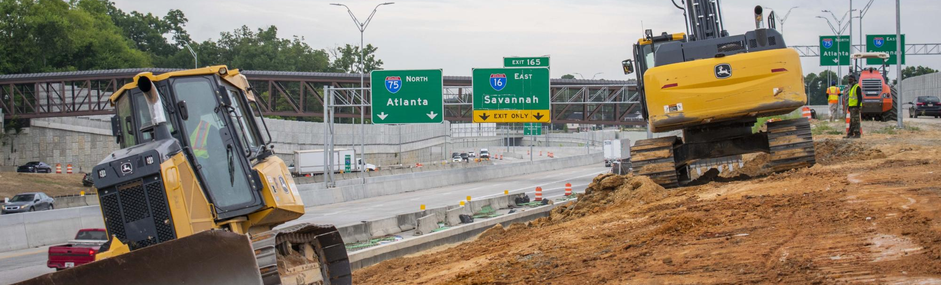
Community Development Block Grant
CDBG
The Community Development Block Grant Program (CDBG) provides funding to assist a wide range of eligible activities, including housing improvement projects, public facilities such as water and sewer lines, buildings such as local health centers or head start centers, and economic development projects. All projects must substantially benefit low—and moderate-income persons.
The maximum amount available per applicant is $1,000,000 for a Single Activity during regular competition and $1,250,000 for a Multi-Activity during regular competition.

Slide 23
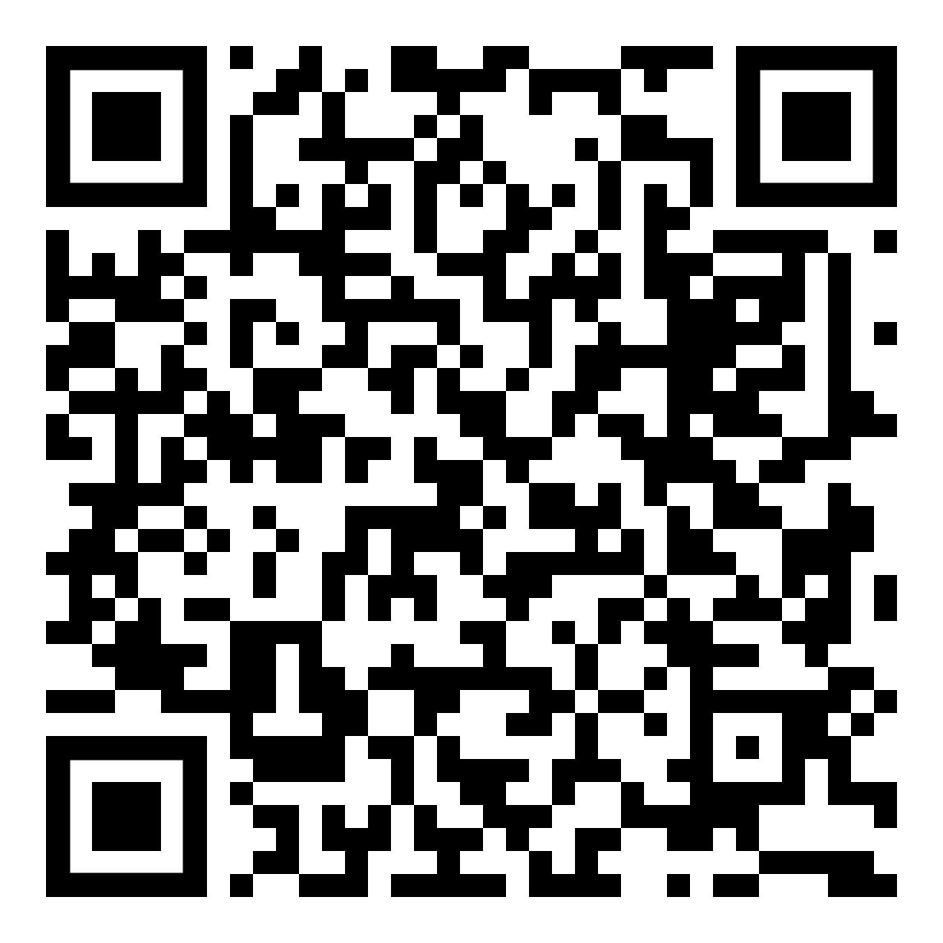
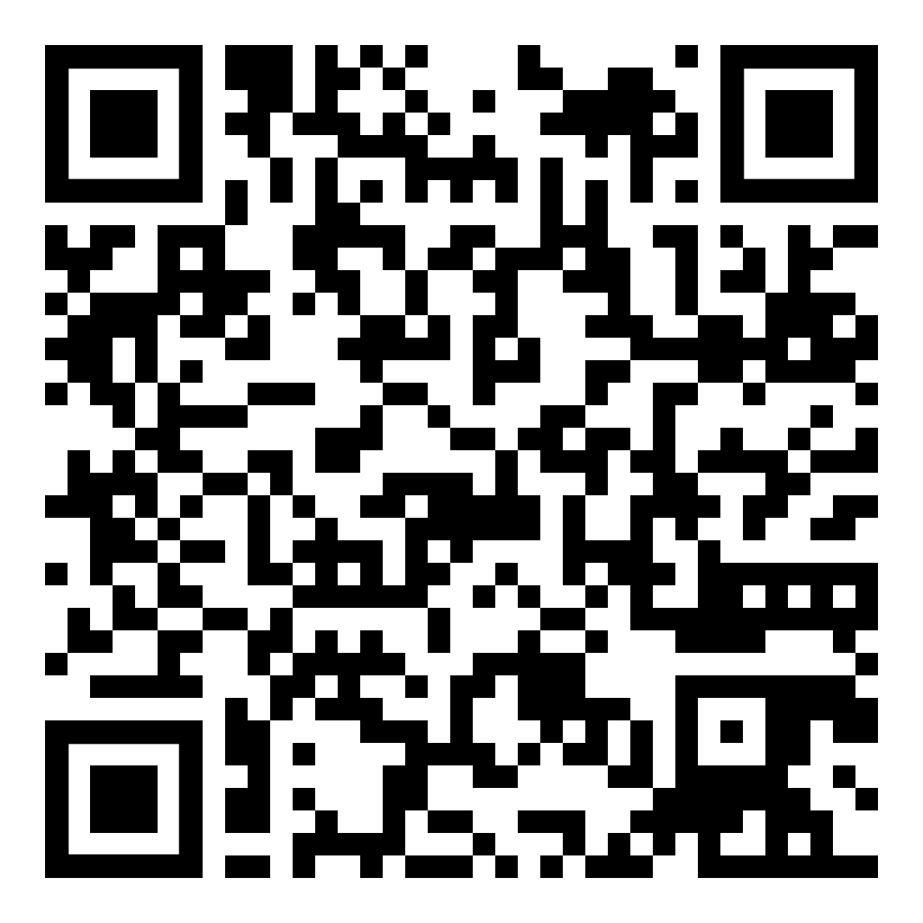
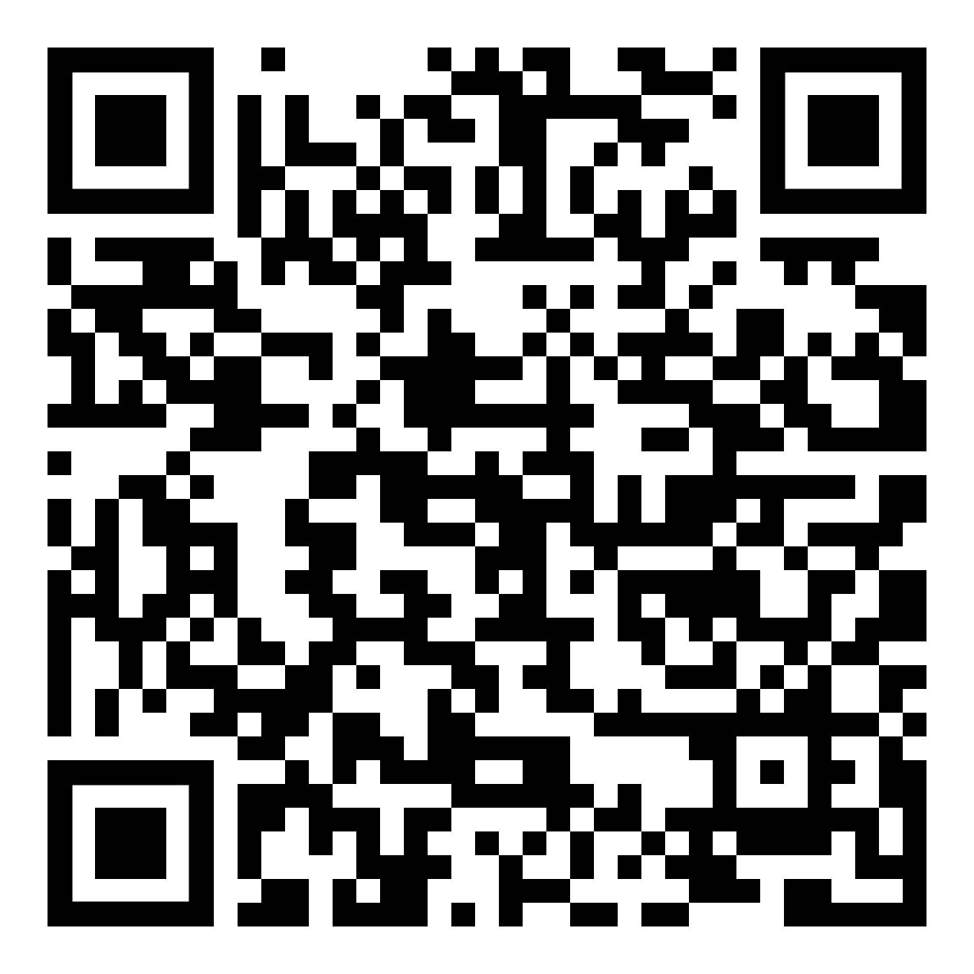
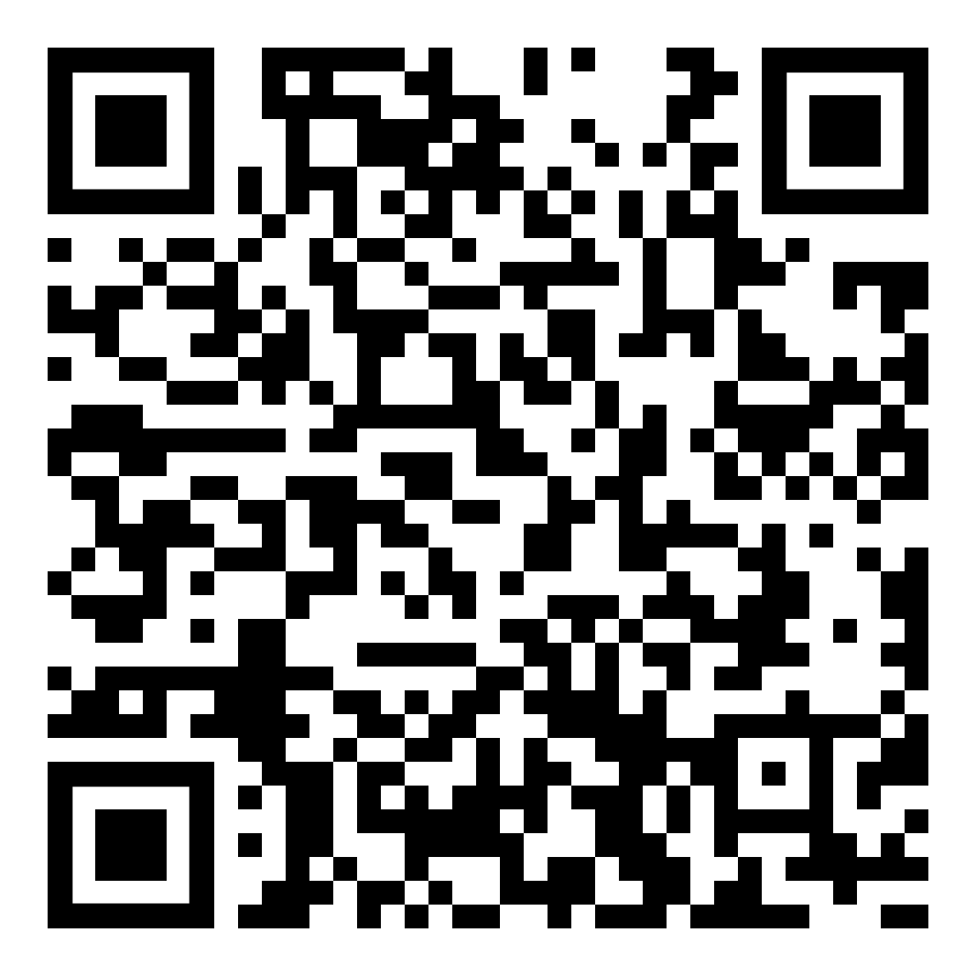
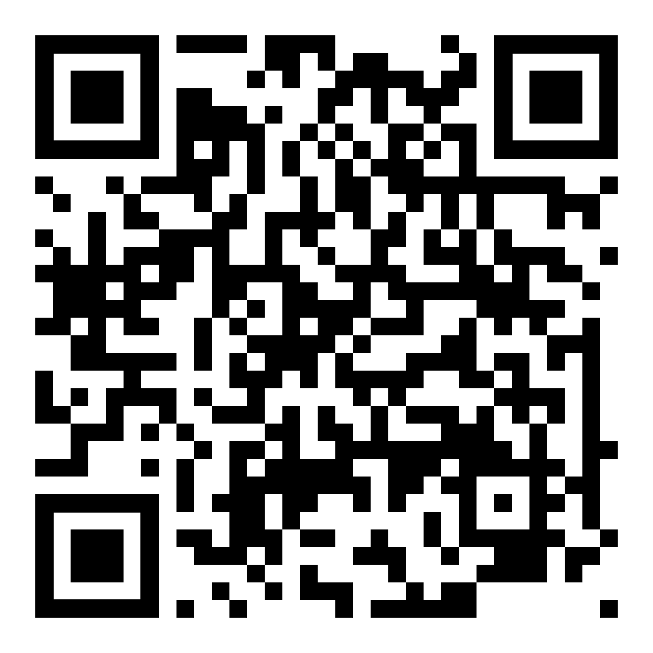
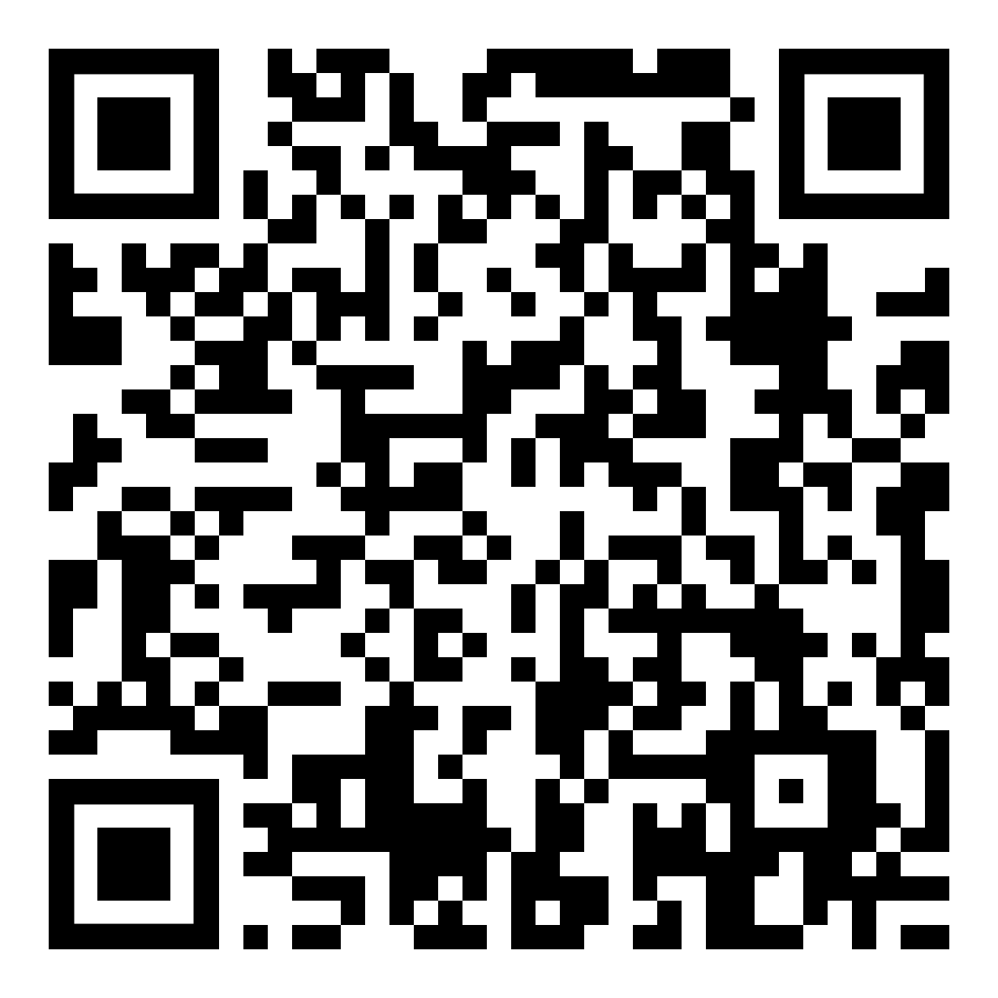
Questions & Resources
CHIP Questions
CDBG Questions
LIHTC Questions
RWHI Questions
Please scan the appropriate QR Code to email a team member or access resources.
DCA Guide to Services
Housing Georgia’s Workforce

Slide 24

Thanks!
Chris Hurley
Chris.hurley@dca.ga.gov
Direct: 470-773-8892
Community Housing Outreach Coordinator
dca.ga.gov

