Slide 1
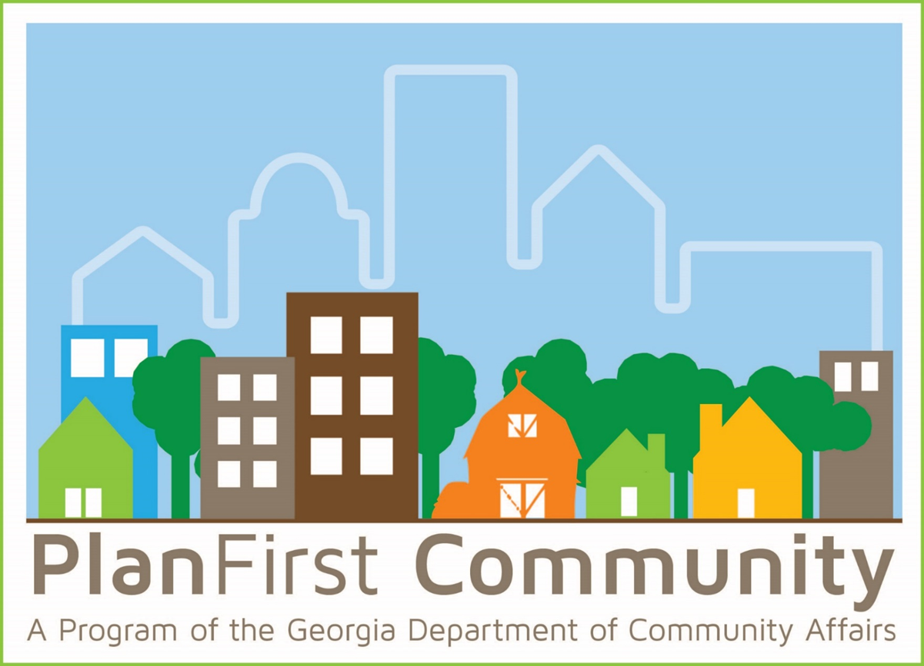


The PlanFirst Program upcoming dates
1. Webinar for new applicants February 19 @ 9 am.
2. Webinar for renewal applicants with their current PlanFirst term ending Dec. 31 2025: February 26 @ 9 am
3. Check for eligibility to our team by April 15 (simply email planning@dca.ga.gov and ask for eligibility)
4. Application due May 15
Daniel Gaddis, Planning Outreach Coordinator
Notes:
You can see we have several upcoming webinars about the PlanFirst program, where we dive deep into the application, talk about the high scoring questions, the low scoring questions, what reviewers are looking for, etc. Our first one is coming up February 19 at 9 am and is open to anyone that may be interested in applying as a new applicant.
For those communities that will be ending their 3-year term as a PlanFirst community. That webinar will only be open to these regional commissions, regional representatives, our planning staff, and those specific communities of: Douglas, Dublin, Grovetown, Gwinnett County, Oconee County, and Vidalia.
You’ll see the other deadlines. To check eligibility, please email planning@dca.ga.gov before April 15. The application is due May 15, 2025.

Slide 2
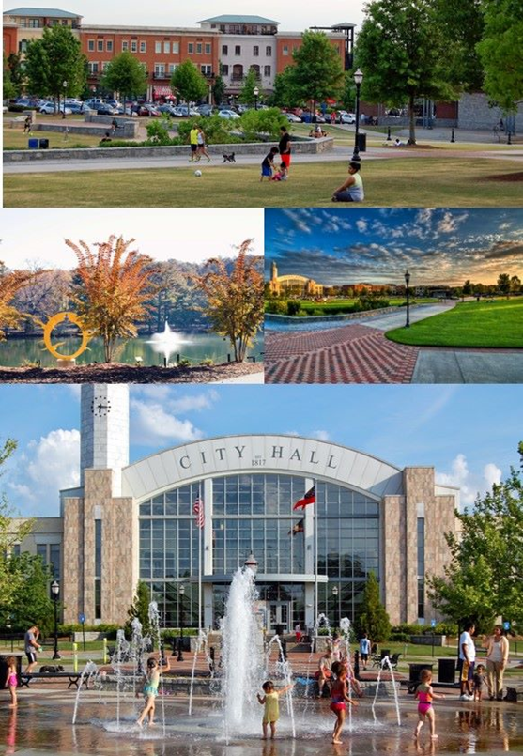
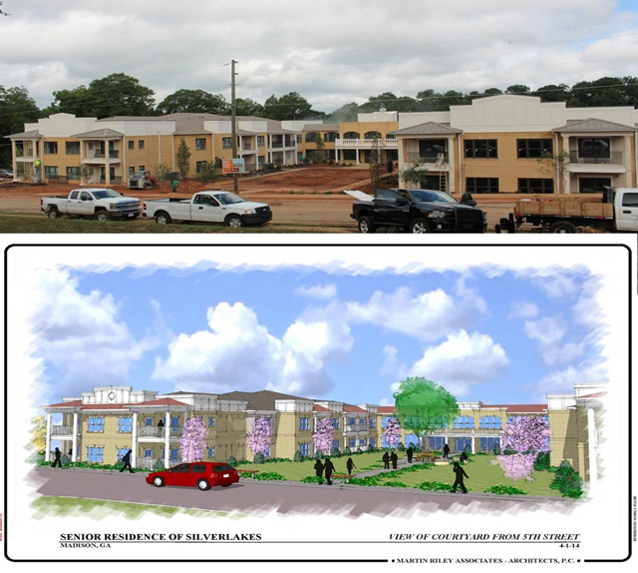
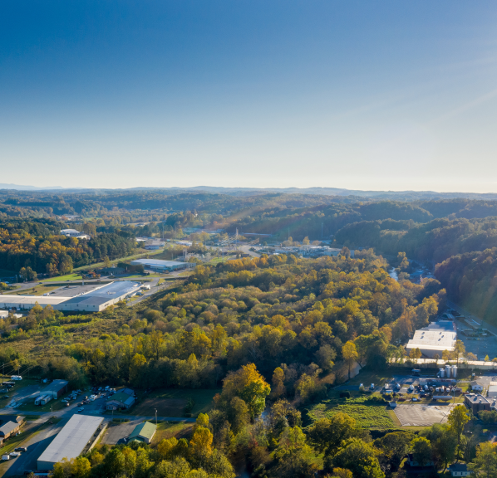
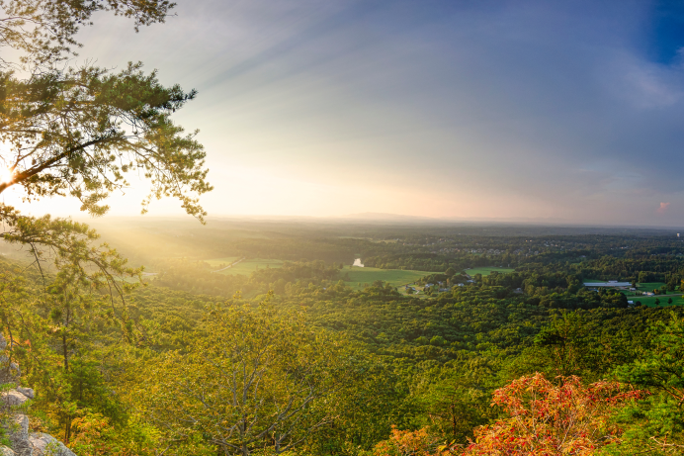
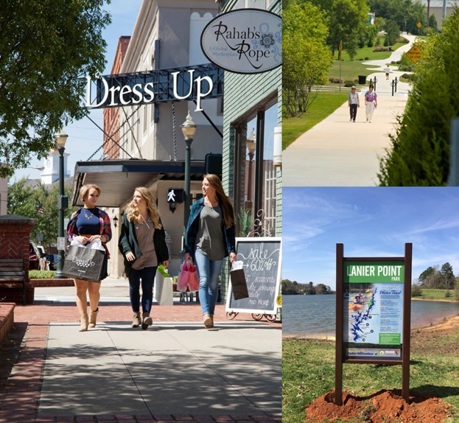
What is PlanFirst ?
Notes:
Put simply, a PlanFirst community is one that is recognized by the State of Georgia’s Department of Community Affairs for implementing their comprehensive plan in an exemplary way.
Through a community’s goals, leadership, public participation, and implementing their plan, communities that are designated a PlanFirst community are going above and beyond what is required to make sure they are keeping effective planning a very high priority.

Slide 3




Why do you want to participate ?
Recognition
Community Development Block Grants
GEFA loan interest reduction
LIHTC and CHIP bonus points
NEW
Notes:
There are several great reasons to apply-each of which may be different reasons for different communities. The last circle here shows a couple of the newest incentives we are very excited about it!
For applications for both the 4% and 9% housing tax credits, if the proposed development falls within the boundaries of a PlanFirst community, it is eligible for an additional 3 points. If you are a community where a housing authority and developers are working to address housing shortages, then applying for this designation is well worth the effort. Oftentimes, these applications are decided by fractions of a point.
To expound: the applicant’s local government must have a qualifying Community Revitalization Plan (CRP) (see pages 104-105 of the QAP).

Slide 4
Benefits of PlanFirst
Statewide recognition for outstanding planning and implementation.
Eligibility to apply EVERY year for CDBG funding.
3 Bonus points on Housing Tax Credits application.
Reduction on certain DCA loans: EIP, Redevelopment Fund and DDRLF.
Reduction on certain GEFA state loans.
2 free registrations at any Community Planning Institute per 3/year cycle.
Notes:
Ok, we’re gonna camp here for a while. And I propose you all listen closely, cause there may be a quiz after this.
As we think about the suite of benefits available to for PlanFirst communities, the architects of this program inserted benefits for communities of all sizes, needs, and demographics. We know that Georgia’s communities are diverse and we have reflected that diversity in this program’s design and benefits.
State-wide recognition by DCA, the use of the PlanFirst logo, announcements on the website and DCA social media, invitation to the Capitol for Planning Day at the Capitol, recognition in a State Senate and State House Resolution honoring your community, and hopefully a photo opportunity with Governor Kemp. We also want to tout your successes and tell your story as a PlanFirst community-we have our PlanFirst communities to submit a success story-this can look like a housing project, stormwater infrastructure improvements, improved transportation, an economic development project, downtown redevelopment, improved parks, the list goes in. We want to celebrate your successes at the state level and we want to invite communities to learn about what you did that overcame challenges, how you engaged with your community, how you tapped critical stakeholders, how you led in your region, all for the benefit of other similar communities that are dealing with the same issues.
Here’s probably one of the biggest benefits in the PlanFirst package. Annual access to apply to Community Development Block Grants instead of bi-annually.
Bonus 3 points on the LIHTC-Part of the Community Revitalization Plan in the application. This is applicable to the 4% and 9% applications.
100 basis point reduction, or 1%, for loans through the Employment Incentive Program • 100 basis point reduction, or 1%, for loans through the Redevelopment Fund Program • 100 basis point reduction, or 1%, for loans through the Downtown Development Revolving Loan Fund Program
Access to the Georgia Environmental Finance Authority (GEFA) state loans at an interest rate that is reduced by 50 basis points, or ½ percent. As an example of this benefit, the interest rate savings over the life of a 20-year water or sewer loan of $200,000 would be just over $13,000.
Communities have signed up for our Fall (now rescheduled to today and tomorrow) CPI and PlanFirst communities are taking advantage of these two free spots! Raise your hand if you took advantage of the free two spots for PlanFirst! That will continue as well when we meet in the Fall-so please consider this benefit.

Slide 5

PlanFirst benefits
½%
Reduction on GEFA loans.
1%
Employment Incentive Program reduction.
1%
Redevelopment Fund Loan reduction.
1%
Downtown Revolving Loan Fund reduction.
3
Bonus points on LIHTC and CHIP applications.
Satisfaction points of being a PlanFirst community…
Notes:
Here are some of the financial benefits displayed in a different visual. Check out that last metric. Probably the best.

Slide 6
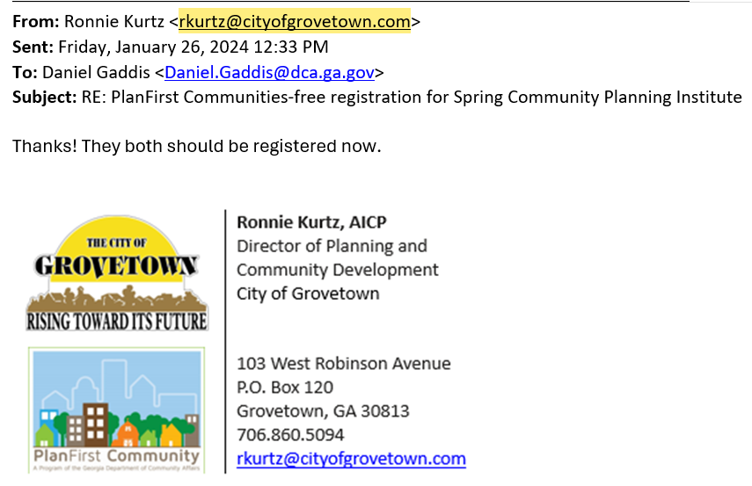
Notes:
I’ve encouraged our active PlanFirst communities to place the logo in their email signature. Here we have the PlanFirst email signature badge in the wild. This signals to all internal and stakeholders that this community is serious about public engagement, accomplishing goals, and casting a community-held vision for the future. This PlanFirst badge is used pretty widely on the community websites. Hopefully this can be a conversation starter and can facilitate some learnings about best practices.

Slide 7
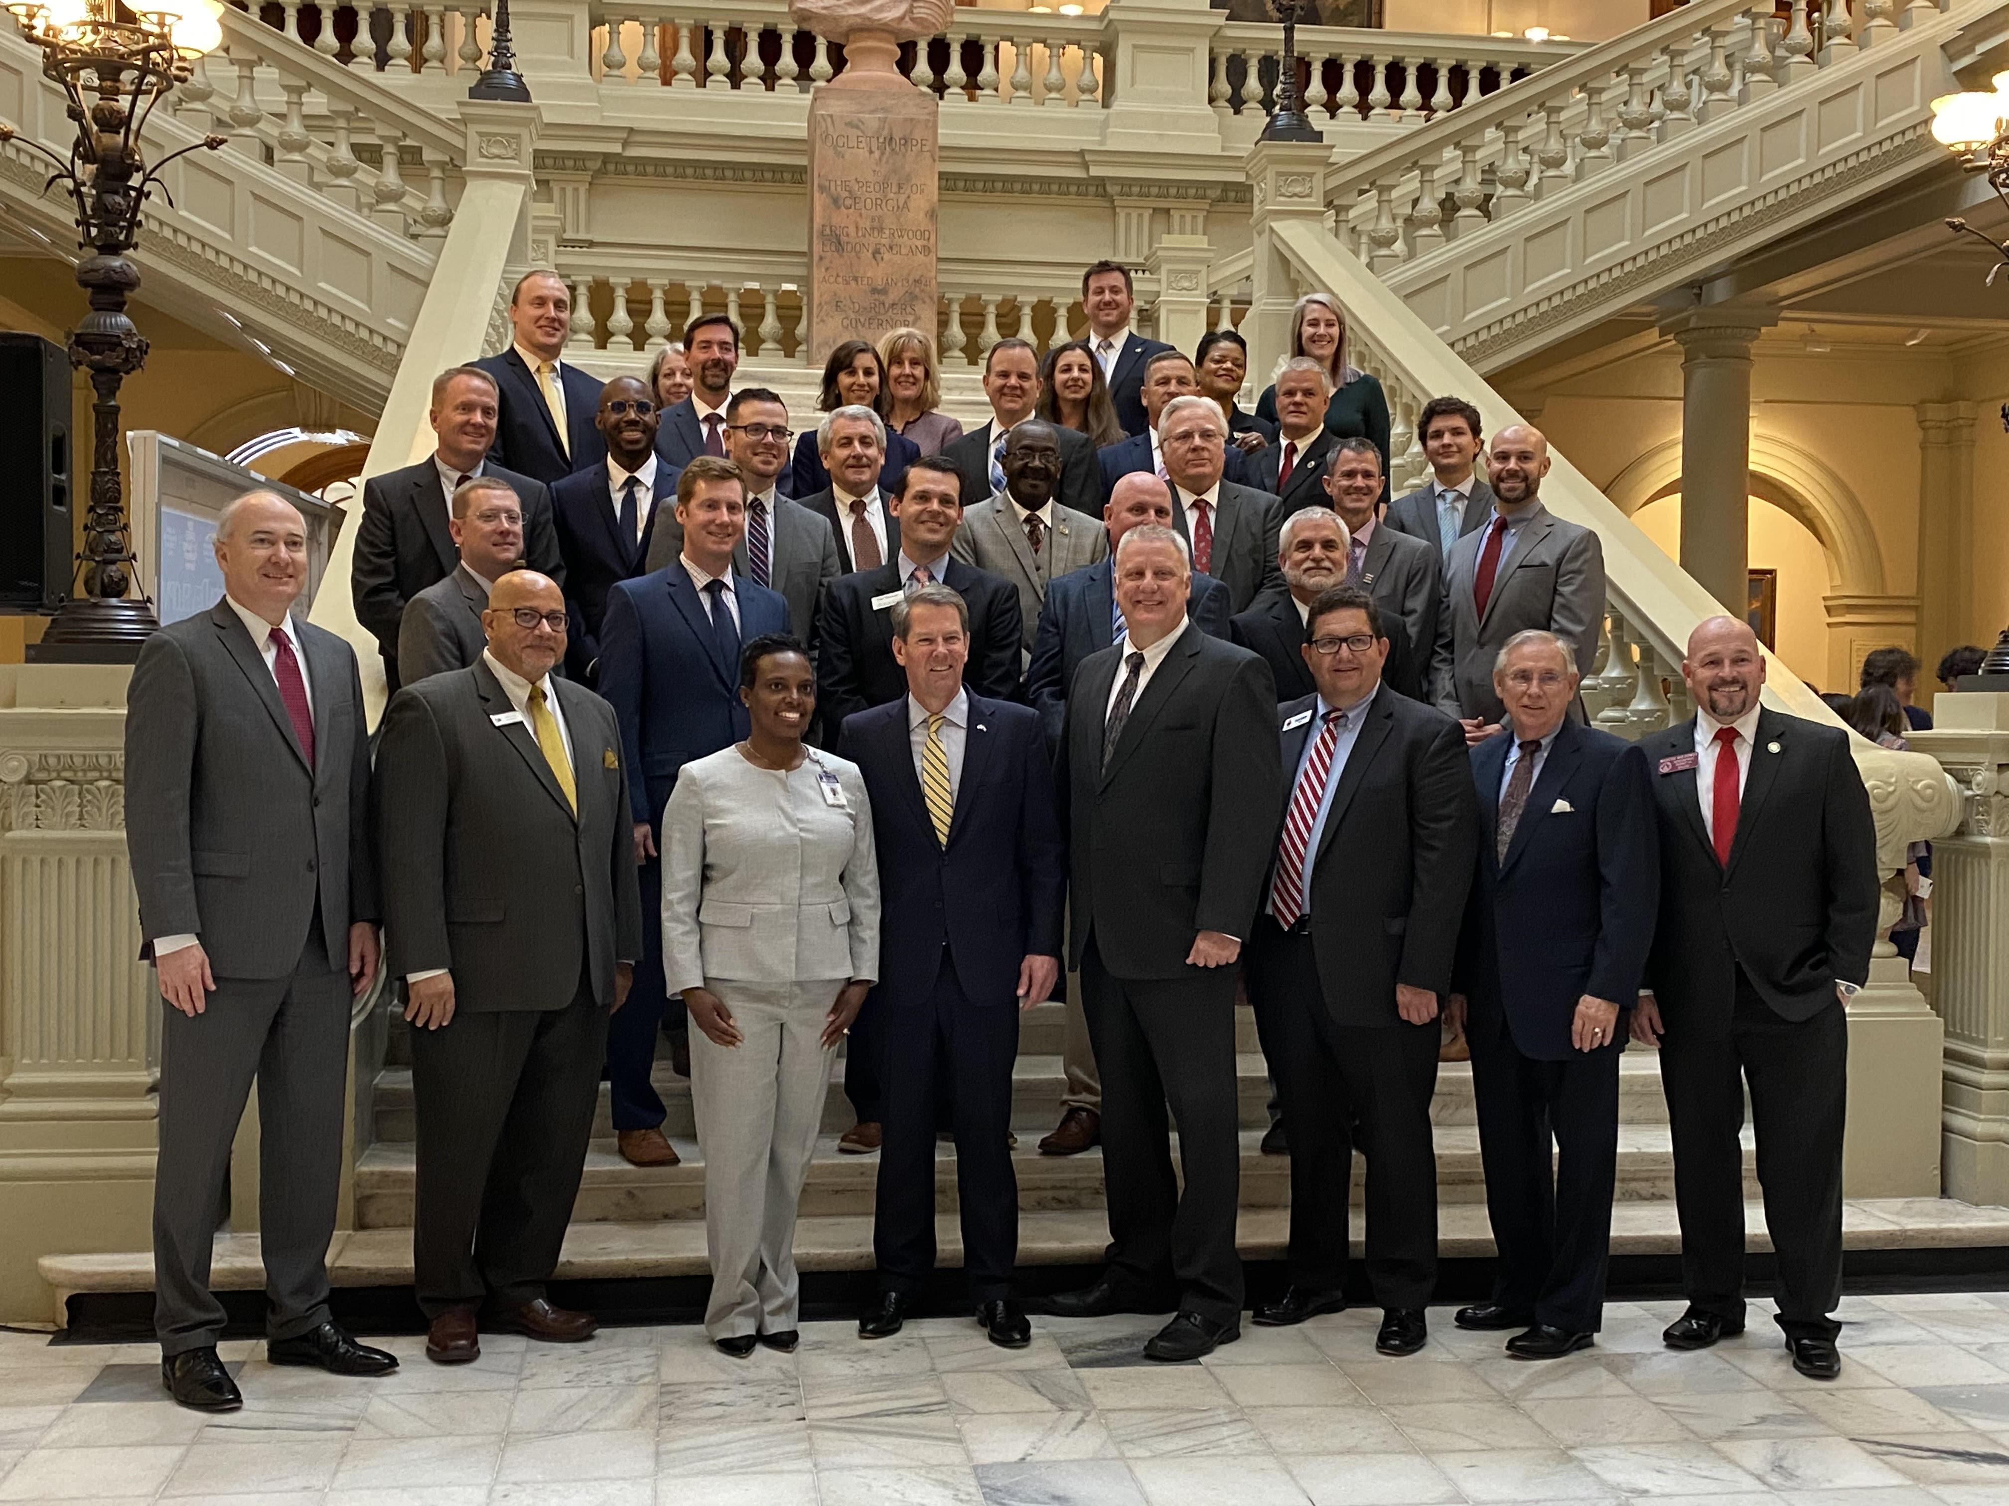
Notes:
Here’s another benefit that falls into the recognition piece. Planning Day at the Capitol-honoring the commitment of these communities to exemplary comp planning. Here’s a picture from February of 2020.
Besides the photo opp and a plaque given out by Commissioner Nunn, these communities are also recognized by a House and Senate Resolution. It’s my hope that we can facilitate more discussion from our communities and state legislators about planning issues.

Slide 8
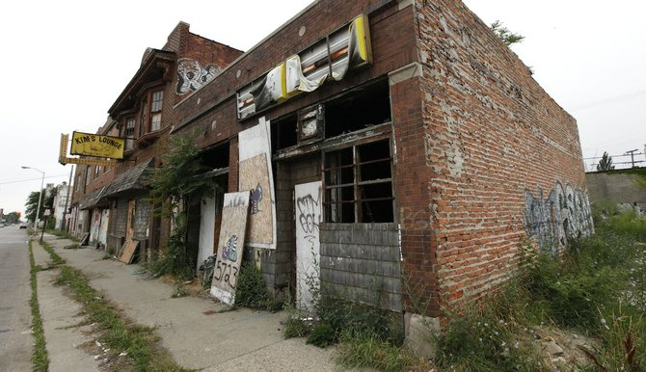



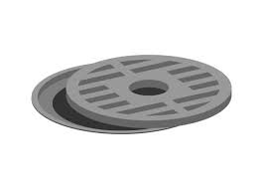

Alphabet soup-lightning round
GEFA
RDF
LIHTC
CPI
CDBG
DDRLF
EIP
Notes:
Now, let’s see if ya’ll were listening.
Ok, welcome to Alphabet Soup Lightning Round! The winner is the table with the most correct answers-because this is a lightning round, we have to move fast.
All you have to do is tell me the what the program acronym stands for by dropping the answer in the chat.
I’ll also ask you what is a defining feature or important information to know about each specific program. But don’t worry-that’s not part of the competition.
Yall ready?
Any questions before we begin?
#1 CPI
Community Planning Institute
What is it? Two-day planning workshop aimed at planning commissioners, elected officials, and planning staff.
#2 GEFA
Georgia Environmental Financing Authority
What is it? Provides low-interest loans for public water, wastewater, and solid waste infrastructure.
#3 LIHTC
Low income housing tax credit
What is it? Provides housing tax credits to qualified developers serving households with incomes between 20%-80% Area Median Income. 4% and 9% credits.
#4
RDF
Redevelopment Fund
What is it? Economic development fund from CDBG that addresses specifically slum and blight.
#5 CDBG
Community Development Block Grant
What is it?
HUD fund provided to states that focuses on low-to moderate income people by providing funding in primarily residential areas. Grants over $300K require local matching funds.
#6 DDRLF
Downtown Development Revolving Loan Fund
What is it?
Financing for populations less than 100K that have a viable downtown development project-funds can be real estate acquisition, development, redevelopment, and new construction; max loan is $250K
#7 EIP
Employment Incentive Program
Economic Development Fund that generates jobs for low-to-moderate income persons and involves assisting private businesses.

Slide 9
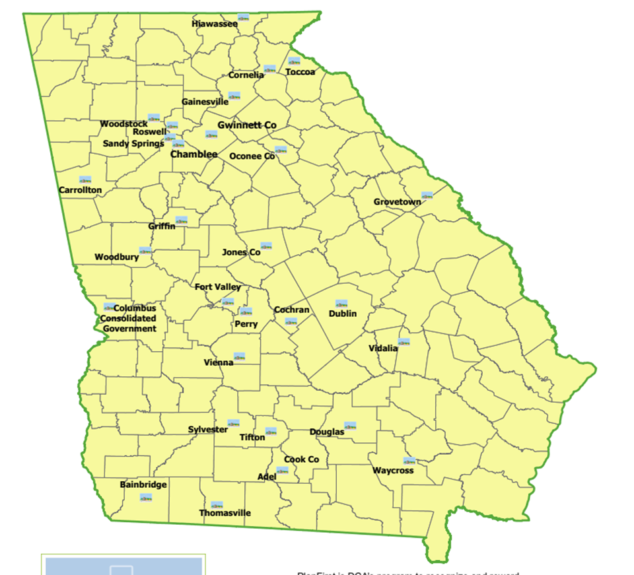

PlanFirst Communities
There are 19 active PlanFirst Communities.
Notes:
Here in attendance we have these active PF communities:

Slide 10
How do I participate?
QLG status
SDS, and surveys (GOMI, RLGF).
Met MINIMUM Performance Standards established by the local regional commission.
Show highly effective Comprehensive Planning
Contact planning@dca.ga.gov by April 15 to check eligibility.
Application due May 15.
Notes:
There are some restrictions to who can even apply for PlanFirst designation. QLG status-cannot have lost status more than 4 weeks (28 days) and/or more than twice within the 10 year period.
This program is at its core about the comprehensive plan-so making sure you meet all your plan submission deadlines is key to your eligibility.
The service delivery strategy must be verified by us, as well as submitting the required annual survey of the Government Management Indicators as well as the Report of Local Government Finances.
As you know may already know, we also require that the applicant community adheres to the regional commission’s minimum performance standards.
If you don’t know these mean, don’t worry, I can explain them to you. Just email me at planning@dca.ga.gov

Slide 11

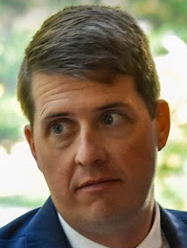
Shoe
Notes:
Miraculously, one of my colleagues captured this real time image of when I was sharing the requirements of having to maintain Qualified local government status for two plan cycles—which is ten years. A local government representative didn’t like that, I narrowly avoided a penny loafer to my temple.
To reward a community as PlanFirst, we have to ensure that the community has a long history comprehensive plan adoption and adhering to the deadlines. And if that makes you want to through your shoe, I’d ask that you please show restraint.

Slide 12
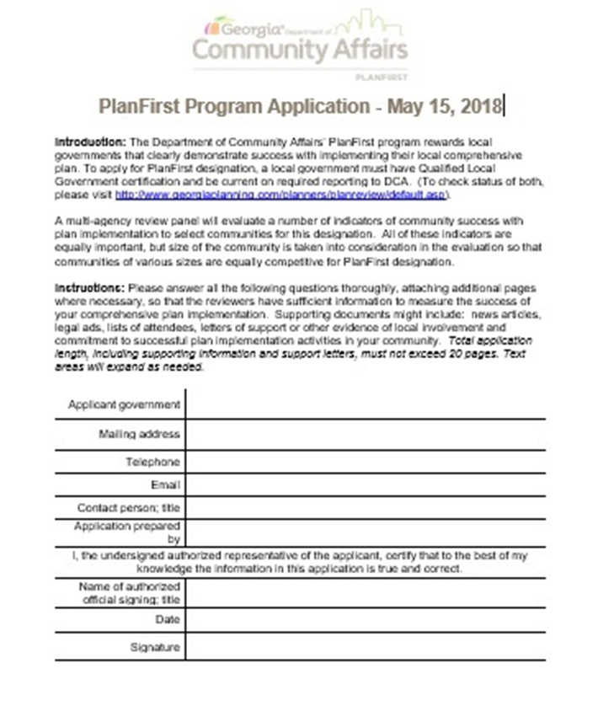
FOUR INDICATORS
Goals
Leadership
Participation
Implementation
Notes:
You might be wondering what the application is asking and by what metrics are the communities being judged? It’s helpful to view the application in 4 major buckets: Goals, Leadership, Participation, and Implementation. We’ll talk about all of these briefly.

Slide 13
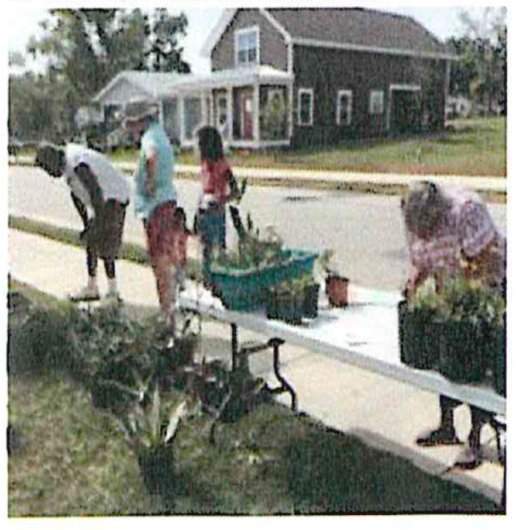
Indicator: Goals
Community and Leadership Support
Ambitious and Achievable
Steer Local Decision-Making
Consistent Progress
City of Thomasville Victoria Place Overlay District
Notes:
Do the goals enjoy community and leadership support? Is the community reaching for aspirational and ambitious goals? Are they achievable? Do these goals actually move the needle on decision making? What about consistent progress?

Slide 14
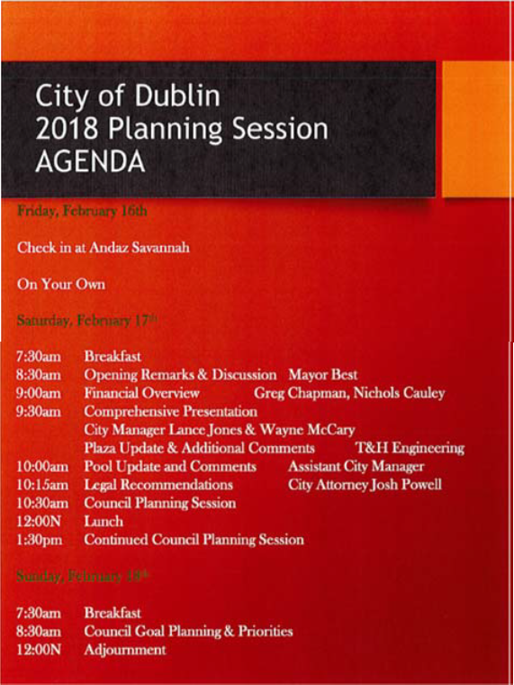
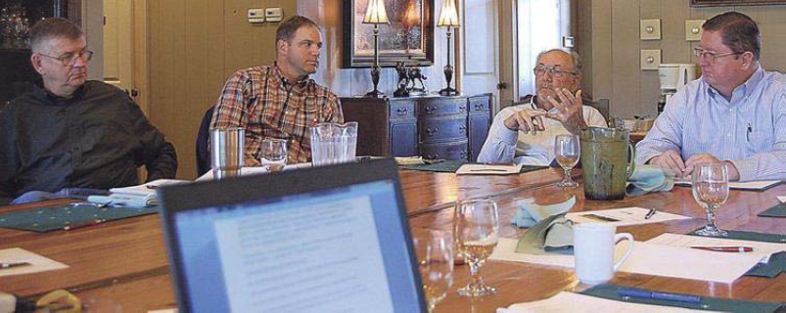
Indicator: Leadership
Effective Planning Staff
Active Planning Commission
Effectively Evaluate Planning
Trained Local Officials
Collaborative Partnerships
Notes:
How is planning done effectively? What’s the staff make-up? Is the Planning Commission active? Are local officials going out and getting the recommend training? Are community leaders being brought to the table?
Let’s talk about that first bullet, we want you to know that an effective planning staff, especially in rural areas means that it may be the clerk, a public works employee, or even sometimes a Mayor. We at DCA have seen highly effective plan implementation coming out of rural communities that had no planner on staff. So, don’t let that be a barrier.

Slide 15
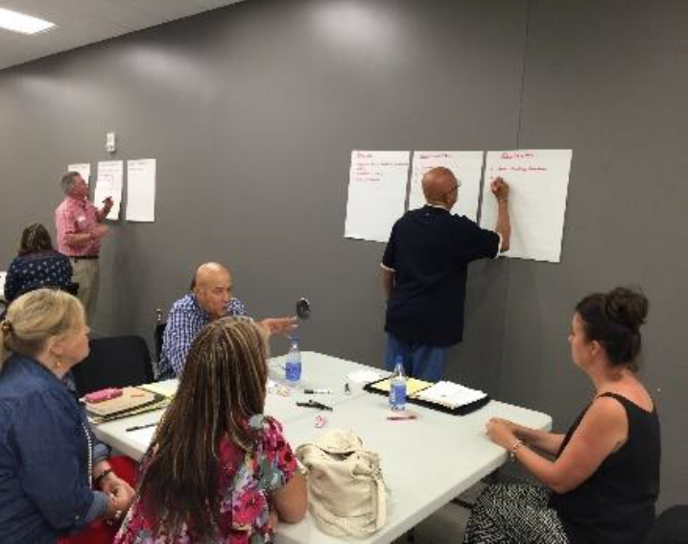
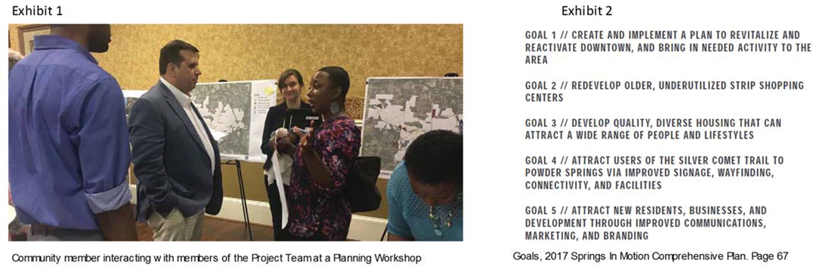
Indicator: Participation
Lots of Opportunities for Community Input
Community Input Incorporated in Your Plan
Steering Committee Guided Process
Effective Outreach Process
Advocates
Jones County Plan Meeting
City of Powder Springs
Notes:
How is the community being engaged? Is the community input actually incorporated or is it just tokenism?

Slide 16
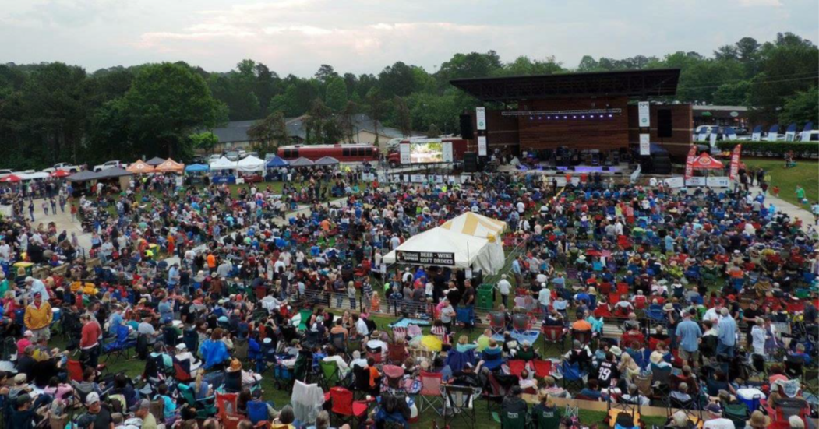
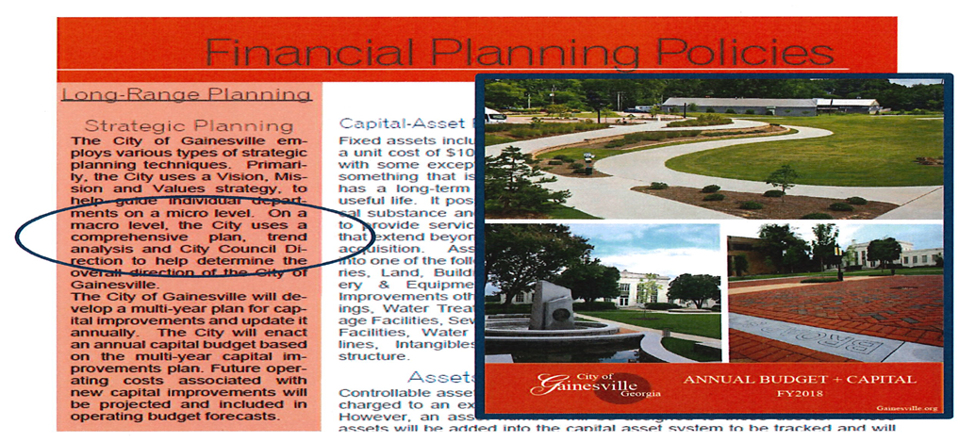
Indicator: Implementation
Action Items in Work Program
Work Program Addresses Local Needs
Good Track Record
Consistent Capital Budget
Recent
Amphitheater in Woodstock City Park
Notes:
How effective has the local government been in implementation? Have they been consistently finished planned projects? Are there recent projects highlighted?

Slide 17
Tips and tricks
01
Read the questions carefully and make sure you answer the question asked in its entirety.
02
Remember-this is about the Comprehensive Plan, not any other strategic plan, like an area plan, or corridor study.
03
Reference the plan with the correct section, date of the plan, and page number.
Notes:
1-You’ll notice that many of the questions are multi-part. Don’t neglect a part of the answer as the reviewers are trained to make sure that all parts are answered.
2. At the most fundamental level, this is a designation for a Georgia community that demonstrates exemplary Comprehensive Planning. Although adjacent or related planning efforts may merit mentioning, keeping your answers tied to the comprehensive plan is the most important idea.
3. Reviewers like to see the correct section referenced. This helps contextualize your answers and helps everyone make a reference to the plan to follow up.

Slide 18
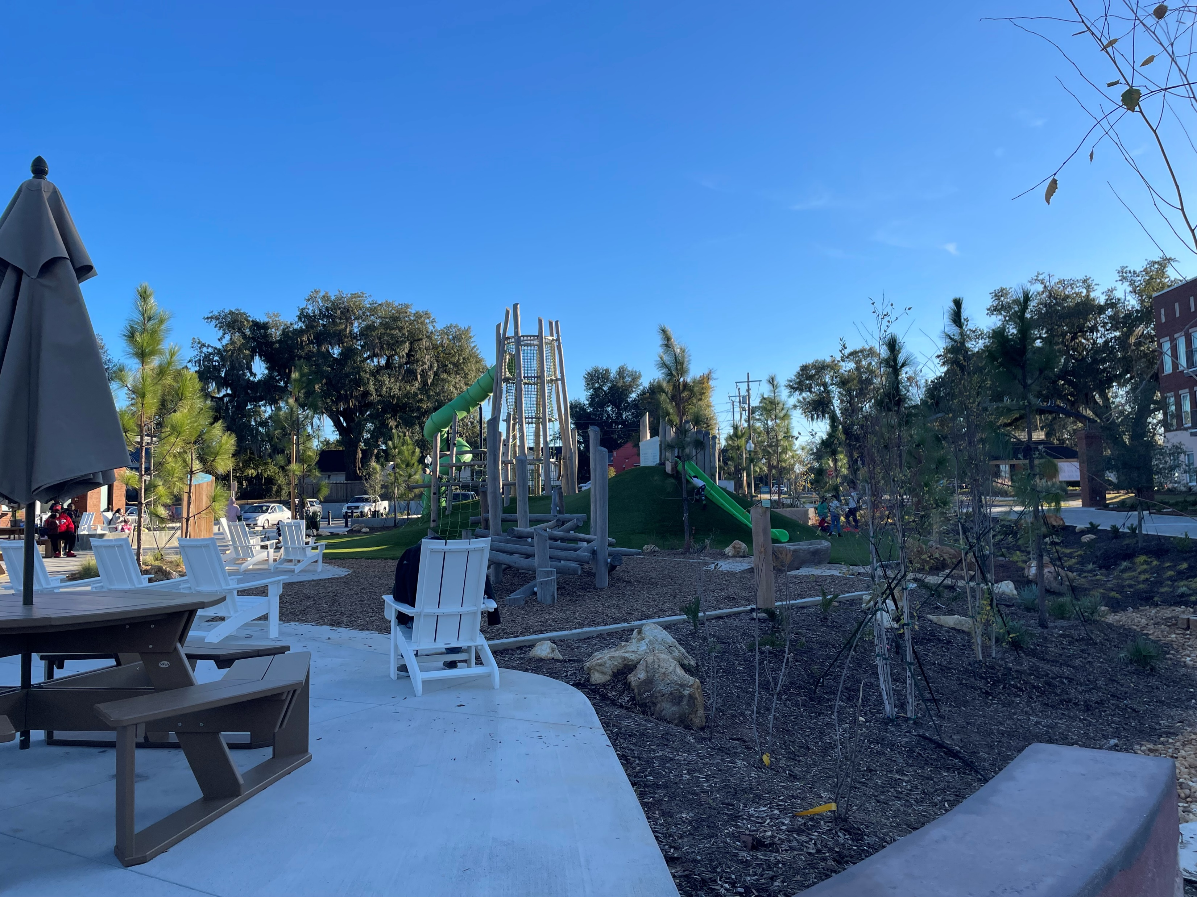
Tips and tricks
04
Tell a complete story with pictures-in focus and clearly identified.
05
Elaborate beyond yes or no answers, explain and be thoughtful and thorough in your answers.
Notes:
We all know that stories resonate better when accompanied by images. Have a new park, streetscaping, or innovative downtown seating projects? Show them to us! Working on stormwater improvements? Show us your sewers! Most of your reviewers can’t go in person to your community, so tell us and show us.
Tip 4 is self explanatory. We do get pictures that are out of focus. We’re not expecting professional photography, but images that aren’t in focus or if the subject isn’t centered can definitely take away from your score.
Lastly, don’t be vague and short. Let your answers be accurate and thorough.

Slide 19




Additional tips for success
Use the application for ideas for your implementation.
Start early! The application is due May 15.
Let other community staff and trusted professionals review your application.
Examples, examples, examples!.
Notes:
Revisit the application regularly throughout the year. Allow the application to provide ideas for your community’s implementation of the Comprehensive Plan. For example, question N is, “After adoption of your Local Comprehensive Plan, what active, ongoing, outreach processes
have you used to solicit input on planning matters from a cross-section of the community?” If you are thinking through a new corridor study, or have received an application for a large-scale rezoning project, consider how you are engaging the public? Are you utilizing creative methods to solicit feedback from a variety of diverse stakeholders?
Next. This application is robust. Just like when were in school, we can all tell when a test or paper was part of a cram session and the answers were hammered out the night before-powered by redbull and vending machine food. Allow several weeks to gather the information you need. This will help your answers be as clear and thoughtful as can be. Also, starting early will give you time to go through several reviews, which we all know will result in a better product.
That brings me to the third suggestion-allow your application to be reviewed. Have your reviewers check for consistency, grammar, syntax, and quality of content. Sometimes, when working on a project like this, it’s easy to get tunnel vision about a certain answer. Others can provide a fresh perspective and can help you focus your answers to make them easier to understand and to allow your point to come across in a cogent, concise way.
This last tip is probably a make or break point. After reviewing several applications, answers, and reviews, one of the biggest positives and negatives are examples. When examples aren’t provided. Reviewers score very negatively. When quality examples are provided, reviewers take note and score very highly. You probably won’t be designated a PlanFirst community if quality examples aren’t provided.
When you are at a Council meeting, and you notice an activist citizen regularly speaking on issues, where it makes sense, bring that person into your comprehensive planning process, engage with that person and the neighborhood or group that that person represents. Note that engagement on your application.

Slide 20

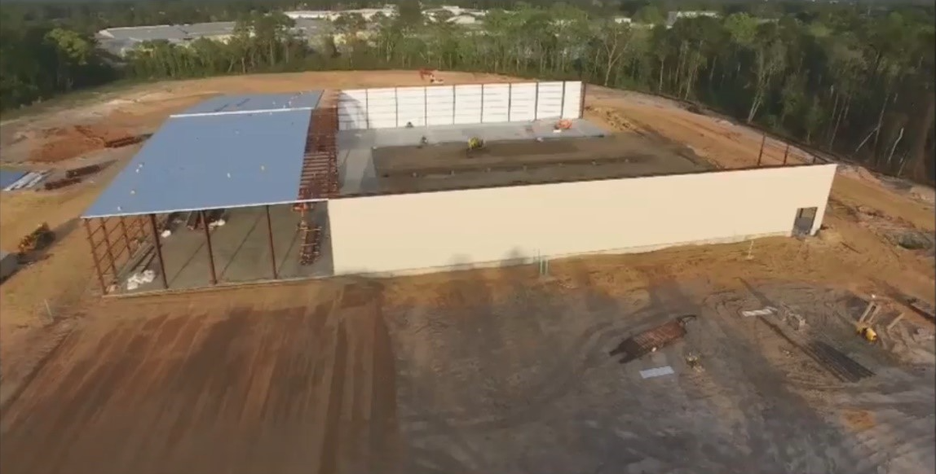
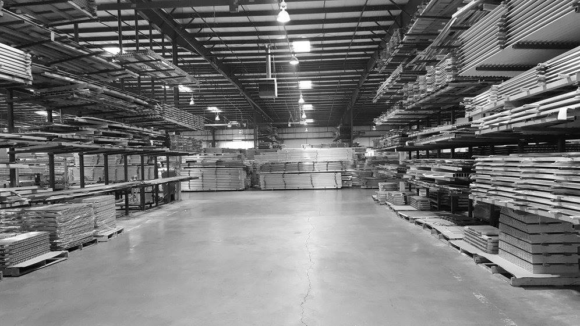
PlanFirst incentives-a success story
PlanFirst community 2017-2025
2017 EIP winner-100 jobs created-infrastructure for Elixer Extrusions manufacturing
2018 CDBG award winner-$459,895-water and sewer improvements.
2019 CDBG award winner-$373,727-drainage and street improvements
2020 CDBG award winner-$750,000-public facility to address mental health benefitting 951 persons
2022 CDBG Annual Competition-$1,000,000 expansion of Early Head Start facility benefiting 125 persons.
2022 GEFA loan to upgrade wastewater treatment plant-$3,000,000-interest rate savings on a 20 year loan~$170,000
Notes:
Here we have one of our PlanFirst superstars- the City of Douglas, Georgia! The City of Douglas is a small, rural town of roughly 12,000 in population. The city of Douglas is the County seat of Coffee County and is one of the few three-time PlanFirst designees in the state.
You can see that the City of Douglas was relentless! They took advantage of 3 successive years of applying for CDBG funds-
They took a short breather in 2021. But then 2022-expanded their head start facility and invested in the youth of the community.
That same year, Douglas enjoyed a half percent interest rate reduction on a $3,000,000 GEFA loan which amounts to roughly $170,000 in savings.
Douglas has been extremely active even outside of these PlanFirst available funds. Truly, they are demonstrating how a local government can really push activities that align with their community’s vision and goals.

Slide 21
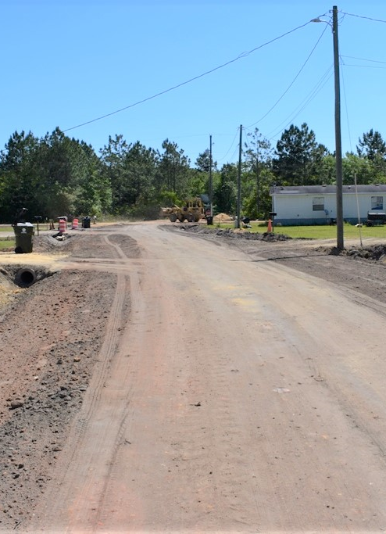
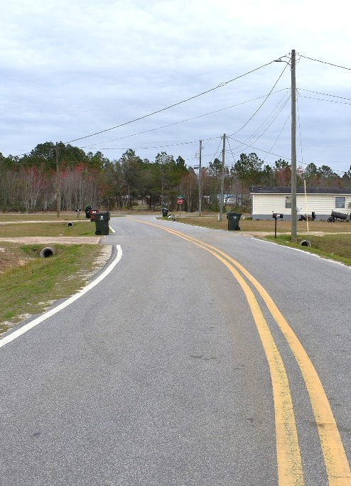
Notes:
Here’s before and after pictures of a residential area in Douglas that made sewer and street improvements with CDBG funds.

Slide 22
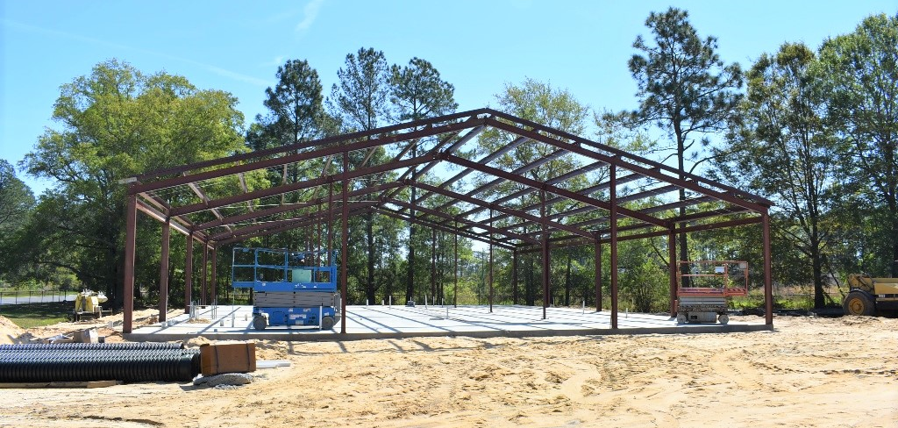
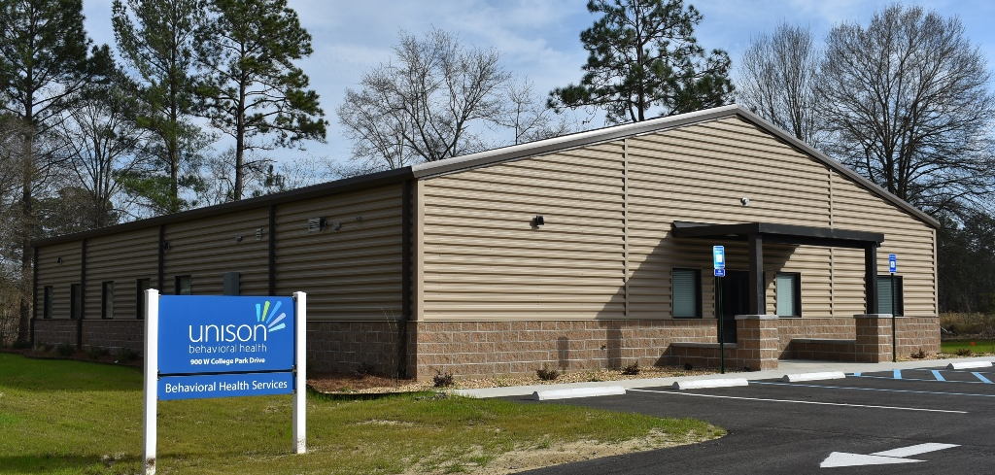
Notes:
The City of Douglas recognized that like many communities in our state, substance abuse and mental health issues were challenges that needed to be addressed. For their 2020 CDBG funds, Douglas was awarded $750,000 to build a mental health/substance abuse treatment facility to address these issues, estimated to benefit 951 people. The City, local employers, and most importantly the residents of Douglas, all stand to gain from this facility and the services it offers.

Slide 23
The PlanFirst Program upcoming dates
1. Webinar for new applicants February 19 @ 9 am.
2. Webinar for renewal applicants with their current PlanFirst term ending Dec. 31 2025: February 26 @ 9 am
3. Check for eligibility to our team by April 15 (simply email planning@dca.ga.gov and ask for eligibility)
4. Application due May 15
Daniel Gaddis, Planning Outreach Coordinator
Notes:
You can see we have several upcoming webinars about the PlanFirst program, where we dive deep into the application, talk about the high scoring questions, the low scoring questions, what reviewers are looking for, etc. Our first one is coming up February 19 at 9 am and is open to anyone that may be interested in applying as a new applicant.
For those communities that will be ending their 3-year term as a PlanFirst community. That webinar will only be open to these regional commissions, regional representatives, our planning staff, and those specific communities of: Douglas, Dublin, Grovetown, Gwinnett County, Oconee County, and Vidalia.
You’ll see the other deadlines. To check eligibility, please email planning@dca.ga.gov before April 15. The application is due May 15, 2025.

Slide 24
Thanks!
Daniel Gaddis, AICP
Daniel.Gaddis@dca.ga.gov
Direct: 404.679.4934
Cell: 470.352.0395
Planning Outreach Coordinator
dca.ga.gov
Notes:
Lastly, I want to share that we are taking a new approach to our Success Stories and Best Practices initiatives. This year, we will be asking for information about projects that our PlanFirst communities have undertaken and then sharing those out with the state. We hope to host a webinar where we can invite other communities that are looking to address issues such as housing stock, blight, stormwater, promoting walkability and bikability, economic development and others. Using the PlanFirst communities as thought-leaders and sharing the challenges and successes they’ve dealt with can be encouraging and instructive to others.
Any questions I can answer for you all?

Slide 25
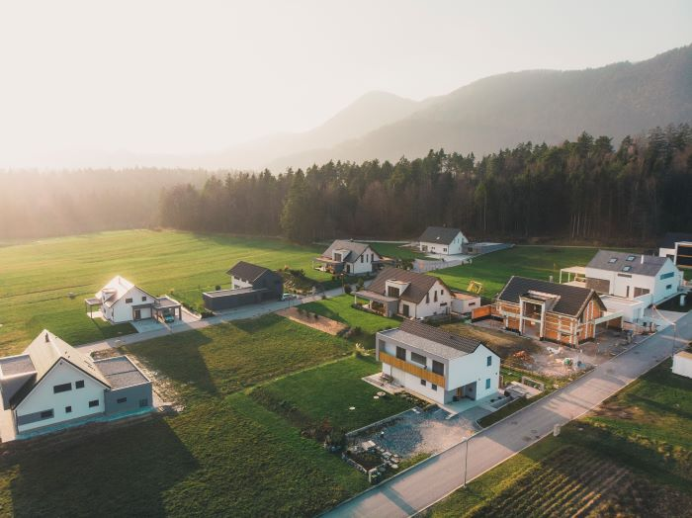
Planning Scenarios
Read through the scenarios
Talk about it as a group (groups of 4-5)
Choose a reporter (1 per table)
Report out!

Slide 26
Scenario 1
A new workforce development study conducted by the Chamber of Commerce and the joint city/county development authority states a critical need for multifamily housing and rental housing for all types. The study also suggests the city and county are built out for their single-family housing needs for the next 50 years. The city’s existing zoning map (See Existing Land Use Map) clearly shows not enough allowable land for multifamily (Note: arrow). There is more development activity occurring in and around the city in recent months. If the city is to address these housing needs before more development happens, they will need to act quickly.

Slide 27
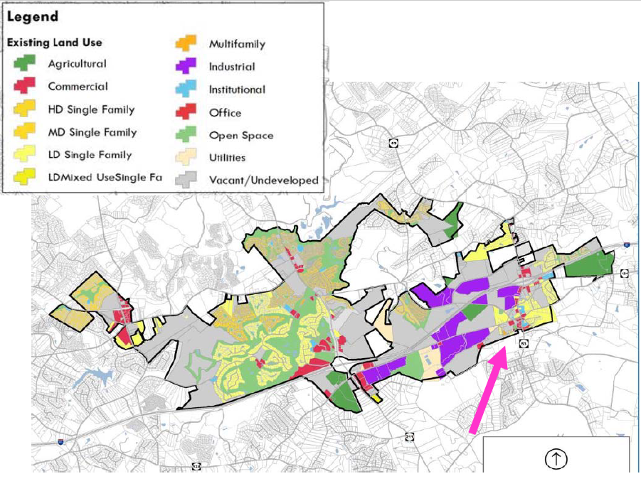
Planning Scenarios

Slide 28
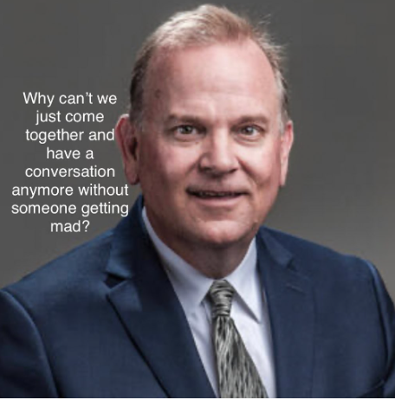
Planning Scenarios
Scenario-workforce housing-
  What actions should the city take?
  How and where will you guide and/or regulate to get the development the city needs for future job growth?
  How will the citizens react?
  How will the city handle their response?
Notes:
Have each table report out the answers here. Provide time to comment.
Start at table 1 and 2-be mindful of time-ask for report outs on their recommendations-. May have to move along on questioning if they are verbose.
Why/who agrees with this approach/is there anyone that disagrees? Who agrees but would like to add more?
Open up to whole room-
Who agrees with this approach?
Is there anyone that disagrees?
Who agrees but would like to add more?
How has your community handled multi-family housing?
What actions should the city take?
Ask planning commission/planning staff to make recommendations as to appropriate locations for multi-family; work with housing authority, DCA, and others to assess housing needs and programs to address.
How and where will they guide and/or regulate to get the development the city needs for future job growth?
Multi-family should be developed on existing public infrastructure (larger roads, water/sewer); can serve as buffer between commercial and single-family housing developments; should be near and around central or other business districts; density of multi-family is a critical consideration with options to disperse lower-densities throughout community; focus on higher densities closest to business districts; smaller minimum lot sizes; allowing accessory dwelling units; and/or housing above retail.
How might the citizens react, and how might the city handle their responses?
Historically, some people have a negative reaction to the development of multi-family housing as they associate it with crime and poverty, while most everyone has lived in multi-family housing at some point in their lives. Design (integration with the public street), location and density are instead the essential features of successful multi-family housing. The need for housing suggest a growing economy and a growing economy means jobs and growth to support a growing community. Public participation should occur along the way as the local government determines where and how this development will occur, with an open and transparent process and free-flow of information.

Slide 29
Scenario 2
The local government has been putting in bike lanes for the last several years as roads need resurfacing. Most of these bike lanes have been identified in the Greenway/Trails Master Plan as essential links to the connectivity of the trails. After the latest installation along a major collector, complaints and conflicts have been occurring frequently. The public works department, the planning department, and the elected officials have been receiving complaints from both drivers and cyclists. Understanding the conflict and getting to a solution will need to involve more than staff. The planning commission offers
to address these issues.

Slide 30
Planning Scenarios
  What are the planning commission’s goals?
  Who are the stakeholders?
  What participation technique(s) should they use?
  What, if anything, should happen before the next repaving/bike lane installation project begins?
Notes:
Have each table report out the answers here. Provide time to comment.
Start at table 1 and 2-be mindful of time-ask for report outs on their recommendations-. May have to move along on questioning if they are verbose.
Why/who agrees with this approach/is there anyone that disagrees? Who agrees but would like to add more?
Open up to whole room-
Who agrees with this approach?
Is there anyone that disagrees?
Who agrees but would like to add more?
What are the planning commission’s goals?
First, the planning commission will want to fully understand the problems from all sides.
They cannot work towards solutions until the problem is fully understood. Then they can
set a goal of working towards solutions that attempt to address the issues on both sides.
They cannot make everyone happy, but they cannot solve the issue for only one side of the
conflict or the other.
Who are the stakeholders?
Drivers, to include both commuters and surrounding neighborhoods; cyclists, to include
commuters, recreational bikers, professional cyclists, any bike groups, bike shops.
What participation technique(s) should they use?
In general, the planning commission will need to hear from identified stakeholders to
understand the problems. This could be done by having all stakeholders attend a meeting
(possibly facilitated) to discuss concerns and, get them back to the table for subsequent
meeting(s) and potential solutions.
Separating the stakeholder groups to vent separately will not encourage joint problem solving and will frustrate both sides unnecessarily. Getting the groups together to hear each other’s issues, and, more importantly, shared
goals is a critical first step.
Public hearings are too formal at this point and only allow input, not discourse.
Gathering input-web surveys, eblasts, mailed surveys can all work to get feel of the whole
community towards bike lanes, etc. but probably won’t lead to solution.
Reconvening the steering committee of the Greenways/Trails Master Plan might be an
option. Workshops/charrettes about bike lane designs if design seems to be part of the problem.
Most of the “partnership’” techniques would work, giving stakeholders more than a
chance at input, but involvement in the process of finding solutions and deciding which
would work best.
What, if anything, should happen before the next repaving/bike lane installation project begins?
Most likely wouldn’t have to have another stakeholders process, but information and
chance for input beforehand to inform/educate and head off problems before they happen
would be a plus. Also, whatever local government learned through the stakeholder
process, make sure they use that going in to the next bike lane project.

Slide 31
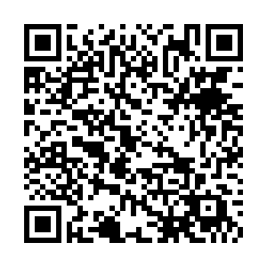
Fill out the survey!
Fill out the survey!

Slide 32
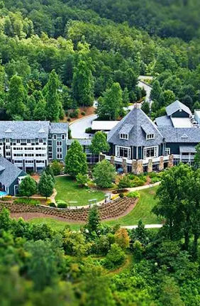
SAVE THE DATE
Community Planning Institute
Brasstown Valley Resort
Fall, October 28-29 2025
Young Harris, GA

