Slide 1

Office of Downtown Development
Cherie Bennett
cherie.bennett@dca.ga.gov

Slide 2
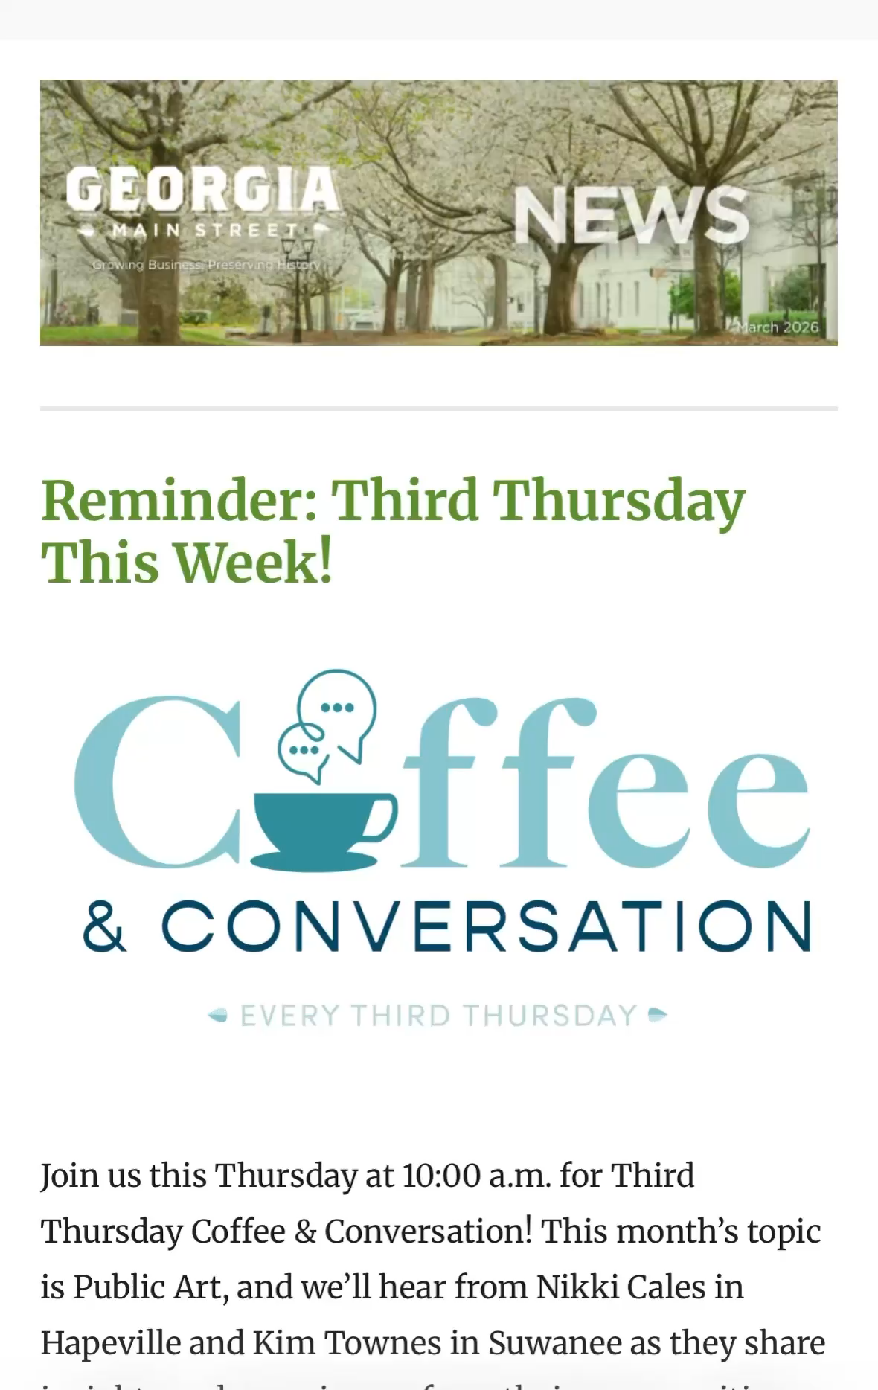
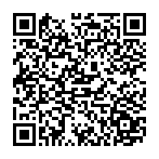
Outreach &
Communications
Helping keep our network informed and engaged
This includes:
Bi-weekly email newsletters
Website (georgiamainstreet.org)
Resource library
Webinars
In-person training opportunities
Share announcements, resources, and helpful information

Slide 3
Upcoming Trainings:
July 17 -Coffee & Conversations – Best ideas from downtowns around the state​
August 17 – Main Street 101
September 9 – Webinar on Evaluating Downtown Events ​
November 5 – Content Creation Workshop in Fayetteville
August 6 - Coffee & Conversations – Preparing for the GDA conference​

Slide 4

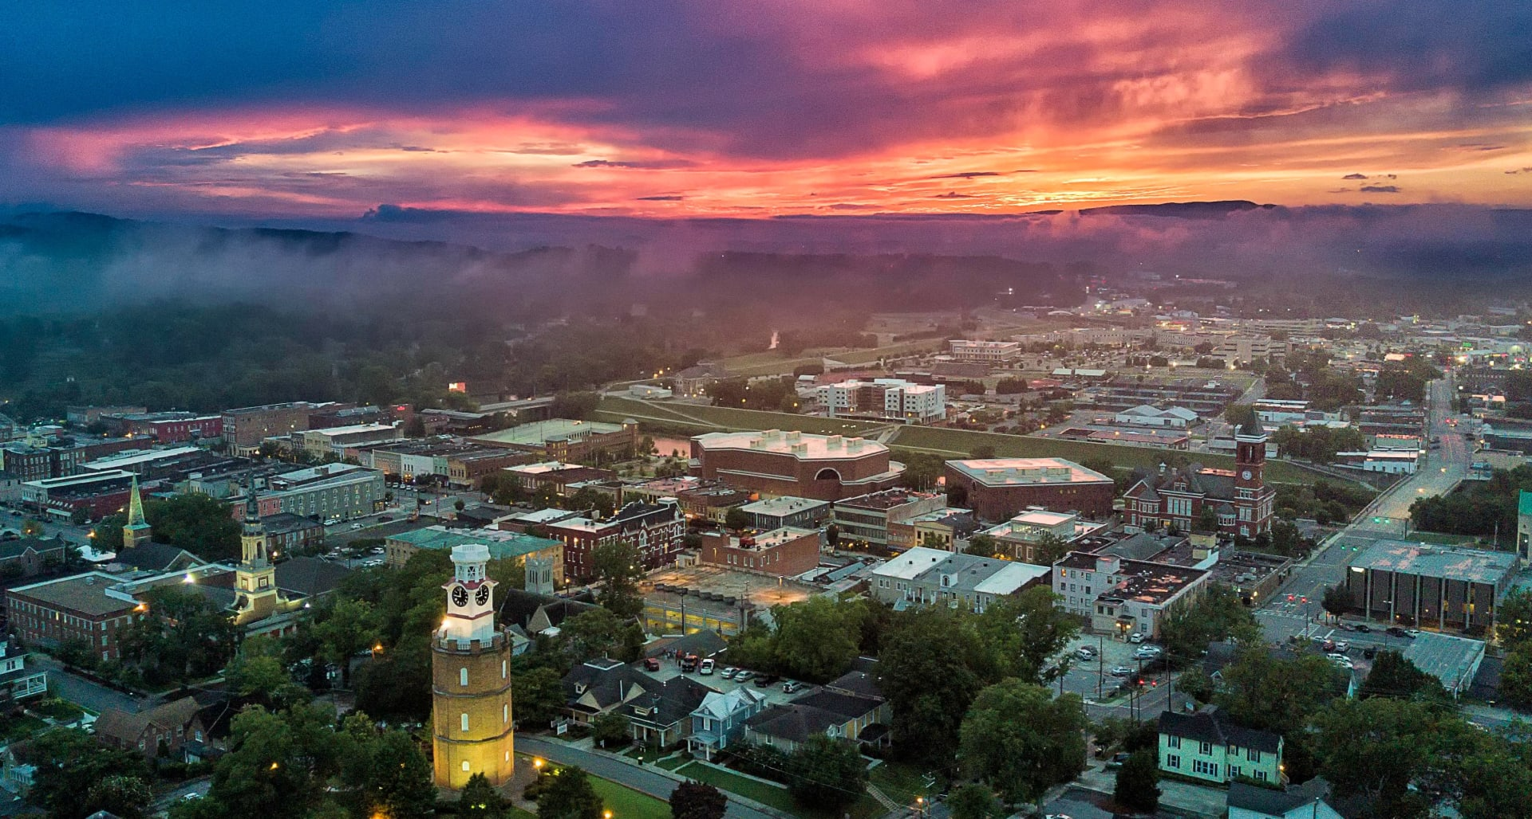
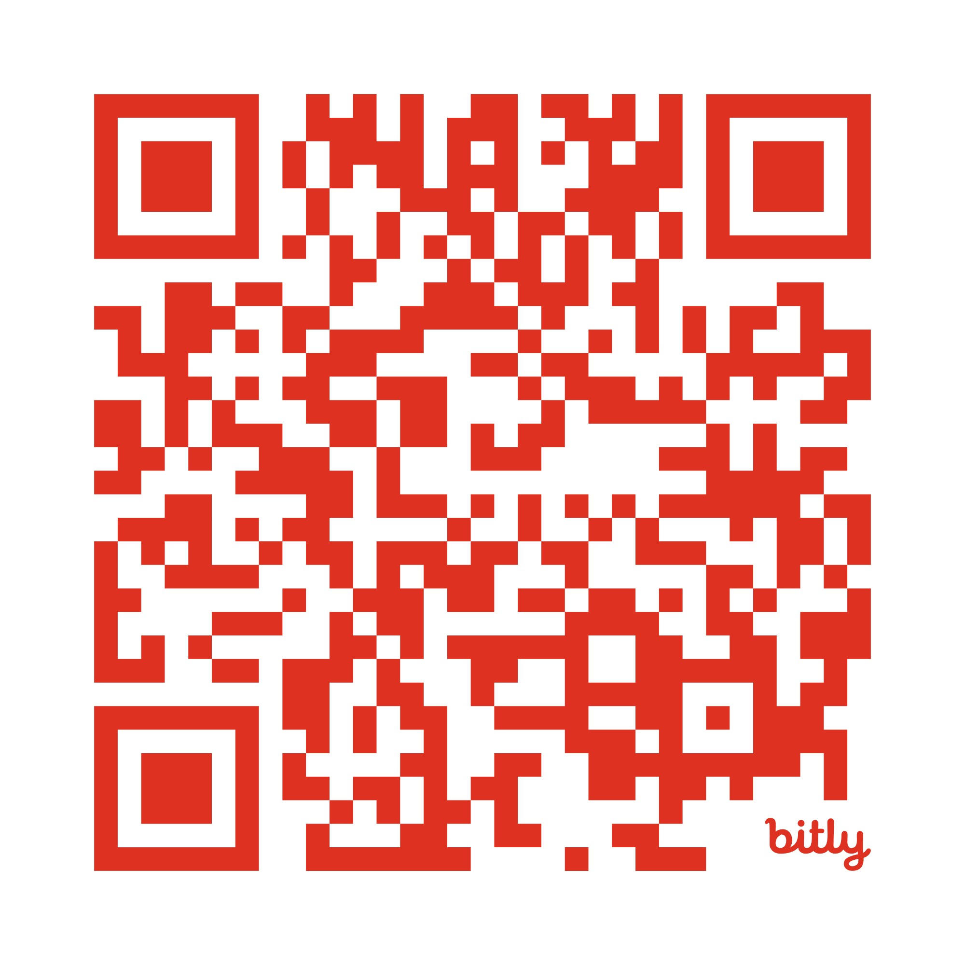
2026 Georgia Downtown Conference
August 17-20
Rome, Georgia

