Slide 1

Community Engagement in
Comprehensive Planning
Community Planning Institute
May 16, 2025
Allison Slocum, AICP
Assistant Director of Planning and Government Services
River Valley Regional Commission
District 7 Representative
Georgia Planning Association

Slide 2
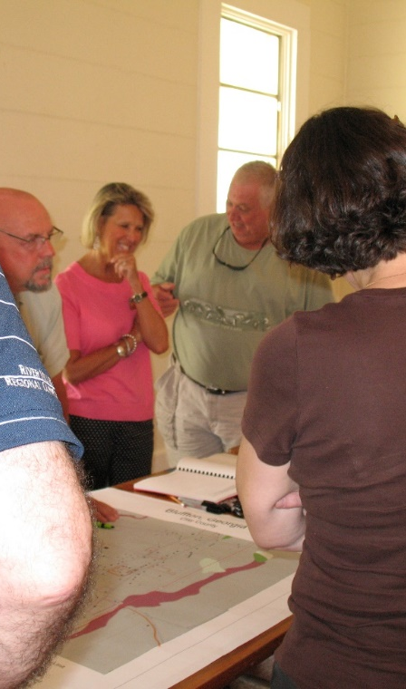
Planning Goals
Build support for the plan
  Business community
  Residents
  Elected officials
  Staff
Transparency
Gather meaningful input
Reflect the community’s unique attributes
Find a champion for implementation
Notes:
Why talk to my community? That’s hard!
How many of you have…
Resident complaints
Right hand doesn’t know what the left hand is doing
A good engagement process can … overcome these obstacles before they start
Can be taken a step further to develop volunteer groups to assist with implementing your plan (Stewart County)

Slide 3
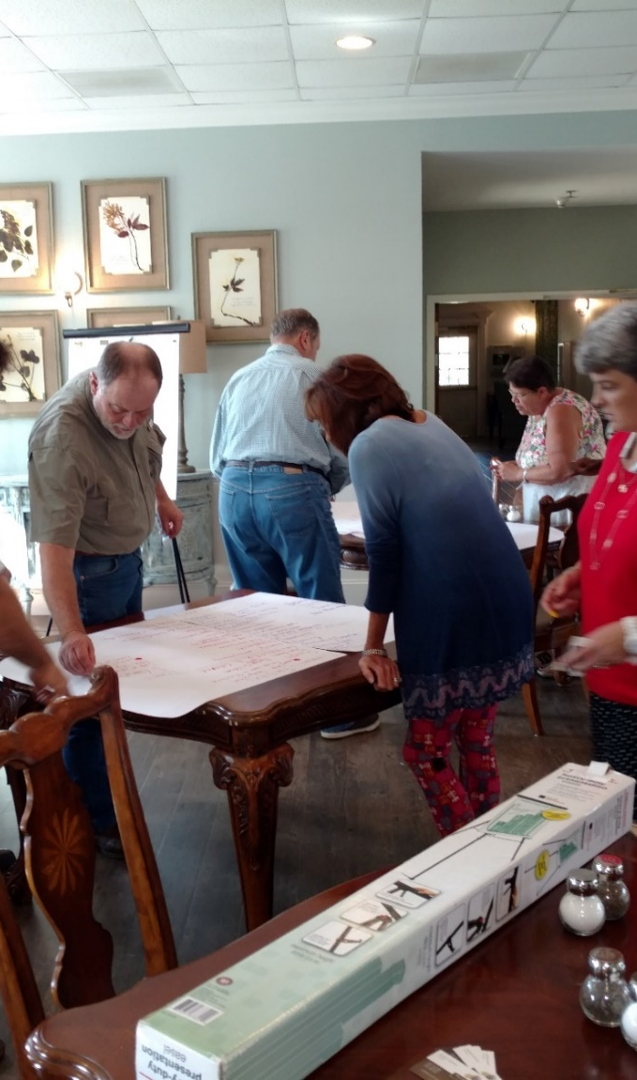
Process Management
How much time do you have?
  Public engagement drives the schedule and cost
How much are you willing to spend?
  In-house or consultant?
How experimental are you?
  Use traditional methods or
  Something original?
Notes:
Public engagement will help you figure out how long the comp plan process will take and how much it will cost
What is the best way to get information to your community and receive input back?
Has what you’ve done in the past worked well?
Do you need to try something different/new?
-pop up engagement
-google
Can you do this yourself?
Do you need to hire someone?

Slide 4
Requirements
Minimum Standards for Local Comprehensive Planning
(Rules of DCA, Chapter 110-12-1-.02)
Identify stakeholders
Identify participation
techniques
Conduct participation
program
Document community
involvement activities
“Each element of the plan must be prepared with considerable opportunity for involvement and input from stakeholders and the general public, in order to ensure the plan reflects the full range of community needs and values.”
Notes:
According to state law, you MUST do these things.
ID stakeholders
Decide how to reach out to people for ideas and information
Do what you say you’re going to do
Prove it!
-sign-in sheets, photos, newspaper articles, social media posts, videos

Slide 5
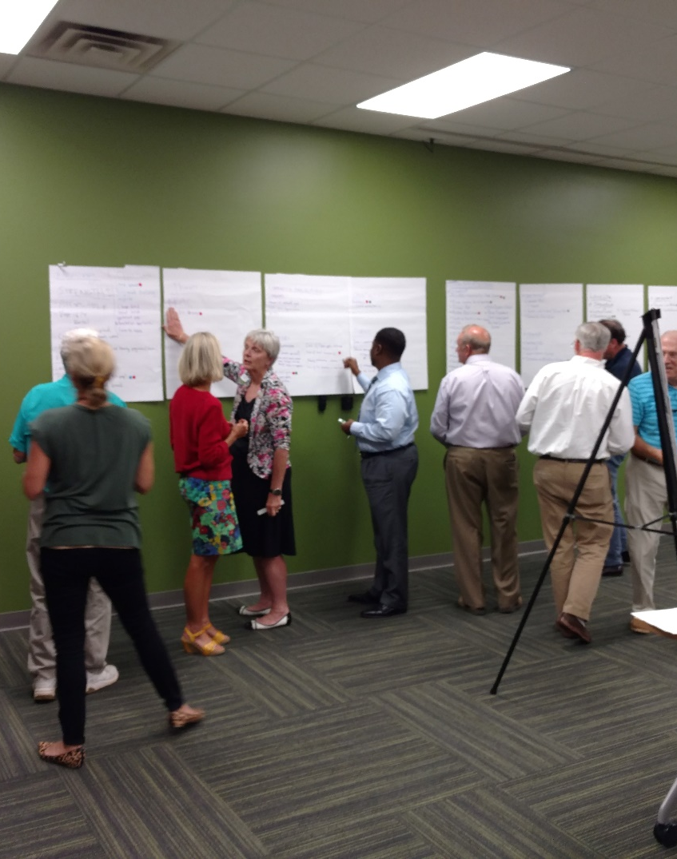
Procedures
Minimum Standards for Local Comprehensive Planning, Procedures
(Rules of DCA, Chapter 110-12-1-.04)
Initial public hearing
Minimum techniques for developing the plan
  Steering committee
  Stakeholders
  Needs and opportunities
  SWOT
Transmittal hearing
Adoption
Publicize the plan
Notes:
These are the MINIMUM to be done during this process.
You can always do more.

Slide 6
Typical Timeline
Consultation/Coordination meeting
Identify steering committee candidates and stakeholders
Identify participation techniques
Hold kickoff meeting (initial public hearing)
Hold first steering committee meeting
Engage the public and receive input
Draft the plan with steering committee and citizen input
Transmittal hearing (final public hearing)
Regional and state review
Adoption
Publicize the final plan
Implement the work program
Notes:
This is a TYPICAL timeline.
Meetings can be in front of the council/commission or be separate.
I usually have a kickoff meeting first.
-ask for volunteers for steering committee/stakeholders

Slide 7
Stakeholders & Steering Committee
Steering committee must include:
  Governing authority
  Local economic development practitioners
  Local government staff
Suggested Stakeholders:
  Individuals & groups
  Interest in future of community
  Supporters & opponents
Compile a list
Seek guidance
  Governing body
  Regional commission
Have the committee meet regularly
What is your community’s composition?
Who typically shows up to meetings?
Where can you find representatives of those that don’t normally show up?
Notes:
You should identify a steering committee and stakeholders.
These are two DIFFERENT groups.
Who should be members?
REQUIRED Steering Committee members…
Local elected officials = beware quorum rules
Local econ dev = realtors, econ dev committee, dev authorities, etc.
Don’t forget public work staff

Slide 8
Records
What to keep
  Photos
  Agendas
  Minutes
  Sign-in sheets
  Email lists
  Advertisements
  Social media posts
Make a record ASAP after the event
Post summaries on website and/or social media
Prepare summary for the comprehensive plan report
Notes:
Make a record IMMEDIATELY. You will forget.
You can NEVER let TOO many people know!
Social Media Posts = (Concerned Citizen Groups) YouTube Videos

Slide 9
Community Engagement
Collaboration and cost are directly related
Deciding when to use a particular technique, ask:
  What issues are you trying to address?
  What audience do you want to target?
  What outcomes are you hoping for?
Cannot control input
  Be prepared for the consequences
Notes:
Community Engagement is an organic process.
What are your issues?
What do you hope to achieve?
Who do you want answers from?
You CANNOT control people.
You CAN be prepared.

Slide 10
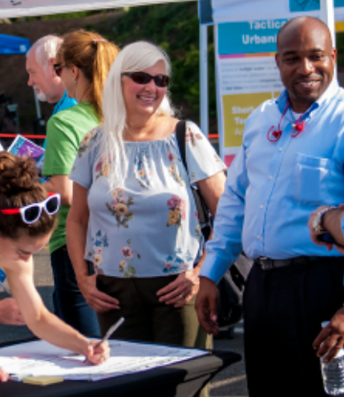
Participation Techniques
Four types of techniques:
  Informative - outgoing information
  Public input - incoming information
  Interactive - collaborative with individuals
  Partnership – collaborative with groups
Notes:
Informative = what you tell others
Public = what others tell you
Interactive = what information you generate together
Partnership = similar to interactive, but information is targeted to specific issues
Civic/Fraternal Orgs have their own missions/causes
Family Connections = strengthening families
Lions Club = blindness/hearing loss

Slide 11
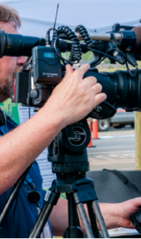
Informative Techniques
Kiosk/Lobby displays
Public information meetings
Printed materials
Website – information only
Cable TV
Direct mail, including utility bills
Email blasts
Social Media Posts
Notes:
How do people find out what’s going on everyday?
Bluffton – FaceBook
Talbot & Webster—Reverse E-911
Muscogee – Civic app
Webster EMA – Facebook
Family Connections – Email blasts
Harris County Citizens Group - YouTube

Slide 12
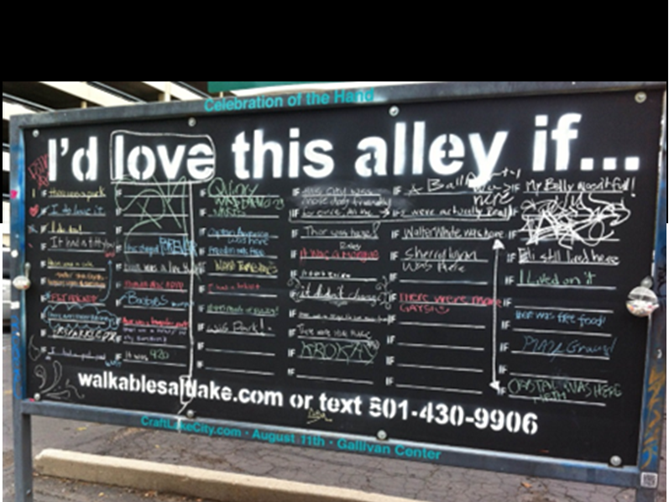
Public Input Techniques
Surveys
Input wall
Open houses
Dynamic website
Social media
Pop Up Engagement
  Tactical urbanism
Notes:
These activities take some planning and money and depend on your audience.
Who is more likely to complete a survey?
Who will come to an open house?
Website vs. Social Media? Do BOTH!
Where do people get their local information?
Pop Up Engagement / Tactical Urbanism = Method of using short-term, low-cost, scalable interventions to catalyze long-term change. (DT Americus = parking change)
-Inspire action
-Draw attention to perceived shortcomings
-Widen public engagement
-Deepen understanding of a problem
-Gather data
-Encourage people to work together
-Test a potential solution

Slide 13
Interactive Techniques
On-the-spot engagement
Online (virtual) engagement
Workshops/Charrettes
Student/Youth programs
Facilitated meetings
Notes:
Requires Planning. What are upcoming community events? Fall Festival? Spring Fling? Youth Sports?
Go to the people!
On-the-Spot Engagement:
-Local public events
-Farmers market
-Festivals
-School Events
Be prepared to deal with the weather
Have giveaways, snacks, and water
Online Engagement: (can be hijacked)
-Beneficial for those who would not typically have the time, means, or inclination to attend a meeting
-Provides an opportunity to submit comments anonymously
-Postings of real time or recorded information
-Allows for as much or as little participation as a person may desire
-Must be closely monitored
Workshops/Charettes:
-an in-depth look at one issue over several days
-Techniques can be done in a simpler way in a shorter amount of time
Student/Youth Programs
-Get permission from governing board (BOE)
-Organize to fit into their curriculum

Slide 14
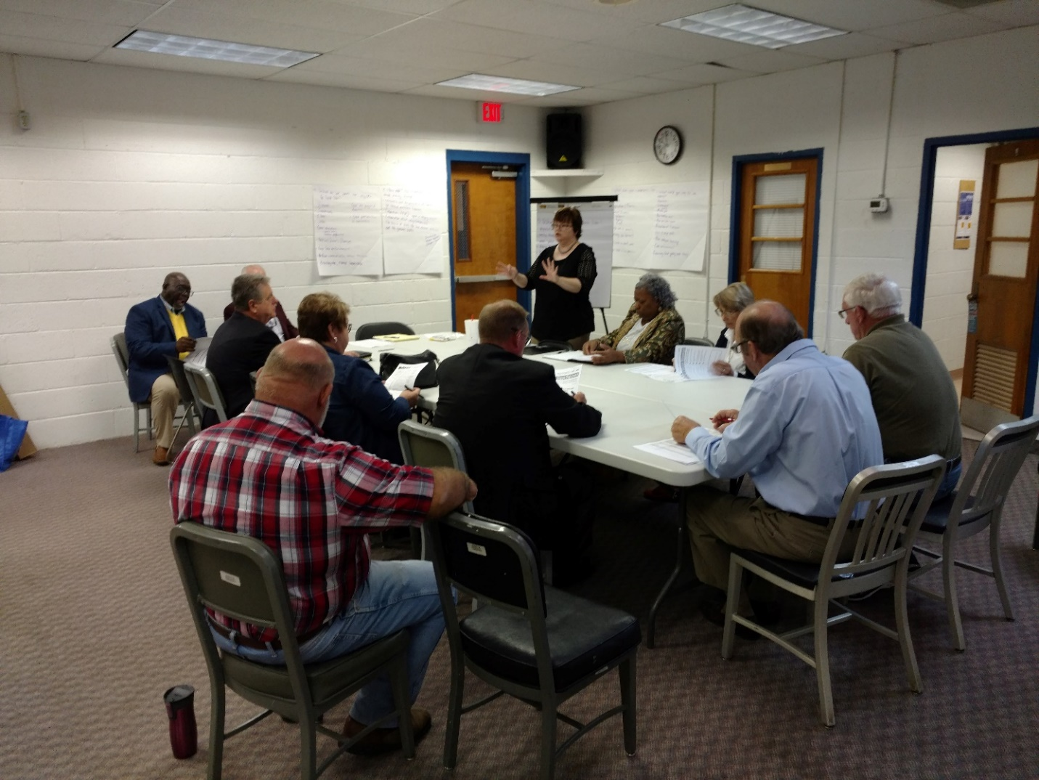
Partnership Techniques
Stakeholder interviews and meetings
Technical advisory committee
Speakers bureau/Focus groups
Civic organization meetings
Intergovernmental partnership meetings
Joint meetings with other planning efforts
Notes:
Remember your purpose
Read the audience
Design your talk around the time of day (first thing in the morning? Before lunch?)

Slide 15

Polling Software
Allows real time voting with interface through PowerPoint
Costs depend on number of users and questions
Most economical type is smart phone dependent
Easy record keeping
Notes:
Gives real time information
Becoming more reasonably priced.
If you can’t afford, borrow.
Purchase of hardware or software (can go out of date)
Subscription services (always up to date)
MENTIMETER.com or SLIDO.com = common polling tool (uses individual mobile devices)
Use of mobile devices – depends on wifi access/bandwidth

Slide 16
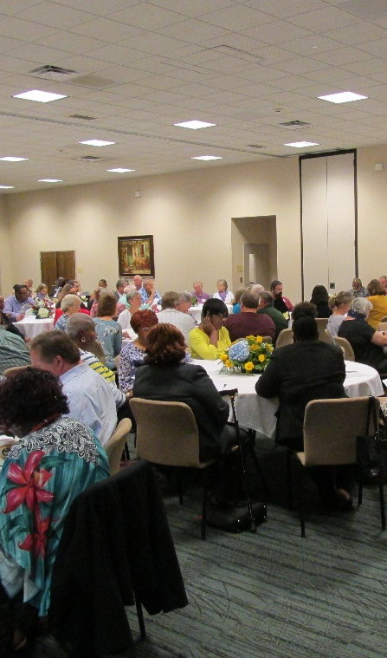
Public Meetings
Steps in the process
  Preparation
  Logistics
  Presentation
  Follow up
  Record keeping
Keys to Success
  Be prepared
  Be flexible
  Be professional
Notes:
Public meeting is the democratic process at its most basic.
That doesn’t mean its easy.
Make a check list.
Have all your supplies lined up.
Test your equipment prior (a couple of days).
Remember, community engagement is organic.
You cannot control, but you can be prepared and attempt to guide.

Slide 17

Preparation
Know your audience
Validate your data
Keep your purpose in mind
Give others the right to be wrong
Be organized and brief
Notes:
Concentrate on the needs of the audience
You are not here to prove you are right and other people are wrong
Put yourself aside for the length of the meeting
If you know you have a temper, designate a wingman to watch you and pull you back if you get heated
REMEMBER:
-Focus is on the participants—NOT you
-Goal is to involve the audience—NOT inform the audience
-Keep the audience ACTIVE—have tasks that engage different types of learners
-Types of Learners: Visual (see the info); Audio (hear the info); Read/Write (take notes and read texts); Kinesthetic (experience/practice the info)
Lumpkin HP

Slide 18
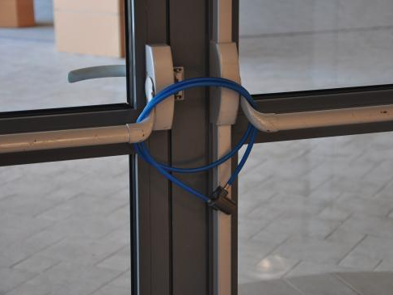
Flexibility
What can go wrong?
  Weather
  Missing the meeting or tardiness
  Equipment malfunction
  Schedule conflict
  Locked out of venue
  No one shows up
  Too many show up
  Hostile crowd
  Wrong information
Notes:
Lots of things can go wrong.
Preparation can overcome many of these.
Make a list and check it twice.

Slide 19
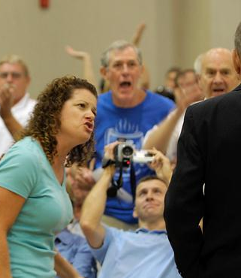
In Person Meeting Best Practices
Dealing with a hostile audience
  Lay out parameters ahead of time
  Know the controversy
  Include counter arguments
  Do NOT ignore the audience
  Do NOT go on the attack
  Steer the conversation
Notes:
There is NO silver bullet for dealing with a hostile audience.
Lay out the rules of conduct/meeting parameters at the beginning of the meeting. Get everyone to agree to them.
Remind people that you know they are busy and you value their time.
Have an idea of the “touchy” subjects and prepare for them. (Talbot County)
Some people will try to bait you. Don’t fall for it.
-Have a wingman
“Parking Lot” Poster
Remain calm. Acknowledge the person; ignoring them will just make it worse.
Speaking with confidence and sincerity acknowledges your authority over the message.

Slide 20
Virtual/Hybrid Meeting Best Practices
Choose a platform
  Computer
  Telephone
Should include information in the public notice
Test all equipment prior to the meeting
Establish meeting procedure
  Identify staff roles
Public feedback
  Dedicated phone line
  Pre-recorded videos/voicemails
  Chat room comments
Notes:
Follow the community attorney’s advice.
Should allow access by both computer/phone
-public should be able to access the meeting for free not via subscription (GoToMeeting vs. MS Teams)
-have the capacity to handle many participants
-can record the meetings and any comments in the “chat” feature (set aside a designated time to read these comments out-loud to the people present)
-can accommodate closed captioning or other disability needs
If internet access/bandwith is a problem at meeting location, consider having some presentations pre-recorded
-RVRC Council Mtg-host meeting where internet access is secure. Actual in-person location is only a participant
Public Notice (put it in more places than just where it is required)
-tell people how they can participate (totally virtual vs. hybrid)
-provide links/passcodes and phone number for audio only (include information on tutorials)
-if you are going to allow comments prior to the meeting give email address and voice mail #
-make a note whether people need to sign up in advance to provide comments
Run a test prior to the meeting (especially for Elected Officials, Steering Committee Members, and Panelists)
-Create a Run-of-Show checklist for the staff
-ID staff roles (running the in-person meeting, running the meeting tech, monitoring/responding to the chat or dedicated phone line)
-Know how to MUTE and UNMUTE
Have the in-person moderator state aloud how the meeting will run.
-Address both meeting procedures and technical issues (how to MUTE/UNMUTE)
-Tell participants they are being recorded
-Require all speakers to state their name and/or address before speaking (in-person/voicemail/phone call vs. chatroom/email)

Slide 21
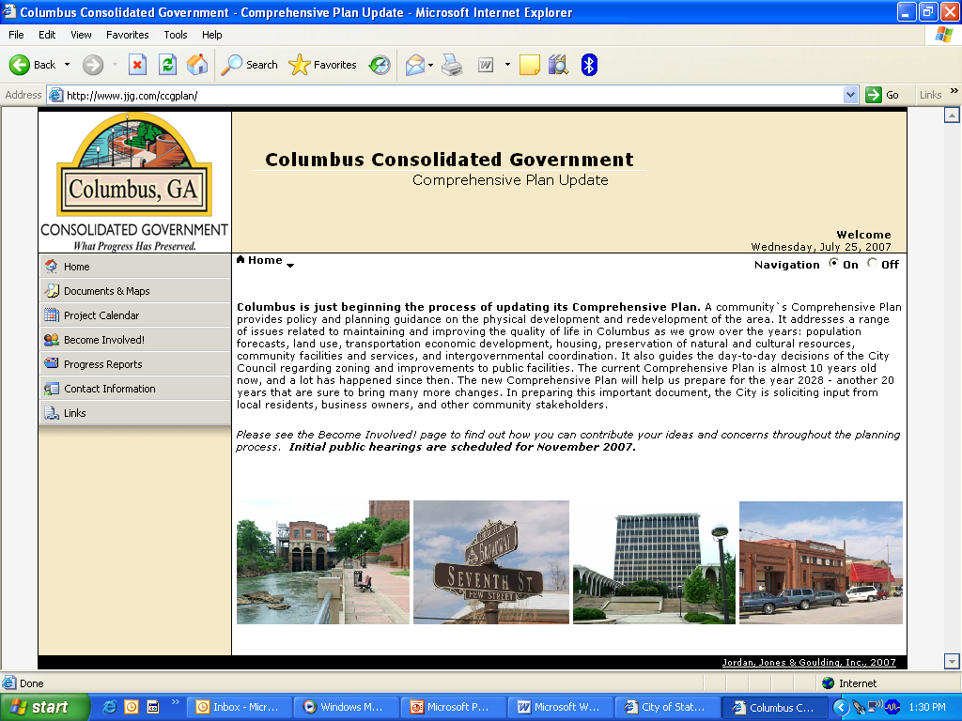
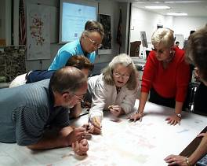
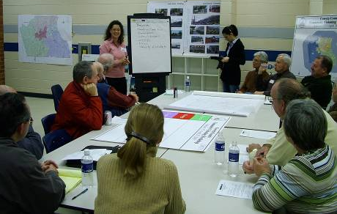

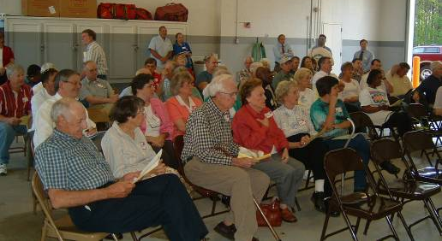
What has worked in your community?

Slide 22

Questions?
Allison Slocum, AICP
Assistant Director of Planning and Government Services
River Valley Regional Commission
District 7 Representative
Georgia Planning Association
(706) 256-2910
aslocum@rivervalleyrc.org

