Slide 2
How to Complete a Casualty Loss Form
By:
Imari Blackwell, Compliance Manager of Audits & 3rd Party Contractors
Imari.Blackwell@dca.ga.gov
Or
Compliance@dca.ga.gov

Slide 3
What you do today can improve all your tomorrows…
Ralph Marston

Slide 4
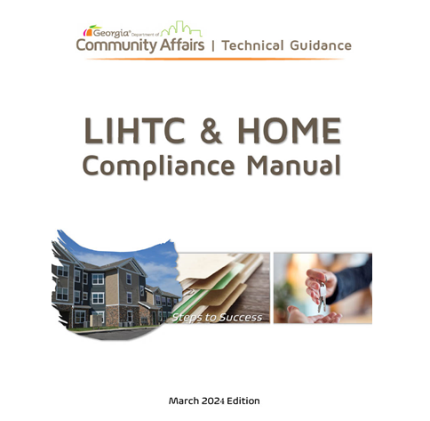
What is Casualty Loss?
The damage, destruction, or loss of the property from any sudden, unexpected, or an unusual event such as flood, hurricane, tornado, fire, earthquake, or volcanic eruption that is beyond an owner’s control. A casualty event doesn’t include normal wear and tear or progressive deterioration.
LIHTC & HOME Compliance Manual
Starting on pg. 202

Slide 5

Where to go to start the process?

Slide 6
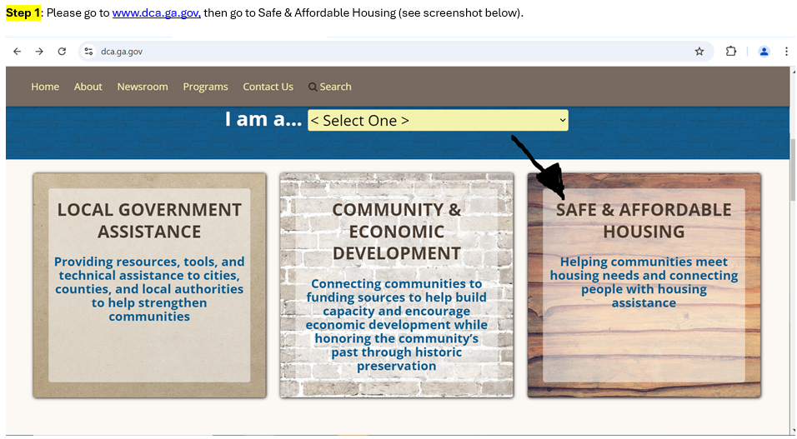

Slide 7
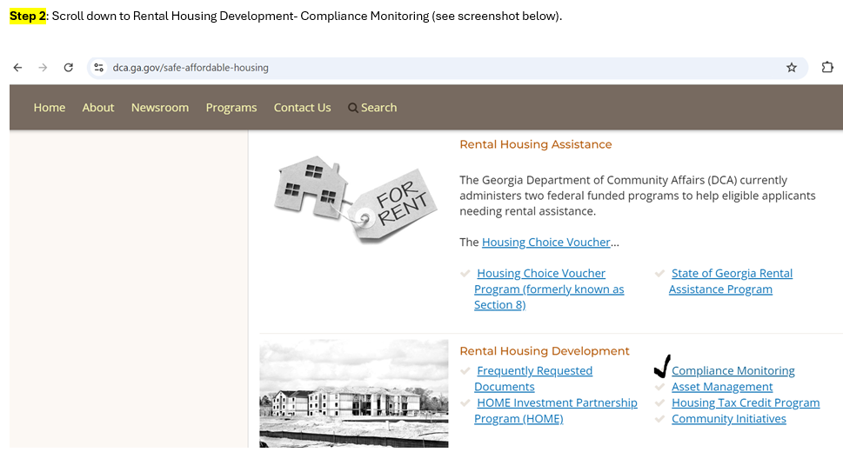

Slide 8
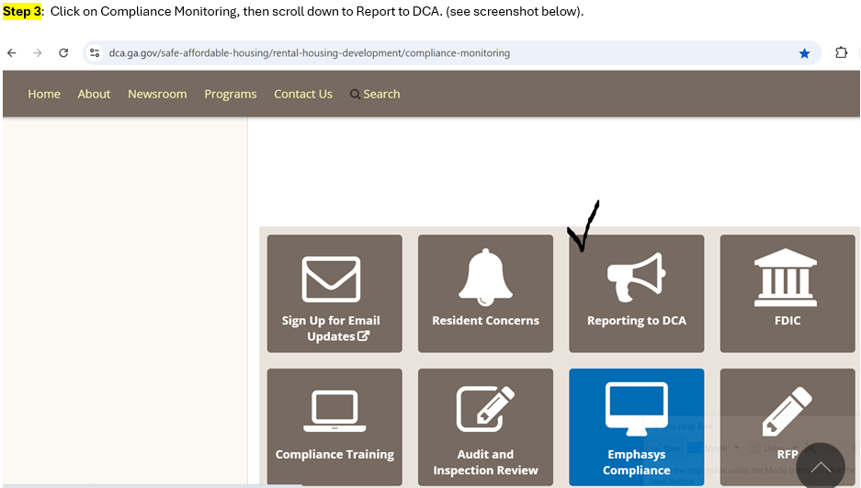

Slide 9
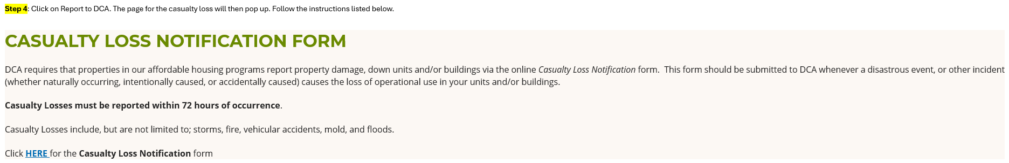

Slide 10
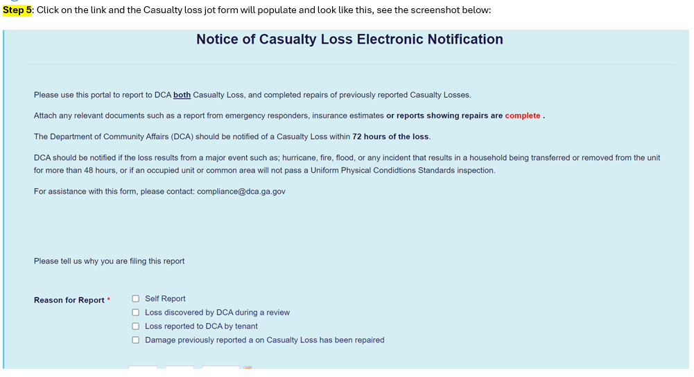

Slide 11




Remember to:
Complete the form here
Attach any relevant documents
Include pictures
Include reason for report

Slide 12
Thanks!
Compliance@dca.ga.gov
dca.ga.gov

