Slide 1
Welcome to the
2026 QAP Workshop

Slide 2

Agenda
8:00 – 9:00 a.m.
9:00 – 9:30 a.m.
9:30 – 10:15 a.m.
10:15 – 10:45 a.m.
10:45 am –12:00 p.m.
12:00 – 1:00 p.m.
1:00 – 1:25 p.m.
1:25 – 2:00 p.m.
2:00 – 2:30 p.m.
2:30 – 4:00 p.m.
| Registration & Breakfast
| Welcome
| Office of Housing Finance Managers’ Updates
| Networking Break
| Office of Multifamily Lending Update, NOFOs, and Supportive Housing
| Lunch
| Housing Development Gap
| Federal Compliance for Environmental Reviews
| Networking Break
| 2026-2027 QAP Updates & 2028-2029 QAP Development

Slide 3
Welcome
Maureen Freehill
Deputy Commissioner for Housing
Denise Farrior
Division Director, Housing Finance and Development

Slide 4
2026 Georgia Affordable Housing Coalition Conference Awards Nominations
Please submit your nominations for DCA’s 2026 affordable housing partner awards!
To be announced at Georgia Affordable Housing Coalition (GAHC) Annual Conference during lunch Thursday, March 5, 2026
Submit nominations by February 15, 2026 (Survey)
Categories:
  Most Impressive Development – Metro/Rural
  Best Resident Testimonial
  Best Community Engagement
  Best Local Partnership
Find the QR Code at the Registration Desk!

Slide 5
Thanks!
Maureen Freehill
Maureen.Freehill@dca.ga.gov
Deputy Commissioner for Housing Assistance and Development
Denise Farrior
Denise.Farrior@dca.ga.gov
Division Director
Housing Finance and Development
dca.ga.gov

Slide 6
Office of Housing Finance Organizational Changes
Kim Golden
Director, Office of Housing Finance

Slide 7
Office of Housing Finance
Kim Golden
Office Director
Sandy Wyckoff
Sr. Tax Credit Development Manager
Gary Huggins
Construction Manager
Meagan Cutler
Sr. Housing Finance Policy Manager
Brendan Waterman
Allocation Manager
LeMoni Burney
Tax Credit Underwriting Manager
Tracie Neal
Development Manager
Samoy Minter
Construction Management Analyst
Bryce Farbstein
Sr. Housing Policy Analyst
Em Persaud
Lead Allocation Analyst
Danielle Bridges
Relocation Specialist
Sanjana Zahin
Tax Credit Specialist
Nelson Bolton
Sr. Development Analyst
Maegan Lawter
Construction Management Analyst
Erin Sampson
Housing Policy Analyst
Jenny Moody
Allocation Analyst
Adria Hollis
Allocation Analyst
Trey Melvin
Tax Credit Underwriter
Jasmine Moore
Development Analyst
Dezire Jackson
Jr. Construction Management Analyst
Ayla McGinnis
Housing Policy Analyst
Rob Golin
Allocation Analyst
Mary Lecesne
Allocation Analyst
Ahsj’a St George
Tax Credit Underwriter
Phyllis Carr
Sr. Program Assistant
Tequila Moore
Construction Program Coordinator
Xzaviea James
Tax Credit Analyst
Melissa Johnson
Records Specialist

Slide 8
OHF Teams & Contacts
Allocation | Underwriting & Development | Construction | Policy
Brendan Waterman | Sandy Wyckoff LeMoni Burney, Underwriting Tracie Neal, Development | Gary Huggins | Meagan Cutler
Tax Credit Application & Award | Financial Feasibility | Architectural Review | Qualified Allocation Plan & Related Docs
Application & Waiver Submissions, Review Progress, Awards | Underwriting, HUD Subsidy Layering Review, Carryovers, LODs | Project Concept Changes (PCCs) | Housing Finance Policy Initiatives
Relocation | Development
Environmental Review | 10% Test, Final Allocation Application, Carryforwards, Credit Exchanges
Allocation@dca.ga.gov |  |  | 26-27 QAP Q&A Survey 28-29 QAP Input Survey
RelocationReview @dca.ga.gov | Development@dca.ga.gov | HFDConstructionServices @dca.ga.gov | OHFPolicy@dca.ga.gov

Slide 9
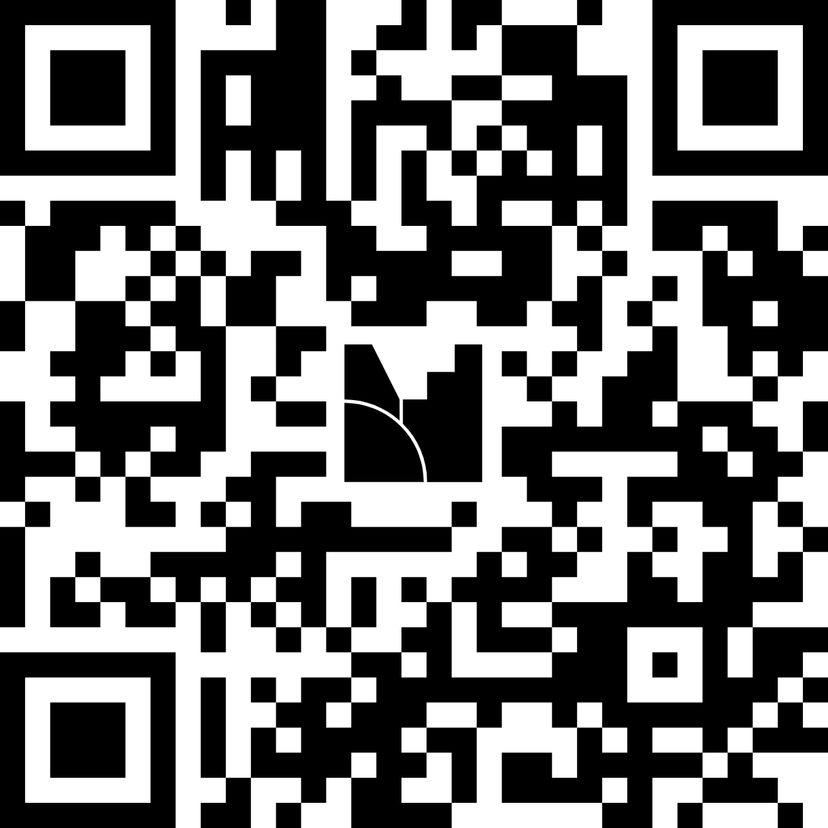
How to Participate
Raise hand for microphone
Submit questions/comments via Menti
  Menti.com
  Code: 9338 1116

Slide 10
Verbal Guidance Disclosure
Nothing that is stated verbally can be used for purposes of Competitive Round review or appeals
You must submit a question through the Q&A process to ensure DCA issues public, written guidance addressing the matter
Goal is to hold discussions that:
  Identify policy ambiguity or concerns from our partners, to help prioritize future guidance
  Provide more context than is often possible in Q&A

Slide 11
Thanks!
Kim Golden
Kim.Golden@dca.ga.gov
Director
Office of Housing Finance
dca.ga.gov

Slide 12
Office of Housing Finance Manager Updates
9:30 – 10:15 a.m.

Slide 13
Allocation
Brendan Waterman
Allocation Manager

Slide 14
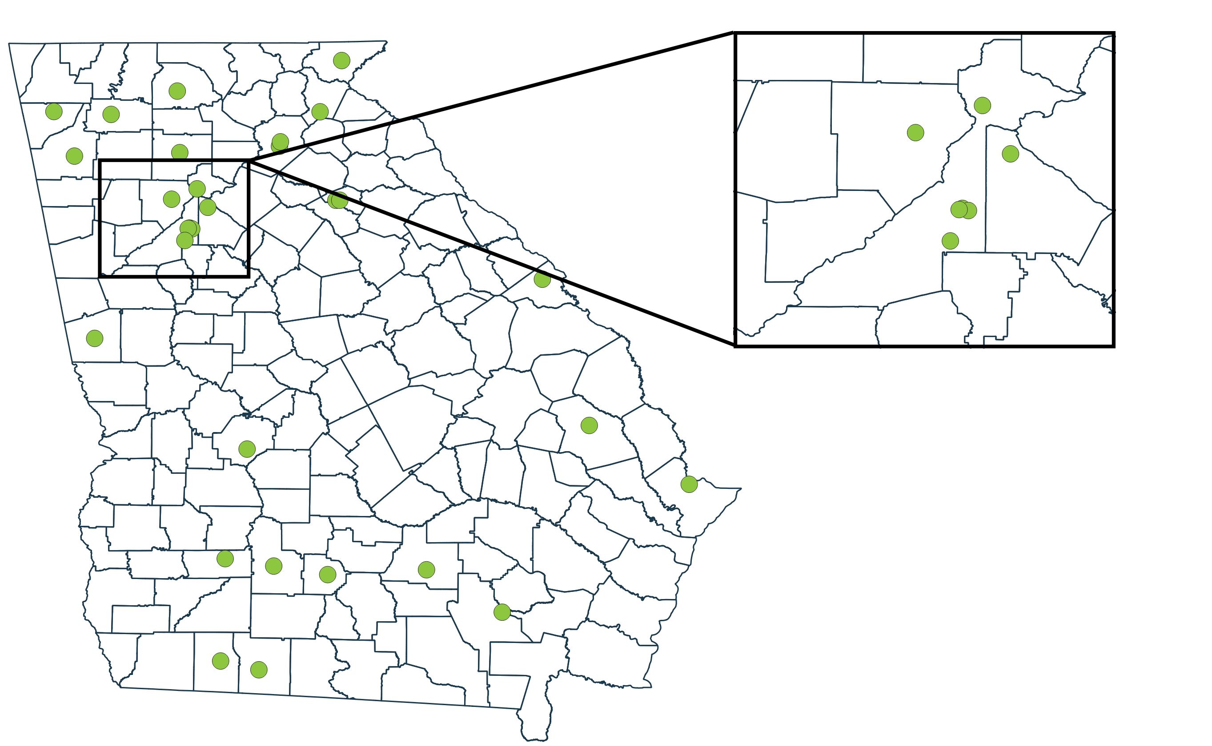
2025 9% Housing Tax Credit Awards
33 Awards
$39,800,164 Credits
1,993 LI / 2,059 total units
28 Cities | 25 Counties
All 14 Geographic Regions

Slide 15
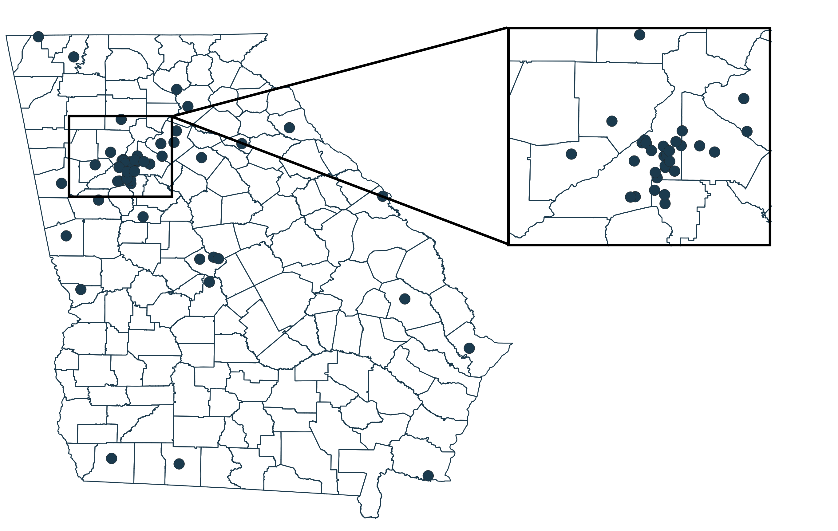
2025 4% Housing Tax Credit/Bond Applications
55 Applications
$1,019,152,643 Combined Request
8,652 LI / 8,740 total units
42 Cities | 13 Counties
All 14 Geographic Regions

Slide 16
Thanks!
Brendan Waterman
Brendan.Waterman@dca.ga.gov
Allocation Manager
dca.ga.gov

Slide 17
Underwriting &
Development
LeMoni Burney
Tax Credit Underwriting Manager

Slide 18
Competitive Review
Site Control Documents
Preliminary Financing Commitments
  Required for all sources listed in the capital stack
  Required at application submission
Energy Credits – 45L sunsetting June 2026
Deferred Developer Fee as a Construction Source

Slide 19
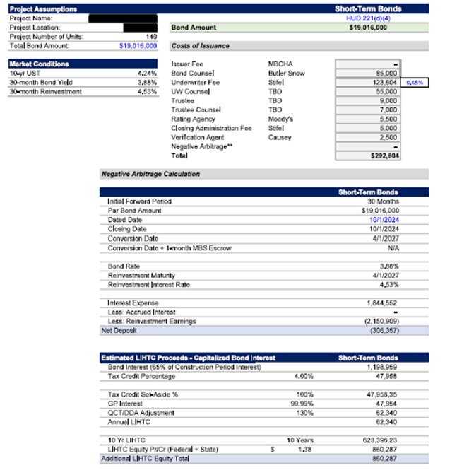
Full Application/Threshold Review
TEB Reinvestment Earnings
Cost of Issuance - COI is required
Must be issued by an Investment Banker
Example of COI →

Slide 20
Full Application/Threshold Review
Resyndication
  LURC/LURA Review Process
  Income Averaging
Income from operations - 3 years of audited financials required
BINs –One Building one BIN

Slide 21
Thanks!
Sandy Wyckoff
Sandy.Wyckoff@dca.ga.gov
Senior Tax Credit Underwriting & Development Manager
dca.ga.gov

Slide 22
Construction
Gary Huggins
Construction Manager

Slide 23
Threshold Sustainability
2026-27 QAP Threshold pg. 53
Green Building Initiatives (Green Globes certification program has been added back to QAP as an option to meet threshold requirements.
2026-27 QAP Threshold pg. 43
Unit Amenities will no longer require water heaters to be energy star certified.

Slide 24
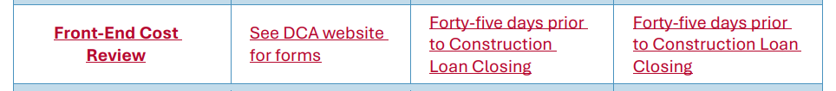
Front End Cost Review
Owners must conduct and submit a Third-Party Front-End Cost Review (“FECR”)
If costs increase more than 10% between Competitive Application and submission of Front-End Cost Review, owners must submit a written explanation to DCA.
  DCA will have forty-five days to respond, plus any days added for questions or clarifications. Owners may not close equity until after the earlier of this time period expiring or DCA’s approval.

Slide 25
Front End Cost Review Consultants
Qualifications: Architectural manual pg. 21 of 66
The DCA Qualification Package must contain, at minimum:
  A statement letter certifying that the consultant meets the minimum “DCA Qualified Consultant” experience requirements and qualifications
  Resumes of firm team members that will conduct the review
  Description of relevant past work conducting architecture/engineering reviews and cost estimate reviews for HUD and LIHTC projects.
  A (sample) copy of a cost estimate review performed for the HUD MAP program or HUD funding in conjunction with LIHTC

Slide 26
Covered Pavilion with picnic/barbecue facilities
Architectural manual pg. 27 of 66
One picnic table for "every 25 units".
At least one picnic table shall have an extension that allows clear knee space for handicap access.
Picnic tables shall have permanent anchorage to the ground.
The picnic tables shall be under the pavilion.
For projects with over 150 units, at least six of the picnic tables must be under the pavilion. The remaining required picnic tables must be either under the pavilion or near the pavilion.

Slide 27
Computer Room
Architectural manual pg. 28 of 66
For larger developments with over 150 units, providing a mix of laptops and desktop computers, there must be a minimum of 6 stationary computers in the computer center.
Laptops must be held in a safe, monitored location with check-in and check-out procedures posted. lab tops

Slide 28
Inspections
After awarded DCA will assign inspection companies to all HTC projects.
Inspections companies will perform 4 quarterly inspections at 25%, 50% 75%, 100% and provide reports to DCA on progress.
DCA will deliver the owners contact information to the assigned inspection company which will be used to schedule site visits and track project completion.
It is the owner's responsibility to inform the assigned inspection company and DCA that your project has begun physical construction.
DCA will also reach out to your project team for status from time to time.

Slide 29
Thanks!
Gary Huggins
Gary.Huggins@dca.ga.gov
Construction Manager
dca.ga.gov

Slide 30
Policy
Meagan Cutler
Senior Housing Finance Policy Manager

Slide 31
Updates
2026-2027 QAP Q&A Survey OPEN
  Responses published 1/28/2026
2026 Pre-App Manuals and Forms published
  Performance Workbook updated – open for public comment 30 days
HTC Properties Map Updated
  2025 9% Awardees added
  2026-2027 QAP Bonds Geographic Distribution Areas added
    Aligns with current US congressional district boundaries
2028-2029 QAP Input Survey OPEN

Slide 32
QAPs and Related Documents Webpage for
All Things QAP
Contacts
  HTCPolicy@dca.ga.gov
  Meagan.Cutler@dca.ga.gov
2026-2027 QAP
  Final QAP, Changes, Drafts
  Q&A Survey and DCA Responses QAP Workshop slides
2028-2029 QAP
  Input Survey
  Policy proposals, drafts, and related documents
Application Materials and Manuals
  Link to Manuals, Forms, Scoring Documents page
2024-2025 and Prior QAPs
  QAPs and related documents from 2002 through 2024-2025

Slide 33

1 Navigate to https://dca.georgia.gov/

Slide 34

2 Click "Menu"

Slide 35
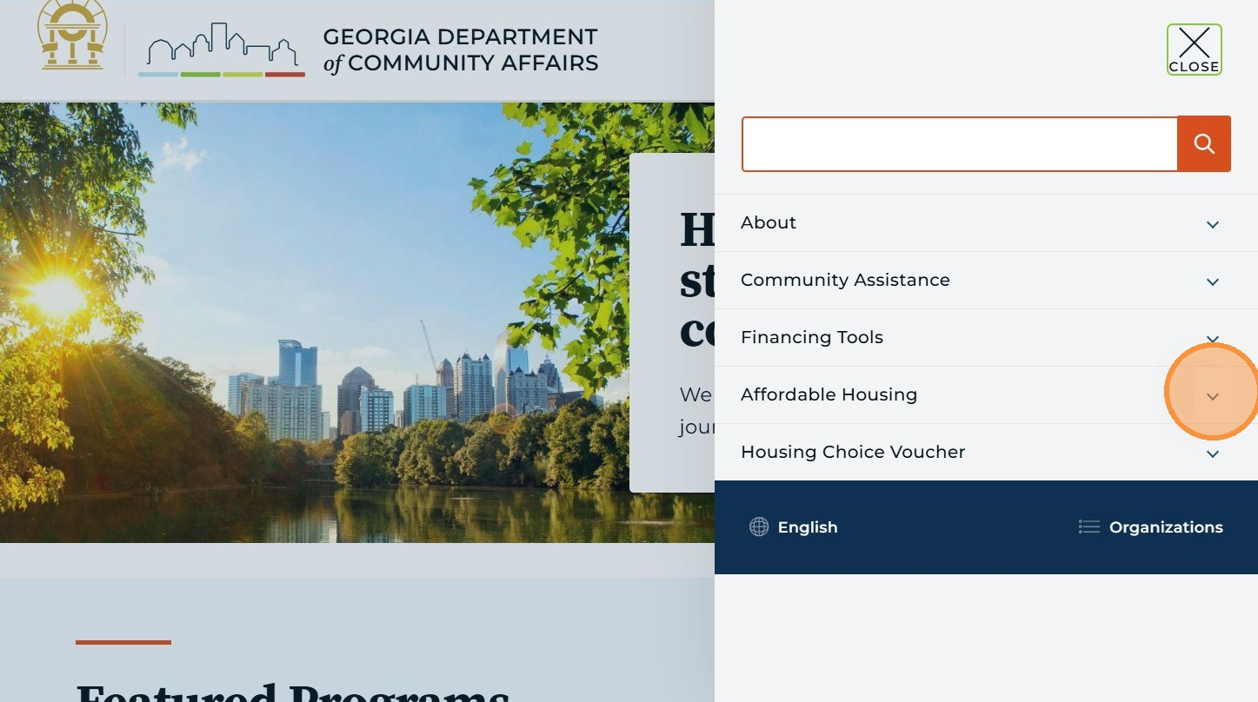
3 Click "Affordable Housing"

Slide 36
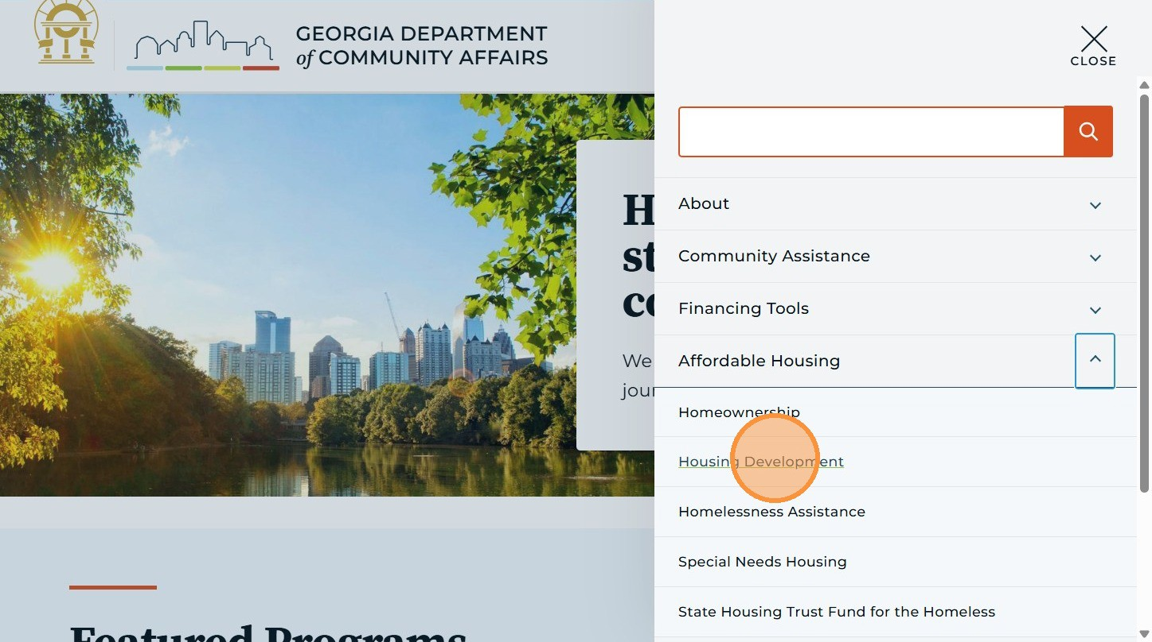
4 Click "Housing Development"

Slide 37
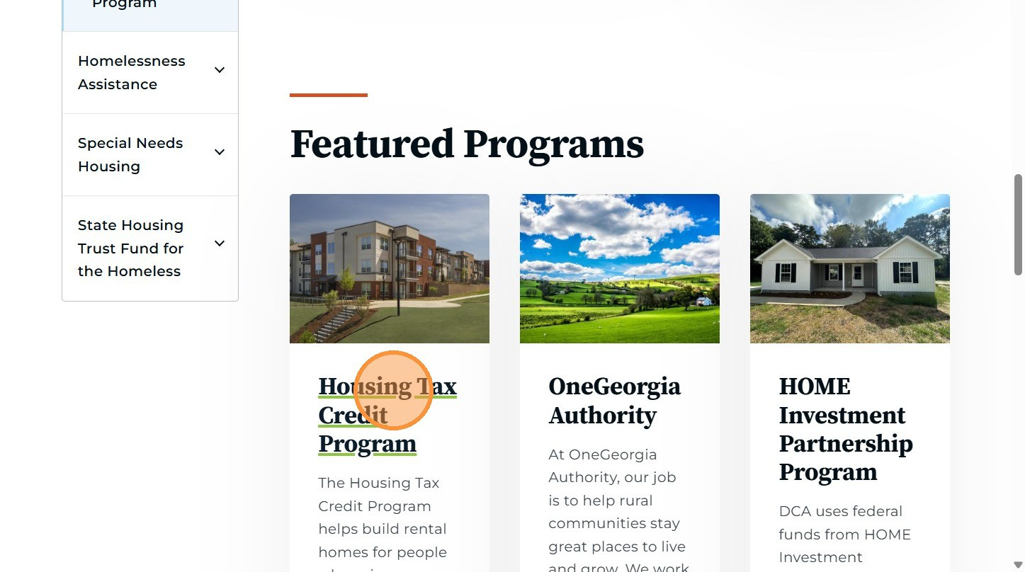
5 Click "Housing Tax Credit Program"

Slide 38
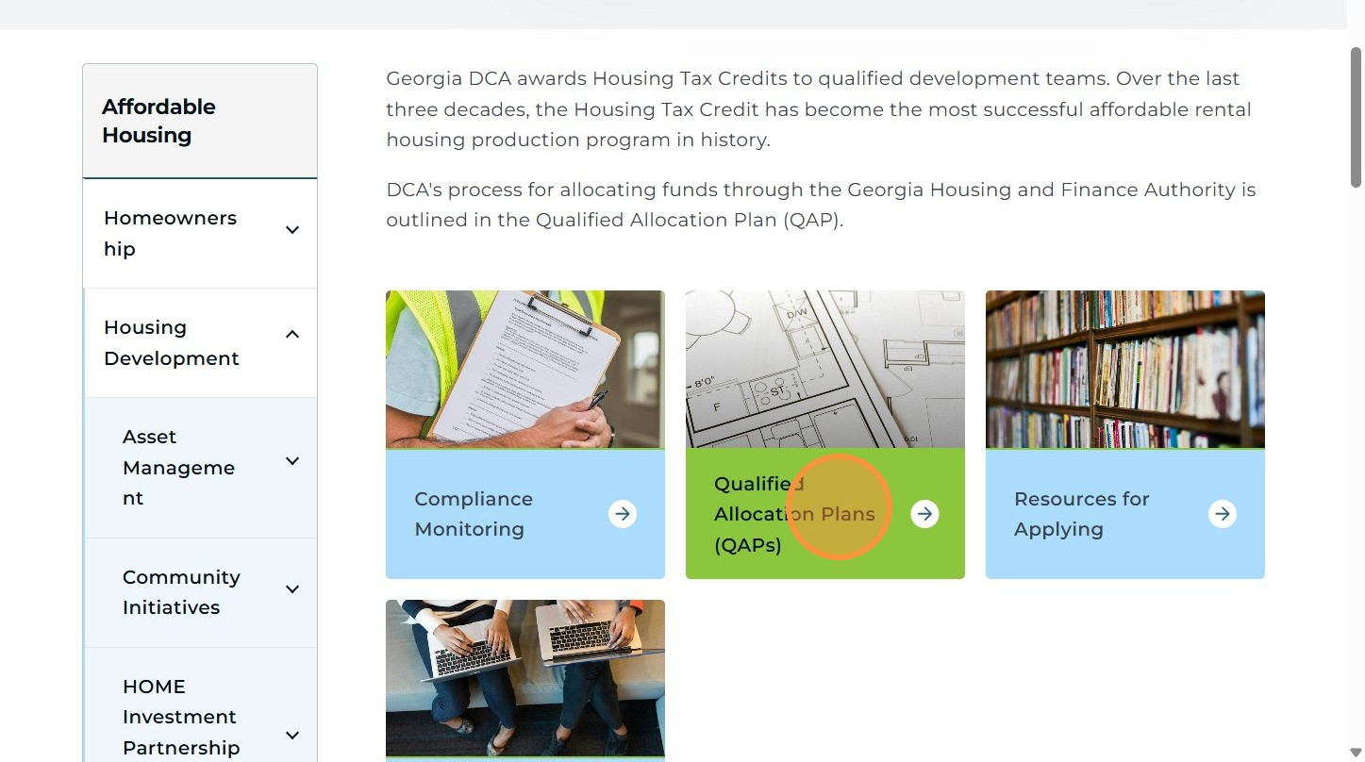
6 Click "Qualified Allocation Plans (QAPs)"

Slide 39
Thanks!
Meagan Cutler
Meagan.Cutler@dca.ga.gov
Senior Housing Finance Policy Manager
dca.ga.gov

Slide 40
Networking Break
10:15 – 10:45 a.m.

Slide 41
Office of Multifamily Lending Update
Notices of Funding Opportunities
(NOFOs)
Supportive Housing
10:45 a.m. – 12:00 p.m.

Slide 42
Office of Multifamily Lending Update
Gary Garner
Director, Office of Multifamily Lending

Slide 43
Thanks!
Gary Garner
Gary.Garner@dca.ga.gov
Director
Office of Multifamily Lending
dca.ga.gov

Slide 44
Supportive Housing &
Notices of Funding Opportunities (NOFOs)
John Stovall
Senior Manager, Policy and Special Projects
Bryce Farbstein
Senior Allocation Analyst

Slide 45

Supportive Housing

Slide 46


John Stovall
Senior Manager
Policy and Special Projects
John.Stovall@dca.ga.gov
404-273-0647
Primary Contact:
- Supportive Housing Institute
- Supportive Housing NOFO
- Emergency Housing Voucher (EHV) Program

Slide 47

What is Supportive Housing?
Definition
SH
Housing intervention that combines affordable housing assistance with voluntary support services
Addresses the needs of chronically homeless people and other vulnerable populations
Services are designed to build independent living and tenancy skills and connect people with community-based health care, treatment and employment services.
Housing Availability
Housing Subsidy
Supportive Services

Slide 48


Who is Served in Supportive Housing?
People who could live independently in the community with affordable housing and services should not be in institutions
Aging Adults
Veterans
Transitional Age Youth
Substance Use
Behavioral Health
Chronic Homelessness
Domestic Response Survivor
Frequent Users of Systems
Notes:
Christina
Who are our Neighbors in Supportive Housing?
One of the most common questions we are asked is who lives in Supportive housing. Supportive housing developments are diverse and often have a diverse tenancy – diverse in racial backgrounds, age, education, and experiences in life.
As we discuss populations, we would like to level set what we mean when we refer to tenants, households, residents and any other term used to reference the people living in a Supportive Housing development. CSH believes in the importance of tenant-centered housing so when use any of these terms, we are referring to all members of the supportive housing household. Some households consist of one person, while others include entire families. If the tenant is a family, providers ensure an equal and intentional focus on housing and, services for the children and the adults. Goals and outcomes for both children and adults are simultaneously tracked. Children or youth temporarily absent from the unit due to out of home placement in foster care are also to be considered part of the tenant household.
So when asked for populations most likely to live in Supportive Housing, it varies from state to state, region to region and city to city. However, the populations most common include:
Older Adults: The proportion of Georgians who are older adults experiencing homelessness has increased since 2018. Georgians over the age of 55 experiencing homelessness increased from 20% in 2018 to 23% in 2021 with a larger share of those individuals being over age 65.
Transitional Age Youth: All children — and especially older children in foster care — need and deserve a loving family with no expiration date. Yet, in the United States, about 20,000 youth exit foster care and are left to fend for themselves each year. This scenario — leaving foster care without achieving permanence — carries lifelong consequences. Youth who age out of foster care face are more likely to engage in risky behaviors and more likely to experience hardships such as homelessness, joblessness, early parenthood and substance use

Slide 49
Cost Effective and Evidence Based
Housing Retention | 96% ¹
Days in Shelter | -256 ²
Returns to Shelter | -70% ³
Psychiatric Hospitalizations | -61% ¹
ED Visits | -81% ⁴
Jail Days | -36% to -62% ⁵
Savings due to reduced incarceration | $1400 to $1800 per person per year. ⁶
¹ Hunter et al. Evaluation of Housing for Health Permanent Supportive Housing Program, 2017.
² Aidala et al., FUSE 10-Year Follow Up Report, 2023.
³ Aidala et al. Frequent Users Service Enhancement “FUSE” Initiative, New York City FUSE II Evaluation Report. Columbia University School of Public Health, 2014.
⁴ M. Lori Thomas et al., MOORE PLACE PERMANENT SUPPORTIVE HOUSING EVALUATION STUDY FINAL REPORT (2015)
⁵ Mondello et al.., Cost Analysis of Permanent Supportive Housing, State of Maine – Greater Portland, 2007
⁶ N.Y.C. DEP’T HEALTH AND MENTAL HYGIENE, NEW YORK/NEW YORK III SUPPORTIVE HOUSING EVALUATION: INTERIM UTILIZATION AND COST ANALYSIS 1 (2013)

Slide 50




Common Supportive Housing Models
Scattered-Site (vouchers)
Sponsor-based (master leasing)
Set-aside units in a property
Single-Site
All these models found in GA

Slide 51
DCA Supportive Housing Initiatives

Slide 52
DCA Supportive Housing Pipeline
GA Supportive Housing Institute
Development Funding
Notes:
Ilona

Slide 53
DCA Supportive Housing Pipeline
GA Supportive Housing Institute
Development Funding
Partnership with CSH
Goal: Build knowledge and capacity around Supportive Housing development
Key Benefits for Participants:
  5-month training institute September - January
  Teams work on real world project concept to prepare for development
  Technical assistance for developer teams
  Opportunity for competitive funding points
2025 Outcomes:
  5+ teams participated in Georgia SHI
Notes:
Ilona

Slide 54
DCA Supportive Housing Pipeline
GA Supportive Housing Institute
Development Funding
Partnership with CSH
Goal: Build knowledge and capacity around Supportive Housing development
Key Benefits for Participants:
  5-month training institute September - January
  Teams work on real world project concept to prepare for development
  Technical assistance for developer teams
  Opportunity for competitive funding points
2025 Outcomes:
  5+ teams participated in Georgia SHI
Funding Opportunities
  2025 & 2026 Single-Site Supportive Housing NOFO – National Housing Trust Fund
  2025 & 2026 9% LIHTC – General Set Aside for Single Site Supportive Housing
  2025 & 2026 9% or 4% LIHTC – Integrated Supportive Housing QAP points
2025 outcomes:
  2 SHI projects fully funded (NHTF/HOME, LIHTC & PBVs)
  102 new units of Supportive Housing funded
    Atlanta – 42 units for homeless seniors
    North Georgia – 60 units for homeless DV survivors
Notes:
Ilona

Slide 55











What is the Supportive Housing Institute?
For developers, property managers, service providers​ & persons with the lived experience of homelessness
A CSH signature approach to seeding a quality pipeline of supportive housing​
Navigation tools for the complex process of developing housing with support services​
Intensive capacity building, training and technical assistance
Built to shorten the length of time spent seeking project funding
Based on best-practice-centered CSH Quality Standards
Notes:
– Why Investing for SHI in Georgia ---?
Address the Shortfall of Affordable & Supportive Housing for Residents who benefit from SH
Building Partnerships to have community impact!
This is for developers, Service providers, property managers, and people with the lived experience of homelessness.
It provides tools for the extremely complex process of developing housing with wrap around support services.
It is built to help shorten the length of time spent seeking funding for the project.
The institute is a CSH approach to seeding a quality pipeline of supportive housing in a community.
It provides intensive capacity building, training, and technical assistance, and it is all based on best practices that are part of CSH's quality standards.
In a nutshell, it has been shown to be the most impactful way CSH can help grow quality supportive housing units to make meaningful impact in communities across the nation.

Slide 56
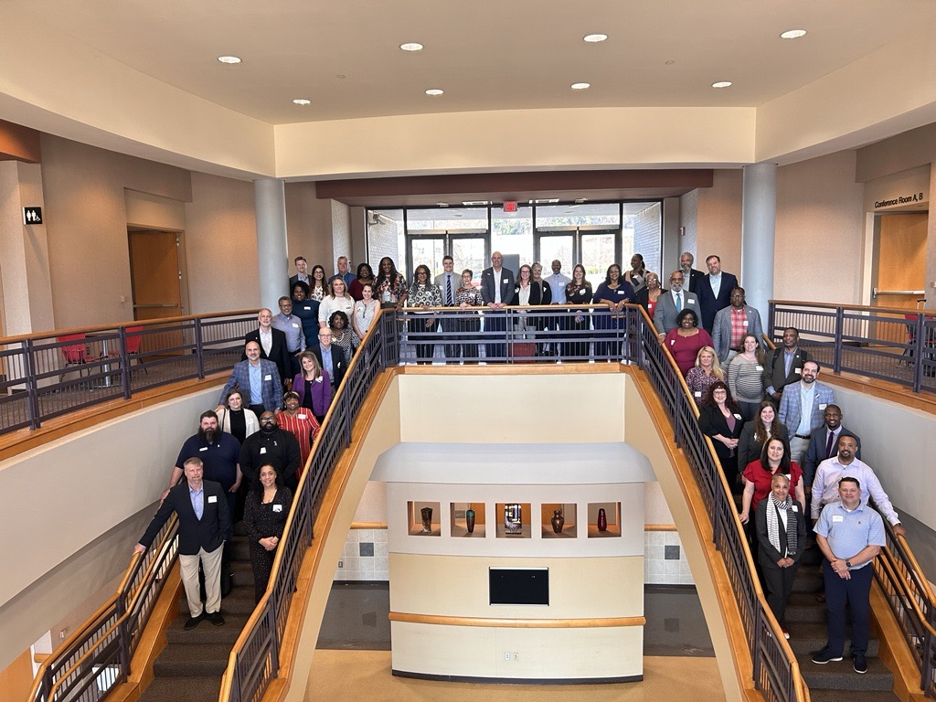
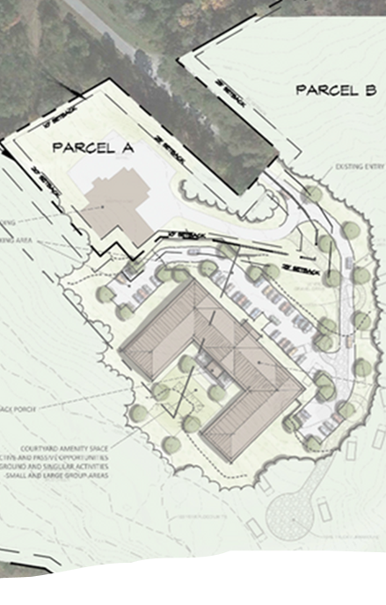
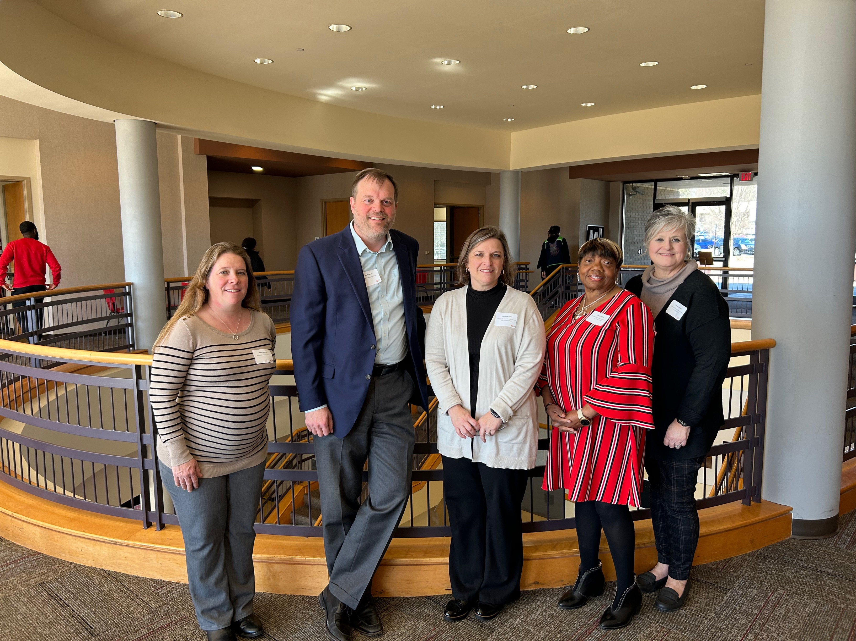
2024-25 Georgia Supportive Housing Institute

Slide 57
GSHI Session Topics
Project Teams, Concepts and Strategy
Designing Your Project
Services Planning
Property Management
Coordinated Entry
Supportive Housing Budgets: Services, Operating and Capital
Fair Housing, Quality Improvement
Quality Endorsement
Institute Finale

Slide 58
GSHI Anticipated Timeline
(subject to change)
2026-27 Institute Applications Open – early July 2026
Applications close – late August 2026
Institute launch – September 2026
Institute finale – January 2027

Slide 59
2026 Supportive Housing NOFO
Funding available: $4 Million National Housing Trust Fund (NHTF)
Purpose: Construction, Rehabilitation, Preservation of Single-Site Supportive Housing
Award includes: Low-interest loan $2M-4M
LIHTC Contingency:
  NOFO awards contingent on 2026 9% LIHTC award
  NOFO awardees will receive Favorable Financing Letter for LIHTC app.
Applications open January 23 – March 12*, 2026
Informational Webinar February 10, 2026, 1-2:30pm
Contact SupportiveHousing@dca.ga.gov with questions

Slide 60
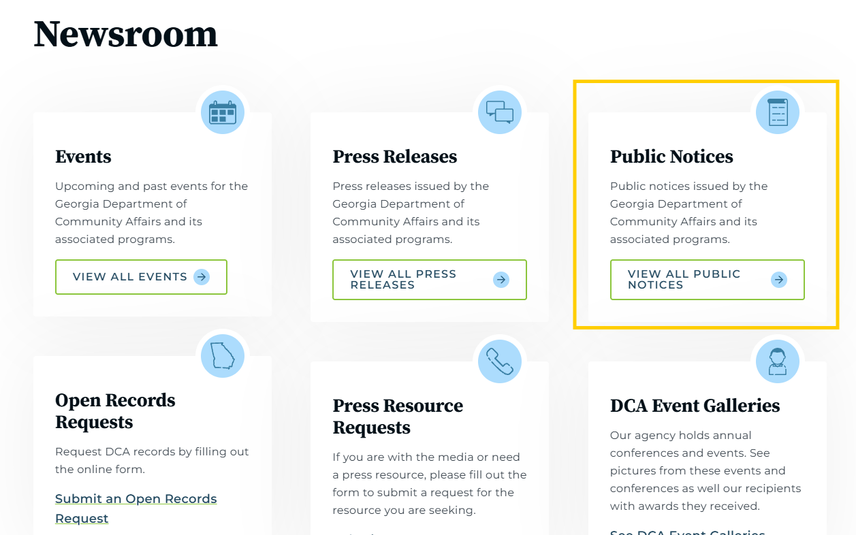
How to Find the NOFO
DCA.GA.GOV
Hover over “ABOUT” tab in top left
Click “NEWSROOM”

Slide 61
9% General Set Aside - Overview
Commissioner may award up to two applications per round
Must be Single-Site Supportive Housing
  Greater than 25% of units dedicated to Supportive Housing
  On-site and/or other community based supportive service delivery
  Coordination between service provider(s) and property management
Applies to the 2026 9% round only
GSA awarded applications are exempt from 25% Supportive Housing unit maximum

Slide 62
9% General Set Aside – Selection Process
Must meet Single Site Supportive Housing Requirements and submit all required documents & uploads
DCA will select highest scoring GSA applications, based on QAP scoring and threshold criteria
May not claim points for Integrated Supportive Housing
DCA will attempt to award New Affordability and Preservation, subject to DCA discretion
GSA applications only compete against GSA applications
If not selected under GSA but still scores well enough for selection in Competitive pool, application may be awarded

Slide 63
9% General Set Aside – Application Process
Apply in 9% LIHTC round
Under “Application Designation” tab, select “General Set Aside – Single Site Supportive Housing”
Complete all fields within the “Supportive Housing” section of Emphasys
Upload all required documents with required naming convention

Slide 64
9% General Set Aside – Required Docs
Executive Summary Narrative
Completed Supportive Services Plan & Budget
Evidence of agreements between developer, property manager & service provider(s). Min: Letters of commitment from service providers.
  Note: Not required to use DCA-approved referring entities from Integrated Supportive Housing section of QAP
Preliminary commitment of PBRA

Slide 65
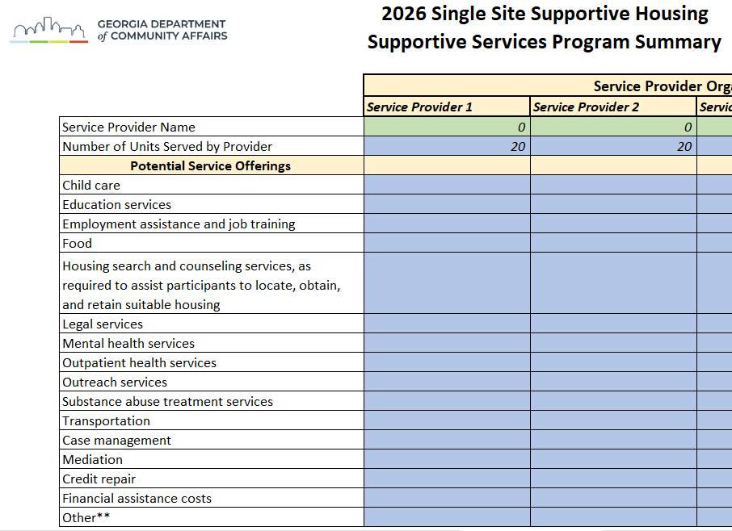
Supportive Services Plan and Budget
Purpose: Assess proposed supportive services programmatically and financially
Program Summary, Services Plan, Budget Years 1-5
Currently only required for Single-Site Supportive Housing Projects

Slide 66
Supportive Housing Underwriting Guidance
DCR & Effective Gross Income – Normal QAP standards apply
Revenue, Vacancy, and Expense Trends – 7% or higher
Developer Fee – QAP standards apply; developer encouraged to apply DDF to reserves
Operating Expenses – no less than $8,000 per unit for all geographic pools
Operating Deficit Reserves – QAP standards apply
Replacement Reserves – 6 months capitalized prior to conversion
Furniture and fixtures reserve – Capitalized prior to conversion
  $2,000 for studio and one-bedroom units
  $3,000 for two-bedroom and greater units

Slide 67
Supportive Housing Compliance
DCA currently developing process for monitoring Supportive Housing units
Anticipated LIHTC & HOME Compliance Manual Addendum in 2026
LURC/LURA Supportive Housing language updates
DCA will be seeking feedback on proposed process in next 1-2 months
Contact John.Stovall@dca.ga.gov if interested

Slide 68
Integrated Supportive Housing
Appreciative of all of you and your teams who have undertaken this commitment over the last couple of years
All of us looking forward to getting those units in service and leased up

Slide 69
Integrated Supportive Housing - Updates
Referring Entities list has been updated to include new points of contacts for MOU outreach
The list also now includes referrals through Area Agencies on Aging (AAAs)
  Only for referrals under the Money Follows the Person (MFP) program administered by the Dept. of Community Health. More info on MFP: https://medicaid.georgia.gov/programs/all-programs/georgia-money-follows-person-ga-mfp

Slide 70
Integrated Supportive Housing - Going Forward
Hoping and anticipating to add more approved Referring Entities
  Individuals living with intellectual or developmental disabilities
  Individuals referred through the HOPWA program
Approved Referring Entities have established statewide networks

Slide 71
Integrated Supportive Housing - Going Forward
Possible referral pathway for other service providers:
  Must serve eligible population (disabled, homeless, at risk of homelessness)
  Designated by Continuum of Care (CoC) to manage referrals and services for the property. Referred individuals must go through CoC.
  MOU(s) must be submitted clearly showing:
    the service provider has been designated by the CoC
    service provider and property commit to Integrated Supportive Housing requirements, as set forth in the MOU guidance.

Slide 72
Integrated Supportive Housing- Going Forward
Newly-approved Referring Entities are still permitted to execute MOUs with properties with already existing MOUs.
  Properties may have more than MOU. The MOU guidance has details ensuring all Referring Entities for a given property receive contemporaneous notice of any vacancies.
  Newly approved Entities may reach out to establish new MOUs.
If/when, under an MOU, a Referring Entity cannot fill all available ISH vacancies (minimum 10% of total units), then in order to maintain the 10% commitment, additional MOUs with additional Referring Entities will need to be created.
The 10% minimum commitment will need to be maintained regardless if any ISH unit is temporarily unfilled by an existing referral.

Slide 73
2026 Notices of Funding Opportunity
(NOFOs)

Slide 74
2026 NOFOs
Community Development Block Grant- Disaster Relief (CDBG-DR)
HOME (Home Investment Partnerships Program)
Low-interest loan awards eligible for Favorable Financing points
Loan awards must be used in conjunction with a 2026 LIHTC app
Application deadline: March 12th
Tentative Awards Announcement: April 6th
Note that all LIHTC Pre-Application requirements and deadlines remain, including for Project Team Qualifications.

Slide 75
Community Development Block Grant- Disaster Relief (CDBG-DR) NOFO
$20M in CDBG-DR awards reserved for areas impacted by Hurricane Idalia, Tropical Storm Debby, or Hurricane Helene.
  44 counties listed
$2M reserved for communities impacted by Hurricane Irma and 2017 tornadoes
  At least $1.4M reserved for projects in zip codes 31701, 31705, 31707, 31548, and 31520
  14 counties eligible for up to $600K of the allocation
The 2026-2027 QAP sets forth up to three set-asides within each tax credit round for projects utilizing CDBG-DR funding.
The NOFO is available on the Housing Tax Credit program website

Slide 76
Community Development Block Grant- Disaster Relief (CDBG-DR) NOFO
CDBG-DR has other unique requirements
  Designs must include features intended to mitigate future disasters
  Data must speak to the community impact related to the disaster
  The NOFO lists possible options for design features and data points, but applications may propose others

Slide 77
HOME NOFO
$16M available in loan amounts from $1M to $4M
Maximum per-unit subsidy limits per the Home Cost Allocation Tool, linked on the NOFO
Evaluation priorities include proposed Preservation developments
These funds are not subject to Build America, Buy America (BABA) requirements. However, if the proposed development is anticipated to receive another jurisdiction’s HOME funds, or other funds subject to BABA, please set that forth in the application Narrative and in the Core App Sources.
This NOFO is also available on the Housing Tax Credit program website

Slide 78
Thanks!
John Stovall
John.Stovall@dca.ga.gov
Senior Manager
Policy and Special Projects
Bryce Farbstein
Bryce.Farbstein@dca.ga.gov
Senior Housing Policy Analyst
dca.ga.gov

Slide 79
Lunch
12:00 – 1:00 p.m.

Slide 80
Housing Development Gap
Federal Compliance for Environmental Review
1:00 – 2:00 p.m.

Slide 81
Housing Development Need
What public data tells us about how we should build across Georgia's regions
Megan Conville
Principal Analyst, Applied Housing Research

Slide 82





Contents
Introduction
Development
Report overview
Dashboard
Q&A

Slide 83

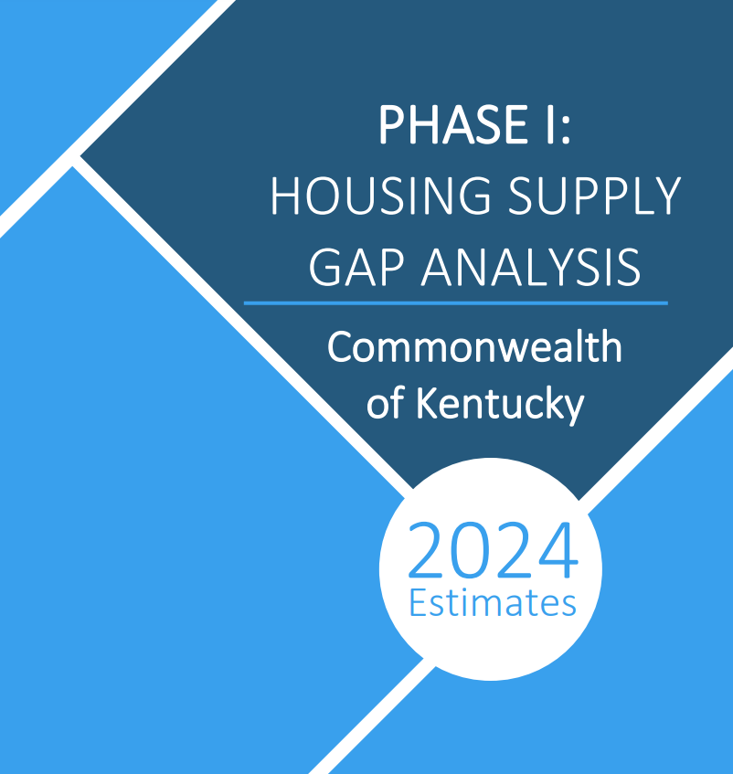

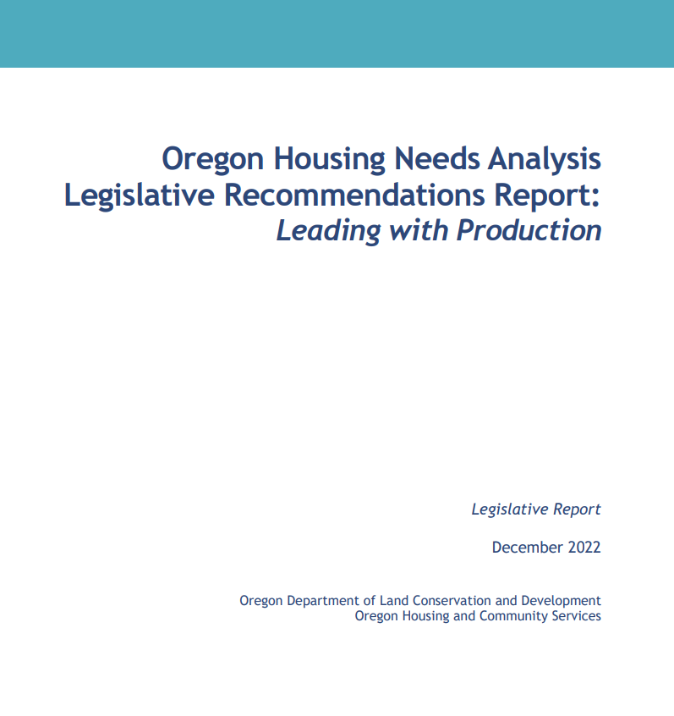
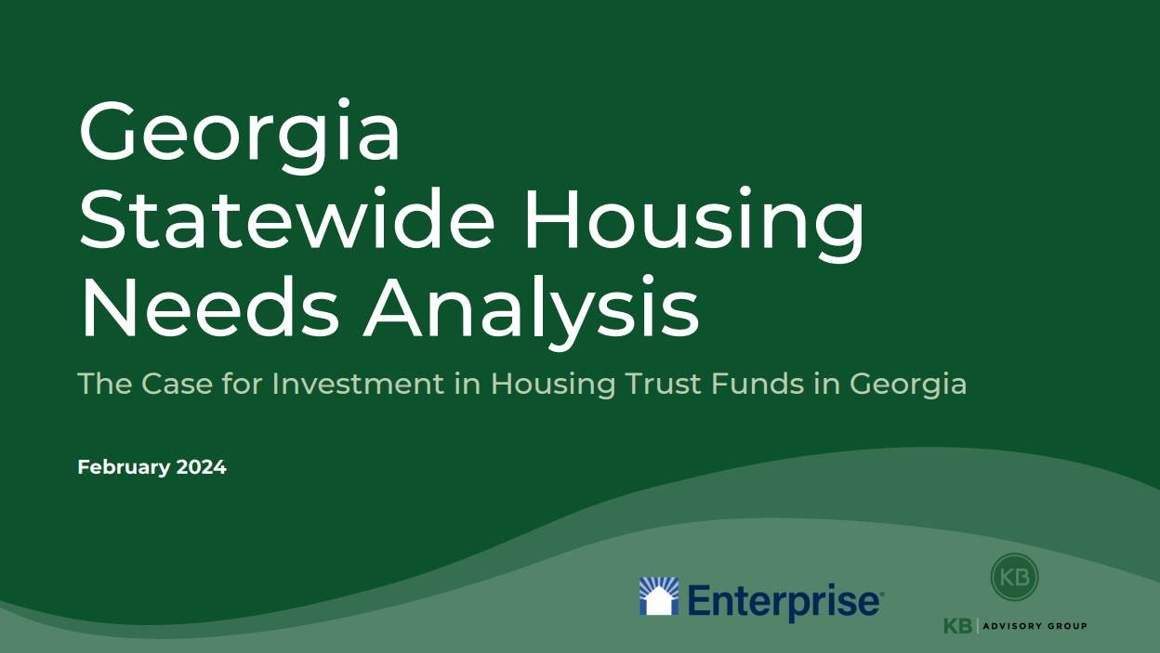
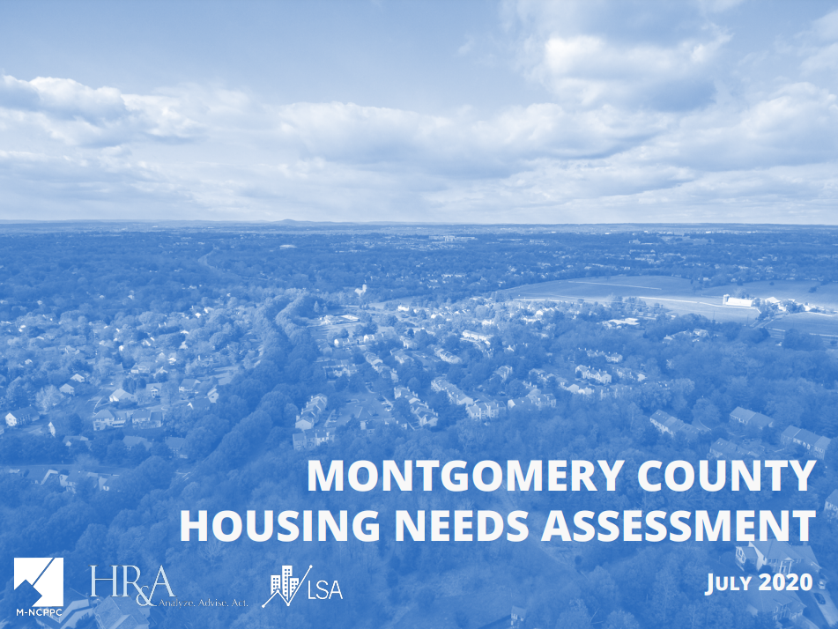
Housing Needs Assessments

Slide 84
Shared structures of Housing Needs Assessments
Housing Needs Assessment
Summarized Housing Need
Metric 1
Metric 2
Metric 3

Slide 85
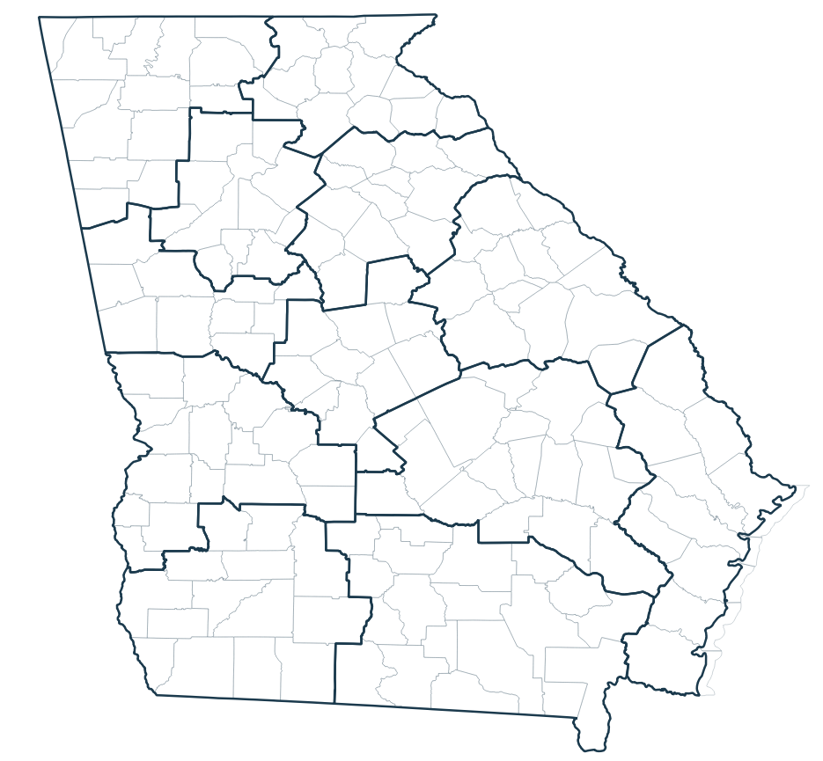
What DCA wanted
To understand the housing need at this moment
Geography: by DCA service regions
By homeownership and rental housing
A unique methodology that reflected the need in Georgia
To equip our local decision-makers with data

Slide 86
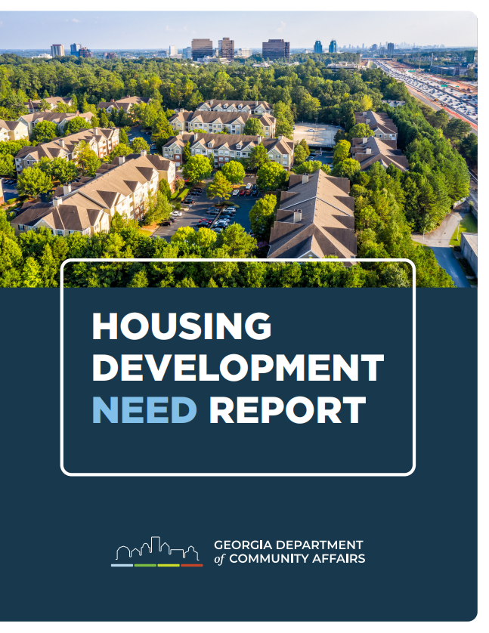
What DCA created

Slide 87

Our university partners

Slide 88
Methodology
Target Housing Stock
Available Housing Stock
Initial Housing Development Need

Slide 89
Methodology
Initial housing development need
Total Housing Development Need
x a conversion of renters to homeowners

Slide 90



Georgia’s Housing Development Need
113,191
Rental homes
101,249
Homeowner homes
Total development need is 5.2% of total available homes in Georgia

Slide 91
A look inside the report

Slide 92
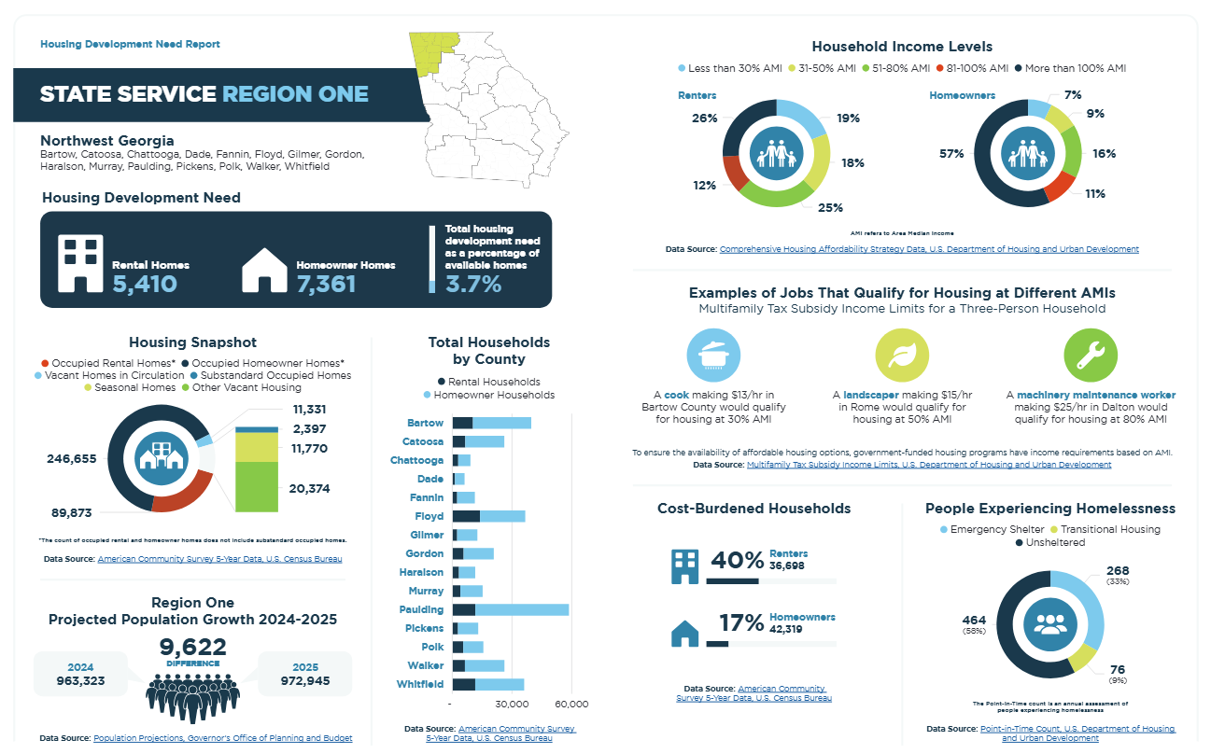

Slide 94
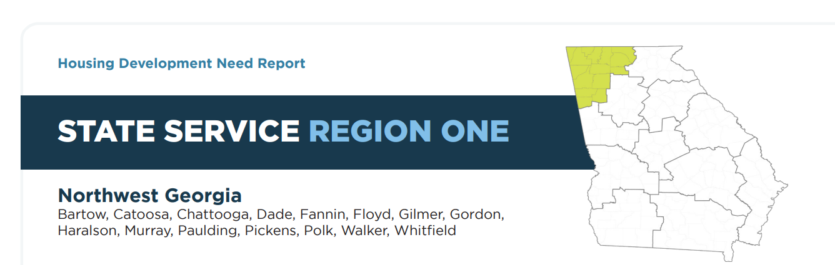

Slide 96
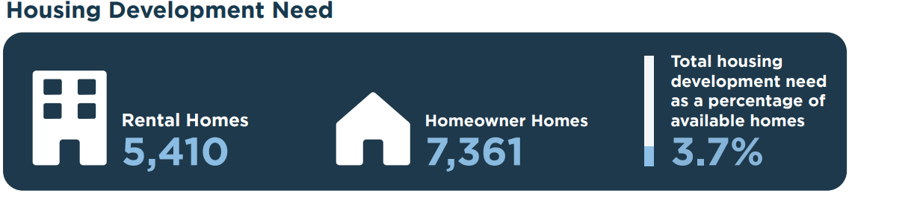

Slide 98
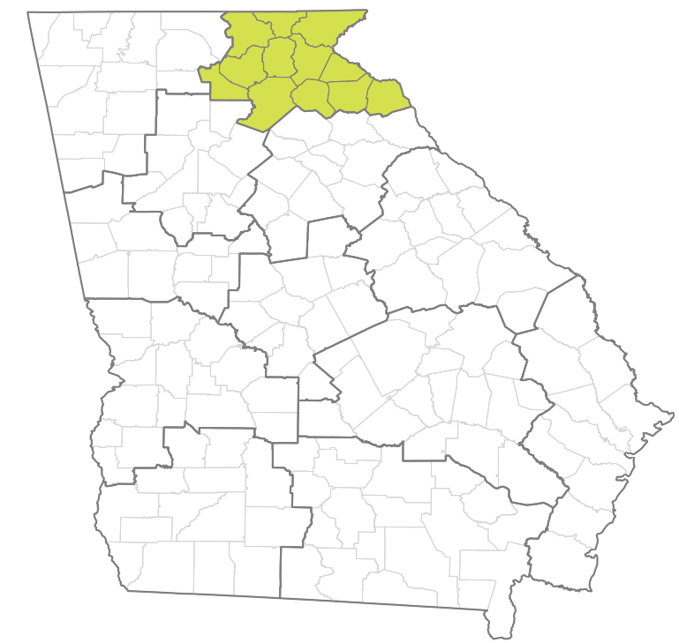
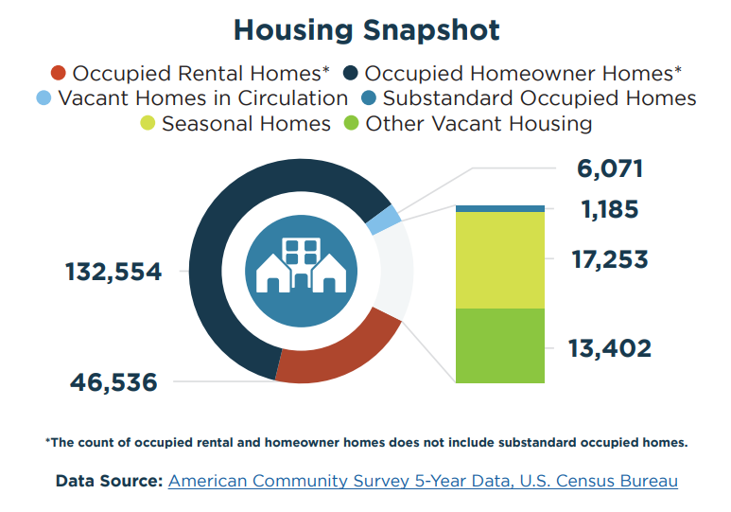
Region 2
Notes:
Takeaways: The rental rate is much lower than the state average, at 26% as compared to the state at 35%. Your seasonal homes make up 8% of all your housing, as compared to 2% across the state. That’s 54% of all your vacant homes that aren’t in circulation, as compared to 25% across the state.

Slide 100
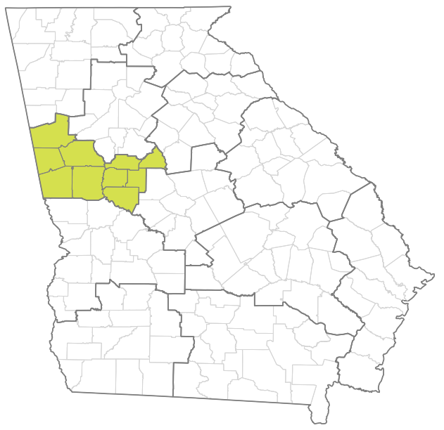
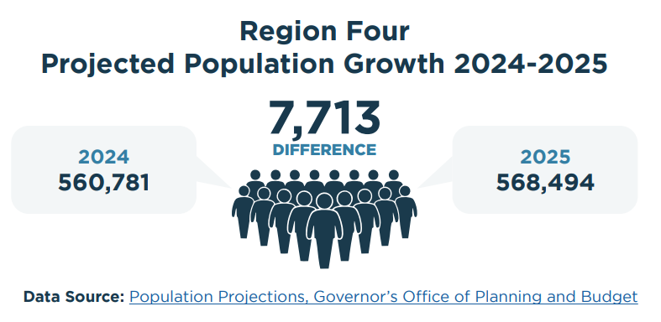
Region 4
Notes:
Population growth in Region 4 is higher than the state average, at 1.4% between two years, as compared to the state at 1.1%. How do you build to anticipate the population moving in?

Slide 102
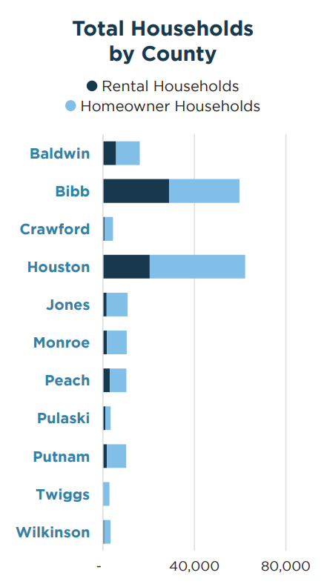
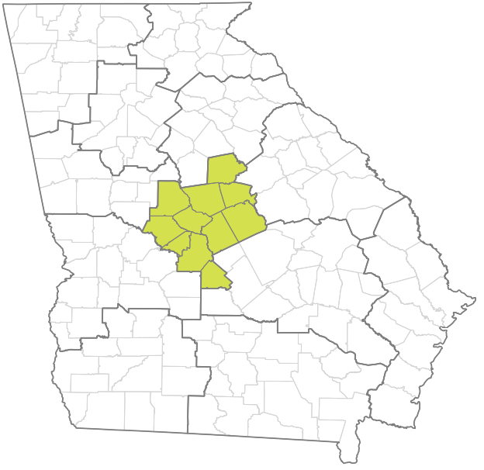
Region 6
Notes:
This snapshot can tell you not only about the actual scale of households in each of your counties, but how to target strategic homeownership or renter opportunities. For example, one of your biggest counties, Bibb, has just above 50% homeownership homes, as compared to the 65% for the state, which is reflective of your wider region. Seven of your counties have below 30% rental homes, which could make sense for the area, but could also mean folks are leaving for other housing opportunities.

Slide 104
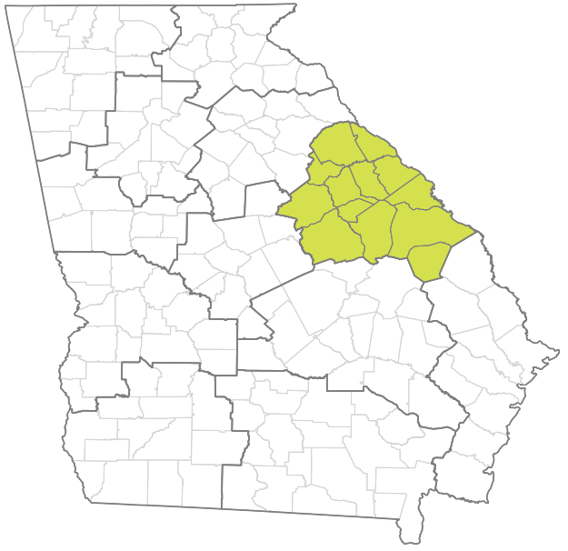
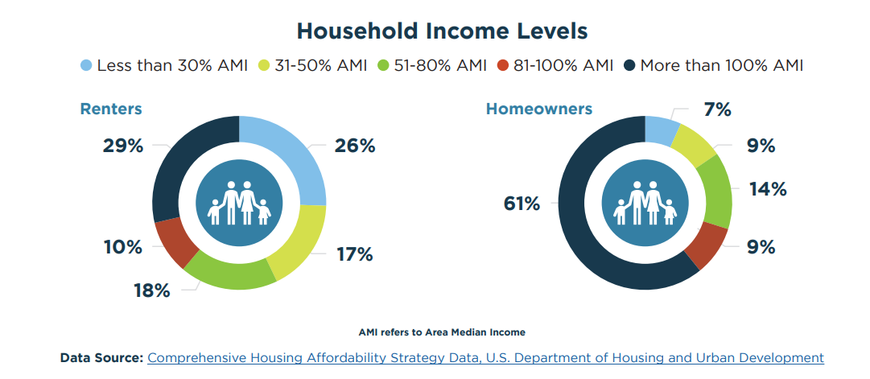
Region 7
Notes:
This tells you a more comprehensive picture of homeowners and renters. In region 7, there are just below 17k renters at or above 100% AMI. This could be important for new homeowner opportunities.

Slide 106
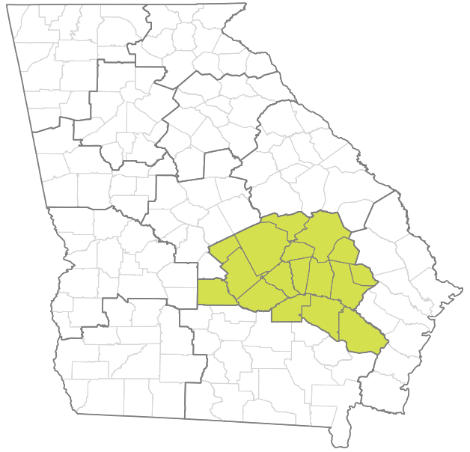
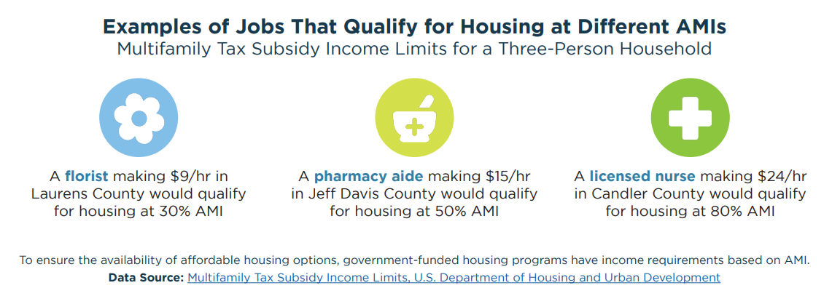
Region 9
Notes:
This is to help your community understand who qualifies for housing at different AMI points for a three person household. Someone making double the minimum wage hourly is qualified for housing at 50% AMI in Jeff Davis County, for example.

Slide 108
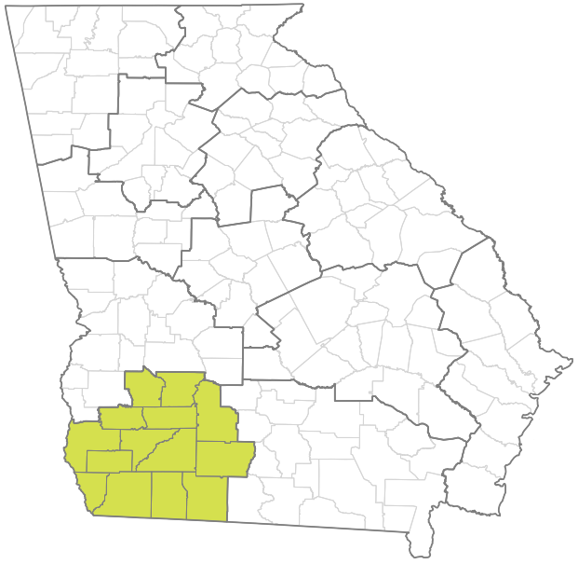
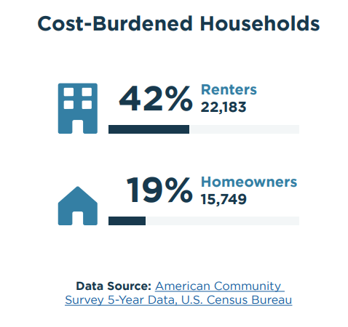
Region 10
Notes:
This ties into reducing the cost burden for renters and homeowners alike. There are 22k renters paying more than 30% of their income towards housing, which takes away from ability to pay for other needs such as food, education, health needs, or transportation. This is slightly below the state average of 48% of renters experiencing cost burden, but is still notable towards looking for solutions for.

Slide 110
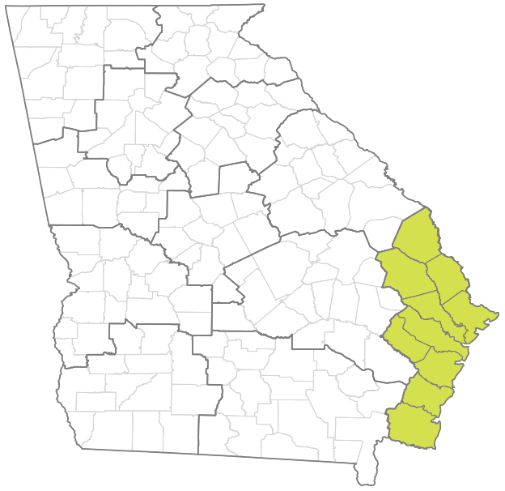
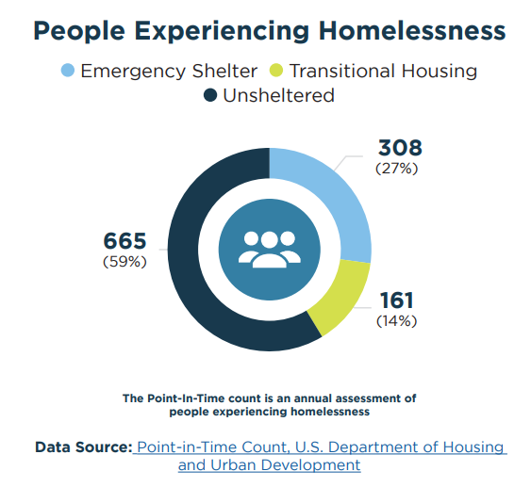
Region 12
Notes:
Homelessness data comes from the point-in-time count. It has limitations such as its definition of homelessness, but we see here there were 1,134 total people experiencing homelessness during the time of the count. For an expanded definition of homelessness, we can use McKinney Vento data through the school district, which includes doubled up (couchsurfing, staying with a friend) and hotels and motels, which 2,035 students were counted as in 2022-23.

Slide 111
Where can you find this?

Slide 112
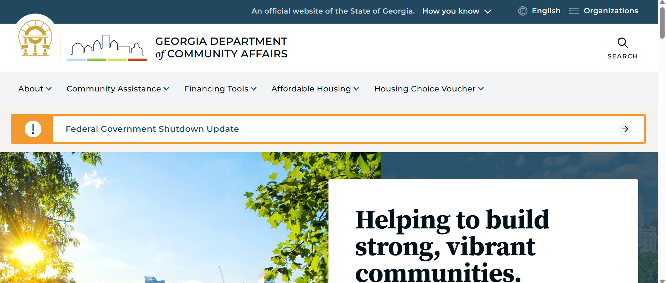

Slide 113
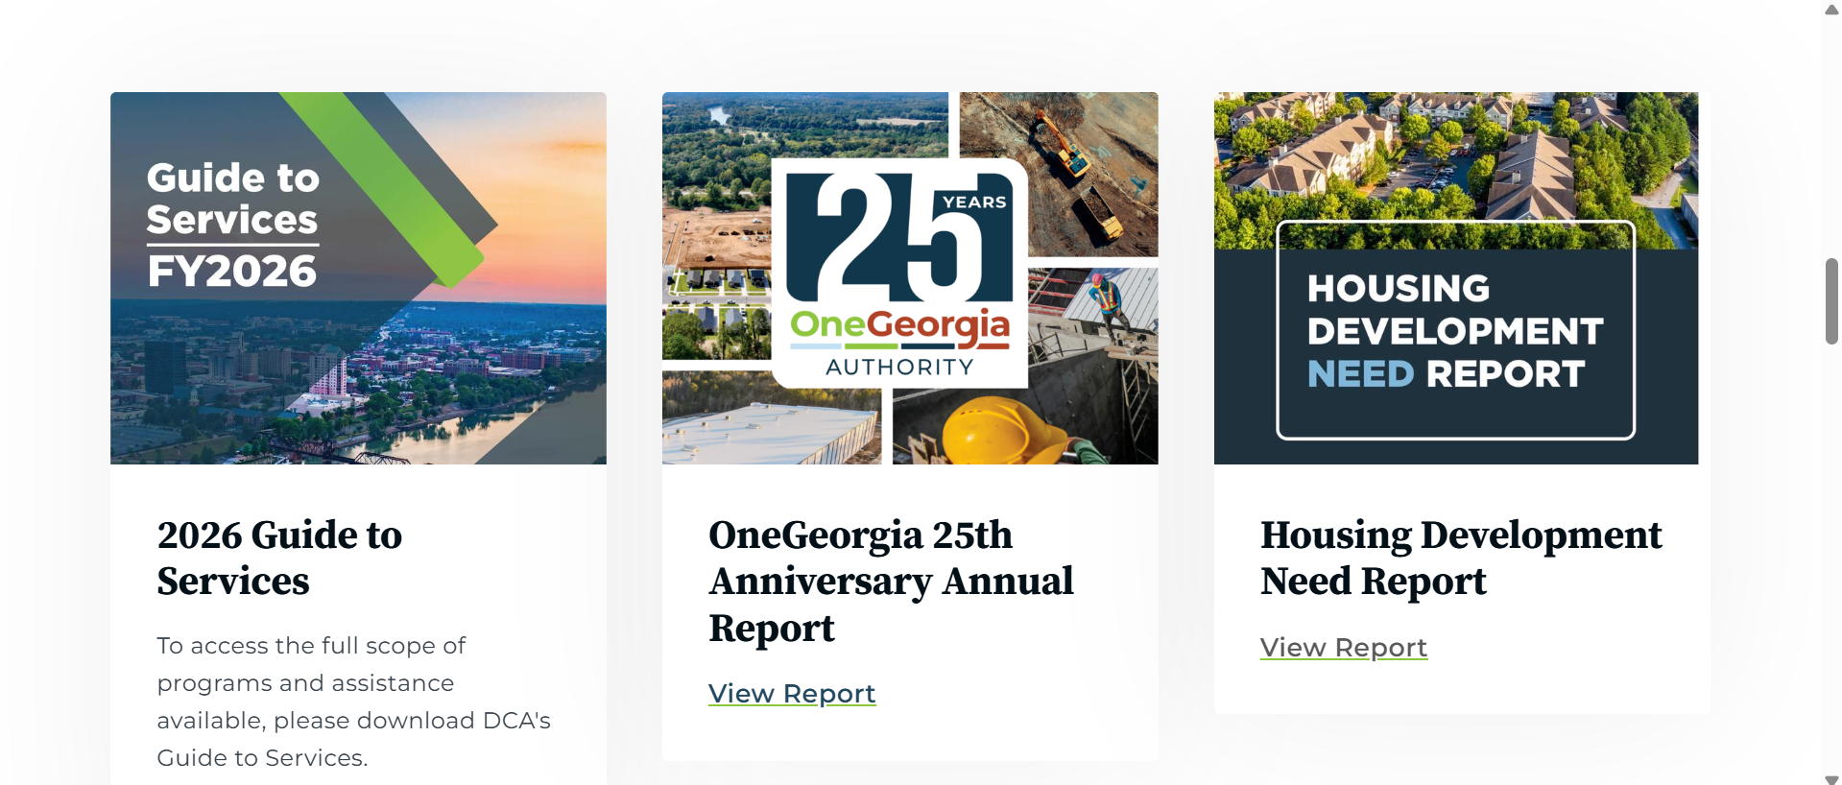

Slide 114
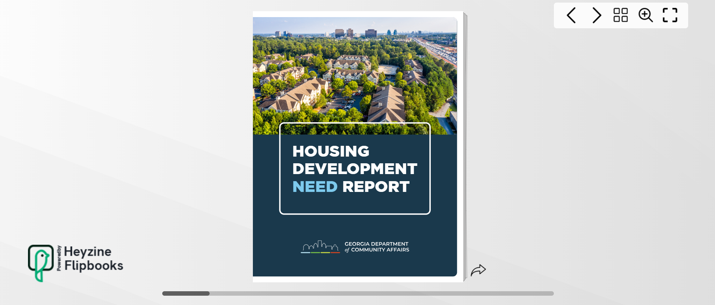

Slide 115
Housing Development Need Dashboard

Slide 116
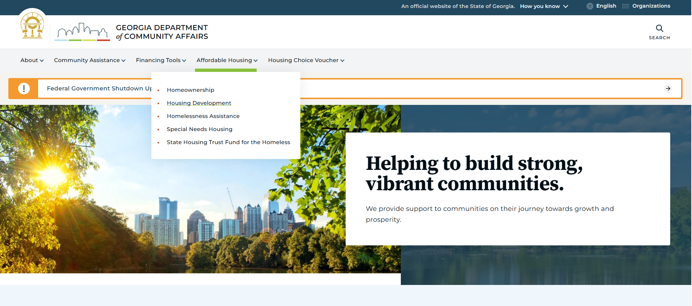

Slide 117
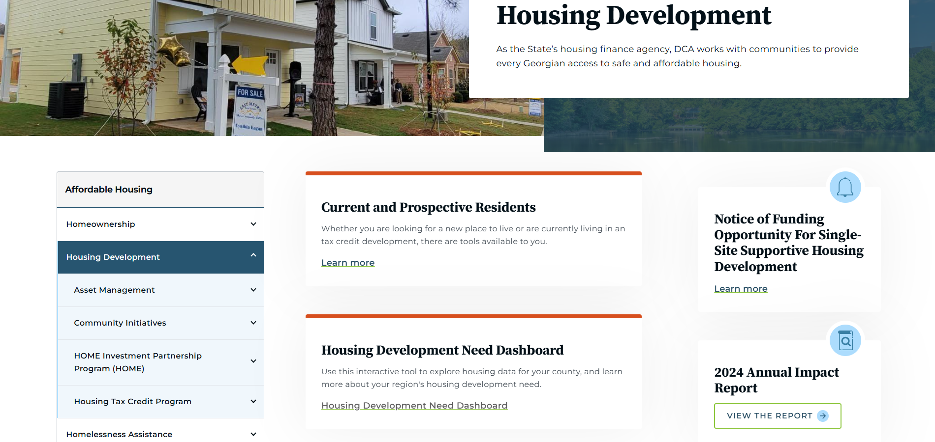

Slide 118
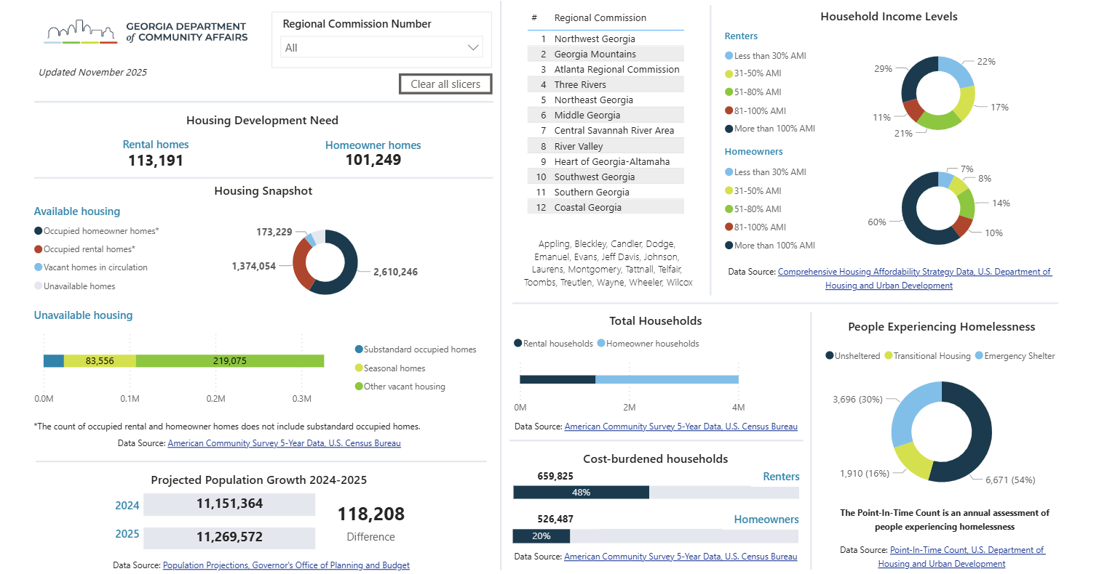

Slide 120
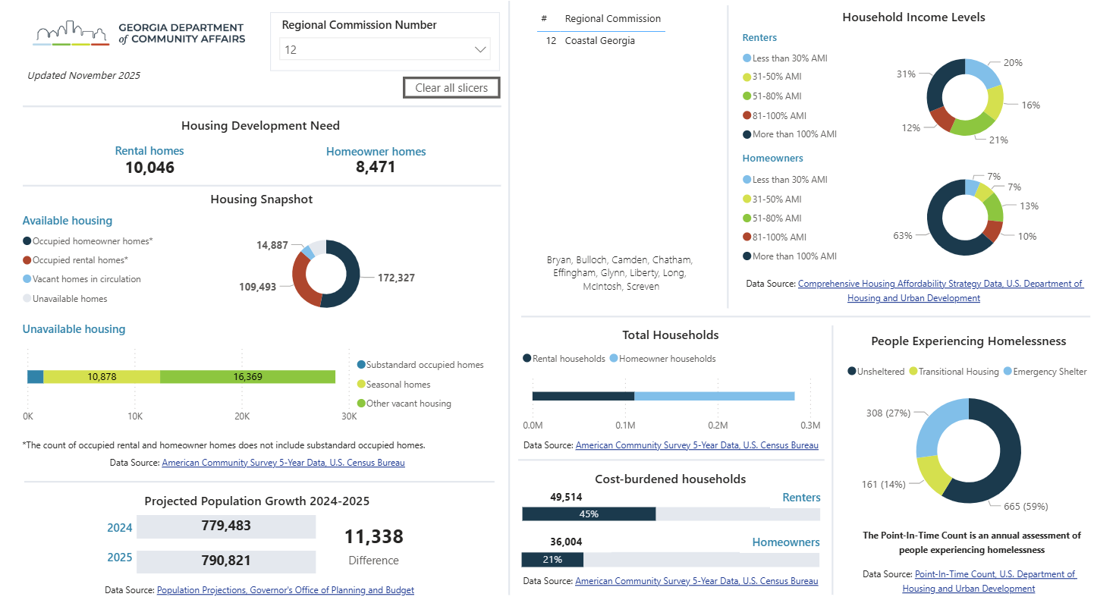

Slide 121
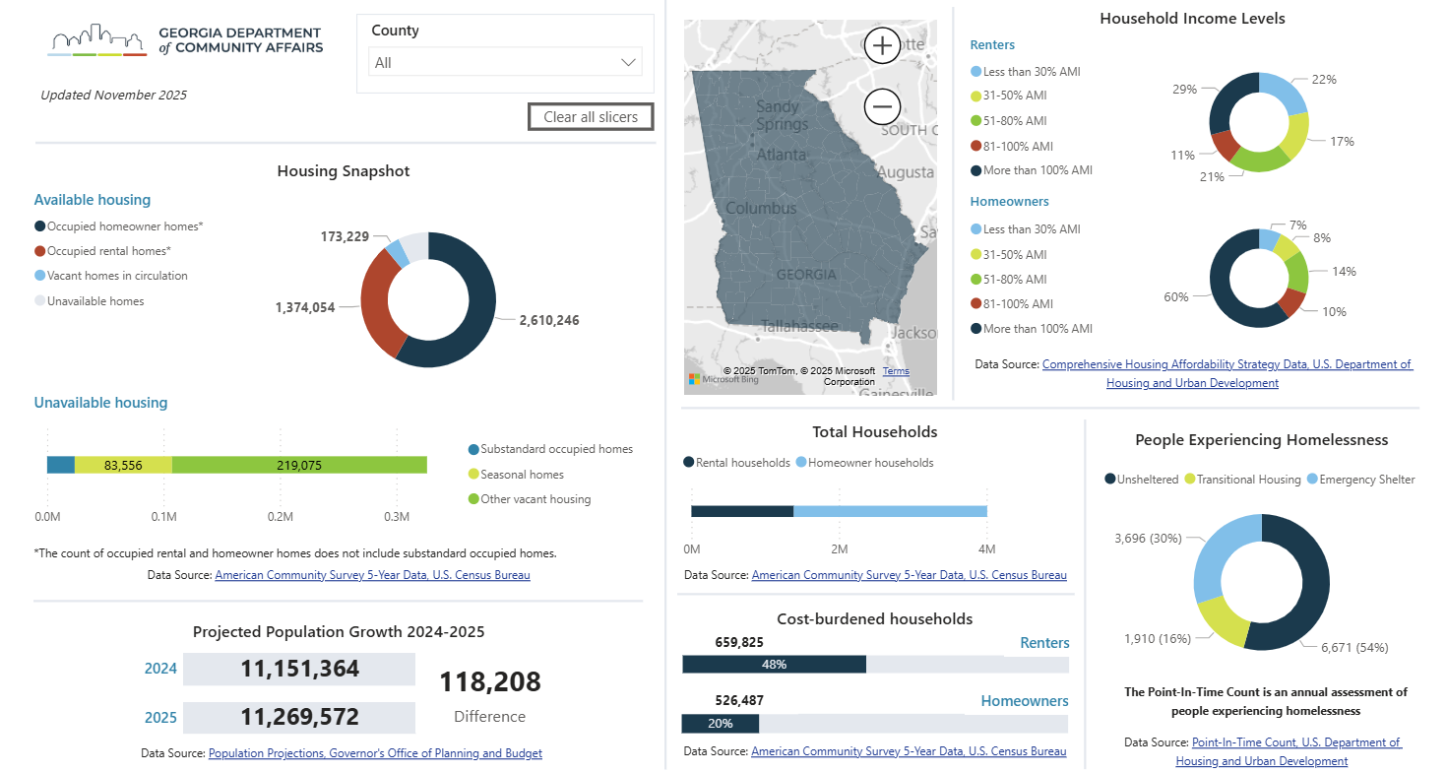

Slide 122
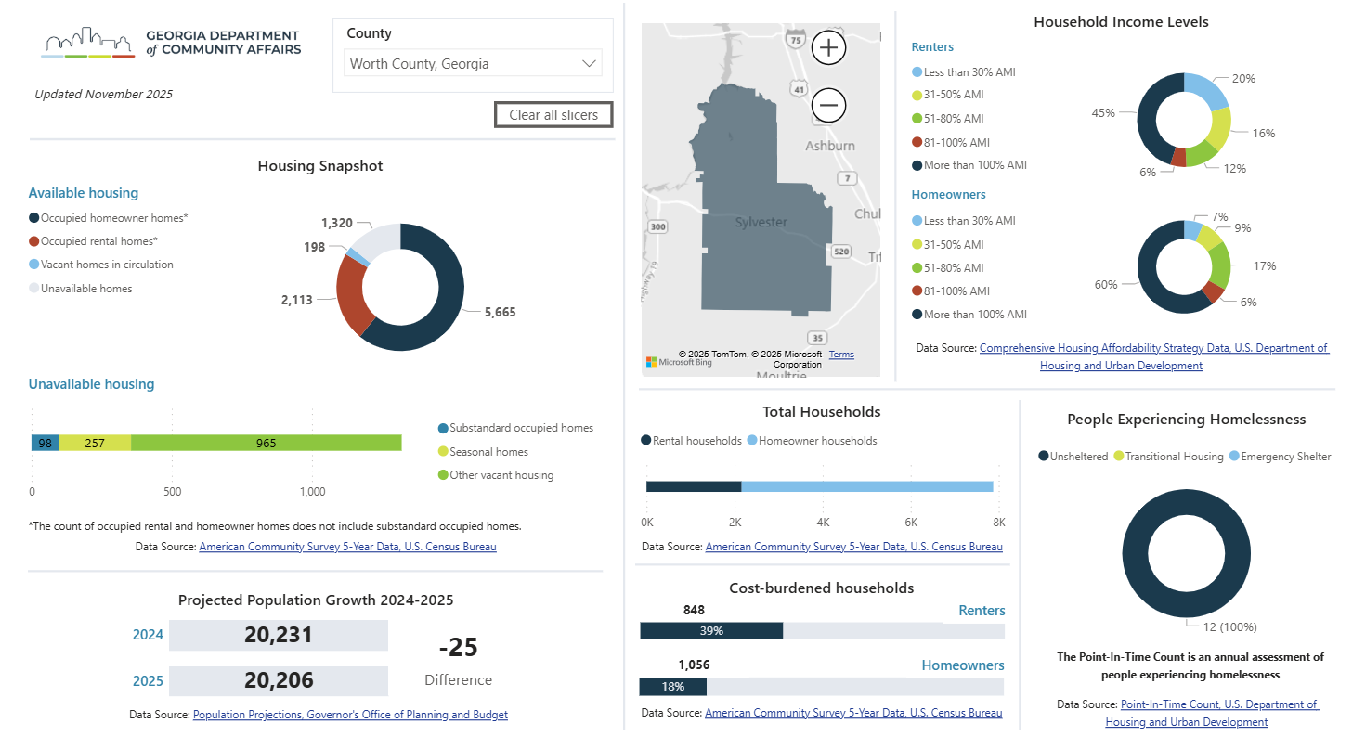

Slide 123
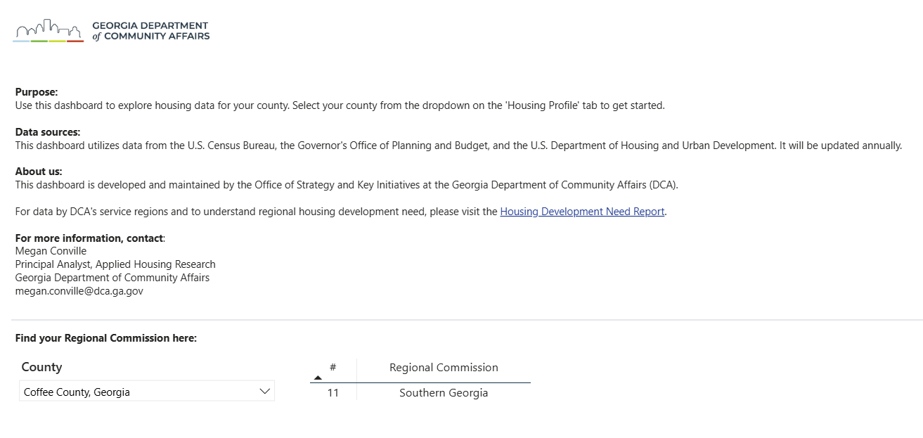

Slide 124
Questions?
Megan Conville
Megan.Conville@dca.ga.gov
Principal Analyst
Applied Housing Research
dca.ga.gov

Slide 125
Federal Compliance for Environmental Review
Shon Walker
Federal Compliance Manager

Slide 126
Thanks!
Shon Walker
Shon.Walker@dca.ga.gov
Federal Compliance Manager
dca.ga.gov

Slide 127
Networking Break
2:00 – 2:30 p.m.

Slide 128
2026-2027 QAP Changes
2028-2029 QAP Development
Upcoming Changes & Goals
2:30 – 4:00 p.m.

Slide 129
2026-2027 QAP Changes
Meagan Cutler
Senior Housing Finance Policy Manager

Slide 130
(Core) Definitions: “Successful Projects”
Definition updated:
"Successful Projects" or "Successful Tax Credit Projects" definition is now updated to include no open 8823s listing uncorrected noncompliance.

Slide 131
(Core) Competitive Rounds: Requirements & Timeline
Submission removed: Intent to Apply submission removed
Submission name changed: Review Conducted Prior to Competitive Round renamed “Pre-Application”
Competitive Application:
  Requirement added: Minimum documentation for (Threshold) Eligibility for Credit Under the Preservation Set Asides and/or (Threshold) Eligibility for Credit under the Non-Profit Set Aside, if applicable
  Requirement removed: Bond inducement resolution
    Now included in (Scoring) Readiness to Proceed and required at Threshold Submission
Threshold Submission:
  Requirement added: Bond inducement resolution

Slide 132
(Core) Competitive Rounds: Set Asides & Limitations
Set Asides:
Set aside amount decreased: 4% Credit/Bond “Portfolio” Preservation of USDA Housing bond set aside amount lowered to $20 million
Application and Award Limitations:
Max bond request decreased: Maximum bond allocation request for 4% Credits/Bond round lowered from $40 million to $25 million

Slide 133
(Core) Competitive Rounds: Tie Breakers & Post-Award Deadlines
Evaluation of Competitive Applications:
New tiebreaker for both 4% and 9%: "for ties between New Construction, Family tenancy applications, 20% or more units are three or four bedrooms."
4% Credit/Bond tiebreaker removed:
  "The Bonds Geographic Distribution area(s) that have not yet received a selected application...”
  "Readiness to Proceed" narrative
Post-Award:
Clarifying language added: Applicants must meet all deadlines indicated in the LOD; DCA reserves the right to rescind award for failure to meet LOD deadlines.

Slide 134
(Core) Tax Credit Administration
New requirement for front-end cost review: "If costs increase more than 10% between Competitive Application and submission of cost review, owners must submit a written explanation to DCA.”

Slide 135
(Core) Project Reconsideration/Application Modification
Policy update: Number of units may not be reduced but may be increased
Clarification: UA source utilized may not change until 18 months after being placed in service.

Slide 136
(Core) Monitoring and Compliance
New requirement: Owners must notify DCA construction services if construction has begun and owner has not been contacted by the assigned inspection company.

Slide 137
(Core) Exhibits to Core Plan
A. DCA Fee Schedule
Due date adjusted: Construction Monitoring Inspection Fee now due at time of 60 Day Submission (no later than 60 days after Carryover)
B. Post-Award Checklist and Deadlines:
New: Front-end cost review due 45 days prior to Construction Loan Closing
Deadline change: 8609s with Part II completed and signed due within thirty (30) days of DCA's issuance of 8609 Part 1

Slide 138
(Threshold) Project Feasibility
Commitments
Added: "DCA reserves the right to request updated commitments for documents dated outside of a reasonable time frame."

Slide 139
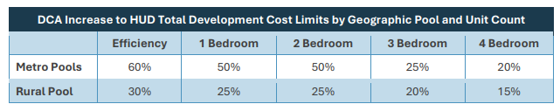
(Threshold) Cost Limits
New Threshold section: Developments are now required to meet HUD Total Development Cost Limits, adjusted for geography and unit type.

Slide 140
(Threshold) Appraisals
Identity of Interest
Added: “Exceptions to this policy may be made for properties purchased during the one-year Qualified Contract sale period.”
Removed: “DCA will not recognize higher values based on actions taken by the Owner/Applicant or any Related Party.”

Slide 141
(Threshold) Site Control
Clarified: “Site control must be in the form of:
Settlement statement or warranty deed that conveys title to the subject property to the property’s current owner; and
If current owner is not the General Partner or Limited Partner:”
  Legally binding contract to purchase in name of GP or LP
    Plus assignment to GP or LP if contract not in GP or LP name
  Long-term ground lease

Slide 142
(Threshold) Site Control
Minimum Documentation Clarified
“Settlement statement or warranty deed that conveys title to the subject property to the property’s current owner
If current owner is not the General Partner or Limited Partnership:
  a legally binding contract to purchase the proposed project site in the name of the General Partner or proposed Limited Partnership and assignment to the General Partner or proposed Limited Partnership if the contract to purchase the site is in the name of an affiliate; or
  a binding long-term ground lease or an option for a binding long-term ground lease, that clearly provides the right for the Applicant to execute a binding agreement upon closing, with a minimum term of forty-five years.”

Slide 143
(Threshold) Site Information and Conceptual Site Development Plan
Added requirement: CSDP must include “9. Location of accessible and adaptable units reserved under (Scoring) Integrated Supportive Housing.”

Slide 144
(Threshold) Building Sustainability
A. Sustainability Standards
Requirement removed: “7. Water Heaters: Comply with ENERGY STAR Multifamily New Construction (MFNC) program (Version 1) for Uniform Energy Factor (UEF).”
B. Sustainable Building Certification
Certification language updated: Enterprise Green Communities Criteria, for single and multifamily buildings, both new construction and rehabilitations
Certification option added: Green Building Initiative's Green Globes Certification

Slide 145
(Threshold) Accessibility Standards
C. Qualified Consultant
Consultant may be Project Team member, but Identity of Interest must be disclosed
  Restriction removed: “The Consultant cannot be a member of the proposed Project Team nor have an Identify of Interest with any member of the proposed Project Team.”
  Disclosure requirement added: “If the Consultant is a member of the proposed Project Team, this Identity of Interest must be disclosed to DCA.”

Slide 146
(Threshold) Project Team Qualifications
Overview
Clarification of existing process:
  Project Team Qualification determinations are only valid for the calendar year in which they are issued
  Requests submitted for 9% deadline are evaluated for qualification for 9% and 4% rounds unless otherwise specified—submissions for 4% are evaluated only for 4%

Slide 147
(Threshold) Project Team Qualifications
Certifying Entity
Eligibility requirements clarified:
  Qualified: Own (at least 20% ownership) and operate 5 Successful Tax Credit Projects placed in service after January 1, 2015
  Qualified with Conditions: Meet Qualified eligibility requirements but DCA has concerns regarding capacity or compliance performance
  Qualified as Probationary: Development experience comparable to Qualified, satisfactory compliance and capacity, but insufficient ownership interest
  Not Qualified: Eligibility requirements not met

Slide 148
(Threshold) Project Team Qualifications
All Project Team Members
Review areas clarified:
  All Project Team members reviews for compliance
    Any member with substantial non-compliance may be ineligible or have additional restrictions or conditions
Significant Adverse Event (SAE) Waiver requirement clarified:
  Any Project Team member with 1 or more SAEs must request a waiver
    No waiver = Not Qualified

Slide 149
(Threshold) Project Team Qualifications
Minimum Documentation
Required vs by DCA request clarified:
Required | By Request
Performance Workbook | Successful Tax Credit Projects documentation:
Performance Workbook Certification Letter | 8609 or occupancy permit
LPA evidencing Certifying Entity effective control (if CE does not have majority ownership) | Letter from Syndicator certifying role and interest
SAE Waiver Form (if applicable) | 12-month occupancy reports
Evidence of DCA communication confirming 8823 cure in progress (if applicable) | Documentation related to “yes” answers in Performance Questionnaire, foreclosures, suspension, debarment
 | Credit & Criminal Release Form

Slide 150
(Threshold) Waiver of Qualified Contract Right
New Section: Applicants are required to waive right to Qualified Contract for proposed development
  This waiver does not preclude the option for transfers of ownership that maintain the affordability or for a request for a subsequent allocation of credits beyond the Compliance Period.

Slide 151
(Threshold) Optimal Utilization of Resources
Budget evaluation method added: “DCA may compare development budgets across Applications in order to determine optimal utilization of resources. Inability to justify costs may result in disqualification of the Application.”

Slide 152
Exhibits to Threshold Criteria: DCA Underwriting Policies
1. Annual Operating Expenses
Minimum expense per unit increased
7. Developer Fee
Maximum fee calculation method added:
  New Construction: 13% of total development cost (excluding developer fee and reserves)
  Rehabilitation and Adaptive Reuse: 30% of hard costs
Per unit and total amounts increased
Limited to the lesser of the 3 calculation methods (% of development cost, per unit, or total)

Slide 153
Exhibits to Threshold Criteria: DCA Underwriting Policies
19. Additional Requirements for 4% Credits/Bonds Applications
Maximum bond financing amount reduced due to 25% Test:
  From 55% to 30%

Slide 154
(Scoring) Applicability of Scoring Criteria
Additional sections applicable to 4% Credits/Bonds New Affordability Applications:
  Economic Development
  Previous Projects
Section removed: Minority- and Women-Owned Business Engagement
  Please submit input regarding modified section for 2028-2029 QAP to the 2028-2029 QAP Input Survey!

Slide 155
(Scoring) Extended Affordability Commitment
Subsection removed: Waiver of Qualified Contract
  Moved to new Threshold section Waiver of Qualified Contract Right
New Subsection: A. Previous Qualified Contract Requests – 5 Points
  Points awarded if no Project Team Principal has requested a Qualified Contract in Georgia on or after May 20, 2025
  Points not awarded if any Project Team Principal has been:
    a Principal which had 20% or more interest
    in the General Partner and/or Developer entities of a Georgia development
    for which a Qualified Contract was requested on or after May 20, 2025

Slide 156
(Scoring) Favorable Financing
A. Qualifying Sources of Favorable Financing:
Source removed: TCAP loans passed through a Qualified CDFI revolving loan fund
B. Property Cost Reduction:
Private Enterprise Agreement
  Point increase: from 0.5 to 1 point
Long-term Ground Lease or Land Donation
  Ground Lease
    Qualifying grantor options expanded: local PHA, government entity, community land trust, or entity that is not a Related Party

Slide 157
(Scoring) Favorable Financing
B. Property Cost Reduction:
Long-term Ground Lease or Land Donation
  Option added: Land Donation
    By a local PHA, government entity, community land trust, or entity that is not a Related Party
      That did not acquire any portion of the real estate from a Principal of the Project Team
    For no more than $5,000 for land and buildings
    Minimum Documentation:
      Real estate records showing ownership as of Competitive Application
      Commitment to transfer ownership to the HTC development’s ownership entity upon award

Slide 158
(Scoring) Compliance Performance
B. Calculation of Point Additions
“Successful” properties criteria change: Applicants will NOT receive point additions for properties which have open 8823s listing uncorrected noncompliance
  Minimum Documentation: “If applicable, proof of communication with DCA confirming cure of open 8823(s) is in progress”

Slide 159
(Scoring) Integrated Supportive Housing
A. Supportive Housing Referrals
Referral population clarified: “for persons with disabilities and those at risk of or experiencing homelessness”
Minimum reserved units reduced for 4%/Bonds Applications: from 10% to 5%
Integrated Supportive Housing units vs Accessibility Standards units clarified: “The accessible and adaptable units reserved under this provision may not be used to satisfy requirements for mobility-impaired and hearing- and sight-impaired residents under Accessibility Standards.”
Referrals with Project-based Rental Assistance Contract
  Documentation updated: units reserved to 30% AMI or lower must be reflected in Revenues & Expenses tab

Slide 160
(Scoring) Integrated Supportive Housing
A. Supportive Housing Referrals
Minimum Documentation
  Added: Letter(s) of support from DCA-approved entity(ies) confirming intent to enter into MOU
  Added for “with PBRA Contract”: Revenues and Expenses tab reflecting reserved units restricted to 30% AMI or lower
  Changed for owner-managed/site-based PBRA waitlist:
    Commitment from PHA to allow site to manage own waitlist
    Commitment from owner to pursue preferences consistent with the MOUs

Slide 161
(Scoring) Readiness to Proceed
Document eligibility clarified:
  “Where applicable, each document must be executed and dated prior to the Competitive Application deadline and may not be expired.”
  Phase 1 Environmental Site Assessment:
    Must be dated within 18 months of Competitive Application deadline
Item added: (2 points) Bond inducement resolution from the issuing authority
  Max section score increased to 15 points
Subsection removed: B. Readiness to Proceed Narrative

Slide 162
(Scoring) Desirable/Undesirable Activities
1. Requirements
Eligibility extended to proposed development characteristics: Desirable characteristics that are proposed to be completed as part of the proposed development may be eligible for points in this section.
  Minimum Documentation added: all minimum documentation required under (Threshold) Site Information and Conceptual Site Development Plan showing plans for proposed desirable characteristics, and all minimum documentation required under (Threshold) Site Zoning.
2. Eligibility
Eligible college/university type expanded: (i) College or university that is part of the Technical College System of Georgia or University System of Georgia
Grocery store/supermarket (c) eligibility clarified: high-end specialty stores, gas stations, and convenience stores not eligible

Slide 163
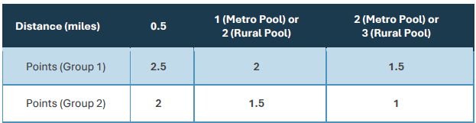
(Scoring) Desirable/Undesirable Activities
3. Point determinations
Distances extended: Distances eligible for points extended

Slide 164
(Scoring) Quality Education Areas
A. College and Career Readiness and Performance Index (CCRPI)
Eligible data years updated:
  2026 Rounds: 2023 CCRPI and later (2023, 2024, and 2025 available)
    2024 and 2025 CCRPI single scores on Dept. of Education website
    2023 CCRPI single scores published to DCA website
  2027 Rounds: 2024 CCRPI and later
Methodology updated: Schools qualify for points if the CCRPI score was above the 50th percentile in any of the eligible years (rather than an average of scores)
  Separate 50th percentiles calculated for 2023, 2024, and 2025
    2025 to be published

Slide 165
(Scoring) Quality Education Areas
B. Beating the Odds (BTO)
Eligible data years updated: 2024 or more recent for both 2026 and 2027 Rounds
C. Positive Year-Over-Year CCRPI Change
Option removed

Slide 166
(Scoring) Revitalization/Redevelopment Plans
A. Revitalization Plan/Qualified Census Tract
Max subsection points increased: from 6 to 7 points
Qualifying Community Revitalization Plan (CRP) points increased: from 2 to 4 points
Planning Best Practices points decreased: from 3 to 2 points
Criteria moved to CRP requirements: Assessment of the targeted area’s existing infrastructure and designation of implementation measures
Document eligibility updated: Comprehensive plan meeting CRP requirements may be eligible for consideration

Slide 167
(Scoring) Revitalization/Redevelopment Plans
B. Community Transformation
Requirements moved: Community Quarterback Board (CQB) requirements moved to Scoring Exhibit B. Community Transformation Post-Award Responsibilities

Slide 168
(Scoring) Stable Communities
Indicator sources updated: Housing Needs Assessment indicators replaced
  Environmental Index (Agency for Toxic Substances and Disease Registry of the U.S. Dept. Of Health and Human Services)
  Travel Time and Employment Rate
Distance measurement method updated: for “Near a Census Tract”
  Within a 0.25-mile radius of a qualifying census tract
    Rather than within 0.25-mile driving or walking distance
Language updated: “in a qualifying range”
  Travel Time and Environmental Index indicators: at or below the 50th percentile
  Other indicators: at or above the 50th percentile

Slide 169
(Scoring) Community Designations
Points increased: Points for HUD Choice Neighborhood Implementation (CNI) Grant increased from 10 to 13 points

Slide 170
(Scoring) Previous Projects
New applicability: 4% Credits/Bonds New Affordability applications
Subsection removed: A. Metro Pool: Awards for Local Jurisdiction
A. Metro Pool: Recent Awards within a Mile
Option added: 15-year Lookback Period – 5 points
4% points eligibility added: No awards within half-mile radius of site

Slide 171
(Scoring) Economic Development Proximity
Timeframe clarified: “an economic development project that is expected to generate or is in the process of generating, within five years from the Competitive Application deadline, net new jobs...”
Minimum Documentation item removed: MOU, MOA or Intergovernmental Agreement approving the project to proceed

Slide 172
(Scoring) DCA Community Initiatives
Maximum points increased: from 2 to 2.5 points
Subsection added: B. Georgia Initiative for Community Housing (GICH) Senior Year – 2.5 points
  Projects with a letter of support from a GICH team currently enrolled in GICH Senior Year program
    One letter per GICH Senior Year team per round

Slide 173
(Scoring) Preservation Scoring Criteria
A. Occupancy
Lookback period extended: from within two months to within two years prior to Application Submission Deadline
B. Rent Advantage
Application eligibility changed: 9% Credits HUD rental Assistance Set Aside and 9% Credits HUD RAD Set Aside applications ineligible
E. Site Characteristics
Qualifying section added for 9%: Housing Needs Characteristics

Slide 174
Exhibits to Scoring Criteria: C. Community Transformation Post-Award Responsibilities
Requirements moved: Community Quarterback (QCB) requirements moved from (Scoring) Revitalization/Redevelopments Plans
CQB eligibility changed: Resident members of QCB are not required to self-certify income below 80% AMI

Slide 175
2028-2029 QAP Development

Slide 176
2028-2029 QAP Development Timeline
Approx. Timeframe | Stage
Feb – Dec 2026 | Engagement 2028-2029 QAP Survey General input & targeted research questions Resident Survey Stakeholder meetings
Jan – Feb 2027 | Priorities & Proposals List
Feb 2027 | QAP Workshop Priorities & Proposals/General Listening Session
May 2027 | QAP Draft 1
May - June 2027 | Draft 1 Listening Session Public comment period
July 2027 | QAP Draft 2
July - Aug 2027 | Draft 2 Listening Session Public comment period
September 2027 | QAP Final
Oct – Nov 2027 | DCA Housing Committee and Board Approval

Slide 177
Thanks!
Meagan Cutler
Meagan.Cutler@dca.ga.gov
Senior Housing Finance Policy Manager
dca.ga.gov

