Slide 1

Historic Preservation 101
Sandra Hall
Certified Local Government Coordinator

Slide 2
Who We Are
A division of the Georgia Department of Community Affairs, we are the Georgia State Historic Preservation Office (SHPO), also known as HPD.
25+ dedicated staff with academic backgrounds and professional expertise in Archaeology, Architecture, History, Historic Preservation, Planning, Education, Geography and other related academic fields.
Federally funded by the National Park Service.
Matching budget appropriations from the Georgia State Legislature.

Slide 3
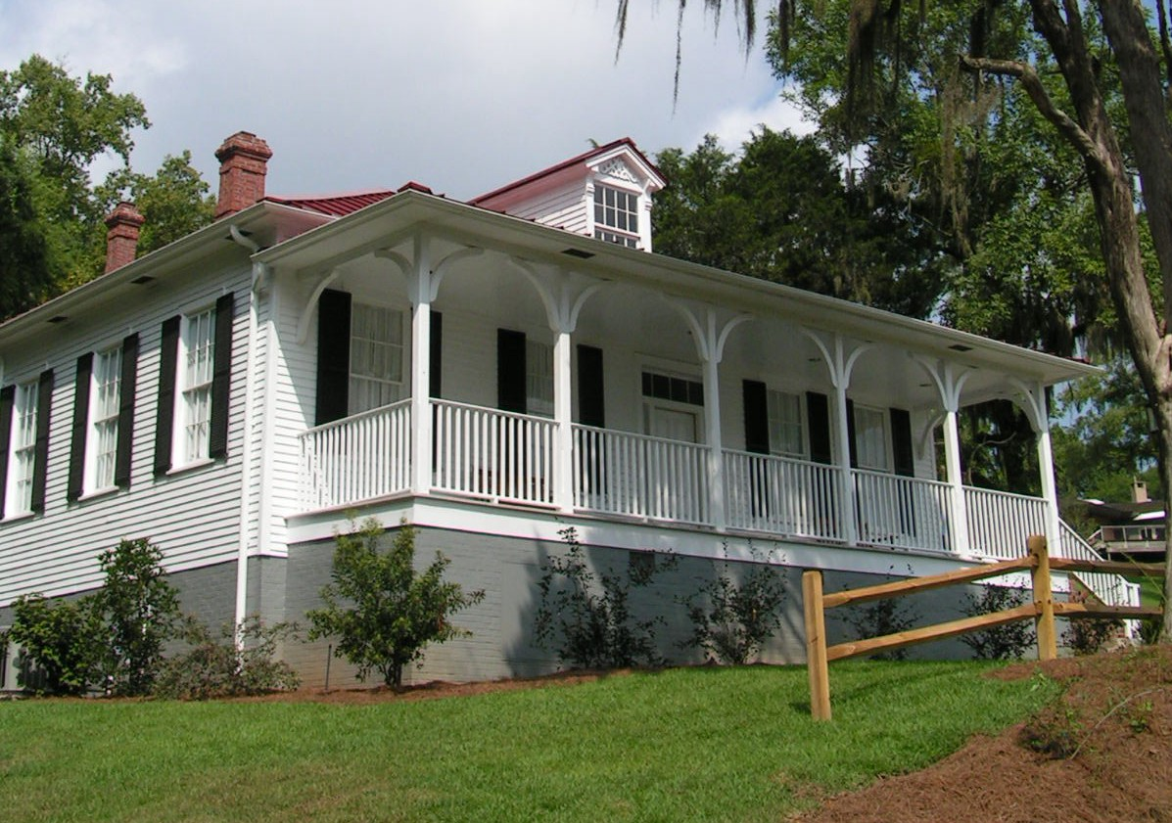
What We Do
Carry out all federal and state mandated historic preservation activities.
Provide preservation education, training, and local technical assistance, and statewide support.

Slide 4
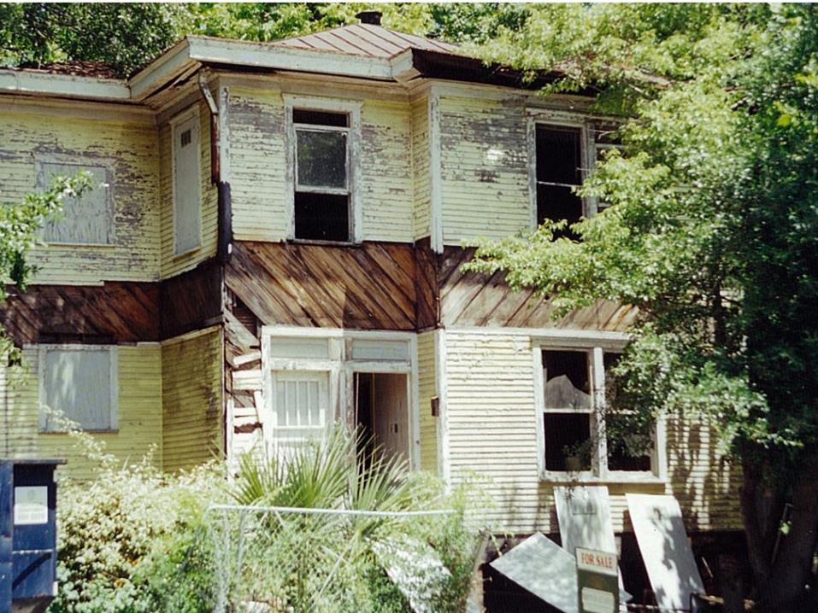
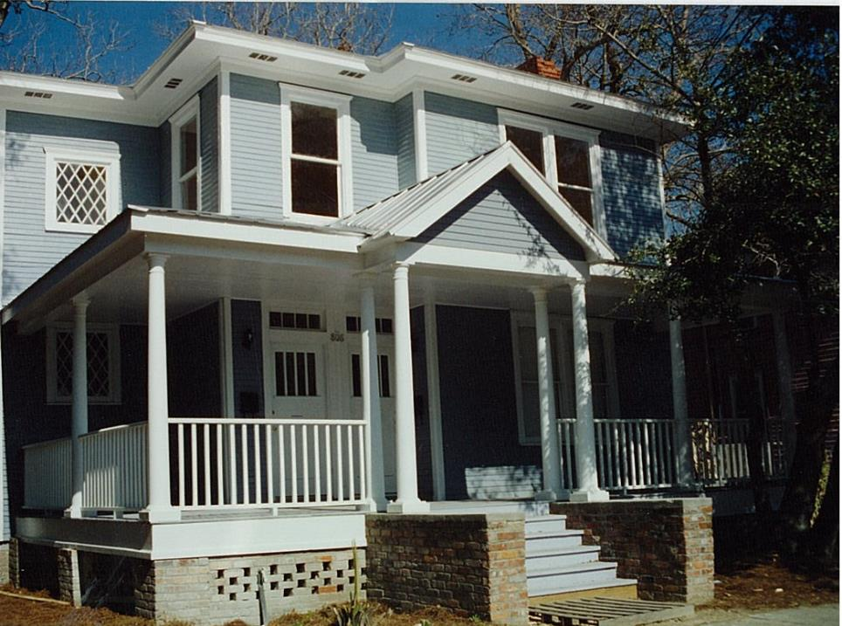
Programs
National Register of Historic Places & Georgia Register of Historic Places
Environmental Review (Section 106)
Tax Incentives
Community Assistance & Outreach
  African American Programs
  Centennial Farms Program
  State Historic Preservation Conference
  Certified Local Government Program
  Technical Assistance
    Preservation Ordinances
    Design Guidelines
    Historic District Designation
    Local Landmark Designation
    Historic Preservation Commission Training

Slide 5
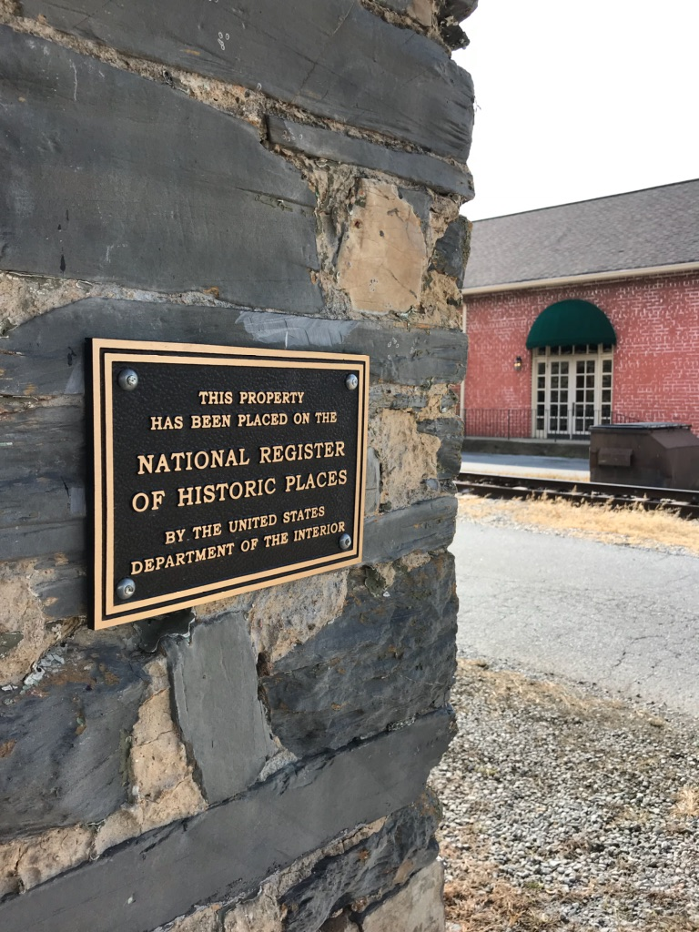
National Register of Historic Places
The National Register currently includes more than 2,100 listings in Georgia
We receive hundreds of applications each year
More than 84,000 historic properties are potentially eligible for the historic rehabilitation tax incentive program
Contact: NationalRegister@dca.ga.gov

Slide 6
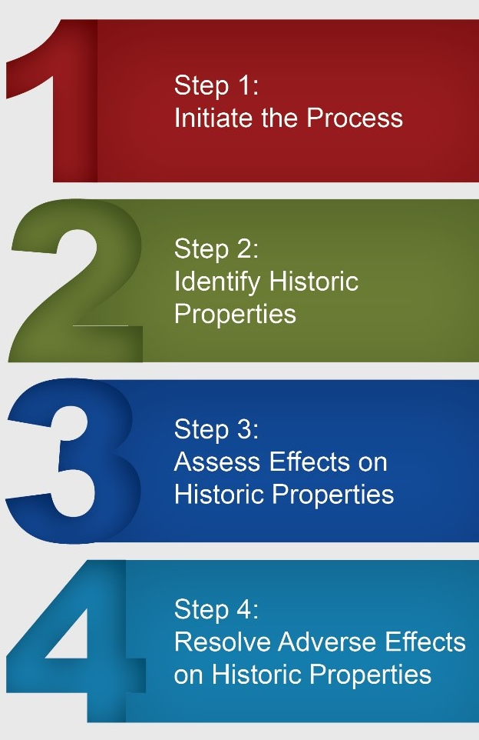
Environmental Review
Section 106 Review Process
Dictated by the National Historic Preservation Act (1966).
Mandates projects to be assessed for adverse effects to historic resources.
Process must be completed prior to the approval of the expenditure of federal funds for the project, or prior to the issuance of any federal license or permit.
Contact: ER@dca.ga.gov

Slide 7
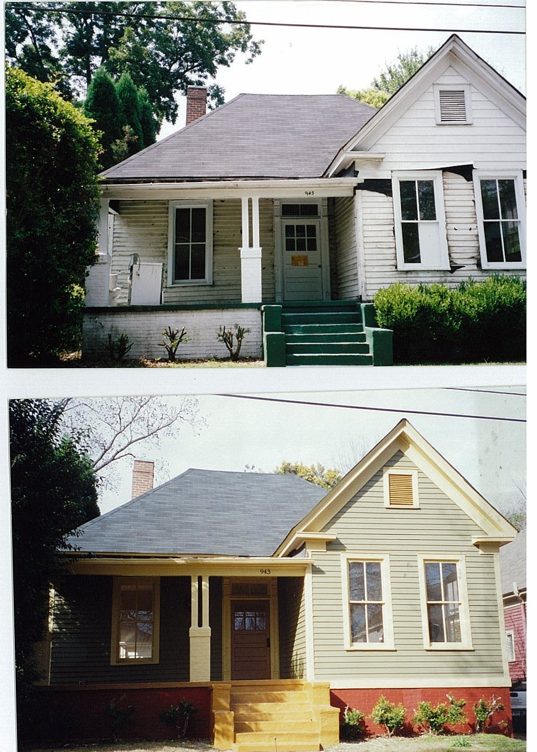
Tax Incentives
3 Tax Programs
Preferential Property Tax Assessment for Rehabilitated Buildings
  Freezes property taxes for 8 years
State Income Tax Credit (Updating 2026)
  Equal to 25% of qualified rehab expenses
Federal Income Tax Credit
  Equal to 20% of qualified rehab expenses
Contact: TaxIncentives@dca.ga.gov

Slide 8
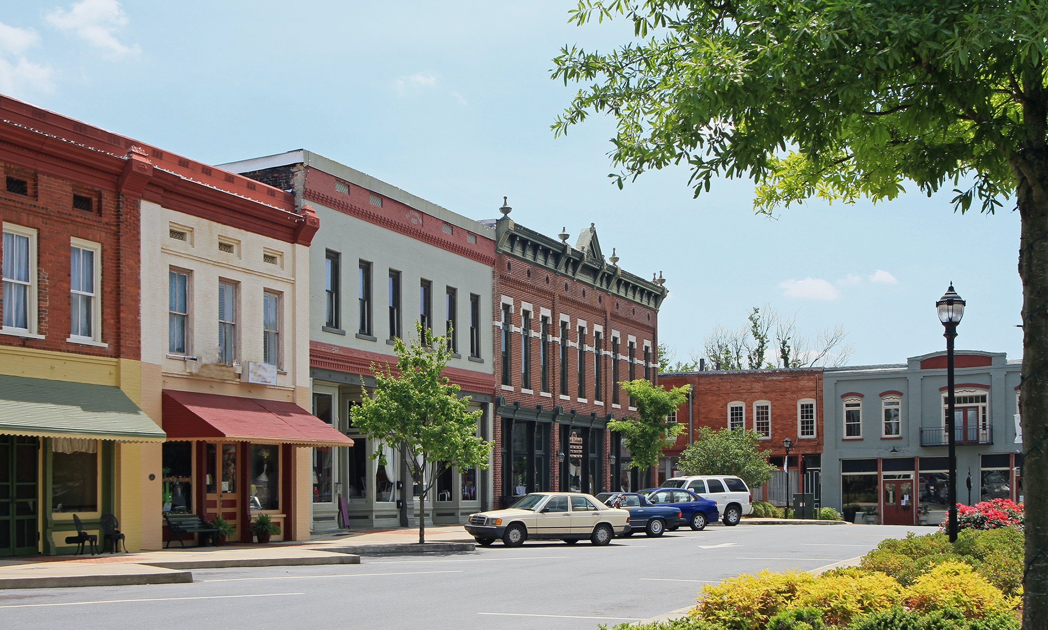
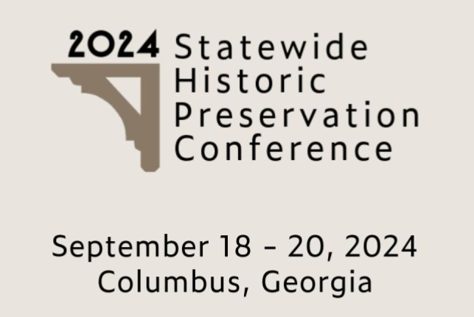
Community Assistance & Outreach
African American Programs
Centennial Farms Program
  560 farms listed
Statewide Historic Preservation Conference
Certified Local Government Program
Technical Assistance
  Preservation Ordinances
  Design Guidelines
  Historic District Designation
  Local Landmark Designation
  Historic Preservation Commission Training
Contact: Outreach@dca.ga.gov
2025
GA Downtown Conference
August 25 - 28, 2025
Gainesville, Georgia

Slide 9
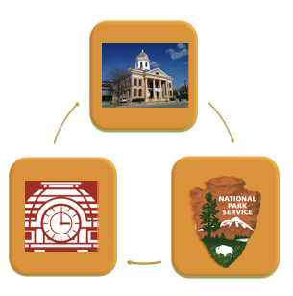
Certified Local Government Program
Partnership program between the local government, HPD, and the National Park Service.
Opportunities for technical assistance in historic preservation are available in the form of training sessions, information material, statewide meetings, workshops and conferences.
Certified Local Governments are eligible for preservation grants from HPD.

Slide 10

Certified Local Government Program
Federal Program Requirements
Establish a Historic Preservation Commission
Enforce State and Local Legislation for Designation and Protection of Historic Properties
Maintain a System for Survey and Inventory
Provide for Public Participation

Slide 11

Certified Local Government Program
State Program Requirements
City Staff Contact
Commission Training
Evaluation
Reporting Commission or Ordinance Changes

Slide 12
Georgia’s CLG Program
Georgia has 100 CLG Communities.
Recent additions to the program include Woodbury, Winterville, Adairsville, and Trenton-Dade County.
Georgia ranks first nationally in the highest number of CLG Communities.

Slide 13
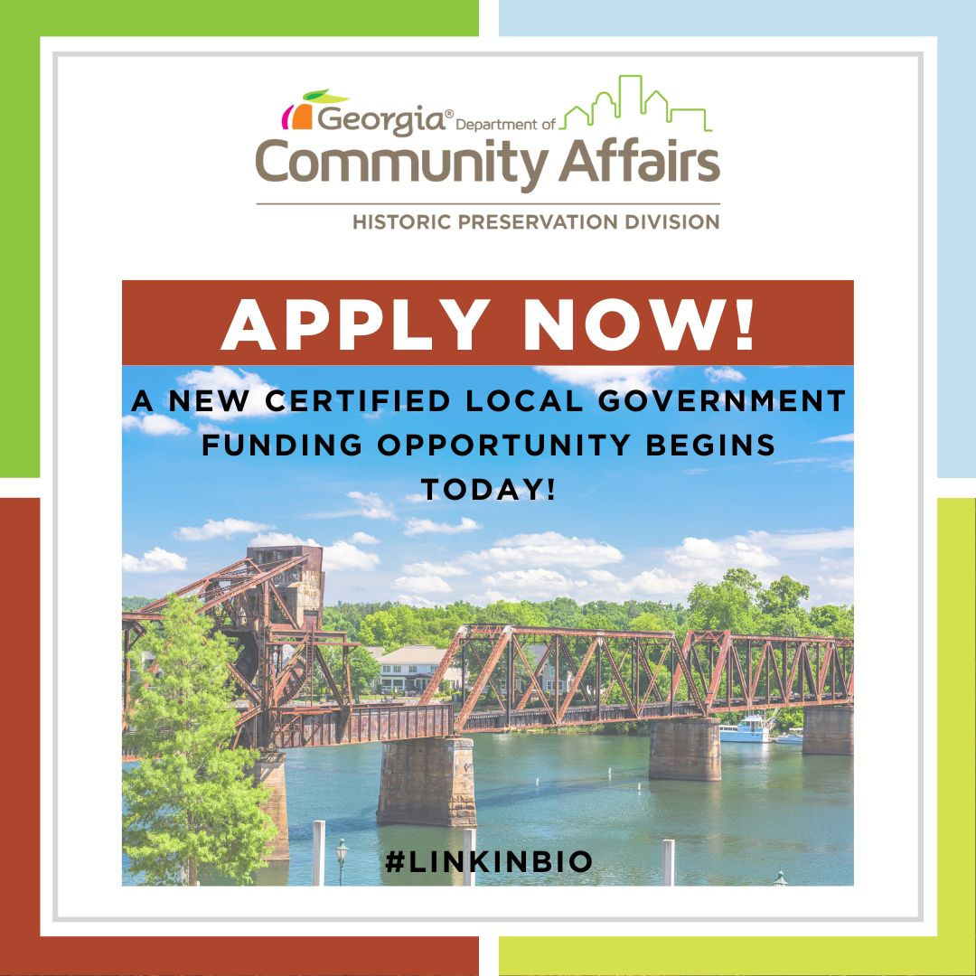
Georgia’s CLG Program
A local government is eligible to apply for HPF/CLG federal historic preservation grant funds that are available only to communities certified as CLGs.
In FFY2020, more than $103,000 in federal funds were awarded to CLG’s across Georgia.
The HPF/CLG grants are 60/40 percent matching grant and some of the 40 percent can be “in kind” match.
2025 CLG Grant window is open! Closes February 1, 2025.

Slide 14
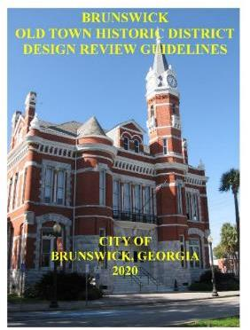
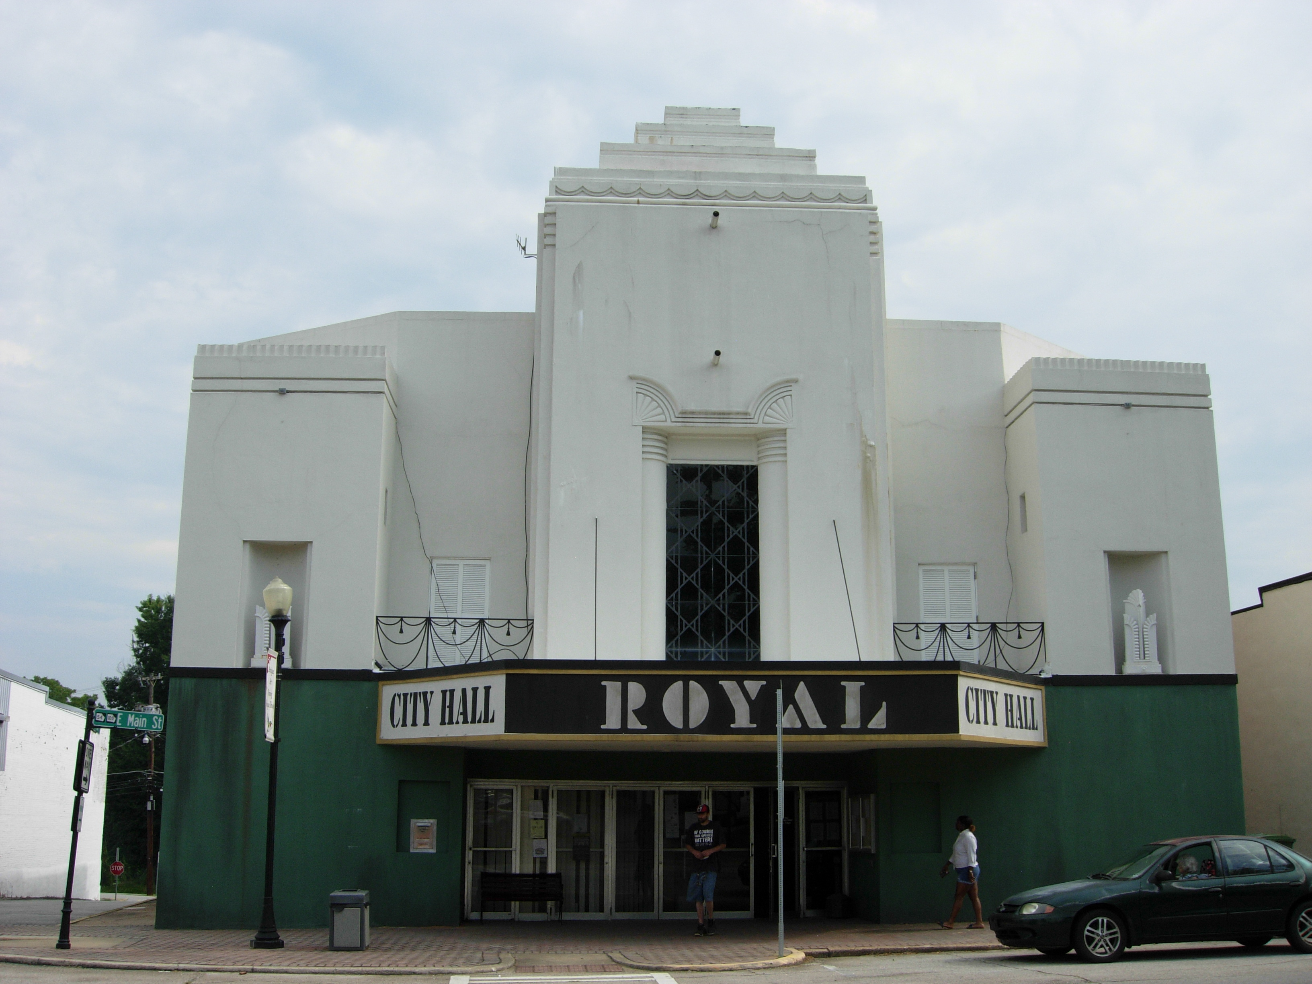
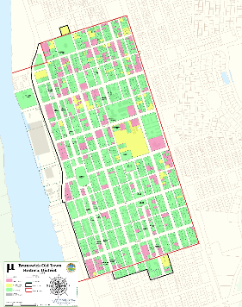
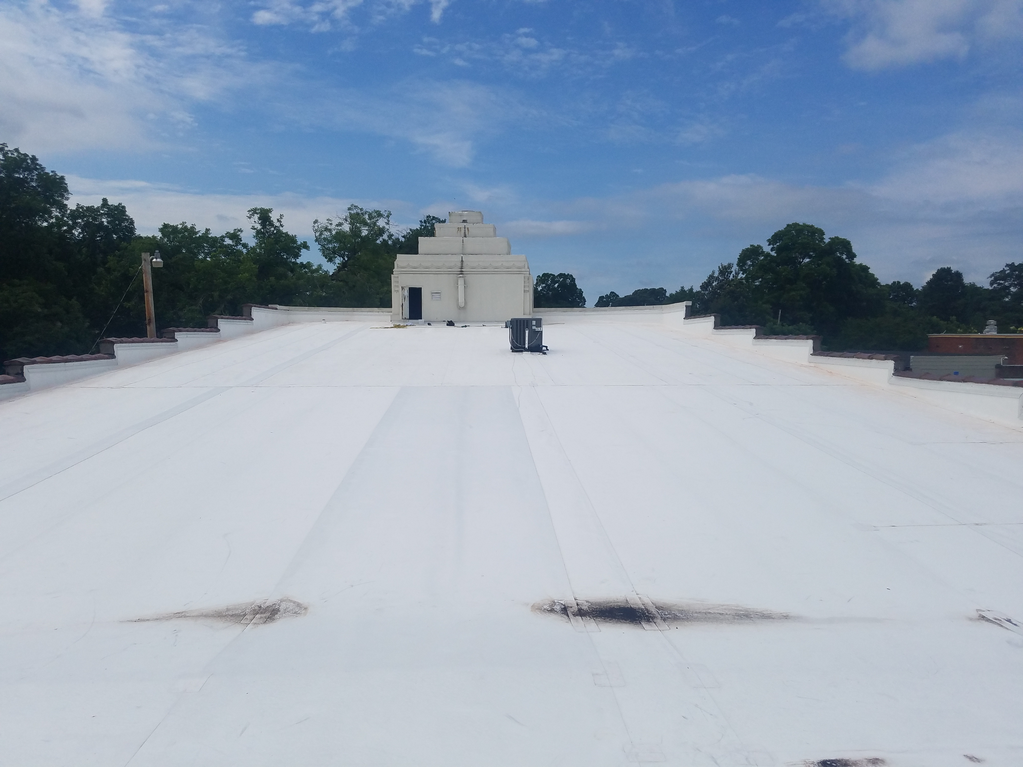
Case Studies
City of Brunswick
City of Hogansville
City of Greensboro
Updated design guidelines for Old Town Historic District
Roof repair for the Historic Royal Theatre
Historic audio stations tour

Slide 15
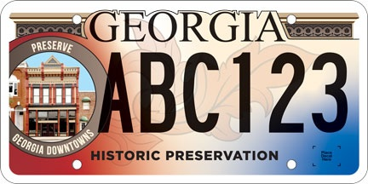
Georgia Heritage Grant
Available every 2 years (ish)
18-month cycle
Funded by GA Historic Preservation License Plates
Available to local governments and 501(c)3 non-profit organizations
60/40 matching grant ($25,000 max)
Project work must meet the Secretary of the Interior’s Standards for Archaeology and Rehabilitation of Historic Properties

Slide 16


Thanks!
Sandra Hall
Outreach
Certified Local Government Coordinator
Email: Outreach@dca.ga.gov
Email: Sandra.Hall@dca.ga.gov
Cell: 470.426.7230
Environmental Review
Torrey Long
Email: ER@dca.ga.gov
Grant Coordinator
National Register
Email: Torrey.Long@dca.ga.gov
Cell: 470.757.2551
Email: NationalRegister@dca.ga.gov
Mary W. Joseph
Tax Incentives
African American Programs Coordinator
Email: TaxIncentives@dca.ga.gov
Email: Mary.WJoseph@dca.ga.gov
Cell: 404.904.4284
Georgia Department of Community Affairs
Rose Mayo
@ga_dca
Outreach Coordinator
Georgia Historic Preservation Division
Email: Rose.Mayo@dca.ga.gov
Cell: 770.855.2586
@georgiashpo
dca.ga.gov

