Slide 1
The PlanFirst Program
Daniel Gaddis, Planning Outreach Coordinator
Notes:
Hello,
For those I haven’t met, I’m Daniel Gaddis, the Planning Outreach Coordinator. I joined DCA in November of last year. My experience includes time as a planner and economic development project manager in the metro-Atlanta area as well as a consultant working with federal grants, public power, and energy efficiency programs. I’m glad to be back working with local governments in Georgia on planning initiatives.
We are very excited about this year with PlanFirst. Lots of great things happening. Our 2025-2027 application is already on our website, we have a Planning Day at the Capitol scheduled for March 14 for our newest class of PlanFirst communities and we have this webinar scheduled for new applicants and a renewal webinar next week.

Slide 2
What is PlanFirst ?
Notes:
Before we dive in to deeply, I want to drop a pop quiz on you all. No pressure here, if you don’t know anything about it, that’s great to know!
Pull up your phone or browser, go to menti.com and use the code: 9594 2335

Slide 3
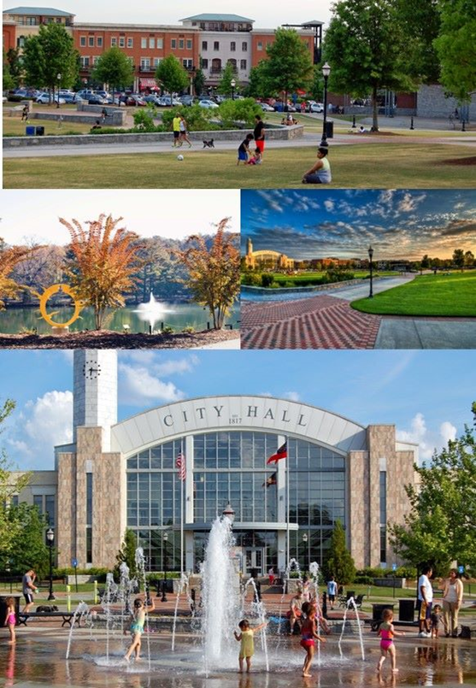
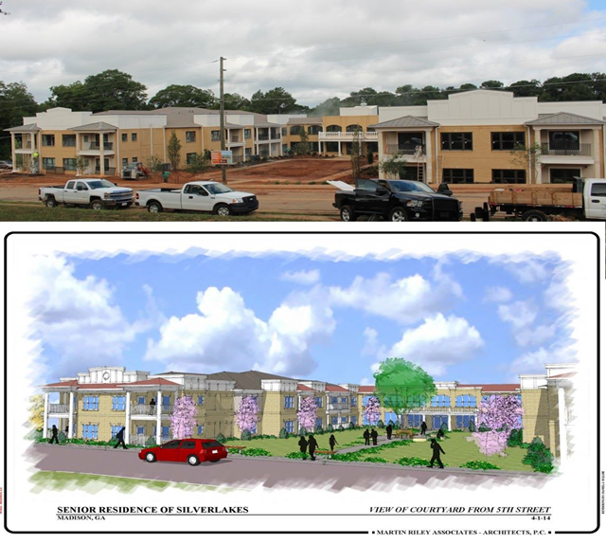
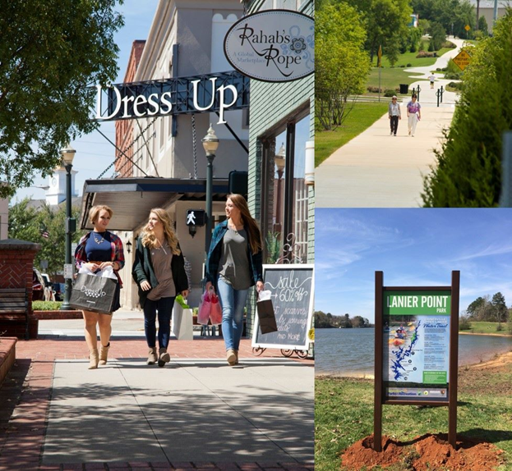
What is PlanFirst ?
Notes:
Put simply, a PlanFirst community is one that is recognized by the State of Georgia’s Department of Community Affairs for implementing their comprehensive plan in an exemplary way.
Through a community’s goals, leadership, public participation, and implementing their plan, communities that are designated a PlanFirst community are going above and beyond what is required to make sure they are keeping effective planning a very high priority.

Slide 4
Why do you want to participate ?
Recognition
Community Development Block Grants
GEFA loan interest reduction
LIHTC and Other DCA programs
NEW
Notes:
There are several great reasons to apply-each of which may be different reasons for different communities. The last circle here shows the newest incentive we are very excited about it!
For applications for both the 4% and 9% housing tax credits, if the proposed development falls within the boundaries of a PlanFirst community, it is eligible for an additional 3 points. If you are a community where a housing authority and developers are working to address housing shortages, then applying for this designation is well worth the effort. Oftentimes, these applications are decided by fractions of a point.
To expound: the applicant’s local government must have a qualifying Community Revitalization Plan (CRP) (see pages 104-105 of the QAP).

Slide 5
Benefits of PlanFirst
Statewide recognition for outstanding planning and implementation.
Eligibility to apply EVERY year for CDBG funding.
3 Bonus points on Housing Tax Credits application.
Reduction on certain DCA loans: EIP, Redevelopment Fund and DDRLF.
Reduction on certain GEFA state loans.
2 free registrations at any Community Planning Institute per 3/year cycle.
Notes:
Ok, we’re gonna camp here for a while. And I propose you all listen closely, cause there may be a quiz after this.
As we think about the suite of benefits available to for PlanFirst communities, the architects of this program inserted benefits for communities of all sizes, needs, and demographics. We know that Georgia’s communities are diverse and we have reflected that diversity in this program’s design and benefits.
State-wide recognition by DCA, the use of the PlanFirst logo, announcements on the website and DCA social media, invitation to the Capitol for Planning Day at the Capitol, recognition in a State Senate and State House Resolution honoring your community, and a photo opportunity with Governor Kemp. We also want to tout your successes and tell your story as a PlanFirst community-we have our PlanFirst communities to submit a success story-this can look like a housing project, stormwater infrastructure improvements, improved transportation, an economic development project, downtown redevelopment, improved parks, the list goes in. We want to celebrate your successes at the state level and we want to invite communities to learn about what you did that overcame challenges, how you engaged with your community, how you tapped critical stakeholders, how you led in your region, all for the benefit of other similar communities that are dealing with the same issues.
Here’s probably one of the biggest benefits in the PlanFirst package. Annual access to apply to Community Development Block Grants instead of bi-annually.
Bonus 3 points on the LIHTC-Part of the Community Revitalization Plan in the application. This is applicable to the 4% and 9% applications.
100 basis point reduction, or 1%, for loans through the Employment Incentive Program • 100 basis point reduction, or 1%, for loans through the Redevelopment Fund Program • 100 basis point reduction, or 1%, for loans through the Downtown Development Revolving Loan Fund Program
Access to the Georgia Environmental Finance Authority (GEFA) state loans at an interest rate that is reduced by 50 basis points, or ½ percent. As an example of this benefit, the interest rate savings over the life of a 20-year water or sewer loan of $200,000 would be just over $13,000.
Communities have signed up for our Spring CPI and PlanFirst communities are taking advantage of these two free spots! Raise your hand if you took advantage of the free two spots for PlanFirst! That will continue as well when we meet in the Fall-so please consider this benefit.

Slide 6
PlanFirst benefits
½%
Reduction on GEFA loans.
1%
Employment Incentive Program reduction.
1%
Redevelopment Fund Loan reduction.
1%
Downtown Revolving Loan Fund reduction.
3
Bonus points on LIHTC applications.
Satisfaction points of being a PlanFirst community…
Notes:
Here are some of the financial benefits displayed in a different visual. Check out that last metric. Probably the best.

Slide 7
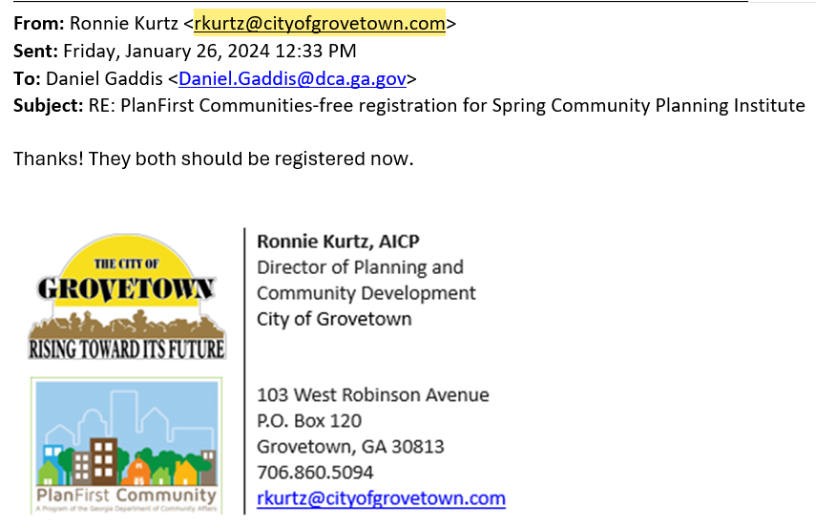
Notes:
I’ve encouraged our active PlanFirst communities to place the logo in their email signature. Here we have the PlanFirst email signature badge in the wild. This signals to all internal and stakeholders that this community is serious about public engagement, accomplishing goals, and casting a community-held vision for the future. This PlanFirst badge is used pretty widely on the community websites. Hopefully this can be a conversation starter and can facilitate some learnings about best practices.

Slide 8
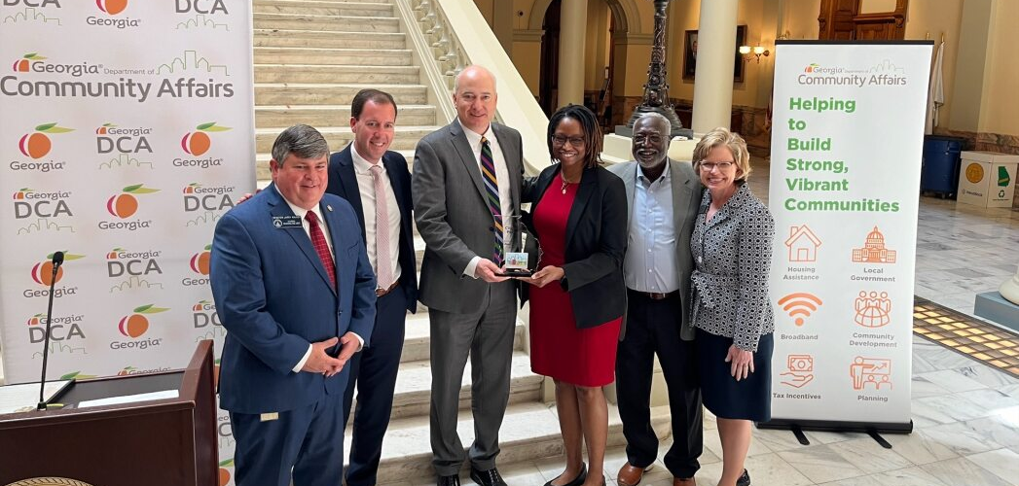
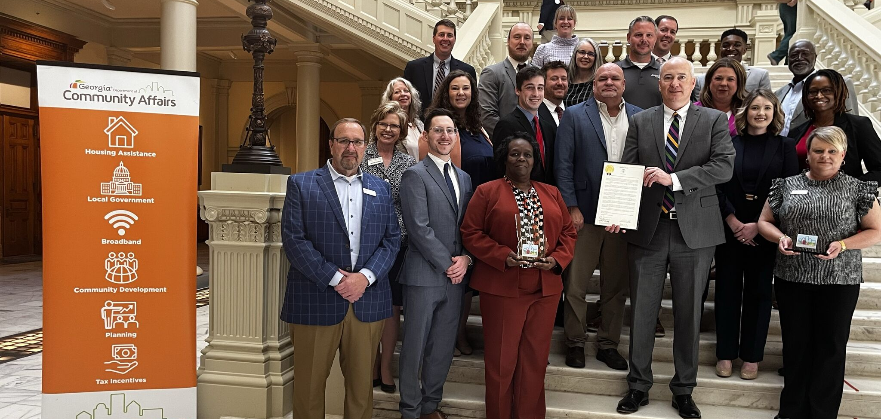
Planning Day at the Capitol March 14, 2024
Notes:
Here’s another benefit that falls into the recognition piece. Planning Day at the Capitol-honoring the commitment of these communities to exemplary comp planning. Here’s a picture from just last week at the Capitol featuring our PlanFirst communities of Bainbridge, Hawkinsville, Marietta, and Perry. Our Commissioner, Christopher Nunn is holding a Senate Resolution honoring these communities.

Slide 9
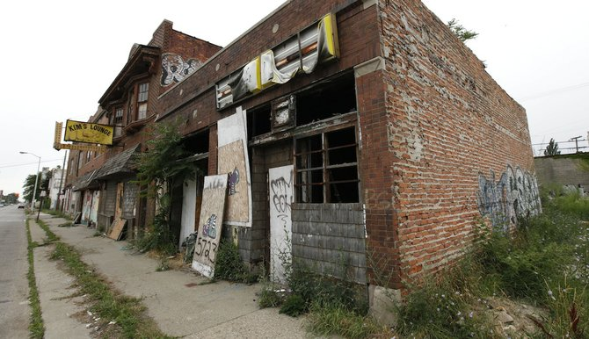
Alphabet soup-lightning round
GEFA
RDF
LIHTC
CPI
CDBG
DDRLF
EIP
Notes:
Now, let’s see if ya’ll were listening.
Ok, welcome to Alphabet Soup Lightning Round!
All you have to do is tell me the what the program acronym stands for by dropping the answer in the chat.
I’ll also ask you what is a defining feature or important information to know about each specific program. But don’t worry-that’s not part of the competition.
Yall ready?
Any questions before we begin?
#1 CPI
Community Planning Institute
What is it? Two-day planning workshop aimed at planning commissioners, elected officials, and planning staff.
#2 GEFA
Georgia Environmental Financing Authority
What is it? Provides low-interest loans for public water, wastewater, and solid waste infrastructure.
#3 LIHTC
Low income housing tax credit
What is it? Provides housing tax credits to qualified developers serving households with incomes between 20%-80% Area Median Income. 4% and 9% credits.
#4
RDF
Redevelopment Fund
What is it? Economic development fund from CDBG that addresses specifically slum and blight.
#5 CDBG
Community Development Block Grant
What is it?
HUD fund provided to states that focuses on low-to moderate income people by providing funding in primarily residential areas. Grants over $300K require local matching funds.
#6 DDRLF Downtown Development Revolving Loan Fund
What is it?
Financing for populations less than 100K that have a viable downtown development project-funds can be real estate acquisition, development, redevelopment, and new construction; max loan is $250K
#7 EIP
Employment Incentive Program
Economic Development Fund that generates jobs for low-to-moderate income persons and involves assisting private businesses.

Slide 10
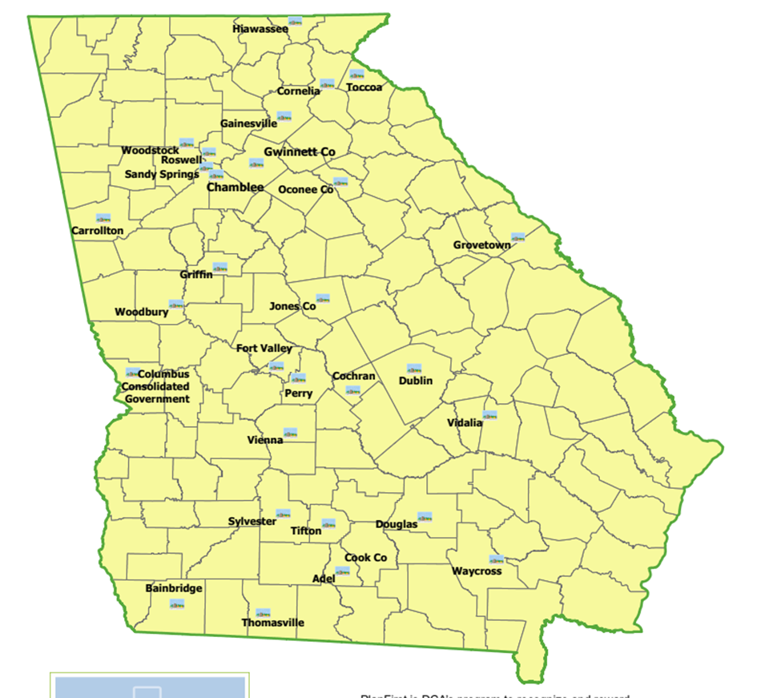
PlanFirst Communities
There are 25 active PlanFirst Communities.
Notes:
You all are the ones coming up for your renewal for the 2025-2027 list. Woodbury (1)
Waycross (1)
Roswell (3)*Just a note, that if you renew successfully, your local government will be the first and only 4-time PlanFirst designee.
Cook County (2)
Griffin (2)
Chamblee (2)
Sylvester (2)
Toccoa (2)
Carrollton (1)
Cochran (1)
Fort Valley (1)

Slide 11
How did we get here?
You must be a Qualified Local Government, and have a history of same.
Must also have a verified SDS, and have submitted the required surveys (GOMI, RLGF).
Must have met (and hopefully exceeded) the MINIMUM Performance Standards established by the local regional commission.
Must illustrate how planning is important to your community.
Required to reach out planning@dca.ga.gov by April 15 to check eligibility.
Must completely fill out the application and sign it - due May 15.
Notes:
There are some restrictions to who can even apply for PlanFirst designation. QLG status-cannot have lost status more than 4 weeks (28 days) and/or more than twice within the 10 year period.
This program is at its core about the comprehensive plan-so making sure you meet all your plan submission deadlines is key to your eligibility.
The service delivery strategy must be verified by us, as well as submitting the required annual survey of the Government Management Indicators as well as the Report of Local Government Finances.
As you know may already know, we also require that the applicant community adheres to the regional commission’s minimum performance standards.
If you don’t know these mean, don’t worry, I can explain them to you. Just email me at planning@dca.ga.gov

Slide 12
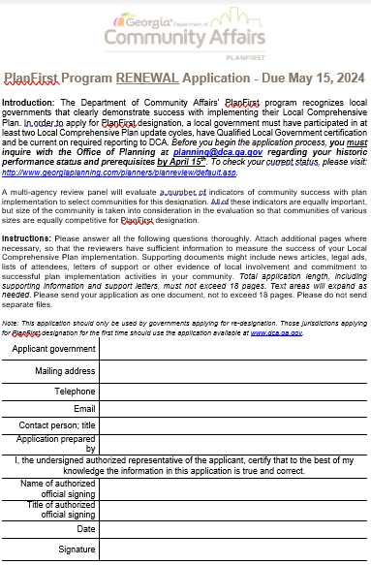
FIVE INDICATORS
Goals
Leadership
Participation
Implementation
Impact
Notes:
You might be wondering what the application is asking and by what metrics are the communities being judged? It’s helpful to view the application in 5 major buckets: Goals, Leadership, Participation, and Implementation and Impact. We’ll talk about all of these briefly.

Slide 13
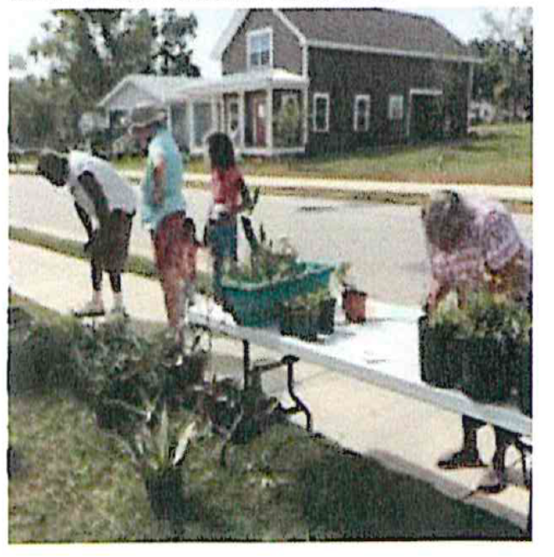
Indicator: Goals
Community and Leadership Support
Ambitious and Achievable
Steer Local Decision-Making
Show how community organizations and other partners continue to support goals in your comp plan
Consistent Progress
City of Thomasville Victoria Place Overlay District
Notes:
Do the goals enjoy community and leadership support? Is the community reaching for aspirational and ambitious goals? Are they achievable? Do these goals actually move the needle on decision making? What about consistent progress?

Slide 14
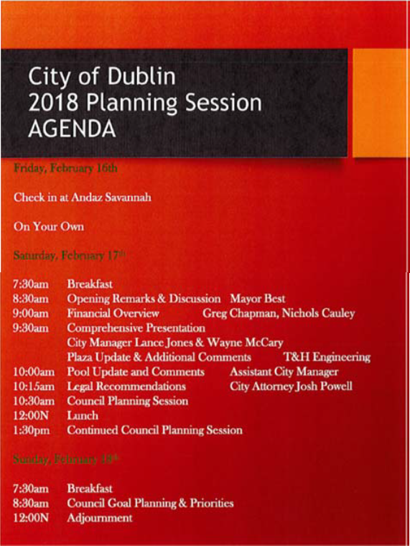
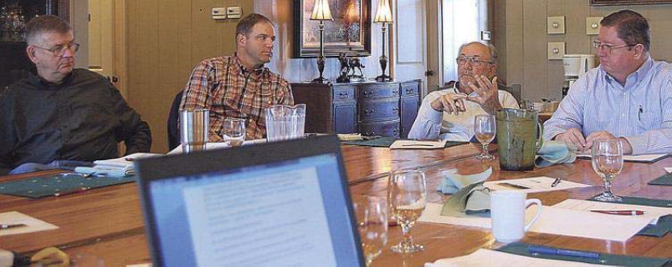
Indicator: Leadership
Effective Planning Staff
Active Planning Commission
Effectively Evaluate Planning
Trained Local Officials
Discuss ongoing or new collaborative efforts
Notes:
How is planning done effectively? How have you assessed your staffing arrangements? Is your staffing arrangement still working for you? Why or why not? Are local officials going out and getting the recommend training? Are community leaders being brought to the table?

Slide 15
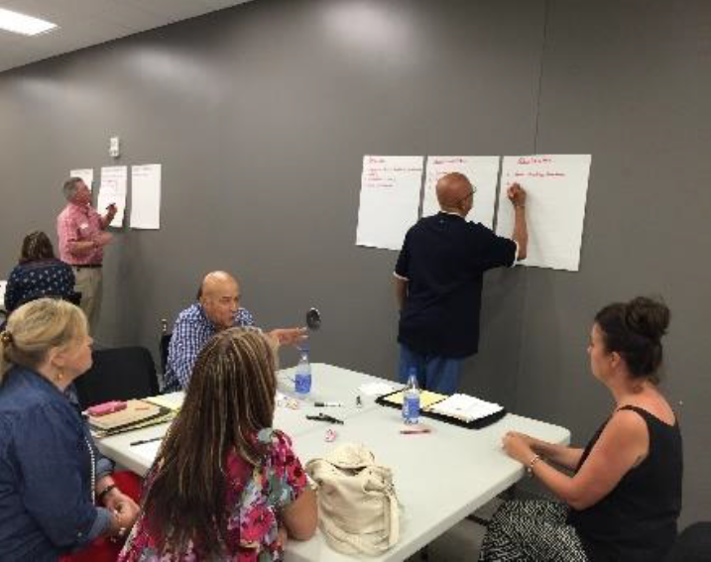
Indicator: Participation
Lots of Opportunities for Community Input
Community Input Incorporated in Your Plan
Effective Outreach Process
Hard-to-reach populations
Jones County Plan Meeting
City of Powder Springs
Notes:
How is the community being engaged? Is the community input actually incorporated or is it just tokenism? Highlight your activities around underrepresented groups and voices. Provide documentation like photos, agenda, sign-in sheets, survey results and other meeting materials.

Slide 16
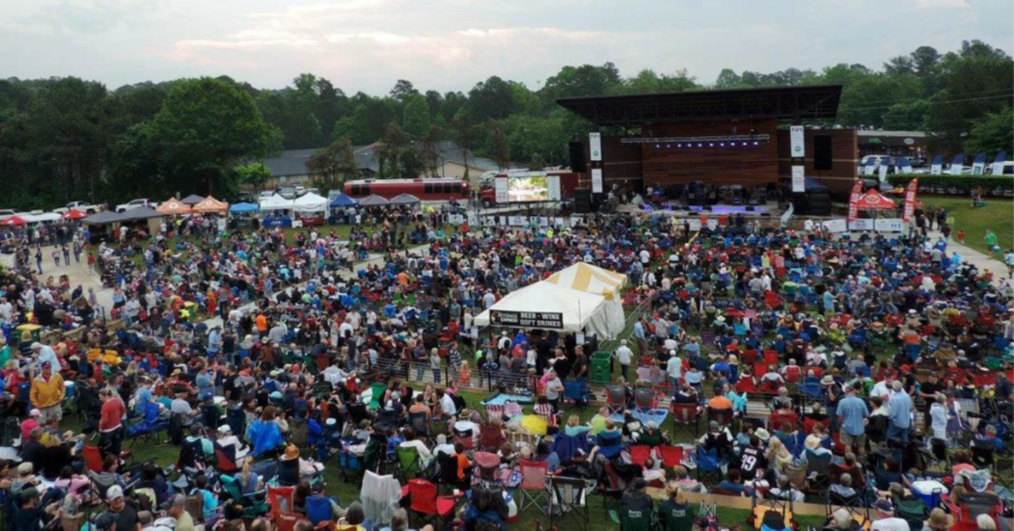
Indicator: Implementation
Five examples!
Work Program Addresses Local Needs
Consistent Capital Budget
Recent
Include comp plan references
Amphitheater in Woodstock City Park
Notes:
How effective has the local government been in implementation? Has your local government consistently finished planned projects? Are you highlighting recent projects? Please include photographs, newspaper articles or other exhibits to elaborate. Include Comp plan references and page numbers!

Slide 17
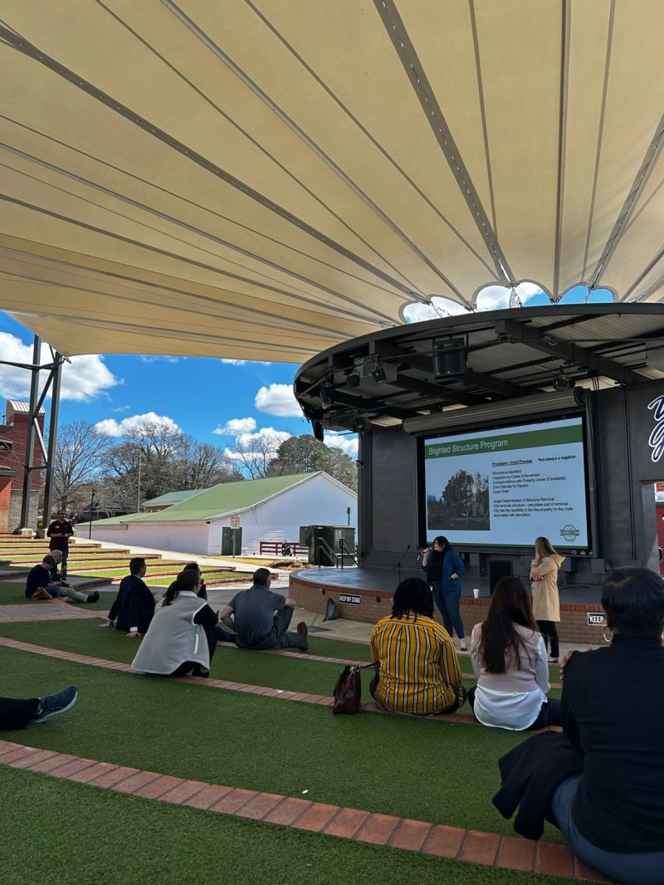
Indicator: Impact
What impact has the PlanFirst designation had on your community?
Has it served a role in educating your leaders and citizens?
Have you pursued PlanFirst incentives?
Has your Comp Plan been impacted by PlanFirst?
Amphitheater in Woodstock City Park
Notes:
We’ve gone over the incentives of PlanFirst. On this application, we want to know how you’ve taken advantage of the incentives. Have you been active in promoting your comprehensive plan? What have your recent efforts around your regional commission’s performance standards been like?

Slide 18
Answer the question completely.
Notes:
This is the biggest takeaway from our team’s years of reviewing applications. When I started this role, I asked the question, “what is the number one bit of advice you could offer to an applicant community. Resoundingly, this was the answer.

Slide 19
Question E: Indicator Leadership
E. Describe your staffing arrangement (local government staff or contracted relationship) for handling community planning issues. Explain why that is the most appropriate arrangement for your community dynamics. Include the number of staff devoted to planning, staff qualifications, continuing education, and organizational structure.
Notes:
Here’s a perfect example of a question that often doesn’t get answered in its entirety. Specifically, there’s one sentence in here that people forget about. Can anyone guess which sentence gets missed? Red, blue, or green?
Answer: Blue!

Slide 20
Lowest scoring question (2023)
I All Reviewers
Since your initial PlanFirst designation, has your community applied for any of the PlanFirst incentives? Those incentives include: the HUD Community Block Grant program (CDBG), the Employment Incentive Program (EIP), the Redevelopment Fund Program (RDF), the Downtown Development Fund Program (DDRLF), and/or the Georgia Environmental Finance Authority (GEFA) state loans.
Notes:
I went through all our team reviews and found the lowest scored question and it was question I. This tell us that communities aren’t really taking advantage of the incentives offered at a rate that is favorable to reviewers. Another possibility is that documentation is not taking place about what incentives are being applied for.

Slide 21
Second lowest scoring questions (2023)
A (PRG reviewers)
A. Since your initial PlanFirst designation, demonstrate how your Goals and Vision Element continues to push your community to strive for planning excellence. In particular, focus your response on your local leadership’s work towards ambitious goals. For example, show how goals continue to influence decisions made by local leadership, and how community organizations and other partners continue to support goals stated in your Local Comprehensive Plan. Give examples of how your local leadership and your community supports and endorses your goals.
J (Regional reps/communities reviewers)
J. Since your initial PlanFirst designation, give three examples how you and your leadership have publicly promoted the Local Comprehensive Plan fostering local access to the Plan by making it generally available to your community. (In addition, if your Local Comprehensive Plan is on your community’s website, please provide the website URL.)

Slide 22
Lowest scored answers of Question A (PRG):
Notes:
A. Since your initial PlanFirst designation, demonstrate how your Goals and Vision Element continues to push your community to strive for planning excellence. In particular, focus your response on your local leadership’s work towards ambitious goals. For example, show how goals continue to influence decisions made by local leadership, and how community organizations and other partners continue to support goals stated in your Local Comprehensive Plan. Give examples of how your local leadership and your community supports and endorses your goals.

Slide 23
Lowest scored answers of Question J (external):
Notes:
J (Regional reps/communities reviewers)
J. Since your initial PlanFirst designation, give three examples how you and your leadership have publicly promoted the Local Comprehensive Plan fostering local access to the Plan by making it generally available to your community. (In addition, if your Local Comprehensive Plan is on your community’s website, please provide the website URL.)

Slide 24
Example of answer to question (B) with highest score
Since our PlanFirst designation, the city has done a complete restructuring of the planning and development departments. The city has an almost entirely new team. Previously, our building inspector was also our zoning administrator and oversaw the planning commission. In 2022, the Community Development Director hired a full-time Main Street Manager and took on the role of city planner and zoning administrator, in addition to Economic Development. The city then created a new City Marshal department. The City Marshal oversees a Code Enforcement officer. Together they do inspections, code enforcement, permitting and plan reviews. The three staff members work together closely with the fire marshal on all permitting applications. The Community Development Director now oversees economic development, the Planning Commission, and handles all zoning requests and annexations. The planning commission also has three of five new commissioners. All of the Planning Commission has completed the required GMA planning training. These changes have been very positive. Together, these new team members have created synergy in the planning and development departments. They have streamlined all processes, developed new protocols, and updated all forms and applications. This has helped to keep all staff members accountable to each other and the citizens. As our city has seen growth and plans to continue to grow, having a smoother process, new protocols, and friendly faces will make it easier for the staff to serve its citizens. All staff and commissioners are dedicated to planning training and working to learn innovative ways to complete projects. Some of the aforementioned updated forms can be founds by clicking the following links:
Notes:
Here we have the highest scoring answer from the 2023 renewal application. This answer scored the highest of all the applicants both from the Planning, Research and Geoanlytics team as well as the Regional reps/communities.
The question was: B. Since your initial PlanFirst designation, how have you assessed your staffing arrangements (local staff or contracted relationship) and planning processes to ensure that they continue to move the community towards the goals it set for itself and the local comprehensive plan? Focus on any changes that might positively augment your ability to implement your comprehensive plan. Explain why (using examples) your current arrangement works for your local government. If there were no changes, please provide a reason (examples) as to why no changes were necessary.
Now, how could their answer have beee even stronger?

Slide 25
Tips and tricks
01
Read the questions carefully and make sure you answer the question asked in its entirety.
02
Remember-this is about the Comprehensive Plan, not any other strategic plan, like an area plan, or corridor study.
03
Reference the plan with the correct section, date of the plan, and page number.
Notes:
1-You’ll notice that many of the questions are multi-part. Don’t neglect a part of the answer as the reviewers are trained to make sure that all parts are answered. 2. At the most fundamental level, this is a designation for a Georgia community that demonstrates exemplary Comprehensive Planning. Although adjacent or related planning efforts may merit mentioning, keeping your answers tied to the comprehensive plan is the most important idea.
3. Reviewers like to see the correct section referenced. This helps contextualize your answers and helps everyone make a reference to the plan to follow up.

Slide 26
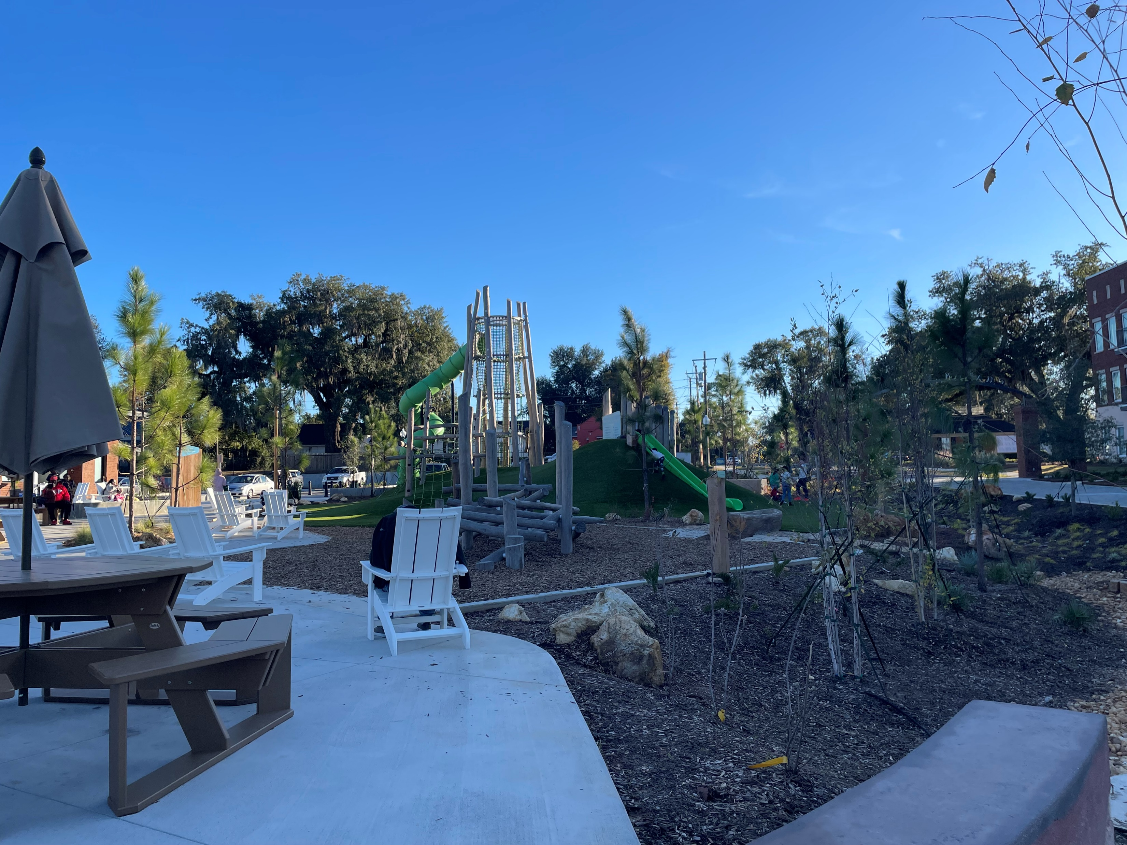
Tips and tricks
04
Tell a complete story with pictures-in focus and clearly identified.
05
Elaborate beyond yes or no answers, explain and be thoughtful and thorough in your answers.
Notes:
We all know that stories resonate better when accompanied by images. Have a new park, streetscaping, or innovative downtown seating projects? Show them to us! Working on stormwater improvements? Show us your sewers! Most of your reviewers can’t go in person to your community, so tell us and show us.
We do get pictures that are out of focus. We’re not expecting professional photography, but images that aren’t in focus or if the subject isn’t centered can definitely take away from your score.
Lastly, don’t be vague and short. Let your answers be accurate and thorough.

Slide 27
Additional tips for success
Use the application for ideas for your implementation.
Start early! The application is due May 15.
Let other community staff and trusted professionals review your application.
Examples, examples, examples!.
Notes:
Revisit the application regularly throughout the year. Allow the application to provide ideas for your community’s implementation of the Comprehensive Plan. Next. This application is robust. Just like when were in school, we can all tell when a test or paper was part of a cram session and the answers were hammered out the night before-powered by redbull and vending machine food. Allow several weeks to gather the information you need. This will help your answers be as clear and thoughtful as can be. Also, starting early will give you time to go through several reviews, which we all know will result in a better product.
That brings me to the third suggestion-allow your application to be reviewed. Have your reviewers check for consistency, grammar, syntax, and quality of content. Sometimes, when working on a project like this, it’s easy to get tunnel vision about a certain answer. Others can provide a fresh perspective and can help you focus your answers to make them easier to understand and to allow your point to come across in a cogent, concise way. This last tip is probably a make or break point. After reviewing several applications, answers, and reviews, one of the biggest positives and negatives are examples. When examples aren’t provided. Reviewers score very negatively. When quality examples are provided, reviewers take note and score very highly. You probably won’t be designated a PlanFirst community if quality examples aren’t provided. When you are at a Council meeting, and you notice an activist citizen regularly speaking on issues, where it makes sense, bring that person into your comprehensive planning process, engage with that person and the neighborhood or group that that person represents. Note that engagement on your application.

Slide 28
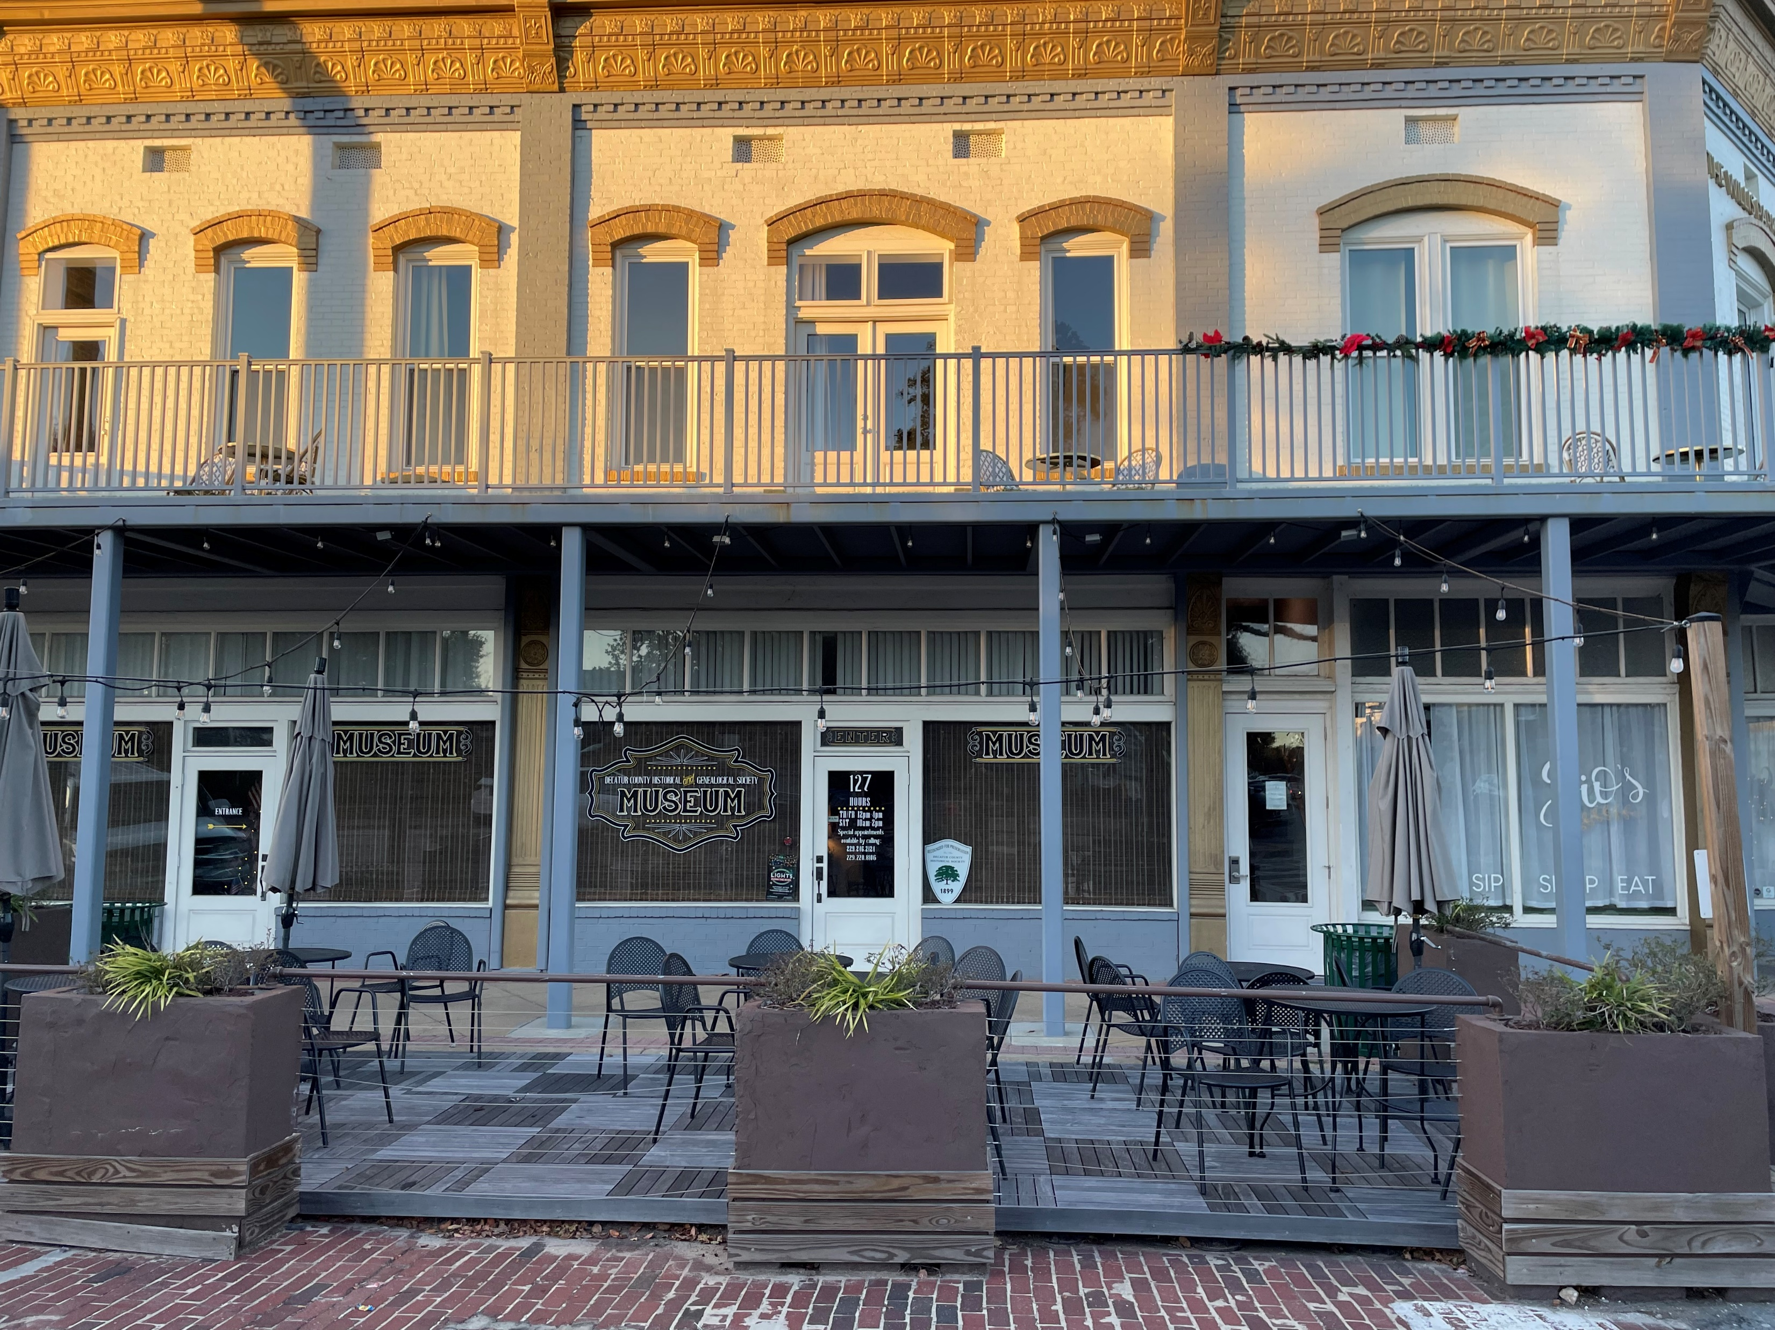
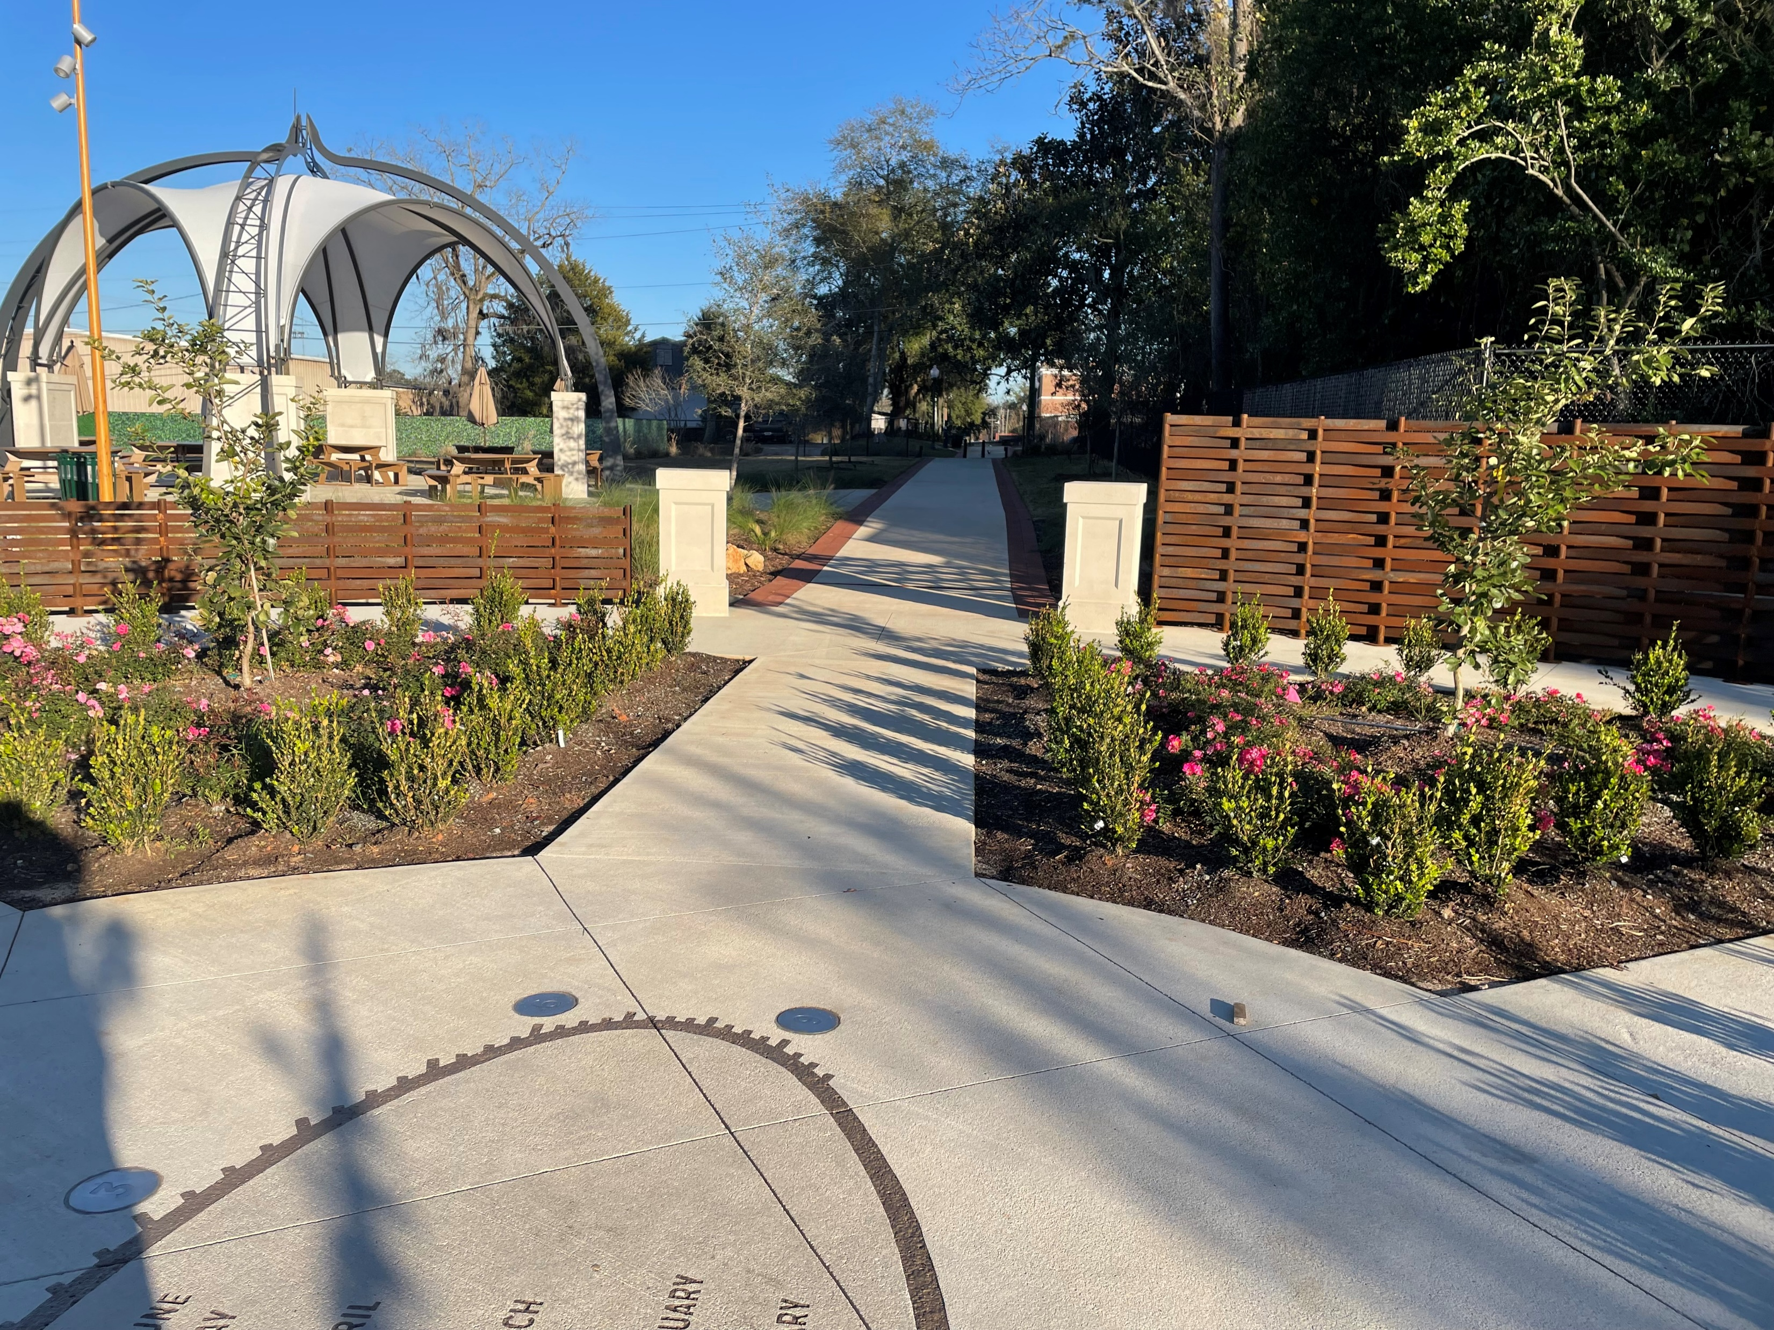
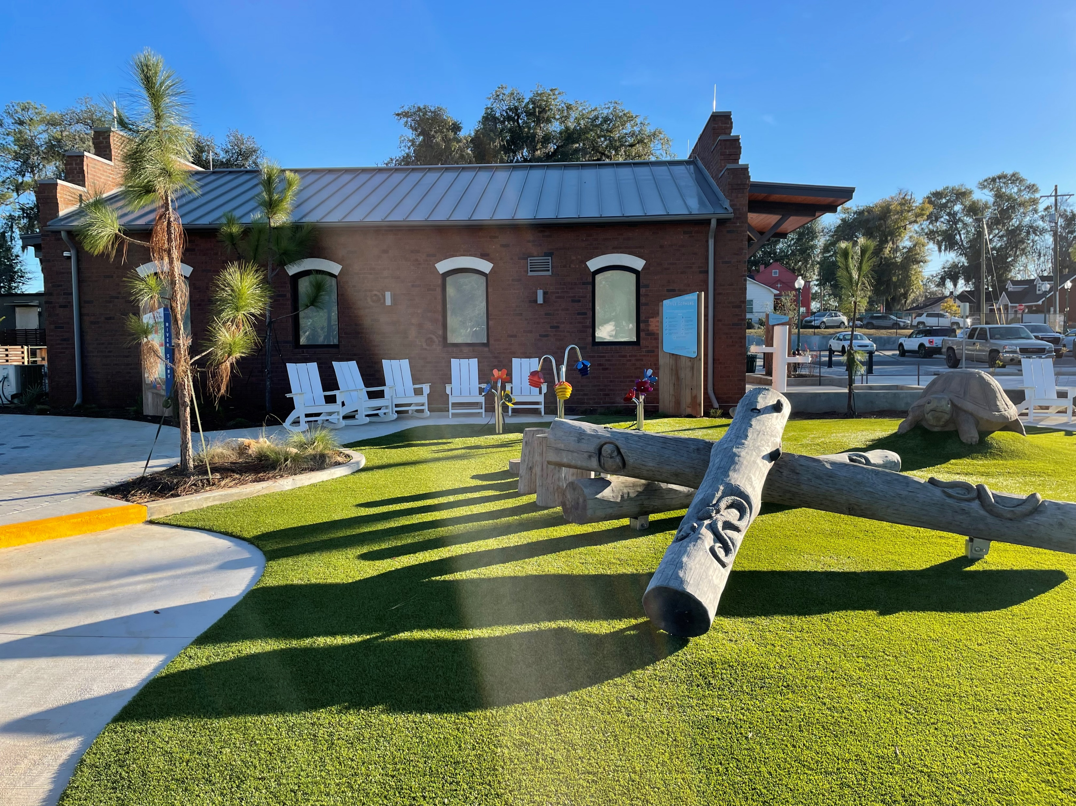
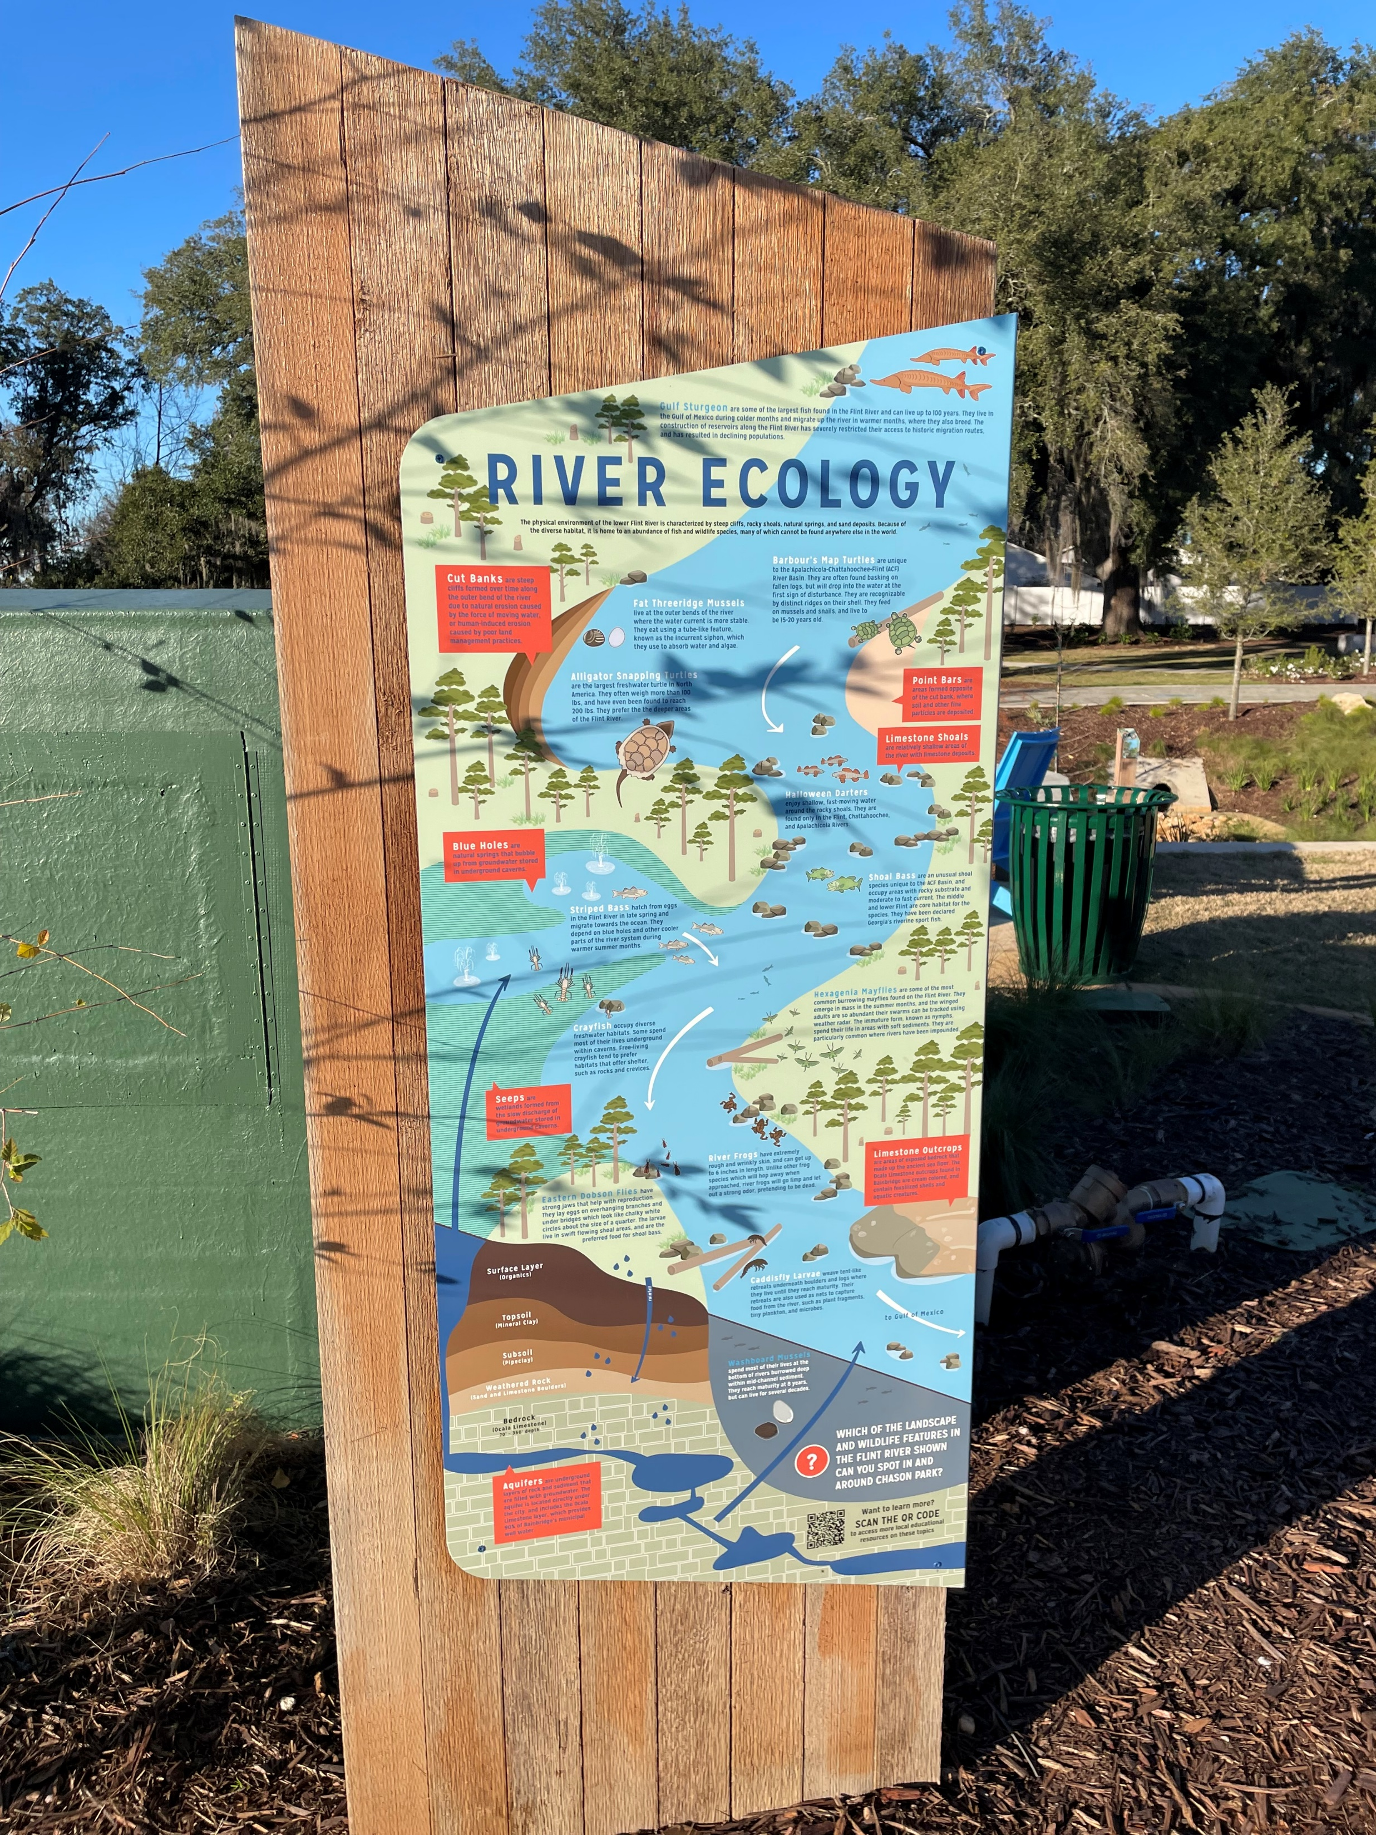
Invite us into to your community through pictures.
Notes:
We know our Georgia communities are doing good things. Good storytelling can be augmented by pictures. Review your Community Work Program and then take a drive around your community. Take photos and upload them along with your presentation. Take several photos and keep the best ones! This will stimulate your thinking and will be a huge help on boosting your application’s chances.

Slide 29
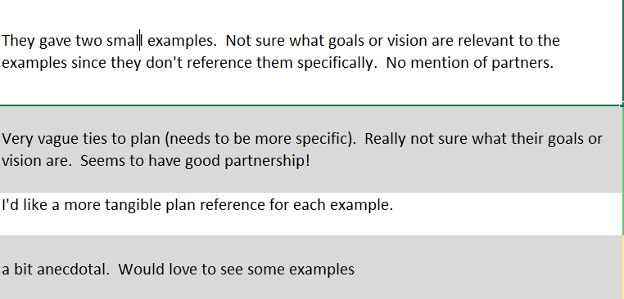
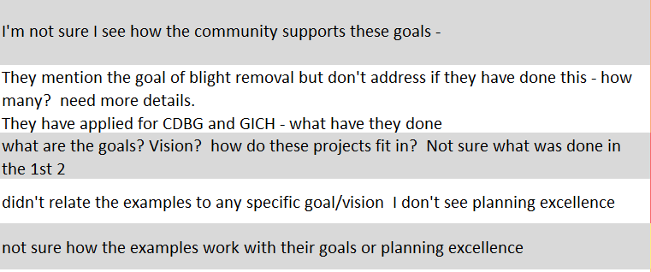
Reviewer responses
Notes:
Here is a collection of reviewer responses on some of the lowest rated questions. Do you see a theme here?

Slide 30
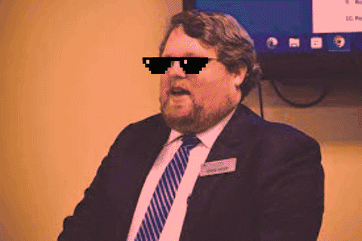
Application: Lessons Learned
The answers need to be very specific: answer the question you’re asked
Regional Commissions can be a benefit in help filling out the application!
Answers have changed somewhat over the years - focus now is more on how they achieved their goals by planning rather than “Look how great we are”
Renewals aren’t automatic, not everybody renews, for different reasons

Slide 31
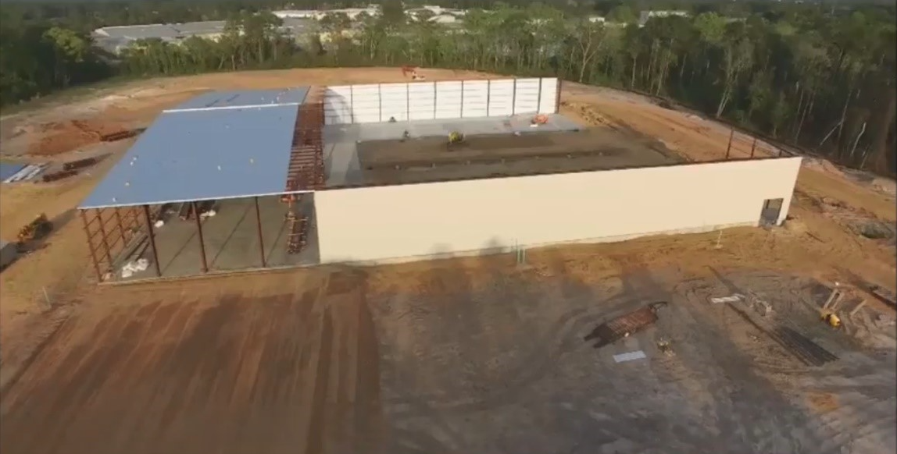
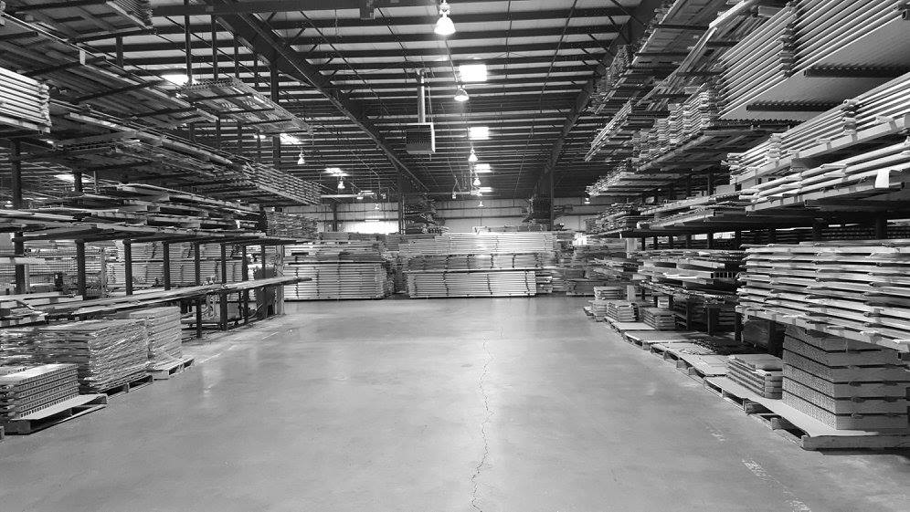
PlanFirst incentives-a success story
PlanFirst community 2017-2025
2017 EIP winner-100 jobs created-infrastructure for Elixer Extrusions manufacturing
2018 CDBG award winner-$459,895-water and sewer improvements.
2019 CDBG award winner-$373,727-drainage and street improvements
2020 CDBG award winner-$750,000-public facility to address mental health benefitting 951 persons
2022 CDBG Annual Competition-$1,000,000 expansion of Early Head Start facility benefiting 125 persons.
2022 GEFA loan to upgrade wastewater treatment plant-$3,000,000-interest rate savings on a 20 year loan~$170,000
Notes:
Here we have one of our PlanFirst superstars- the City of Douglas, Georgia! The City of Douglas is a small, rural town of roughly 12,000 in population. The city of Douglas is the County seat of Coffee County and is one of the few three-time PlanFirst designees in the state.
You can see that the City of Douglas was relentless! They took advantage of 3 successive years of applying for CDBG funds-
They took a short breather in 2021. But then 2022-expanded their head start facility and invested in the youth of the community.
That same year, Douglas enjoyed a half percent interest rate reduction on a $3,000,000 GEFA loan which amounts to roughly $170,000 in savings. Douglas has been extremely active even outside of these PlanFirst available funds. Truly, they are demonstrating how a local government can really push activities that align with their community’s vision and goals.

Slide 32
Notes:
Here’s before and after pictures of a residential area in Douglas that made sewer and street improvements with CDBG funds.

Slide 33
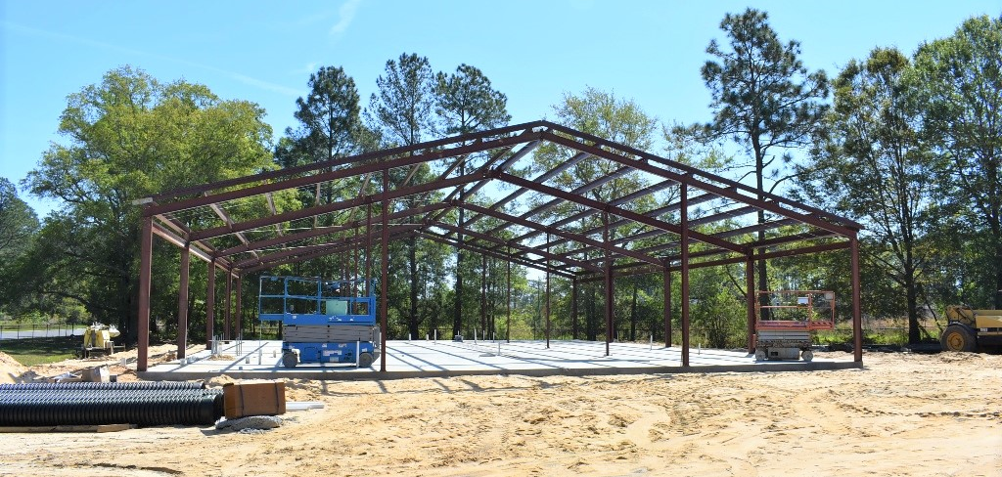
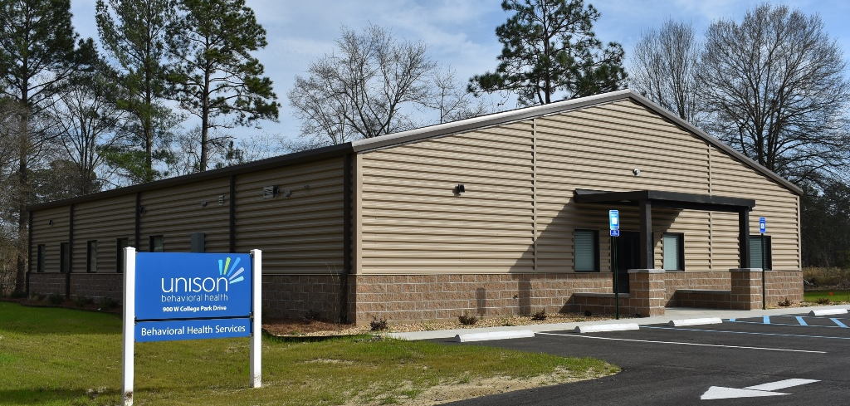
Notes:
The City of Douglas recognized that like many communities in our state, substance abuse and mental health issues were challenges that needed to be addressed. For their 2020 CDBG funds, Douglas was awarded $750,000 to build a mental health/substance abuse treatment facility to address these issues, estimated to benefit 951 people. The City, local employers, and most importantly the residents of Douglas, all stand to gain from this facility and the services it offers.

Slide 34
The PlanFirst Program upcoming dates
Application due May 15
Communities review applications June-August
Communities notified of their 2025 PlanFirst designation September/October
Fall CPI October (Dublin)
Communities invited to Georgia State Capitol for Planning Day at the Capitol(January)
Daniel Gaddis, Planning Outreach Coordinator
Notes:
I’m showing this slide again in case any of you wanted to jot down those dates that didn’t get a chance to earlier.

Slide 35
Thanks!
Daniel Gaddis
Daniel.Gaddis@dca.ga.gov
Direct: 404.679.4934
Cell: 470.352.0395
Planning Outreach Coordinator
dca.ga.gov
Notes:
Lastly, I want to share that we are taking a new approach to our Success Stories and Best Practices initiatives. This year, we will be asking for information about projects that our PlanFirst communities have undertaken and then sharing those out with the state. We hope to host a webinar where we can invite other communities that are looking to address issues such as housing stock, blight, stormwater, promoting walkability and bikability, economic development and others. Using the PlanFirst communities as thought-leaders and sharing the challenges and successes they’ve dealt with can be encouraging and instructive to others.
Any questions I can answer for you all?

