Slide 1
ICC Code Development Process
March 2022
2021/2024 Cycle
Notes:
Thank You for allowing me to attend and speak today.
Code Official for 26 years. Retired, moved to SC and was hired by the ICC. I am a former ICC Board member and past-board president. I handle GA, NC, SC, TN & NJ...

Slide 2
Presented to:
Georgia State Codes Advisory Committee (SCAC)
March 9, 2022

Slide 3
ICC Vision
Protect the health, safety and welfare of people by creating safe buildings and communities

Slide 4
ICC Mission
To provide the highest quality codes, standards, products and services for all concerned with the safety and performance of the built environment

Slide 5
The I-Codes
15 Codes
Building, Residential: IBC, IRC
Fire, Wildland-Urban Interface: IFC, IWUIC
Fuel Gas, Mechanical, Plumbing, Pool: IFGC, IMC, IPC, IPSDC, ISPSC
Existing Buildings, Property Maintenance: IEBC, IPMC
Energy, Green, Performance, Zoning: IECC, IgCC, ICC Performance (ICC PC), IZC
Notes:
Note about IECC...process changed after this past cycle. 2 committees. One handling residential, One handling everything else.

Slide 6
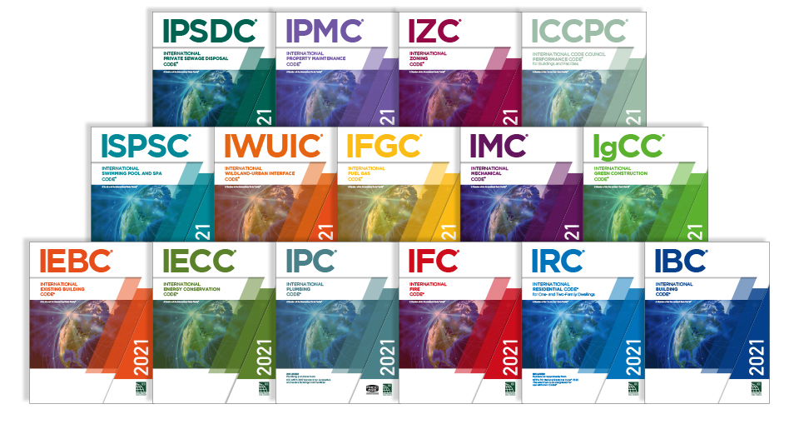
The International Codes
The International Codes (I-Codes) are model codes.
The I-Codes provide uniformity and consistency in format and language.
The I-Codes form the basis of building and safety regulations in all 50 states, D.C, U.S. territories and U.S. Federal Agencies.
Notes:
24 codes are currently in development. We are in year 2 of a 3yr cycle for development.

Slide 7
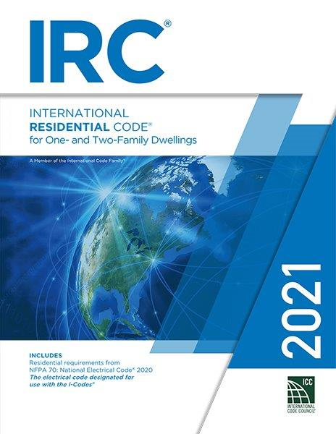
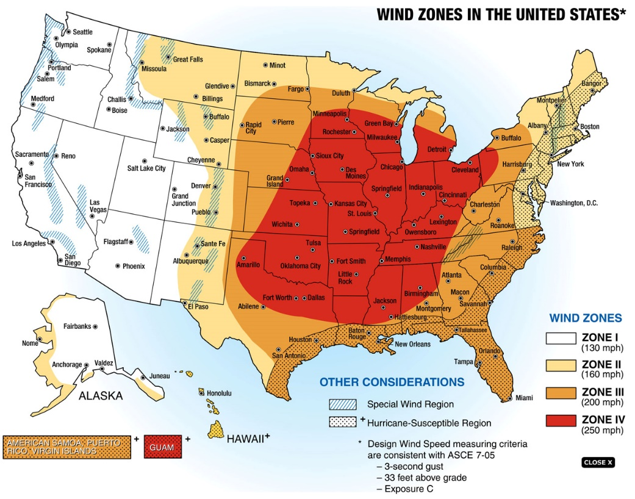
How the I-Codes are Used
The I-Codes are meant to be adapted by the jurisdictions in order to meet specific climate, geographic, or local needs.
There is no one size fits all. Jurisdictions in states throughout the U.S. follow their own processes for review and adoption

Slide 8
I-Codes Referenced in Federal Law
Used by the Federal Agencies
Cited in:
U.S. Code of Federal Regulations
Executive Orders
FEMA policies
Federal guidance documents by:
The Architect of the Capitol,
Department of Agriculture,
Department of Energy
Department of Defense
Department of Housing and Urban Development
FEMA
Internal Revenue Service
And more!
Notes:
The I-Codes are used by the Federal Agencies and are cited in the U.S. Code of Federal Regulations, Executive Orders, FEMA policies and in guidance documents by the Architect of the Capitol, Department of Agriculture, Department of Energy, Department of Defense, Department of Housing and Urban Development, Department of State, Veterans Affairs, EPA, FEMA, General Services Administration, Internal Revenue Service, National Aeronautics and Space Administration, National Park Service, Smithsonian Institution, USAID, Consumer Product Safety Commission …

Slide 9
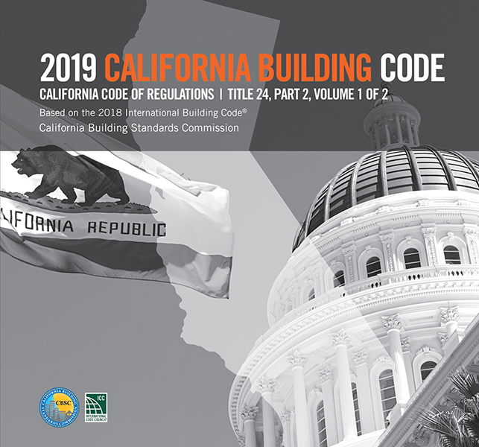
How the I-Codes are Used
Some states adopt the code statewide.
“Home rule” states might adopt for state owned or leased buildings and leave it up to local jurisdictions to adopt.
Some jurisdictions opt to have custom codes published using the I-Codes as their base codes, i.e. California, NYC, Virginia, Chicago, Ohio, and Florida
Other jurisdictions amend the model codes for their use but do not publish “custom codes.” (Tennessee, Georgia)
Notes:
Most states, if they don’t adopt statewide require local jurisdictions to have codes equal to or greater than the state version of the codes.

Slide 10
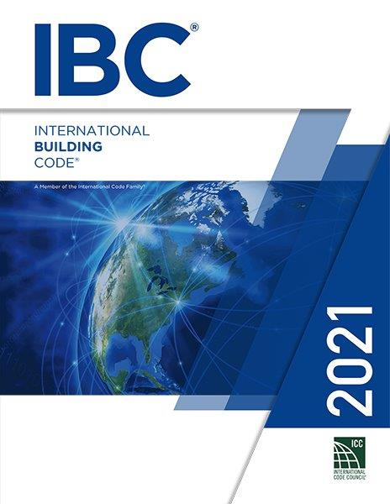
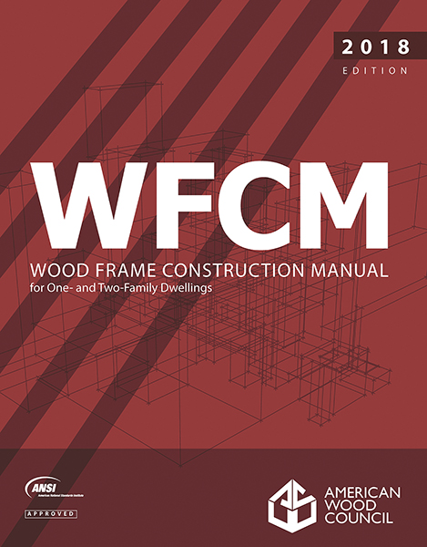
Making Sense Out of the Codes &
Standards World of ICC
The I-Codes are designated national voluntary consensus standards developed using a governmental consensus process that must comply with Federal principles outlined in United States Standards Strategy, Public Law 104-113 and Circular OMB A119.
Code Council Standards are developed using an ANSI Process developed for American National Standards known as ANSI Essential Requirements for due process.
Notes:
Office of management and budget.

Slide 11
Currently Adopted Codes in Georgia
Current Mandatory Codes as Adopted by DCA:
International Building Code, 2018 Edition, with Georgia Amendments (2020), (2022)
International Residential Code, 2018 Edition, with Georgia Amendments (2020)
International Fire Code, 2018 Edition (Contact State Fire Marshal Below)
International Plumbing Code, 2018 Edition, with Georgia Amendments (2020), (2022)
International Mechanical Code, 2018 Edition, with Georgia Amendments (2020)
International Fuel Gas Code, 2018 Edition, with Georgia Amendments (2020), (2022)
National Electrical Code, 2020 Edition, with Georgia Amendments (2021)
International Energy Conservation Code, 2015 Edition, with Georgia Supplements and Amendments (2020), (2022)
International Swimming Pool and Spa Code, 2018 Edition, with Georgia Amendments (2020)
For information and questions regarding the Life Safety Code (NFPA 101), IFC Georgia Amendments or the Georgia Accessibility Code please contact the State Fire Marshal's Office.
Current Permissive Codes as Adopted by DCA:
Disaster Resilient Building Code IBC Appendix(2013)
Disaster Resilient Building Code IRC Appendix (2013)
International Property Maintenance Code, 2018 Edition, with Georgia Amendments (2021)
International Existing Building Code, 2018 Edition, with Georgia Amendments (2021)
National Green Building Standard, 2008 Edition, with Georgia Amendments (2011)

Slide 12
The I-Codes
Each code is comprehensive
All codes are coordinated and compatible with each other
All codes reference consensus standards developed by Standard Developing Organizations (SDOs)
Notes:
Coordination of Codes:
Defined scope of each code
Interdependence and reliance on the entire family of codes
Cross referencing and duplication of provisions with code scopes

Slide 13
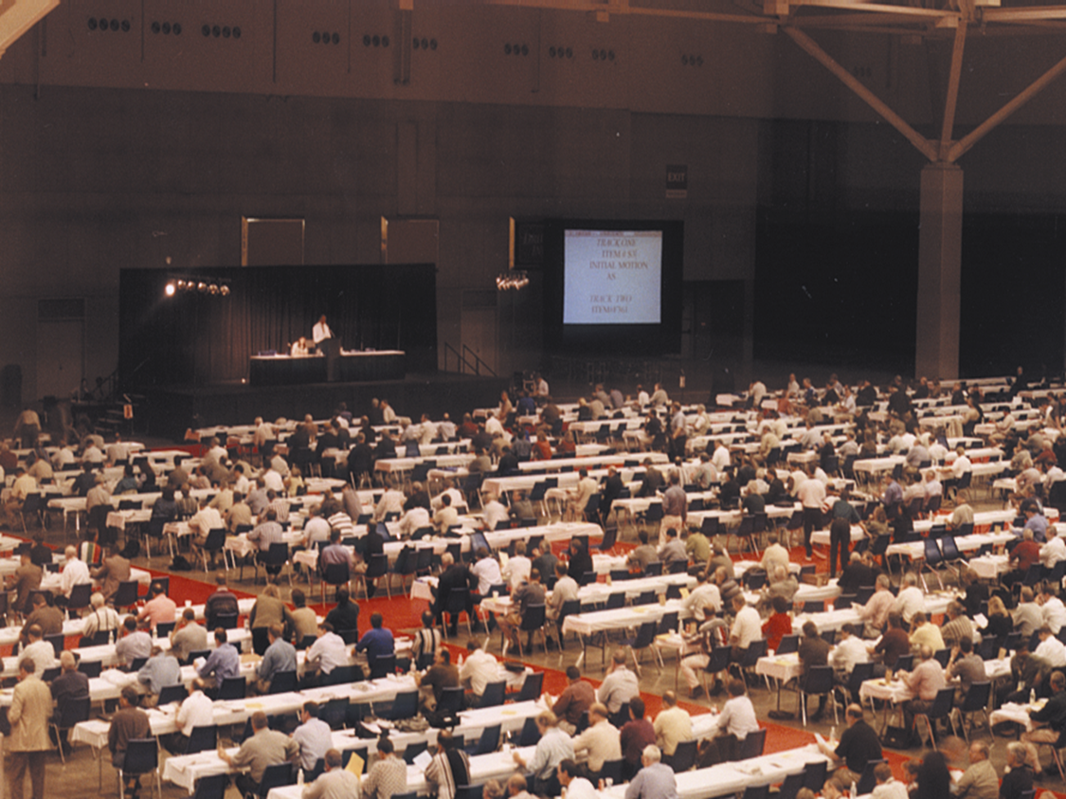
ICC Code Development Process
aka “Making the Sausage”!
Notes:
Most boring and informational thing you will ever do! Sometimes it is more important to know what did NOT get in the codes....

Slide 14
Goal
Utilize a process open to all parties with safeguards to avoid domination by proprietary interests. ICC Governmental Consensus Process achieves this with the final vote resting with those administering, formulating or enforcing regulations relating to public health, safety and welfare. (Governmental Members)

Slide 15
Code Committees
Representation of interests
General: Consumers, Regulators
Producer: Builders, Contractors, Manufacturers, Material Associations, SDOs, Testing Labs
User: Academia, Designers, Research Labs, Owners, Product Certifiers
Not less than 33% of each committee are Regulators

Slide 16
Code Committees
Call for 2021/2022 committees posted March/2020
Applications due June/2020
Applications reviewed by the Codes and Standards Council who make recommendations to the ICC Board
Committees appointed by the ICC Board

Slide 17
Code Committees
17 Code Committees:
-IBC 4 Subcommittees: Egress; Fire Safety; General, Structural
-IEBC
-IFC & IWUIC combined
-IFGC
-IMC
-IPC & IPSDC combined
-IPMC & IZC combined
-IRC 2 Subcommittees: Building, Mechanical/Plumbing
-ISPSC
-Energy 2 committees: Commercial (IECC); Residential (IRC & IECC)
-Administrative Provisions Committee-Chapter 1 of all I-Codes (with exceptions such as IECC, IgCC and IRC) and updates to currently Referenced Standards
-IgCC, see next slide

Slide 18
The Players
Code officials
Design professionals
Code consultants
Trade associations
Builders/contractors
Manufacturers/suppliers
Government agencies
Anyone with an interest

Slide 19
The Process
Open
Transparent
Balance of Interest
Due Process
Consensus
Appeals Process
Notes:
All aspects of the ICC Code Development Process are regulated by published procedures which are approved by the ICC Board of Directors.
-Council Policy (CP) 28: Code Development
-CP 44: Code Correlation Committee
-CP 7: Committees and Members
-CP 1: Appeals

Slide 20
Code Changes Submitted
Code Change Agenda Posted
New Edition Published
Committee Action Hearing (CAH)
Online Governmental Consensus Vote (OGCV)
I-Code Development Cycle
Powered by cdpACCESS®
CAH Results Posted
Public Comment Hearing (PCH)
Public Comments
Submitted
Public Comment Agenda Posted

Slide 21
Typical Cycle Snapshot
Code Change deadline: Typically, during the second week in January (with flexibility to accommodate Holidays)
Committee Action Hearings: Apr-May
Public Comment Hearings: Oct-Nov

Slide 22
Typical Cycle Snapshot
Edition published
-2021 Edition published Nov/2020
2021/2022 Cycle
-Group A: Code Changes due January 11, 2021
-Group B: Code Changes due January 10, 2022
Edition published
-2024 Edition in 2023

Slide 23
Current Code Groupings
Group A codes
-IBC (except Structural), IFC, IFGC, IMC, IPC, IPMC, IPSDC, IRC-M, IRC-P, ISPSC, IWUIC, IZC
Group B codes
-IBC Structural, IEBC, IECC-C, IECC-R/IRC-E, IgCC (Ch.1), IRC-B
-Administration: Chapter 1 of all Codes except IECC, IgCC and IRC; updates to currently Referenced Standards
Notes:
. NOTE CHANGE TO IECC

Slide 24
Code Change Submittal
Code change deadline posted
Anyone can submit a code change
Submit online via cdpACCESS®
Name and entity represented
Copyright release
Proposed language:
-Legislative revisions to current text:
Underline proposed new text and strike out text to be deleted
Substantiate change with reasons and supporting documentation
Provide cost impact information and substantiation

Slide 25
Referenced Standards
Currently Referenced Standards
-ICC contacts SDOs to determine which standards will be updated and completed by December 1st of third year in cycle (per CP28)
-ICC publishes list of standards as an Administrative Provision code change (Group B)
Notes:
Proposed new Referenced Standard
-Submitted as a code change with the scope and application of the proposed standard identified in the code text
-Code change submitted to the applicable Group A or B code group
-Standard must be completed and published by the Public Comment Hearings for the applicable code group

Slide 26
Staff Review of Code Changes
Form and format: Based on current text and in legislative format
Reason/Documentation
I-Code coordination
Bibliography
Cost impact and substantiation
New referenced standard compliance
Copyright release

Slide 27
Staff Review of Code Changes
Staff contacts code change proponent as necessary to assist in processing the code change
Editorial code changes reviewed/acted on by Code Correlation Committee
Code changes posted: Approx 45 days prior to Committee Action Hearings (30 days minimum per CP28)

Slide 28
Committee Action Hearings (CAH)
Public Hearing
Applicable Group A or B code committee presides over hearing
Anyone can attend and participate/testify
No cost to attend/participate/testify
All committee actions and reasons for action published
Notes:
Approximately 300 code changes being heard March 27th-April 6th in Rochester NY
Modifications:
Regulated by Section 5.5.2 of CP28
Must be within the scope of the original submittal
Submitted online via cdpACCESS®
Proposed during hearing testimony
Chair procedural ruling in/out of order
Viewed online via cdpACCESS®
Hearing testimony on modification only
Committee under no obligation to consider the modification in their deliberations

Slide 29
CAH Committee Action
Committee action (50% majority)
-Approval as Submitted (AS)
-Approval as Modified (AM) based on a modification presented and discussed during testimony
-Disapproval (D)

Slide 30
Report of Committee Action Hearings
Committee action
Committee modifications, if any
Reason for committee action
Posting: Approx. 30 days after Committee Action Hearings

Slide 31
Public Comment Submittal
Public Comments on Report of Committee Action Hearings – due approximately 60 days after report posted
Allows anyone to submit a comment in response to the results of the Committee Action Hearings

Slide 32
Public Comment Submittal
Submit Public Comment online via cdpACCESS®
Note disagreement with the committee action and why
Note disagreement with the assembly action and why
Propose revisions to the code change. Revisions must be within scope of original proposal. Revisions proposed in legislative format with supporting reasons and documentation
Copyright release
Provide cost impact information and substantiation

Slide 33
Staff Review of Public Comments
Form and format: Based on proposed code change with legislative revisions to code change
Scope consistent with original code change or committee/assembly action
Reason/Documentation
Cost impact and substantiation
Copyright release
Staff contacts commenter as necessary to assist in processing the comment

Slide 34
Public Comment Agenda
Public Comment Agenda includes:
-Original code change with the committee action and successful assembly action (if any)
-Public commenters requested action, including modifications to the code change in legislative format, with reasons and documentation
Posting – Approx. 45 days prior to Public Comment Hearings (minimum 30 days per CP28)

Slide 35
Public Comment Hearings
Public hearing
Anyone can attend and testify. No cost to attend and participate/testify at the hearings
Agenda
-Consent agenda: Block vote CAH actions on all code changes which did not receive a public comment or successful assembly action
-Individual Consideration Agenda: Vote individually each code change which received a public comment or successful assembly action

Slide 36
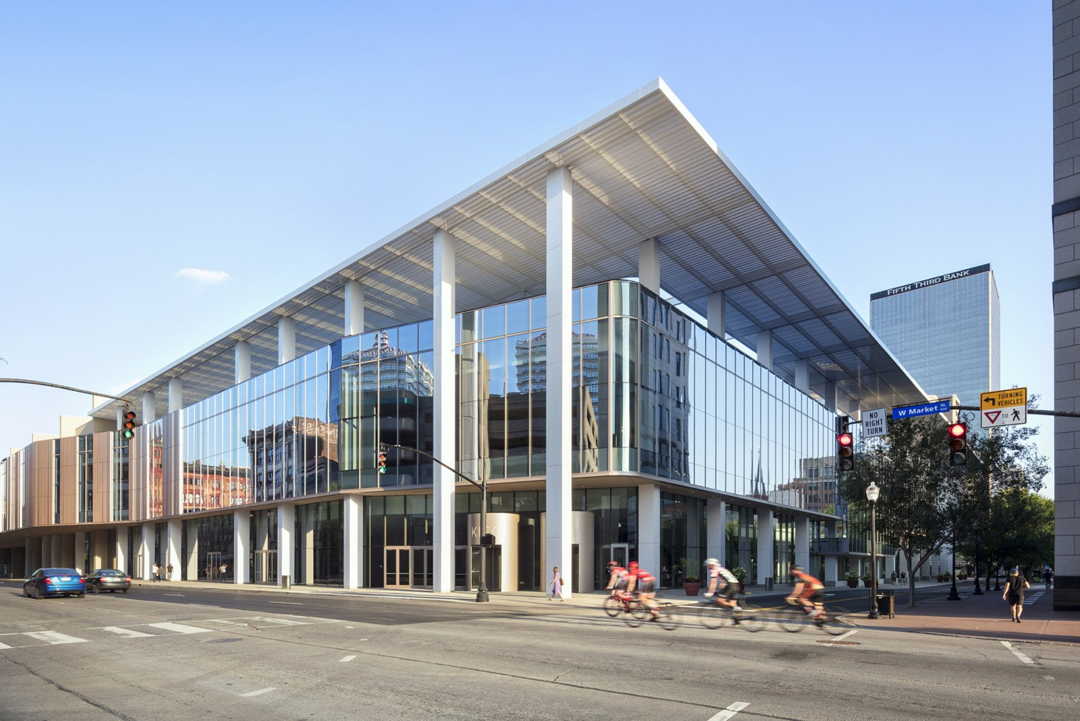
Public Comment Hearings!
September 14th-21st in Louisville, KY!

Slide 37
Public Comment Hearings
In person hearing and vote on whether or not to change the code rests with the ICC Governmental Member Voting Representatives (GMVRs)-those who administer, formulate or enforce the regulations and are charged with the public’s health, safety and welfare
In person PCH vote sets the agenda for the final step in the process – the Online Governmental Consensus Vote

Slide 38
Online Governmental Consensus (OGCV)
Online ballot of the PCH results. Vote limited to GMVRs but anyone can access the ballot on cdpACCESS®
OGCV opens approximately 2 weeks after the close of the PCH. Open for 2 weeks.
OGCV regulated by Section 8.0 of CP28
OGCV occurs via cdpACCESS® and includes
-Video of CAH and PCH hearing testimony
-Public comment agenda for the specific code change
-PCH result and vote count
-PCH approved modifications incorporated into the original code change
-Allowable OGCV actions (see next slide)
Notes:
Final Action:
Section 10.1 of CP28
“Following the closing of the online ballot period, the votes received will be combined with the vote tally at the Public Comment Hearing to determine the final vote on the code change proposal”

Slide 39
Coordination of Final Actions
The Code Correlation Committee (CCC) resolves correlation issues
The process by which the CCC resolves such issues is an open and transparent process regulated by CP44 Code Correlation Committee
See Section 11.2 of CP28 and the process outlined in CP44

Slide 40
RESULTS
First edition of full family of I-Codes in 2000
Editions follow every 3 years
2021 Edition published in 2020
2024 Edition to be published in 2023

Slide 41
HEARING WEBCASTS
Debut at 2002 Committee Action Hearings
All subsequent hearings (Committee Action and Public Comment) webcast
Streaming video and audio
Internet access on your computer
Notes:
All code development documents are posted.
All information including schedules, procedures, code change cycle documents and a historical record of past cycles is posted (see next slide)

Slide 42
CONCLUSION
The ICC remains dedicated to a single family of comprehensive and coordinated model codes. The ICC code development process allows all interests to actively participate in the update of each and every I-Code.

Slide 43
Stephen D. Jones, MCP, MS, CBO
Lead Sr. Government Relations Regional Manager,
Representing: GA, NC, NJ, SC & TN
-International Code Council
O: 1-888-ICC-SAFE (1-888-422-7233) x6243
C: 973-296-5210
www.ICCSafe.org

Slide 44
QUESTIONS?

