Slide 1
Briefing Prepared for the Georgia State Codes
Advisory Committee
Dale K. Thomure, CBO, CFM
Manager – Community Hazard Mitigation
Underwriting Solutions
March 9, 2022

Slide 2
Building Code Effectiveness Grading Schedule (BCEGS®)
Unique Insurance Industry Program
Focused on mitigation of natural hazard impacts through effective building code enforcement.
Assigned at the community level based on building code enforcement service delivery.
    City or Town
    County and Third-Party
Aggregated into classifications of between 1 and 10 in personal and commercial lines for use in rating and underwriting.
BCEGS started in Georgia in 1996
Classification data is refreshed on a 4-year cycle and upon request
Historic data specific to each evaluation year is maintained
Community metrics are maintained
BCEGS is designed to measures resources and support made available to the enforcement of building codes and the utilization of those resources at the community level.
VS.

Slide 3

What goes into a BCEGS Classification?
BCEGS Areas of Focus
Code Administration | Adopted Building Code Adopted Sub-Codes State and Local Code Amendments Method of Code Adoption Natural Hazards Impacting the Jurisdiction Staff Training and Education Certification of Staff Qualification of the Building Official Utilization of Design Professionals Zoning and Land-Use Provisions Contractor Licensing Programs Public Awareness Programs Appeals Process Administrative Policies and Procedures Quality Assurance Programs
Plan Review | Plan Review Staffing Experience of Plan Review Personnel Detail of Plan Review Management of Plan Review Activity
Field Inspection | Inspection Staffing Experience of Inspection Personnel Management of Inspection Activity Inspection Checklists Special Inspections Inspections for Natural Hazard Mitigation Final Inspections Certificates of Occupancy
Code Admin
Inspection
Plan Review
54%
23%
9
6
2
23%
BCEGS Class

Slide 4
How does BCEGS impact my community?
BCEGS
Nationwide Filed Advisory Ratings PL and CL
FEMA BRIC Grant Program
Studies Support Predictiveness of Product
NFIP CRS Program
ICC Code Tracking
FEMA BCATS
LOCATION
Pro-Metrix
AIR Hazard Models
Filed advisory ratings impact to insurance costs
Classifications and enforcement data utilized in underwriting decisions – impacts to coverage offerings in certain areas
Discounts for flood insurance in CRS participating communities
Grant funding opportunities via the FEMA BRIC program

Slide 5
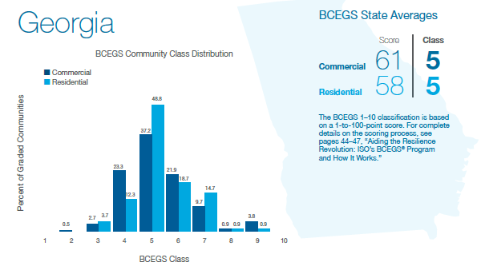
Classifications in Georgia
65% of Georgia Communities Meet the BCEGS Criteria for BRIC and CRS Programs

Slide 6
Actions to Improve or Maintain BCEGS Classifications
Maintain a regular and timely code development process
Maintain a state code without structural weakening of design elements related to natural hazards
Promote increased training and model code certification for code officials
Targeted Outreach
  Communities without departments
  Communities that do not have sufficient classifications to fully benefit from FEMA BRIC or CRS Programs
FACTORS INFLUENCING EFFECTIVE CODE ENFORCEMENT
State Level | Local Level
Mandatory vs. Local Option Enforcement | Costs of Department Operations
State Code Development Cycles | Access to Qualified Candidates
State Code Amendments - Weakening | Scalability of Workforce
Limitations on Local Enforcement | Code Amendments – Weakening
Understanding of Natural Hazard Risk Recognition of the Value of Code Enforcement – Benefit vs. Cost

Slide 7
Moving Forward - Collaboration
A couple of questions:
How do we communicate this information to state and local decision makers?
Increased outreach to community leaders (Mayors, County Commissioners)
Use existing partnerships and organizations (ICC, FLASH, FEMA)
What data can be used to assist the state and local leaders in understanding risks associated with ineffective building code enforcement?
Verisk can assist State Hazard Mitigation Officers, Emergency Managers and Building Code Officials with basic metrics to better inform decision making and provide targeted outreach to jurisdictions that may benefit from additional resources.

